Slide 1
RXTE Observations of an Extraordinary Pulsar in the LMC
F.E. Marshall / GSFC
16 Years of Discovery with RXTE
March 29-30, 2012

Slide 2
Acknowledgements
This work is a collaboration with:
Eric Gotthelf of Columbia U.
John Middleditch of LANL
Daniel Wang of U. Massachusetts
William Zhang of GSFC

Slide 3
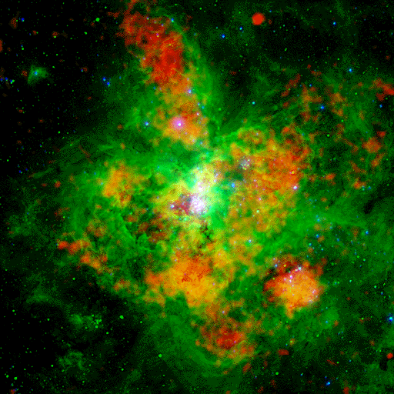
30 Doradus – The Tarantula
PSR J0537-6910 is located near the center of SNR N157B, which is near the SW edge of 30 Doradus. 30 Dor is the most active (~100 M/Myr) starburst region in the Local Group of galaxies.
J0537-6910
2’
30 Dor in UV (blue), X-ray (red), and
Hα (green) from Wang (1999).

Slide 4
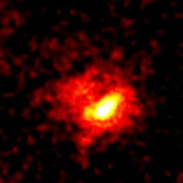
Chandra Image of N157B
Chandra HRI observations reveal the pulsar, a compact nebula, and diffuse emission embedded in SNR N157B.
PSR J0537-6910
20”
from Wang et al. 2001

Slide 5
PSR J0537-6910 Overview
PSR J0537-6910 was discovered serendipitously with RXTE while searching for a pulsar associated with SN 1987A.
PSR J0537-6910 is a Crab-like pulsar powering the SNR N157B in the LMC. Its pulsed X-ray luminosity is ~2 x 10³⁵ ergs/s or ~0.04% of the pulsar’s total spin-down power.
At 62 Hz, PSR J0537-6910 is the fastest rotating young pulsar.
The age of N157B has been estimated as:
24,000 years using the kinematics of Hα-emitting gas (Chu et al. 1992)
5,000 years using Sedov age (Wang & Gotthelf 1998)
The estimated period of the pulsar at birth is a few msec.
The rotation of PSR J0537-6910 glitches every few months with a relative amplitude of ~1 ppm.
Characteristic age (-0.5ν / dν/dt) for the pulsar is ~5,000 years.

Slide 6
The Role of RXTE
Almost everything we know about PSR J0537-6910 is from observations with RXTE.
The pulsar has not been detected in radio or optical bands.
Phased searches with Υ–rays and gravitational waves also unsuccessful.
ASCA observations associated the pulsar with N157B.
After its discovery in 1996 with RXTE, it was monitored from Jan. 1999 until the end of the mission (13 years).
The pulsar phase is known throughout this interval.
43 glitches in the rotation rate were seen.

Slide 7
Pulsar Evolution
Rotation rate (ν) of pulsars gradually slows as the rotational energy is converted to radiation and energetic particles.
For each time segment, we have modeled the observed ϕ and ν using a 3rd order polynomial:
ϕ(t) = ϕ₀ + Δt ν + 1/2 dν/dt Δt² + 1/6 d²ν/dt² Δt³
dν/dt slowly changes, and different emission mechanisms predict specific behavior.
The braking index n ≡ ν d²ν/dt² / (dν/dt)²
For E-M dipole radiation, n = 3
The braking index has been measured for only a handful of pulsars, and none have n=3.

Slide 8
Glitches
There are also sudden increases in the rotation rate (“glitches”):
Typically dν/dt simultaneously abruptly changes.
Complicated post-glitch response.
Possible causes include:
“Starquakes” in the crust of the pulsar
Sudden transfer of angular momentum from the interior to the crust
PSR J0537-6910 is one of the glitchiest pulsars known.

Slide 9
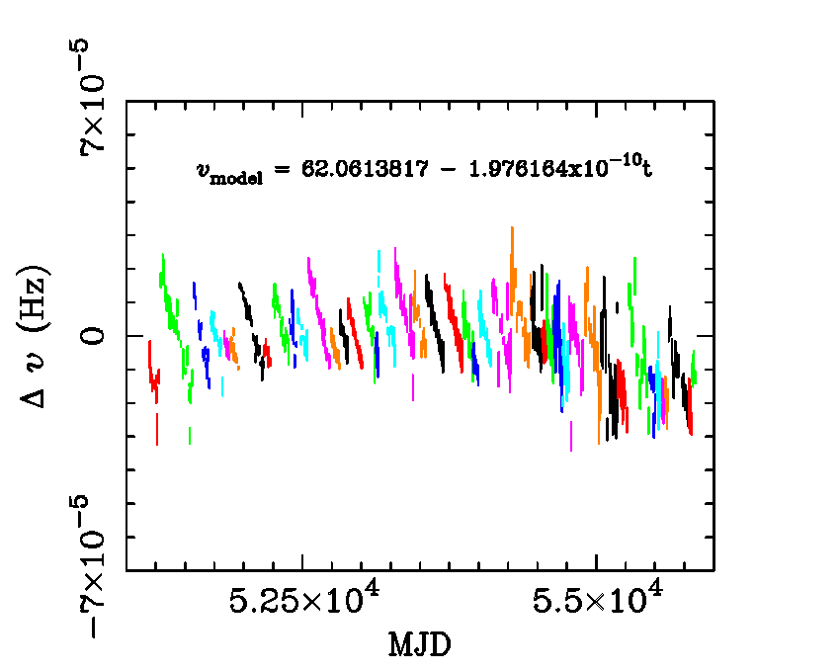
Pulsar History
The evolution of the rotation rate of PSR J0537-6910 is punctuated with rapid increases (“glitches”), but the long-term average frequency derivative remains ~ -1.9762 x 10⁻¹⁰ Hz/s.
Intervals between glitches shown with different colors.

Slide 10
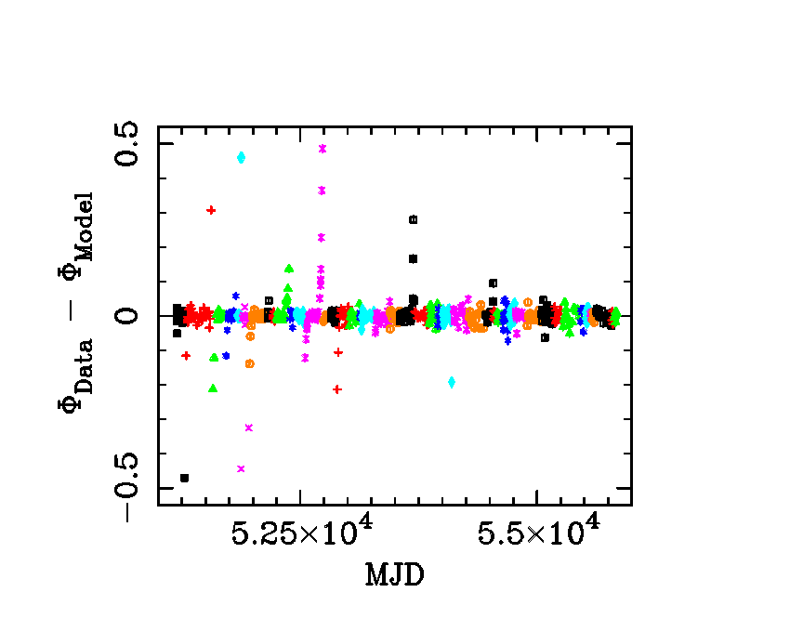
Model Phase Residuals
Model fits well except near the glitches. There is often a period of “recovery” after the glitch and timing noise or “precursors” before the glitch. These periods can last several weeks.

Slide 11
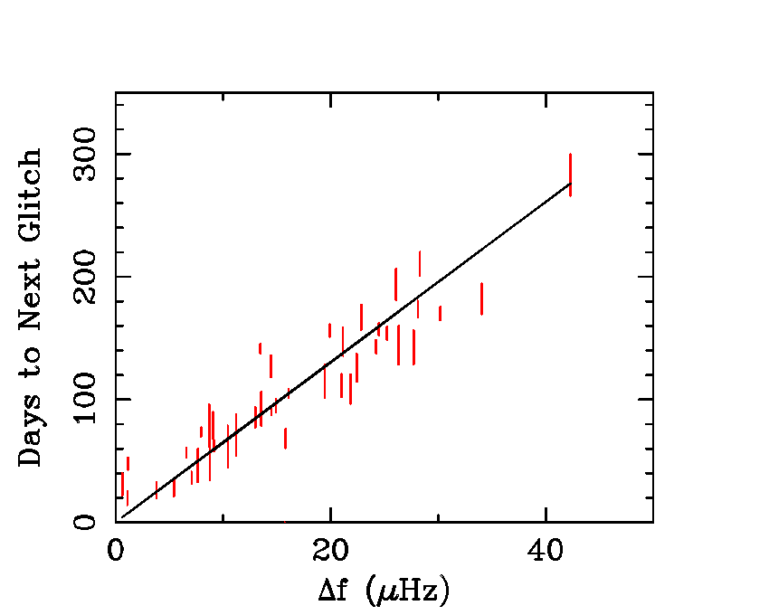
Predictable Glitches
The time to the next glitch is correlated with the amplitude of the current glitch. The slope is ~6.3 days / μHz.
The prediction is accurate to ~10 days and was used to schedule RXTE observations.
No other pulsar shows this behavior.

Slide 12
Age of the Pulsar
Traditionally the age of a pulsar is estimated with the characteristic age τ_{c} = -(ν/2) / dν/dt
The actual age of an initially rapidly rotating pulsar is t ≅ -ν / ((n-1) dν/dt)
For PSR J0537-6910, the glitches have a major effect on dν/dt, more than offsetting the continuous changes during the inter-glitch intervals.
As a result, τ_{c} decreased during the campaign, and in some sense the pulsar has been growing younger.
Consequently, it is difficult to extrapolate the current properties of the pulsar backwards to determine the age and initial spin rate of the pulsar.

Slide 13
Summary
PSR J0537-6910 is the fastest rotating young pulsar (2x the rate of the Crab Pulsar).
The time to the next glitch is proportional to the amplitude of the previous glitch.
Suggests a maximum allowable difference in rotation in crust and core (e.g., Andersson et al. 2004).
Unique to PSR J0537-6910
The maximum glitch is ~40 μHz for all pulsars.
The glitches substantially affect the evolution of dν/dt
The amplitude of the glitch in dν/dt correlates with the time since the previous glitch.
Truly an extraordinary pulsar.

Slide 14
The End
Questions?

Slide 15
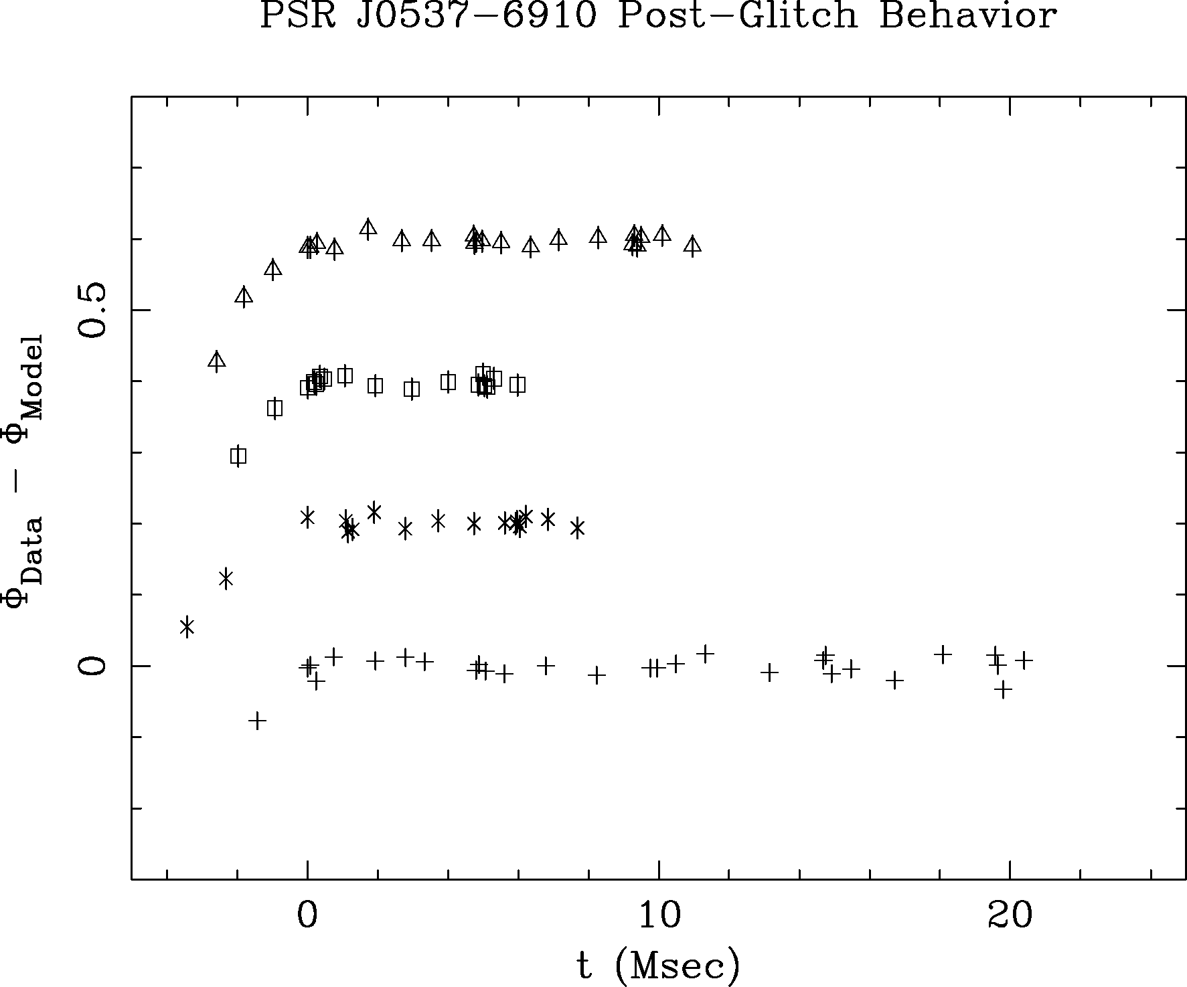
Glitch Recovery
Phase residuals immediately after the 4 largest glitches. The offsets in time are chosen so that the model provides a good fit for t > 0. The slopes for t < 0 are typically ~ 0.1 μHz or ~2% of the glitch amplitude.

Slide 16
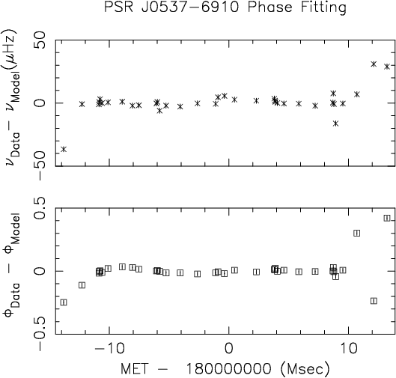
Model Fit for One Interval

