Slide 1
The Long-Term Spectral and Temporal Evolution of the Swift J1818.0-1607 Magnetar Outburst
Alex Van Kooten
On behalf of a larger collaboration
NICER/IXPE Workshop
July 29, 2024

Slide 2
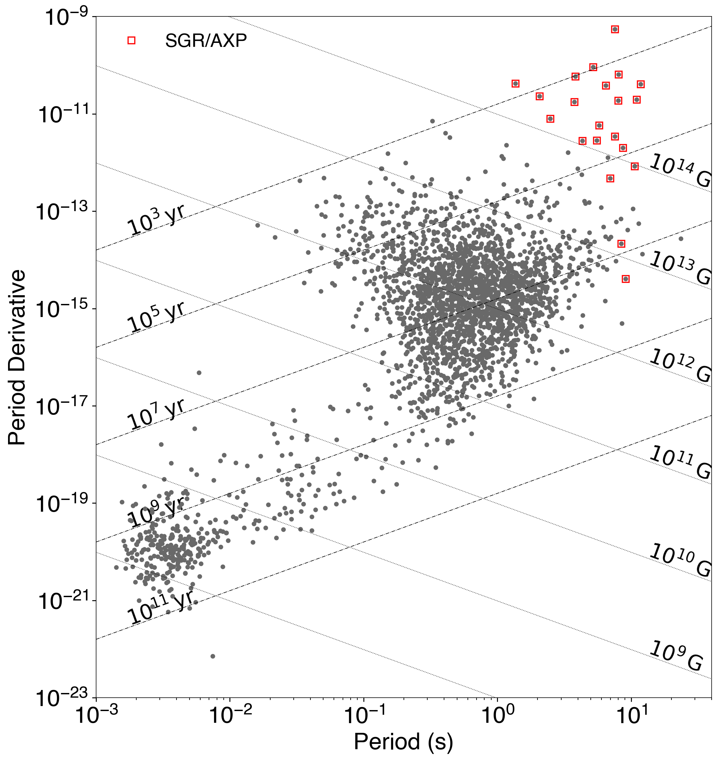
Magnetars
Magnetars
Large $P, \dot{P}$
Young: $τ \sim 1$-$100$ kyr
Huge magnetic fields: $B≳{10}^{14}$ G
Rotation Powered Pulsars
Partially Recycled Pulsars
Recycled Pulsars
Notes:
Characteristic age: Assuming low initial spin period, constant B-field
B field: Assuming magnetic dipole braking

Slide 3
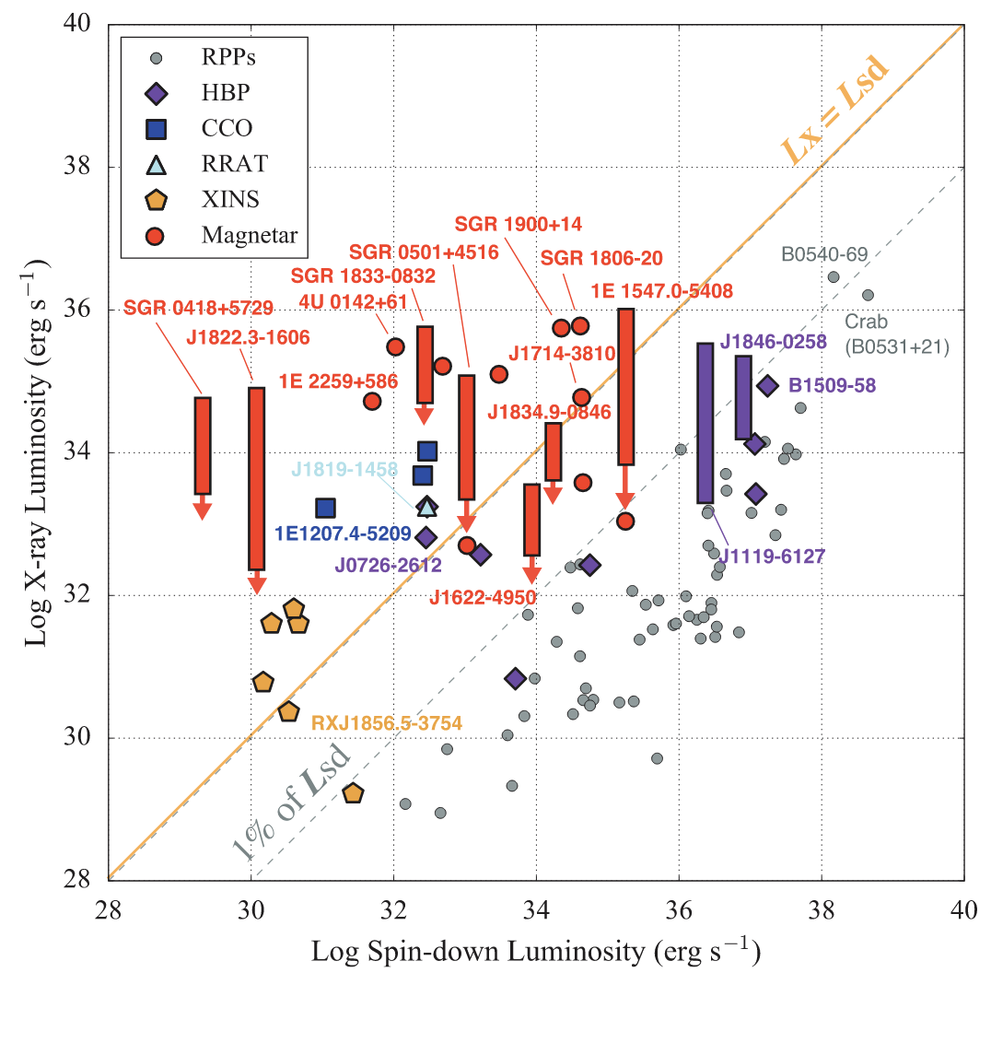
Magnetars
Bright X-ray sources
Rotational energy loss insufficient
Must be another energy source
Magnetic field decay
Enoto et al. 2019

Slide 4
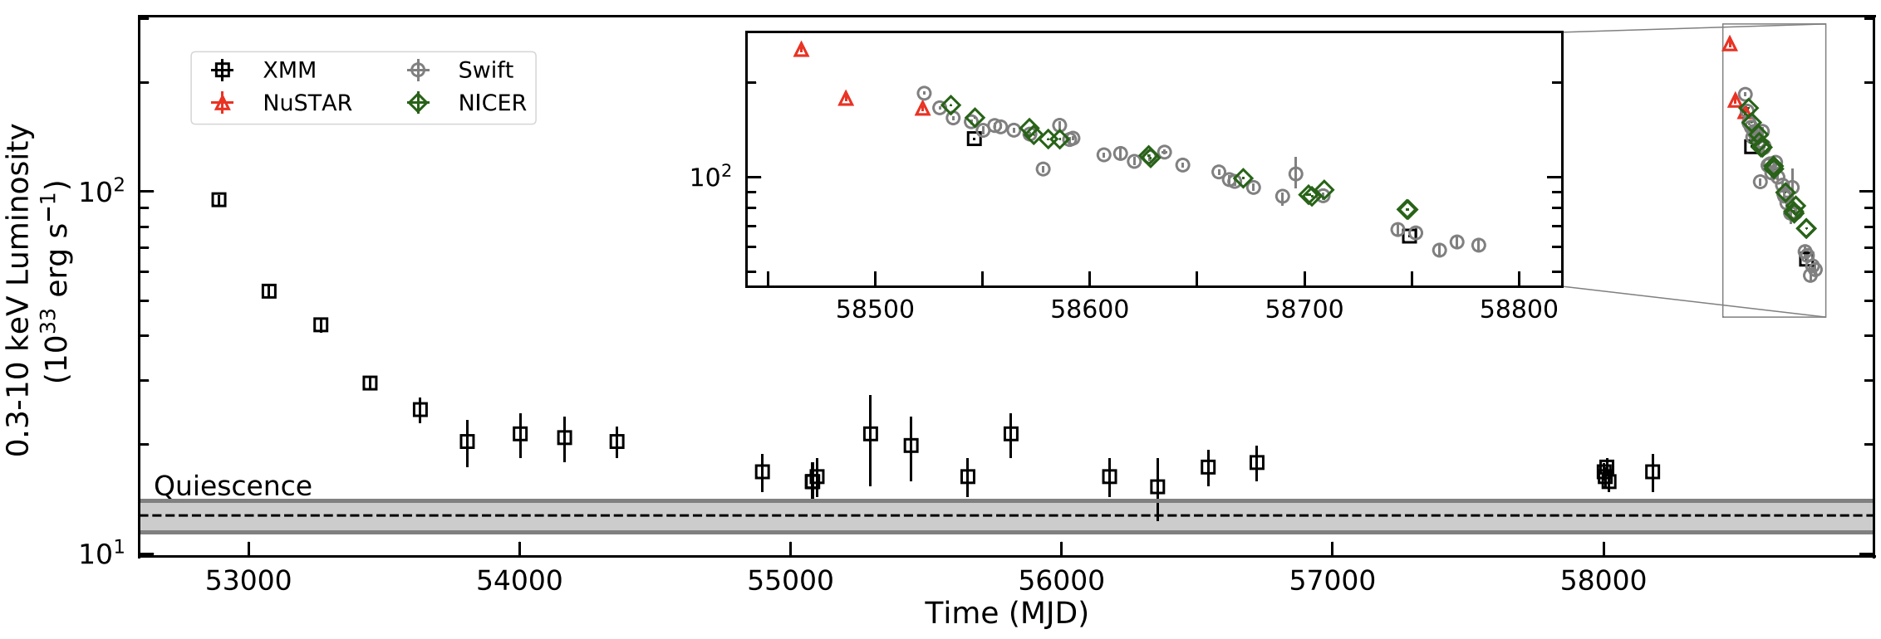
Outbursts
Sudden increase in X-ray flux by a factor of 10-1000
Decay back to quiescence over months to a few years
Borghese et al. 2021
Notes:
Decay modelled by single or double exponential
XTE J1810-197
First outburst in Sept 2003
Second outburst in 2018
Quiescent level from ROSAT obs in 1993

Slide 5
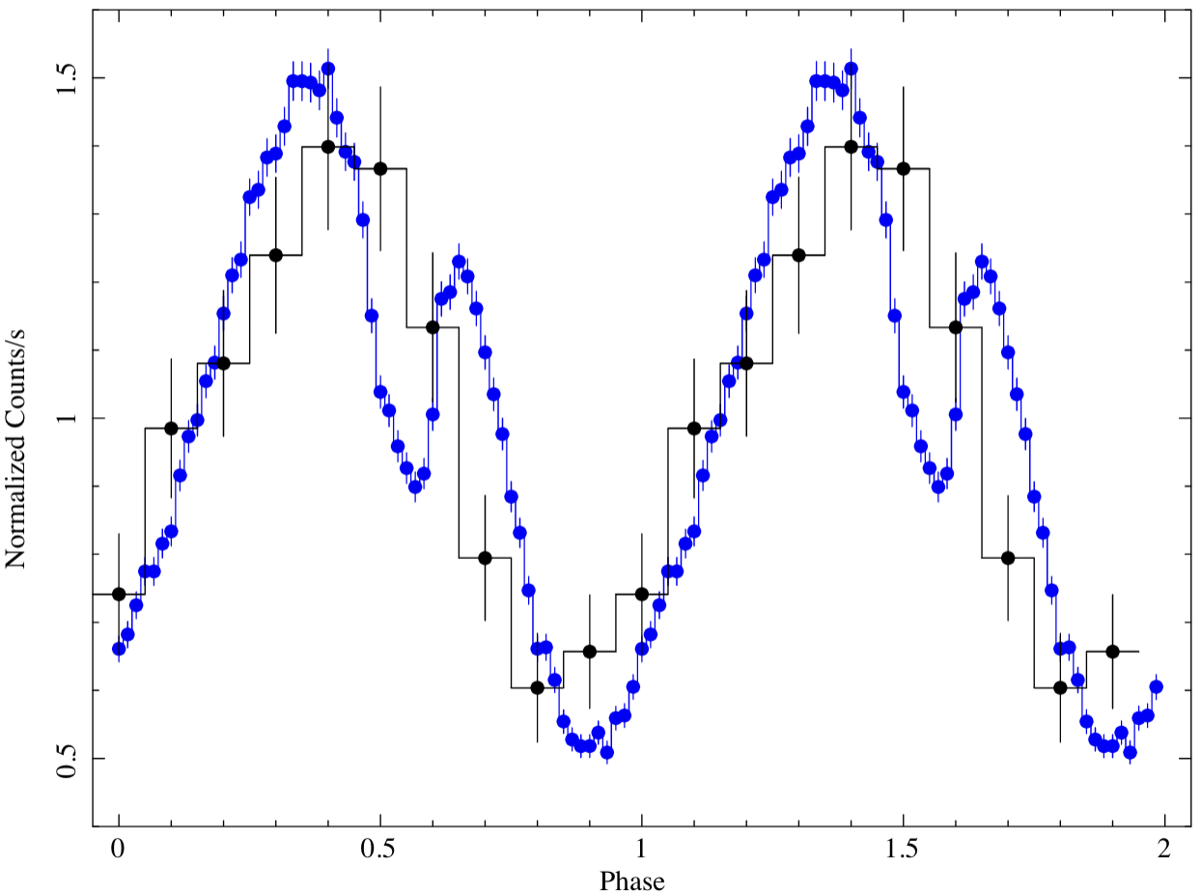
Outbursts
Hot spots responsible for outbursts
Small regions of magnetar surface, hotter than the rest of the surface
Changes in pulsed fraction, pulse profile
Notes:
SGR 1830 post-outburst, using NICER

Slide 6
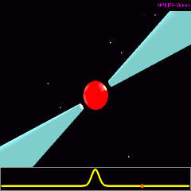
Outbursts
Hot spots responsible for outbursts
Small regions of magnetar surface, hotter than the rest of the surface
Changes in pulsed fraction, pulse profile
Notes:
SGR 1830 post-outburst, using NICER

Slide 7
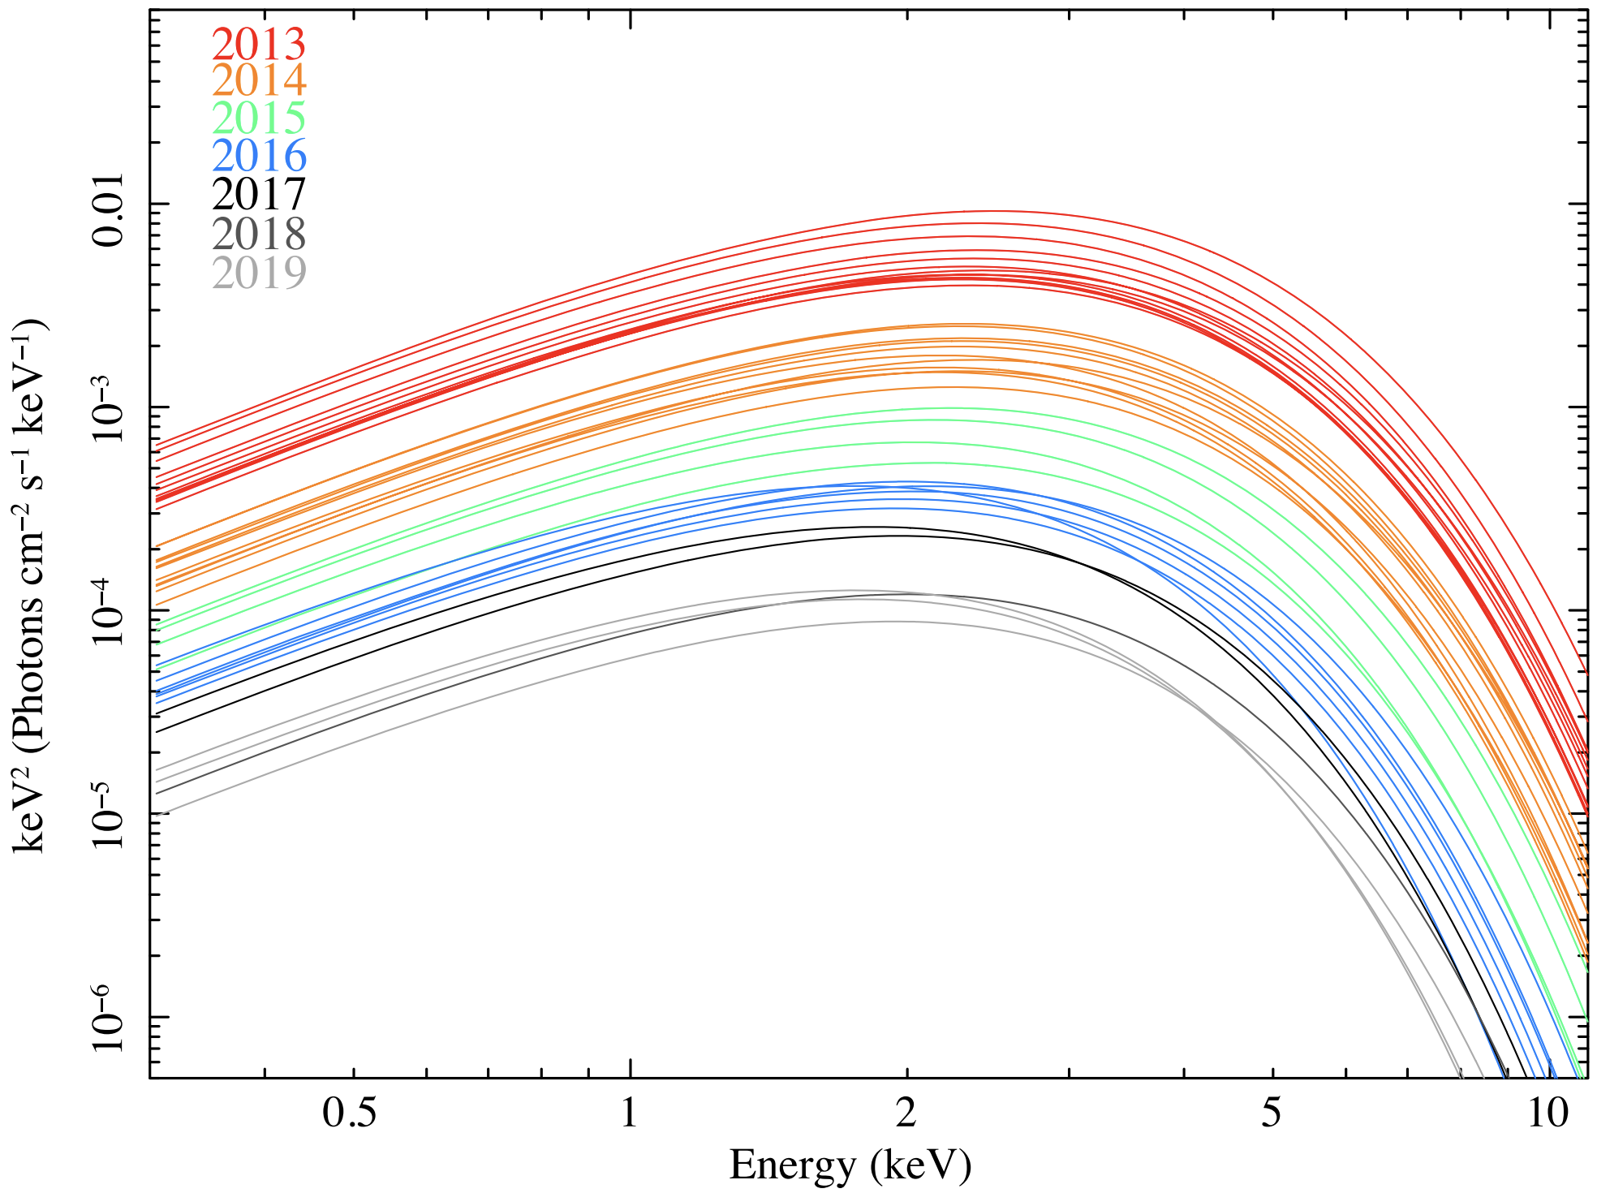
Outbursts
Spectral changes
Initial spectral hardening
Rea et al. 2020
Notes:
SGR J1745−2900, Galactic Center magnetar.

Slide 8
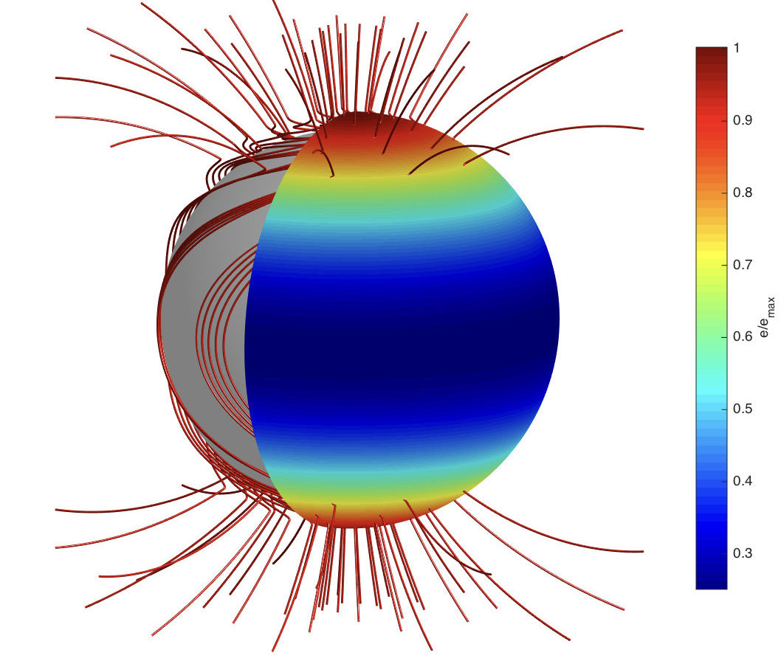
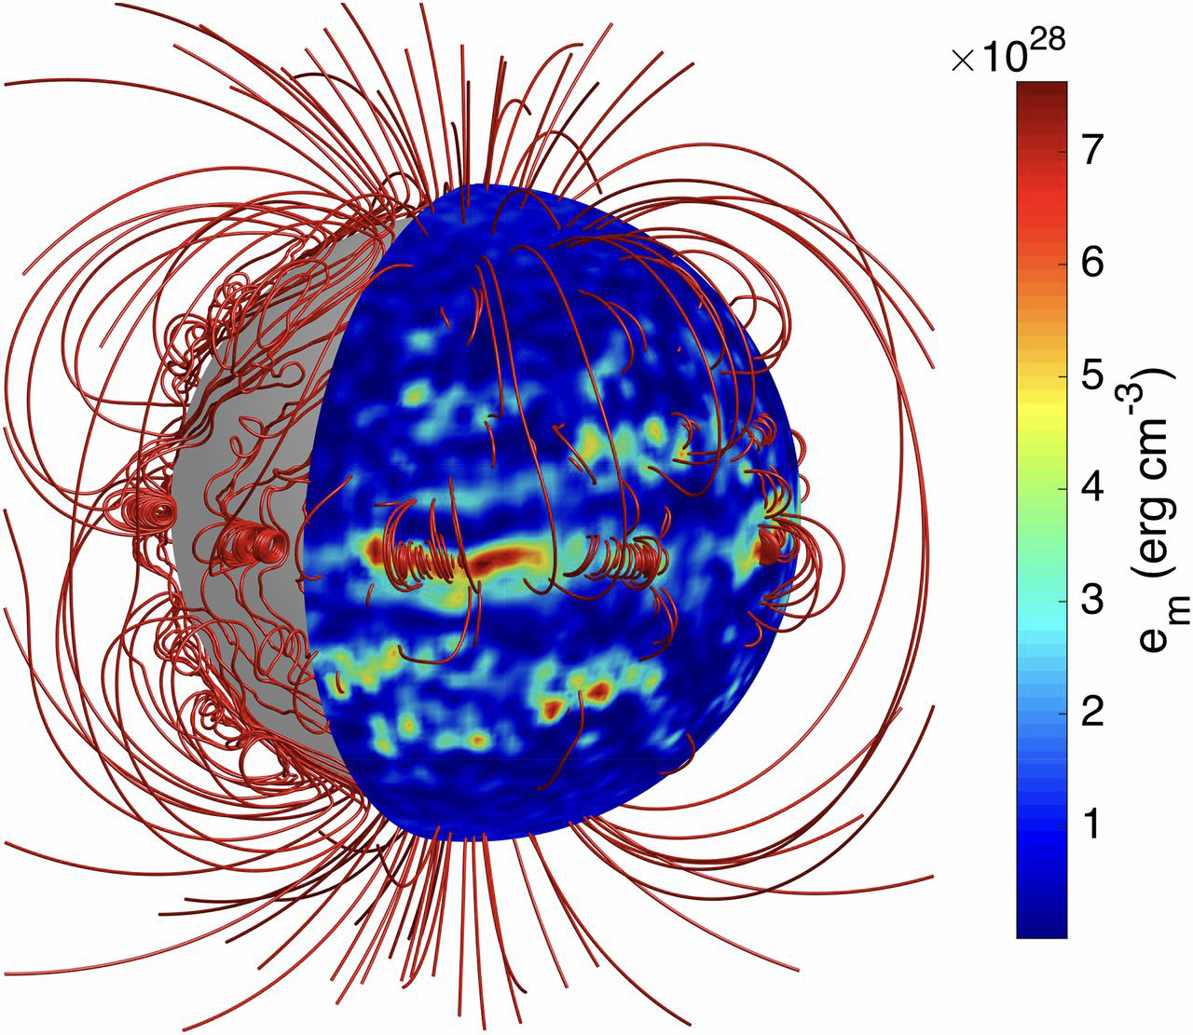
Outburst Theory
Powered by magnetars’ incredibly strong magnetic fields
Dipole fields and crustal toroidal fields
Hall drift causes more complex field geometry
Crustal stresses leads to plastic deformation
Internal heat deposition could lead to surface hot spot
Crust motion twists external magnetic field lines
Current flow along twisted field lines bombards surface, creates hot spot
Models are not exclusive
Gourgouliatos 2016

Slide 9
Swift J1818.0-1607
Magnetars
J1818
Discovered March 2020
P = 1.36 s
Very young: $τ$ ~ 250-500 years
Radio loud
High spin-down luminosity
$\dot{E}\sim {10}^{36}$ erg s⁻¹
Could bridge the gap between magnetars and high-B pulsars
Outburst spectral evolution
Notes:
Period rivals high-B pulsars like PSR J1119−6127 and PSR J1846-0258
$\dot{E}$ = 7 x 10³⁵ erg s⁻¹
$\dot{P}$ = 8.2 x 10⁻¹¹ s s⁻¹
B = 2.5 x 10¹⁴ G

Slide 10
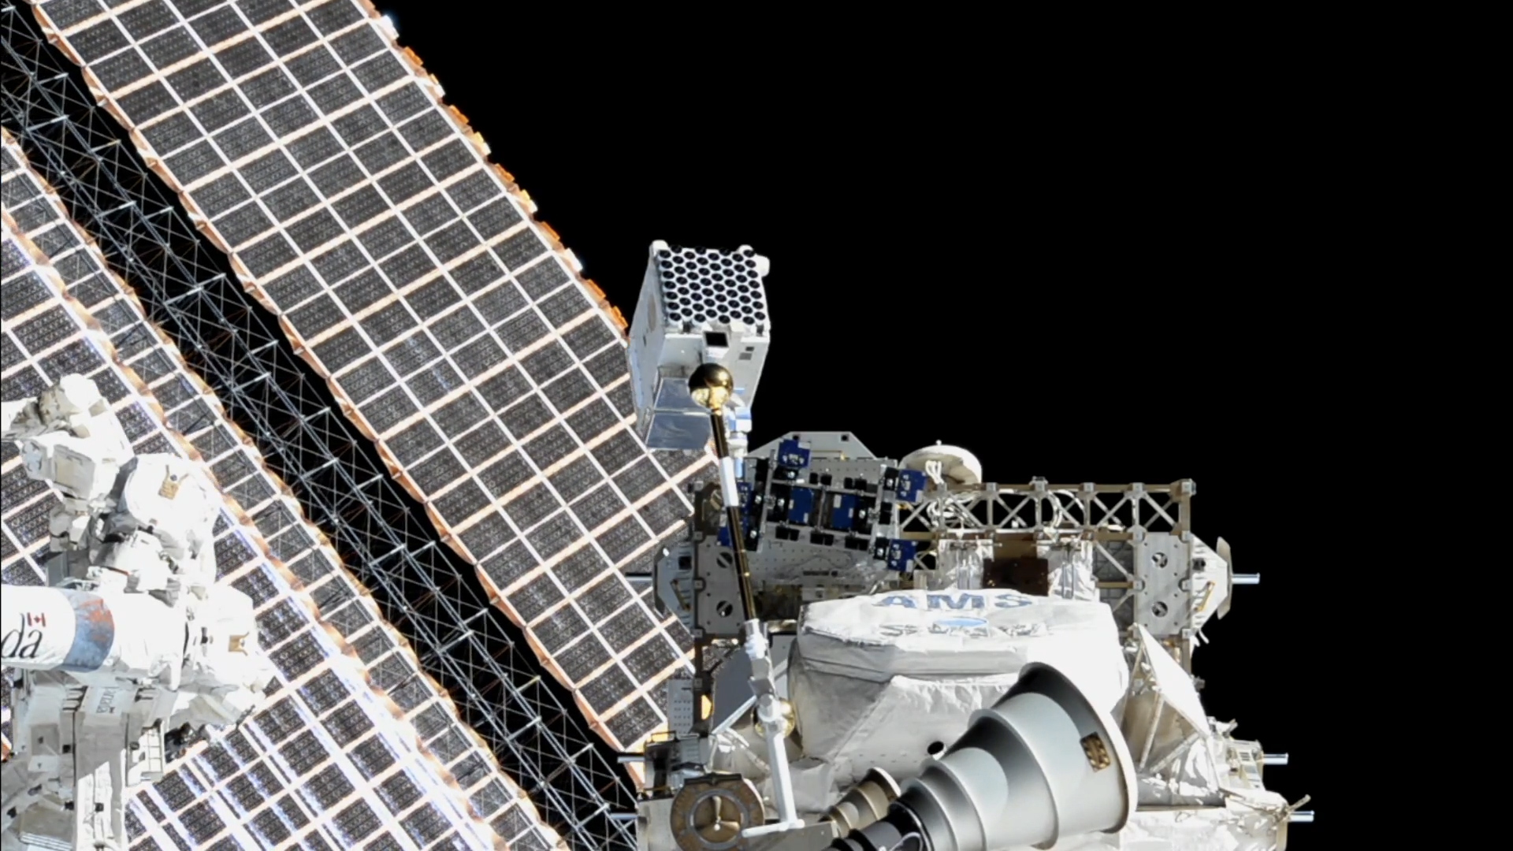
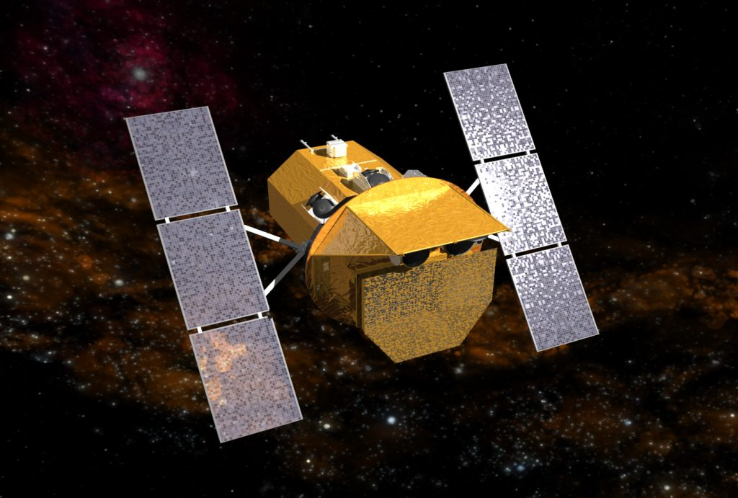
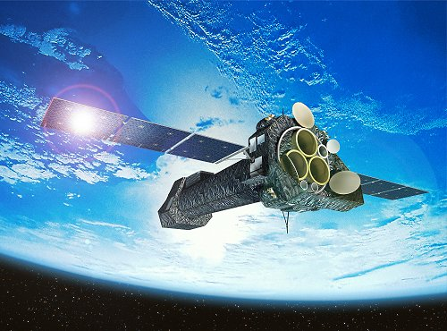
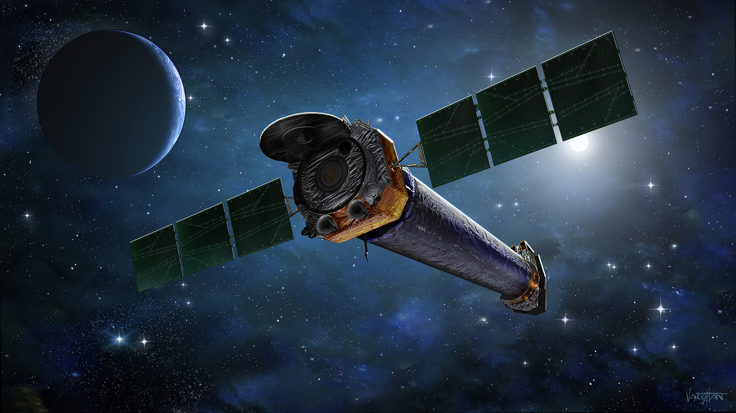
Instruments
NICER
Excellent sensitivity, timing resolution, frequent observations
Combine short observations
Swift-XRT
Frequent observations but lower sensitivity
Combine short observations
XMM-Newton, Chandra
High sensitivity, low background, longer exposures

Slide 11
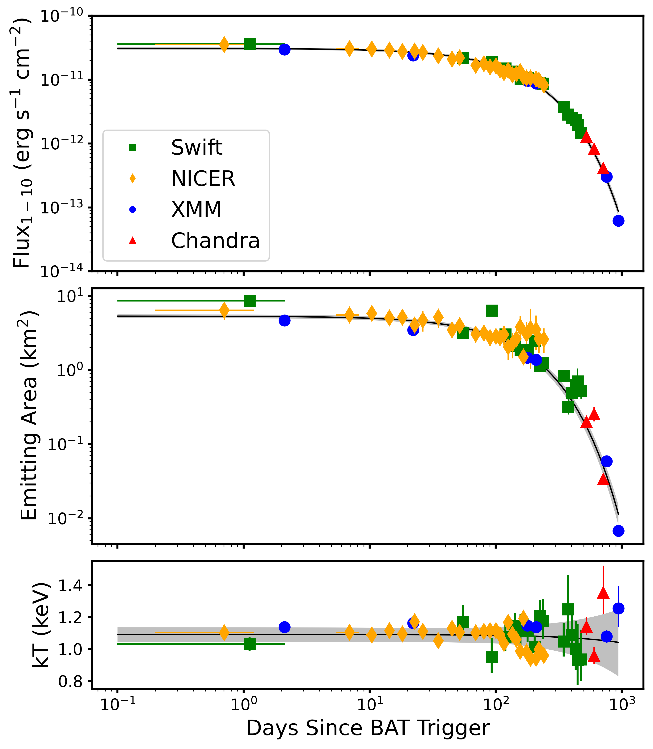
Spectral Evolution
f$\left(t\right)=Ae^{−t/τ}$
Flux:
$τ$ = 160 $±$ 3 days
Area:
$τ$ = 152 $±$ 4 days
Notes:
Flux: $A$ = (3.08 $±$ 0.07) x 10⁻¹¹ erg cm⁻² s⁻¹
Area: $A$ = (5.3 $±$ 0.2) km²

Slide 12
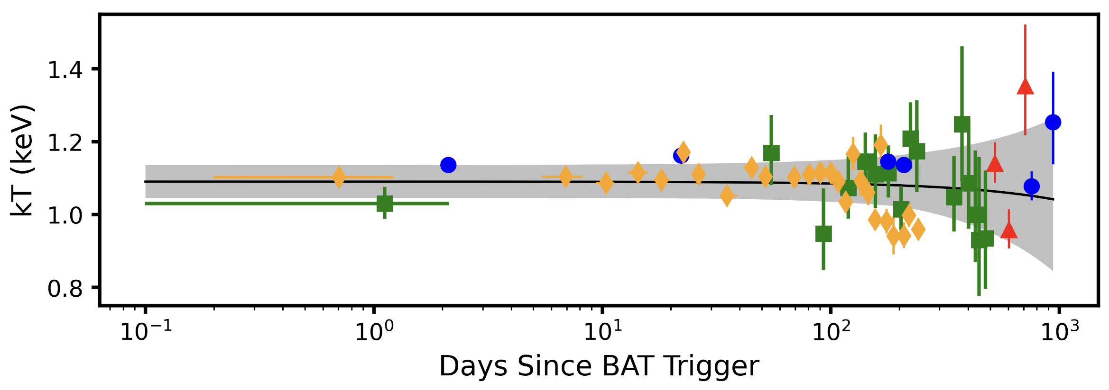
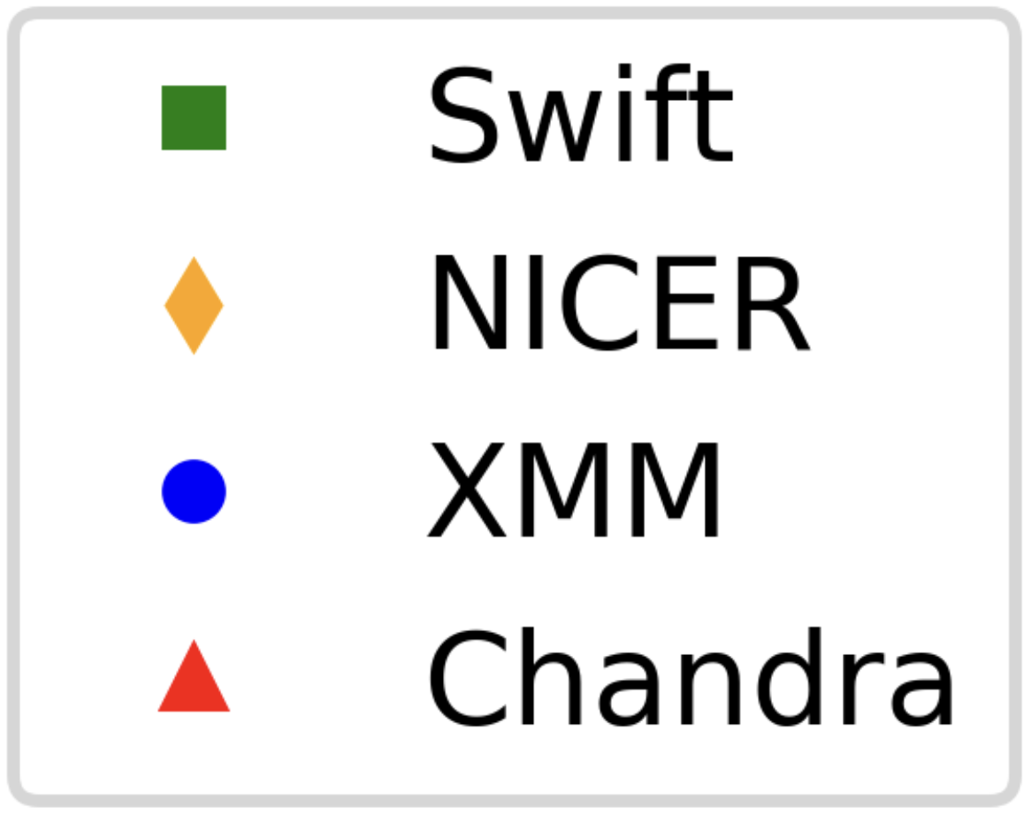
Blackbody Temperature
Blackbody temperature
$kT(t)=mt+b$
$m$ = (-0.5 $±$ 1) x 10⁻⁴ kT day⁻¹
$b$ = 1.09 $±$ 0.03 keV
Notes:
Swift J1555.2-5402

Slide 13
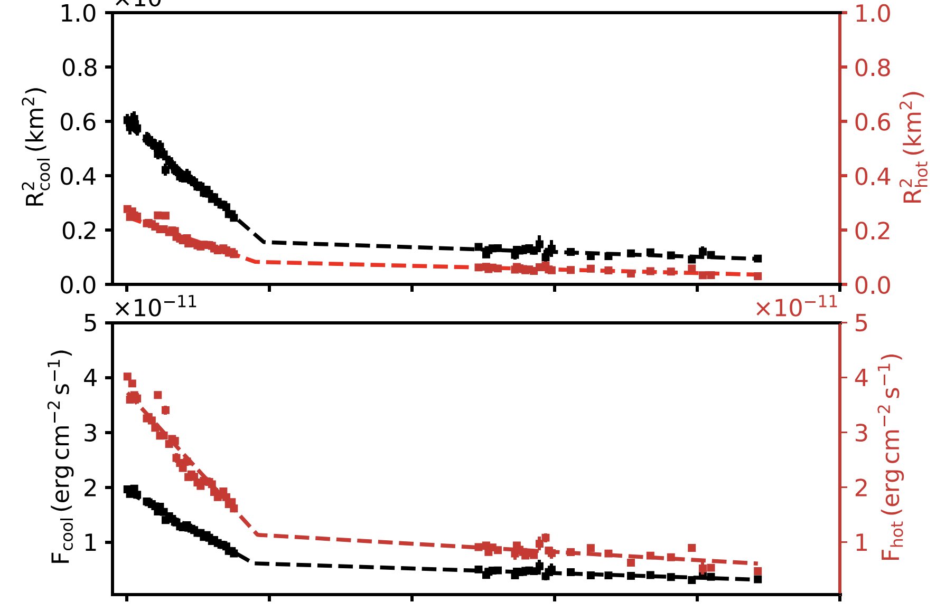
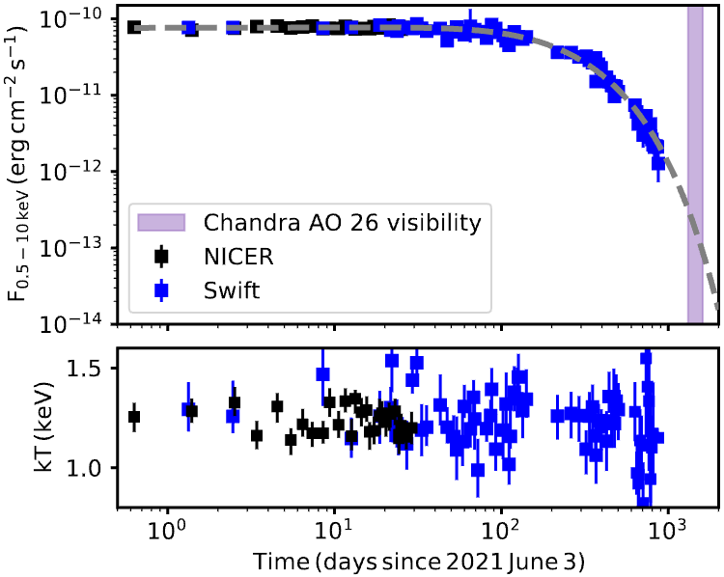
Swift J1818.0-1607: Results
Constant temperature inconsistent with outburst models
However, not unique:
Ex. SGR 1830-0645 (2020), Swift J1555.2-5402 (2021)
SGR 1830
J1555
J1818
Notes:
1555 outburst in 2021

Slide 14
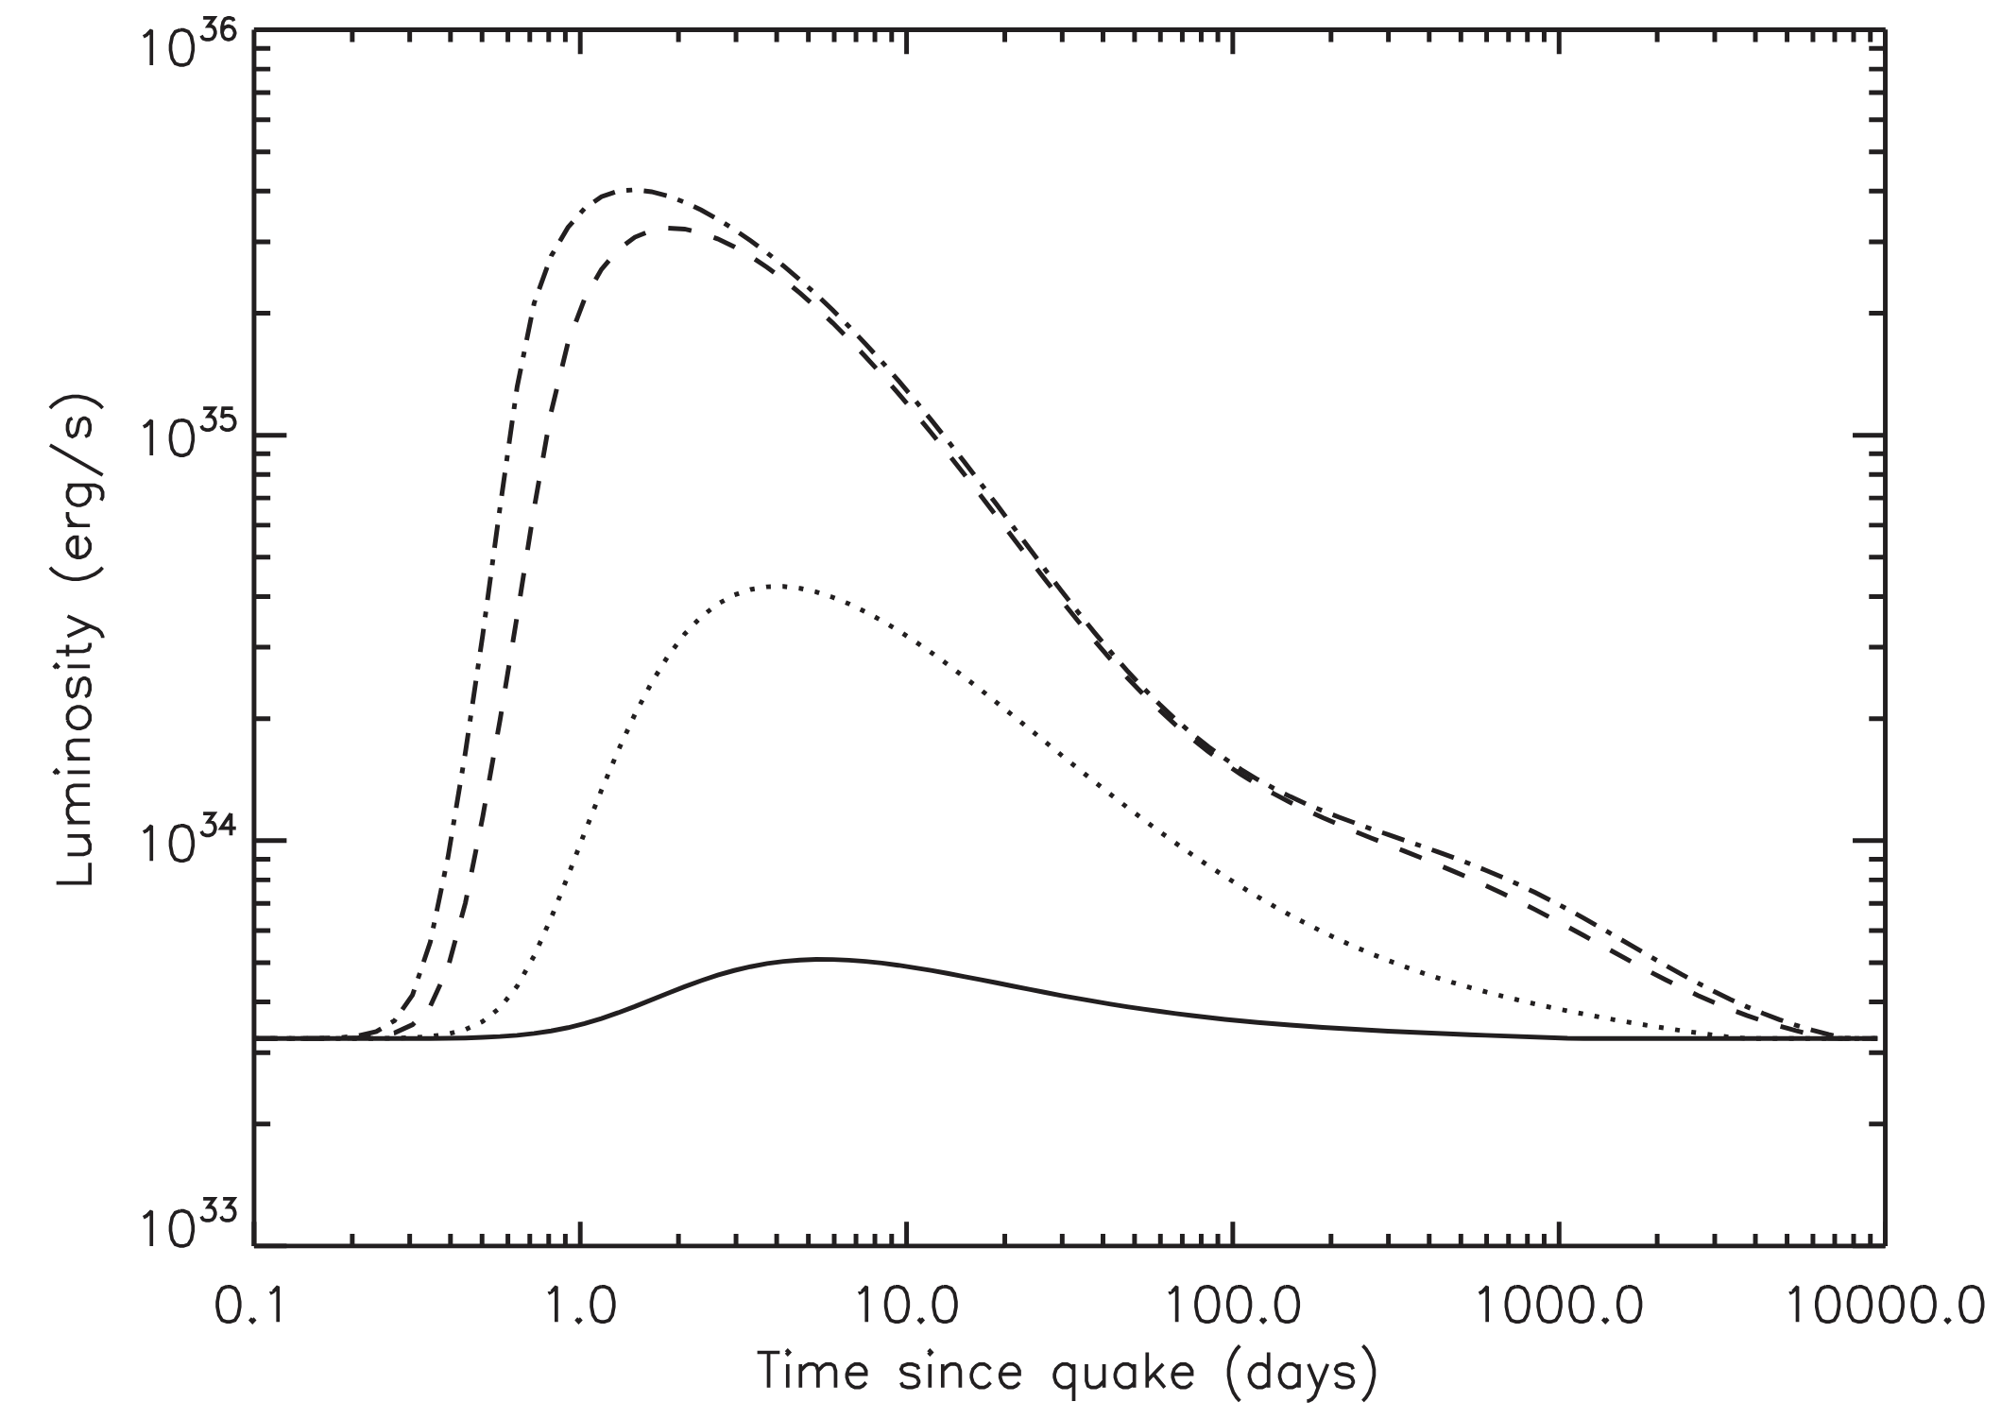
Swift J1818.0-1607: Results
What causes this behavior?
Implications for outburst formation models, neutron star cooling
Neutrino emission could limit crust temperature
How common?
Observational biases?
Interstellar absorption
Covariant model components
Quiescent surface emission
Pons & Rea 2012
Notes:
Saturation at >10^43 erg deposited in outer crust

Slide 15
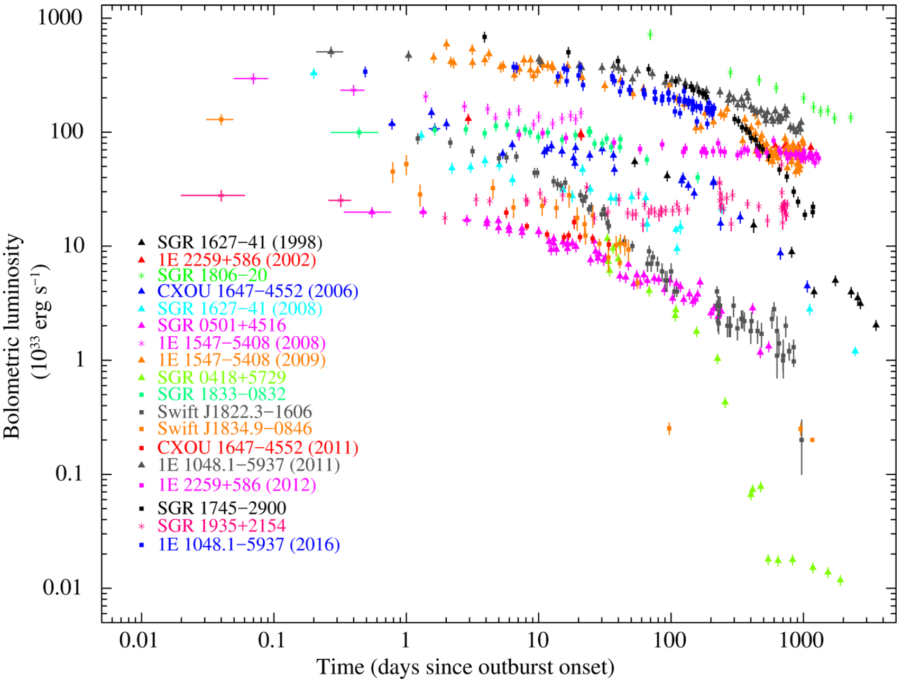
Outbursts
Others have studied flux evolution
Lack of high-quality spectra has precluded detailed spectral study
Early observations rely on Swift
Sparse XMM/Chandra observations
Coti Zelati et al. 2018

Slide 16
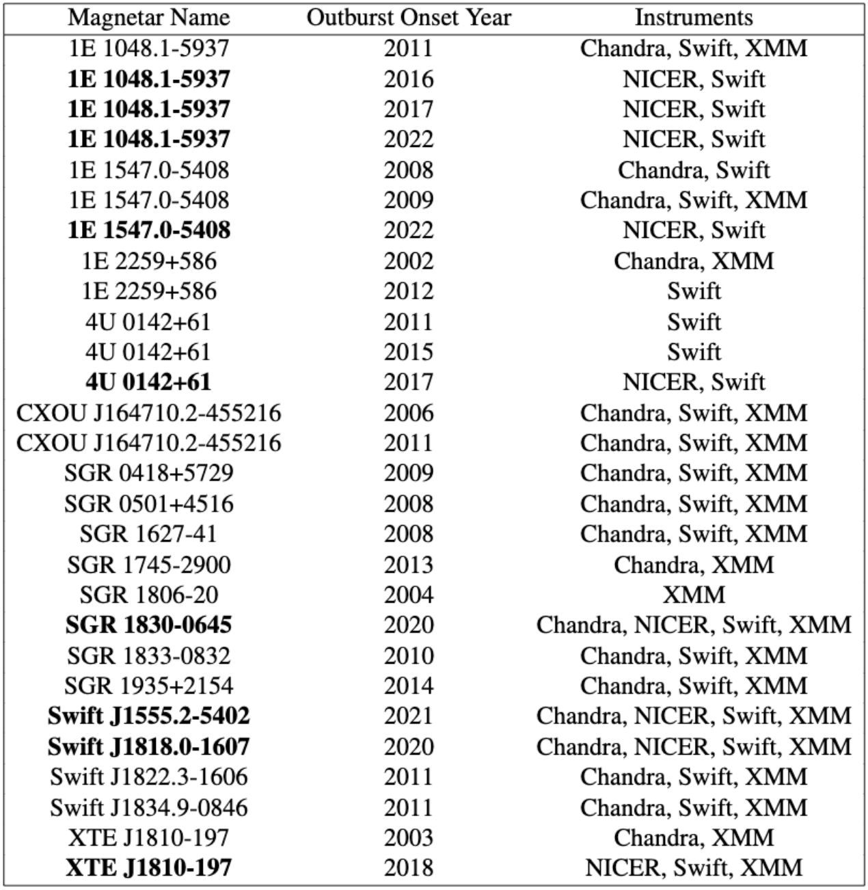
Outburst Spectral Analysis
Recent outbursts have great NICER coverage
Prime candidates for J1818-style analysis
Reanalyze all past outbursts
Focus on high SNR observations
Effects of interstellar absorption, covariant model components, quiescent surface emission

Slide 17
Timing Analysis
Constant pulsed fraction after first 20 days, despite shrinking area
Hu et al 2020
Area $≈$5 km²
Area $≈$2.5 km²

Slide 18
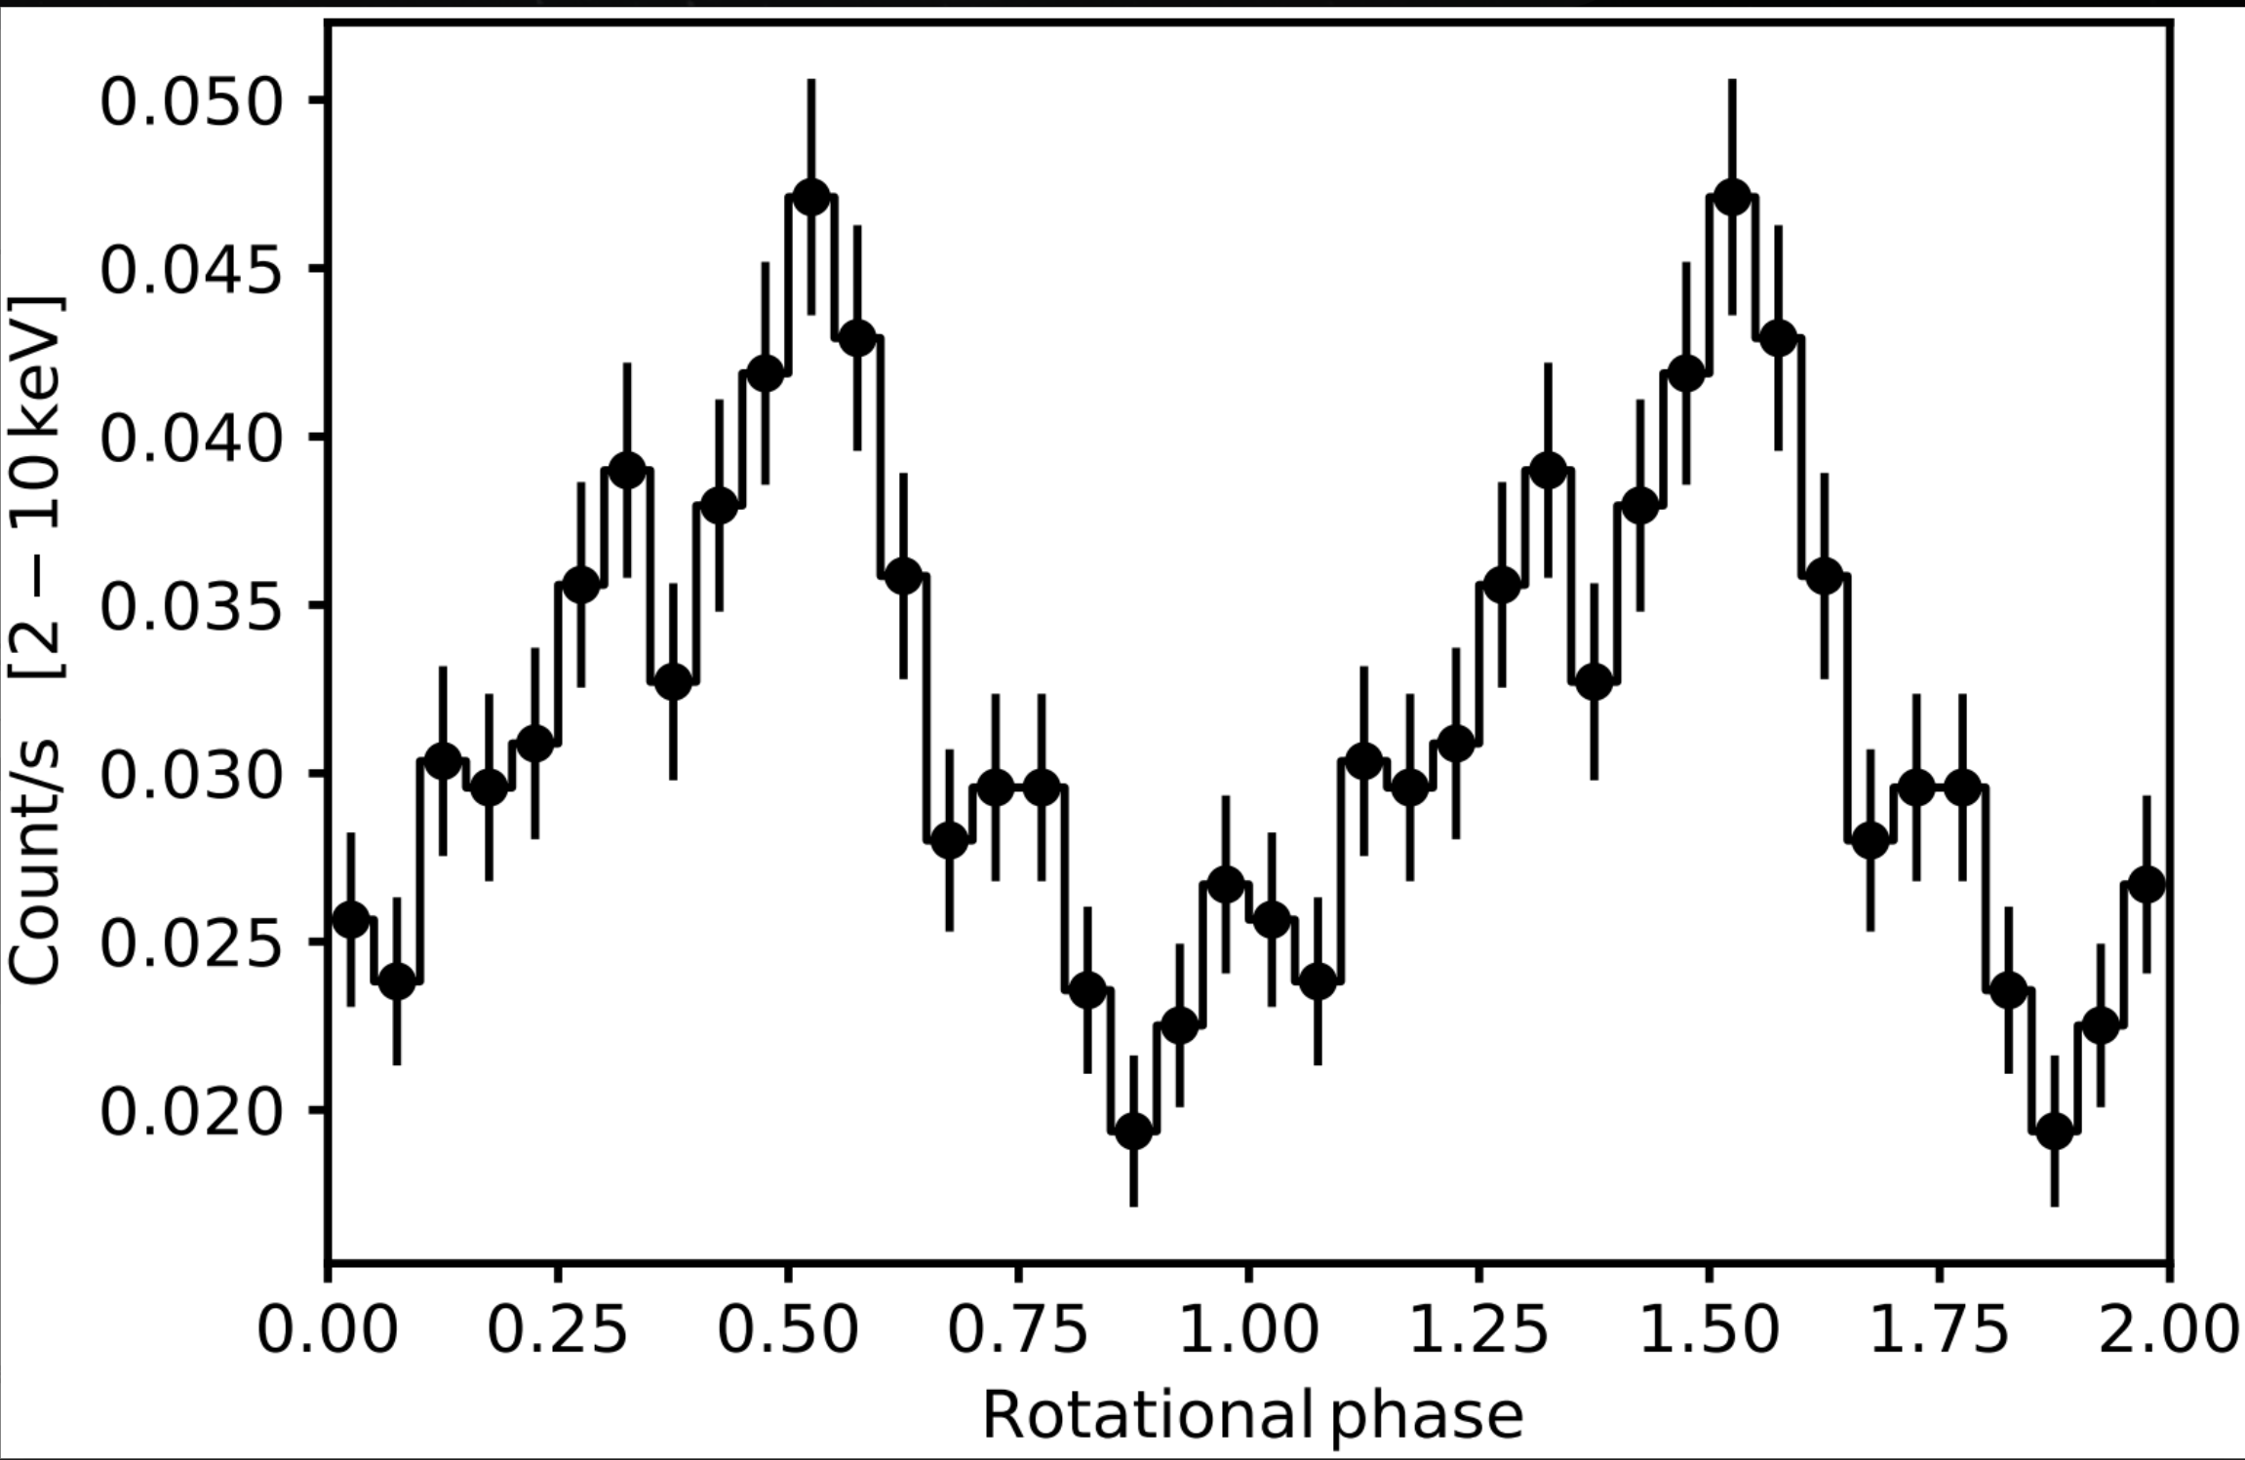
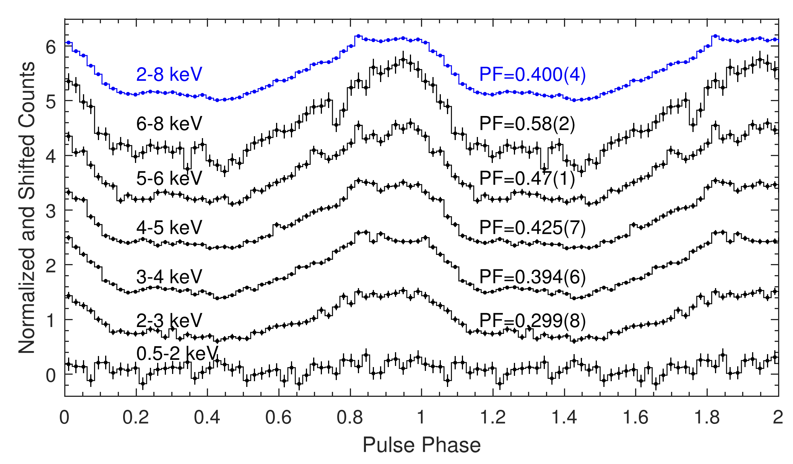
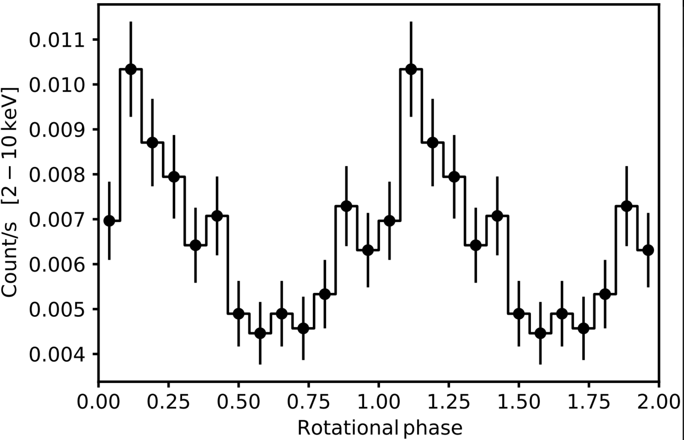
Timing Analysis
Pulse shape and pulsed fraction remain constant out to 940 days
Suggests unique system geometry
2022-04-10 (760 days)
First 100 days
Area
~10⁻² km²
Hu et al 2020
2022-10-09 (940 days)

Slide 19
Conclusions
Constant blackbody temperature in contrast with outburst models
Constant pulsed fraction despite shrinking emitting area
Outburst spectral evolution provides insight into the physics of magnetar crusts and magnetospheres
Population-level study needed

Slide 20
Extras

Slide 21
Outburst Spectra Analysis
Quiescent surface emission generally considered negligible
Bright magnetar’s surface emission could be significant
Properly account for surface contribution to outburst spectrum
Gourgouliatos 2016

Slide 22
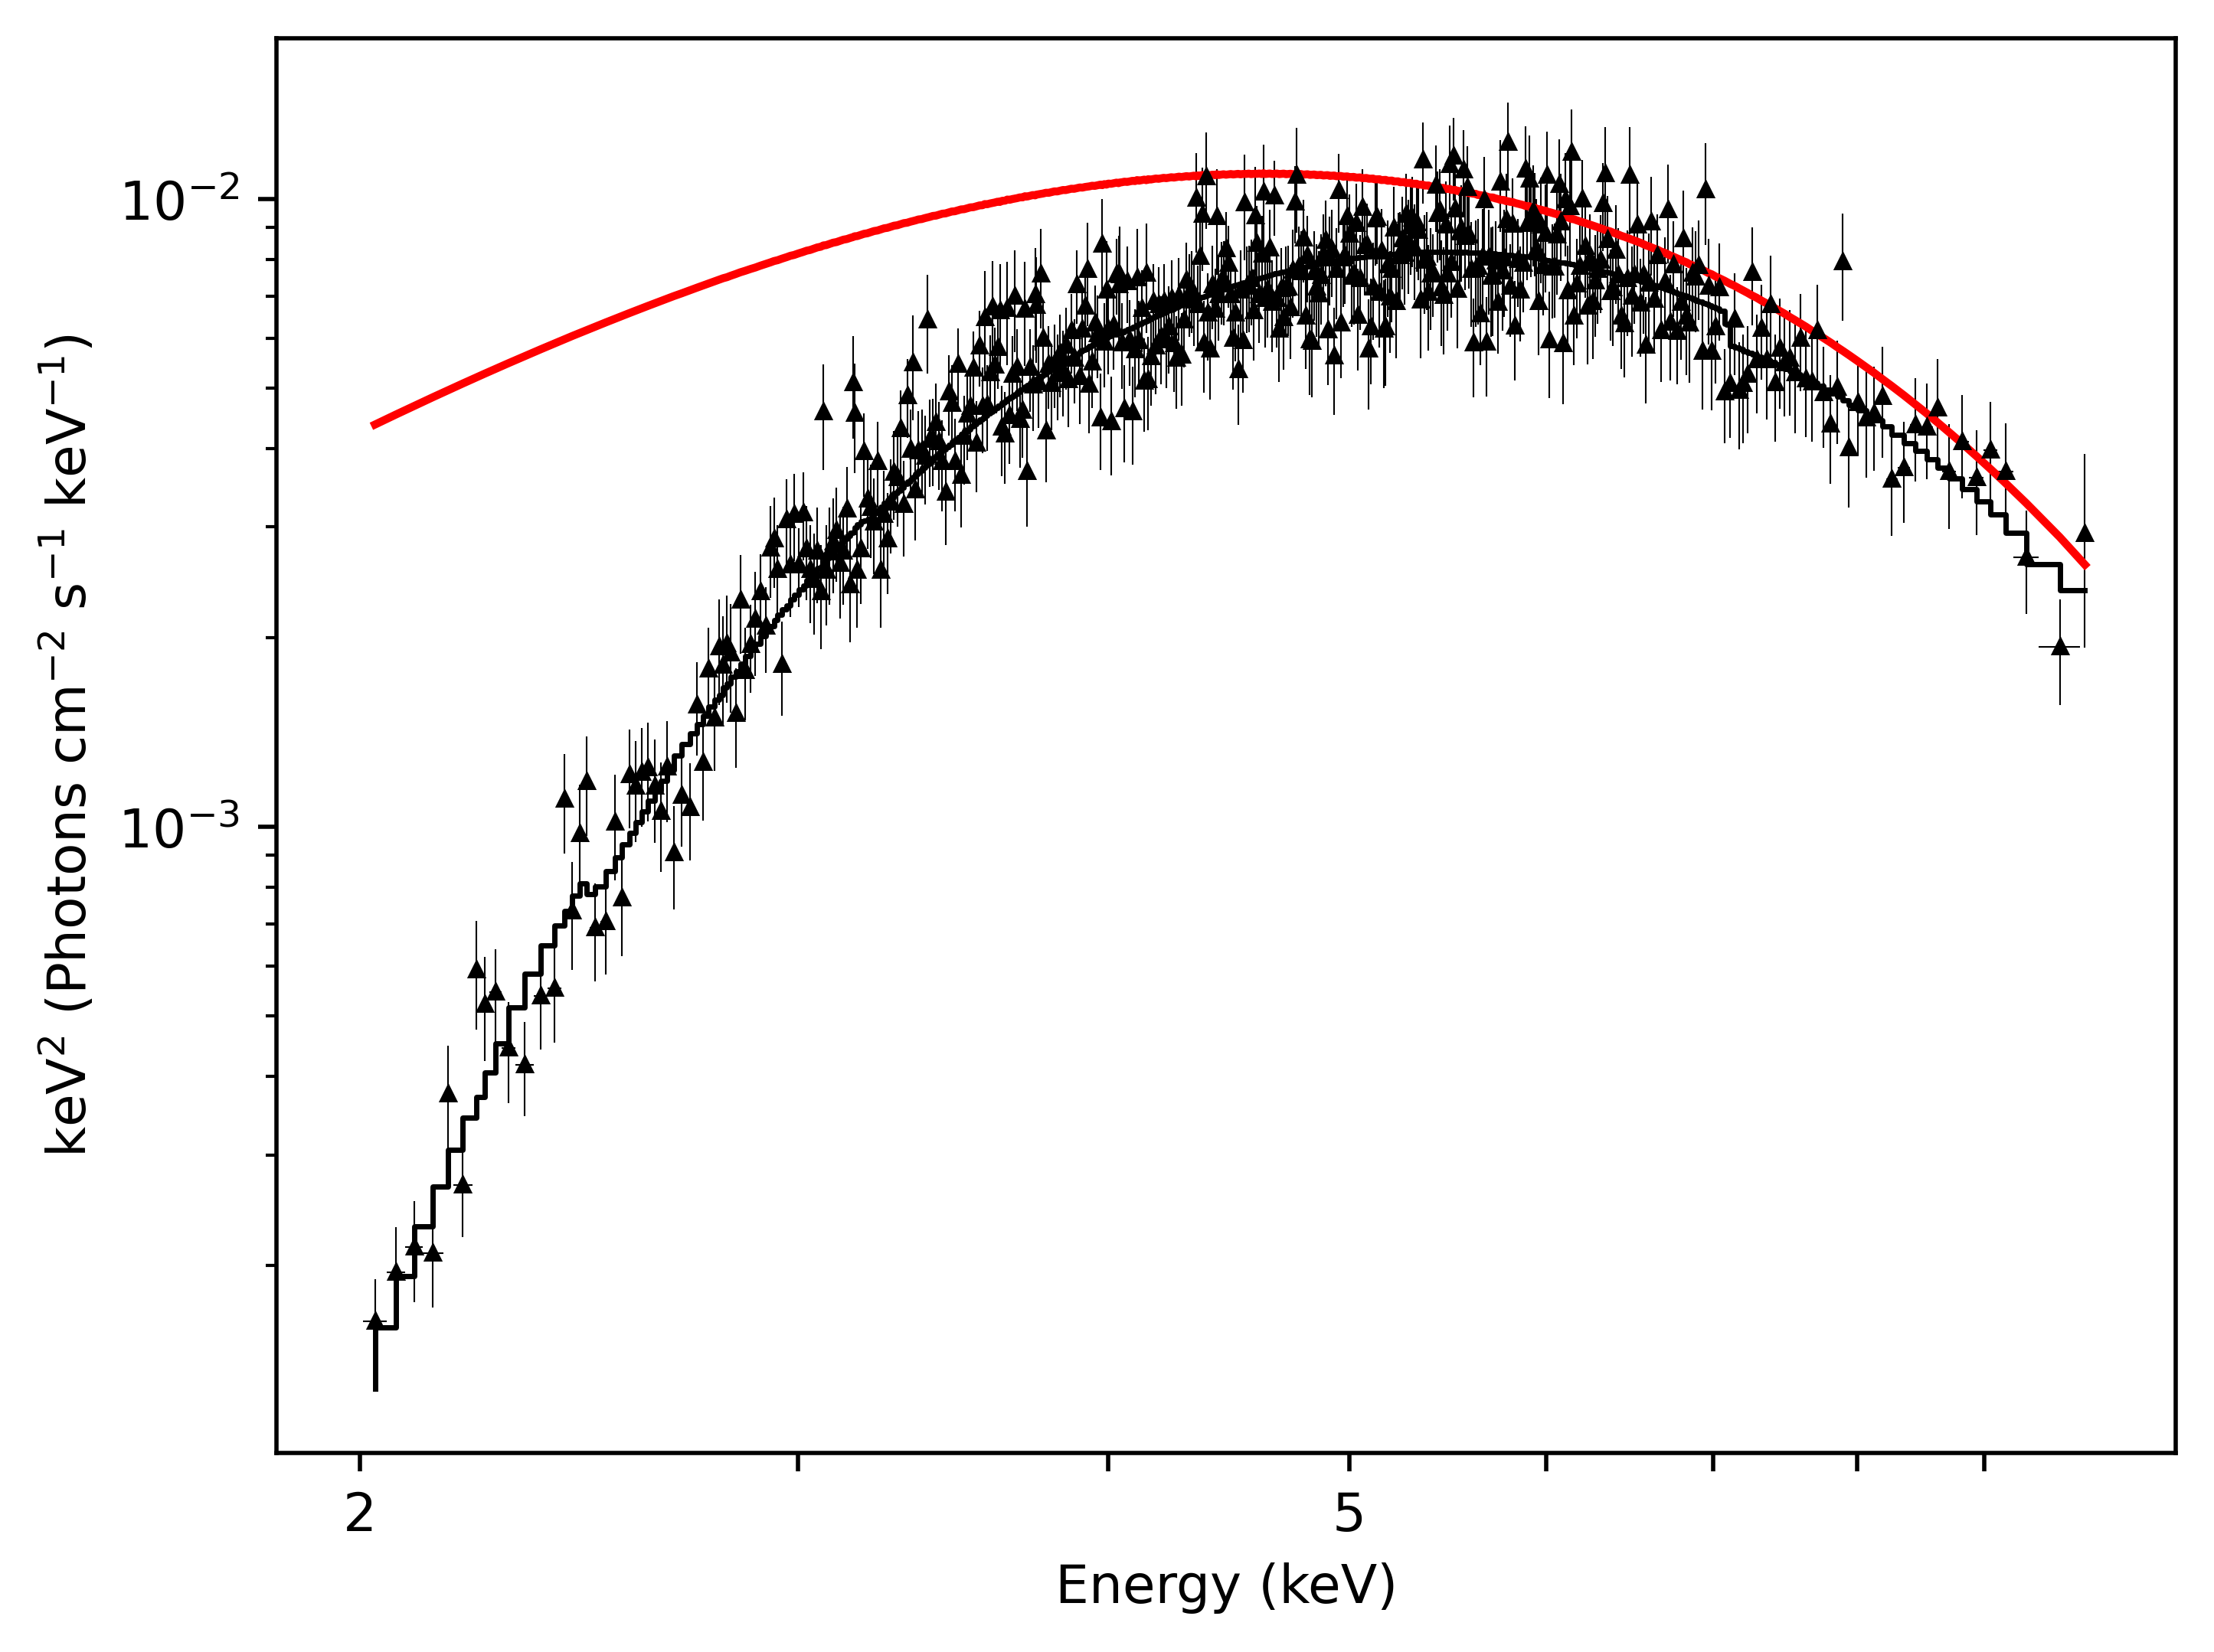
Outburst Spectral Simulations
Intrinsic factors
Triggering & dissipation mechanism
Extrinsic factors
Interstellar absorption
Signal-to-noise ratio
Narrow energy range (0.5-10 keV)
Red: Unabsorbed blackbody
Black: Absorbed blackbody

Slide 23
Outburst Spectral Simulations
How significant are these external factors?
Simulations of outburst spectra will clarify the extent of their contributions
Better understand intrinsic factors
Red: Unabsorbed blackbody
Black: Absorbed blackbody

Slide 24
Extras!

Slide 25
Proposed timeline to graduation

Slide 26
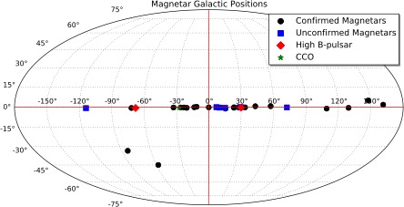

Slide 27
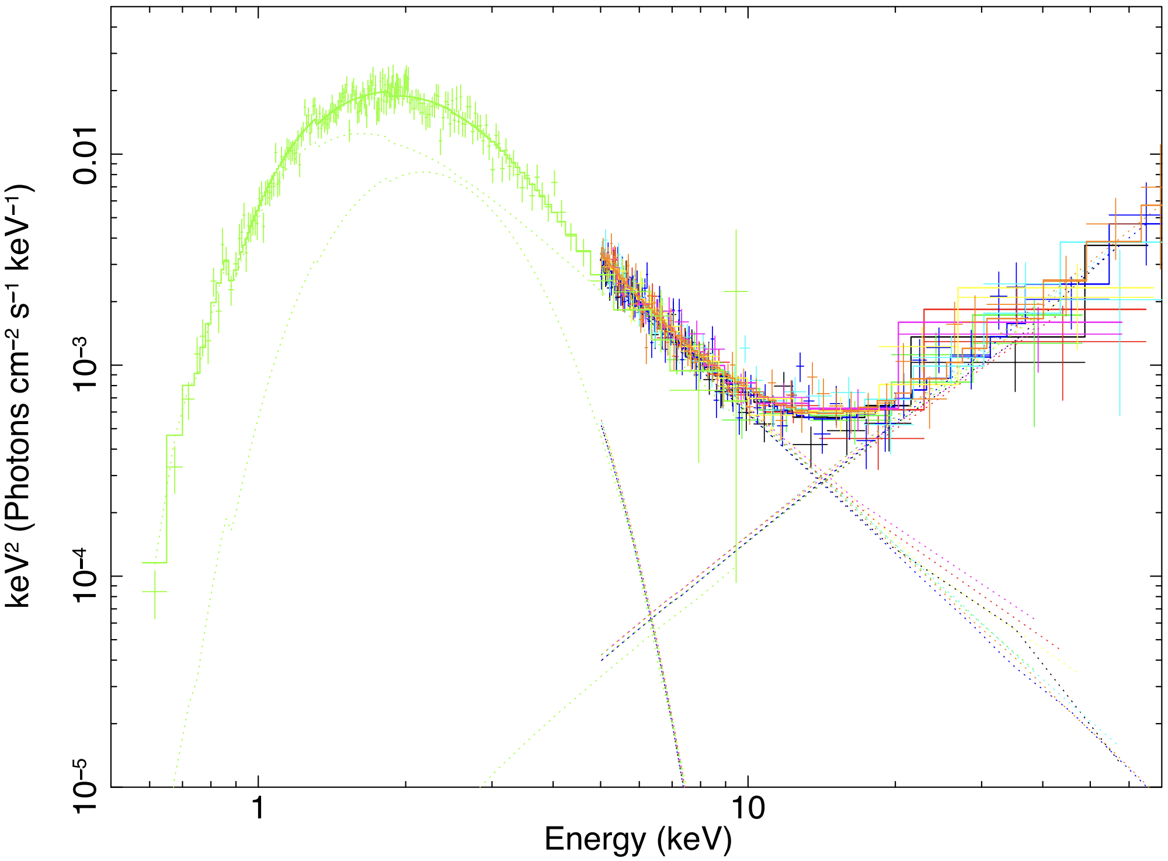
Vogel et al., 2014
Notes:
1E 2259+586

Slide 28
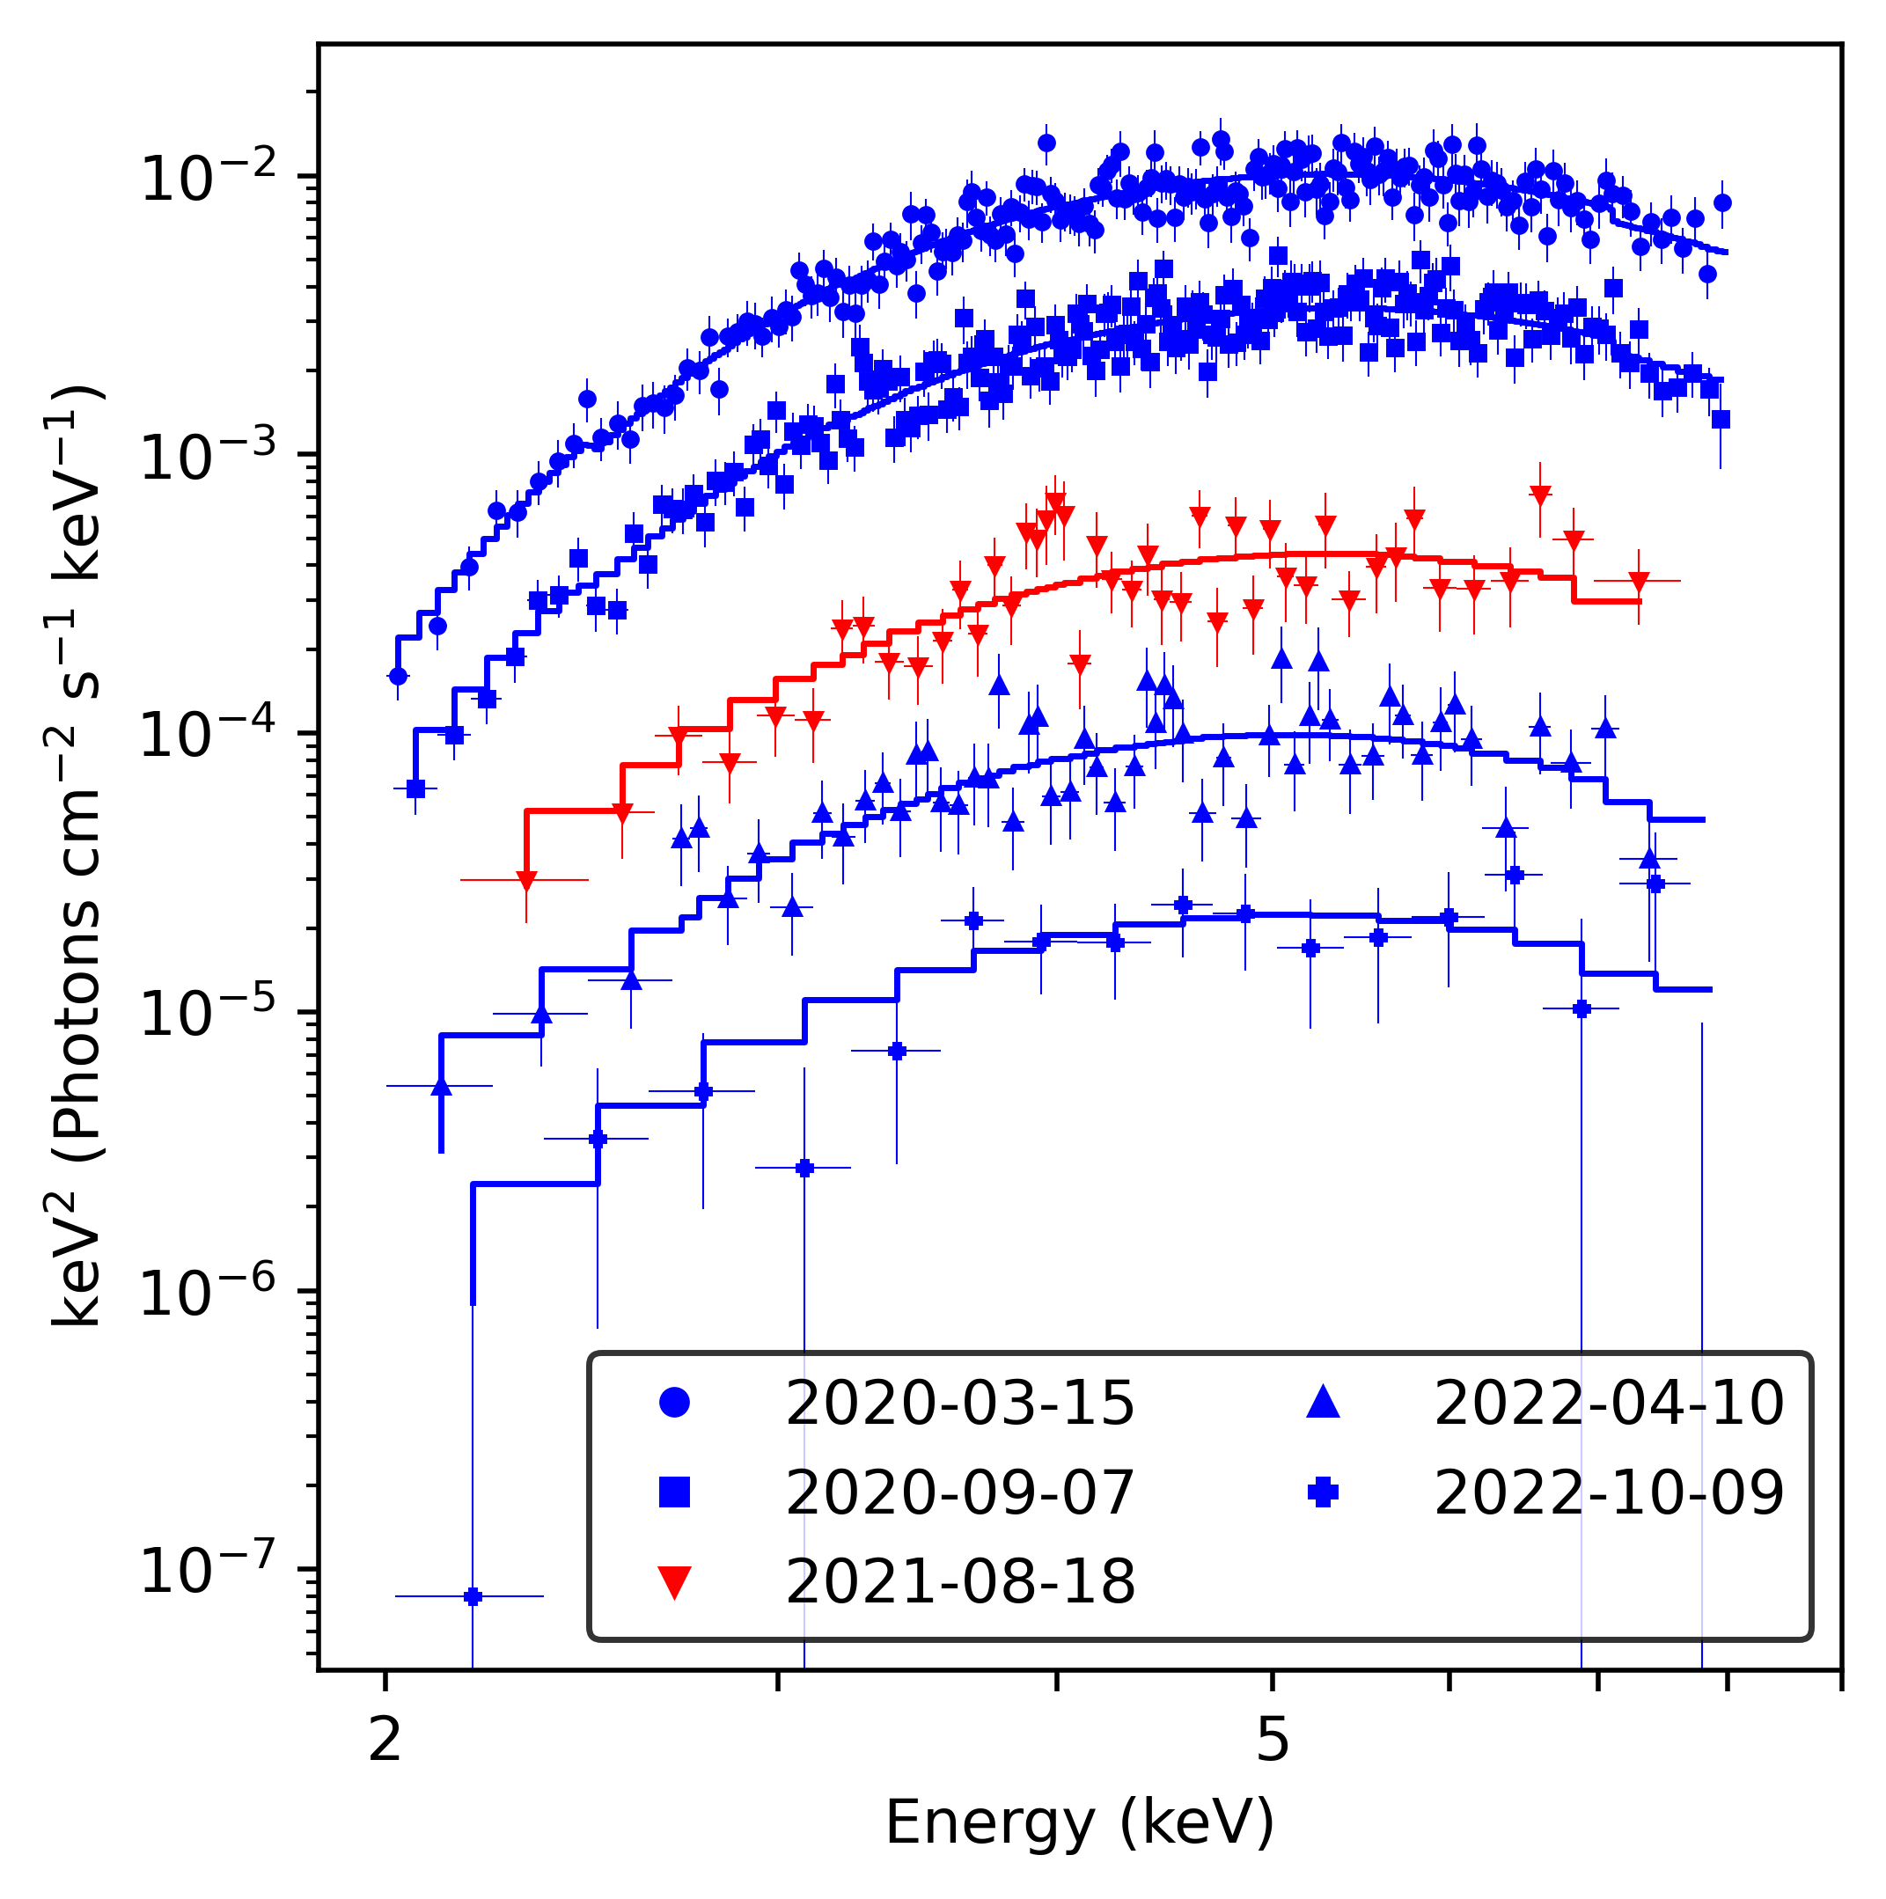
Spectra from Chandra and XMM
Notes:
Shorter XMM observations are 30-50 ks
NICER and Swift are typically a few ks or less
NICER within 7 days, Swift within 14 days (based on observing cadence)

Slide 29
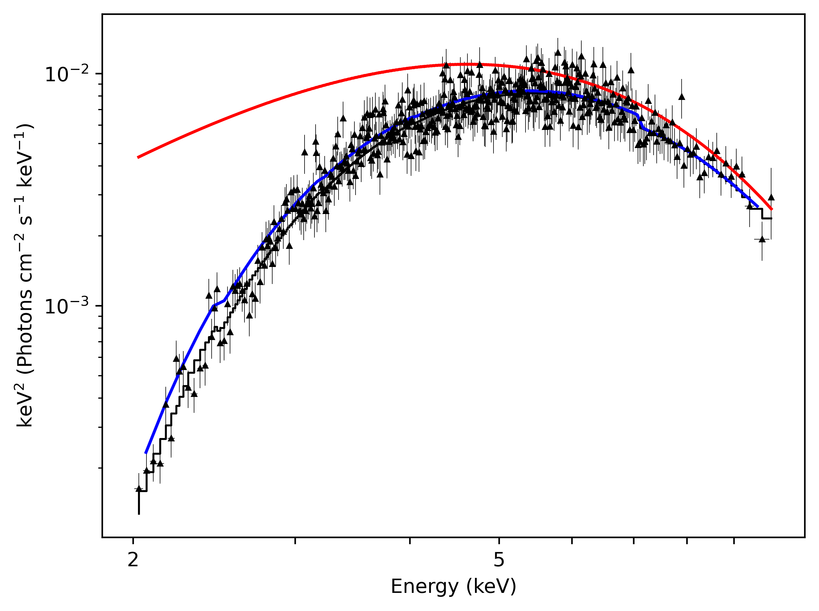
Red: Unabsorbed blackbody
Black: Absorbed blackbody
Blue: Absorbed double blackbody

Slide 30
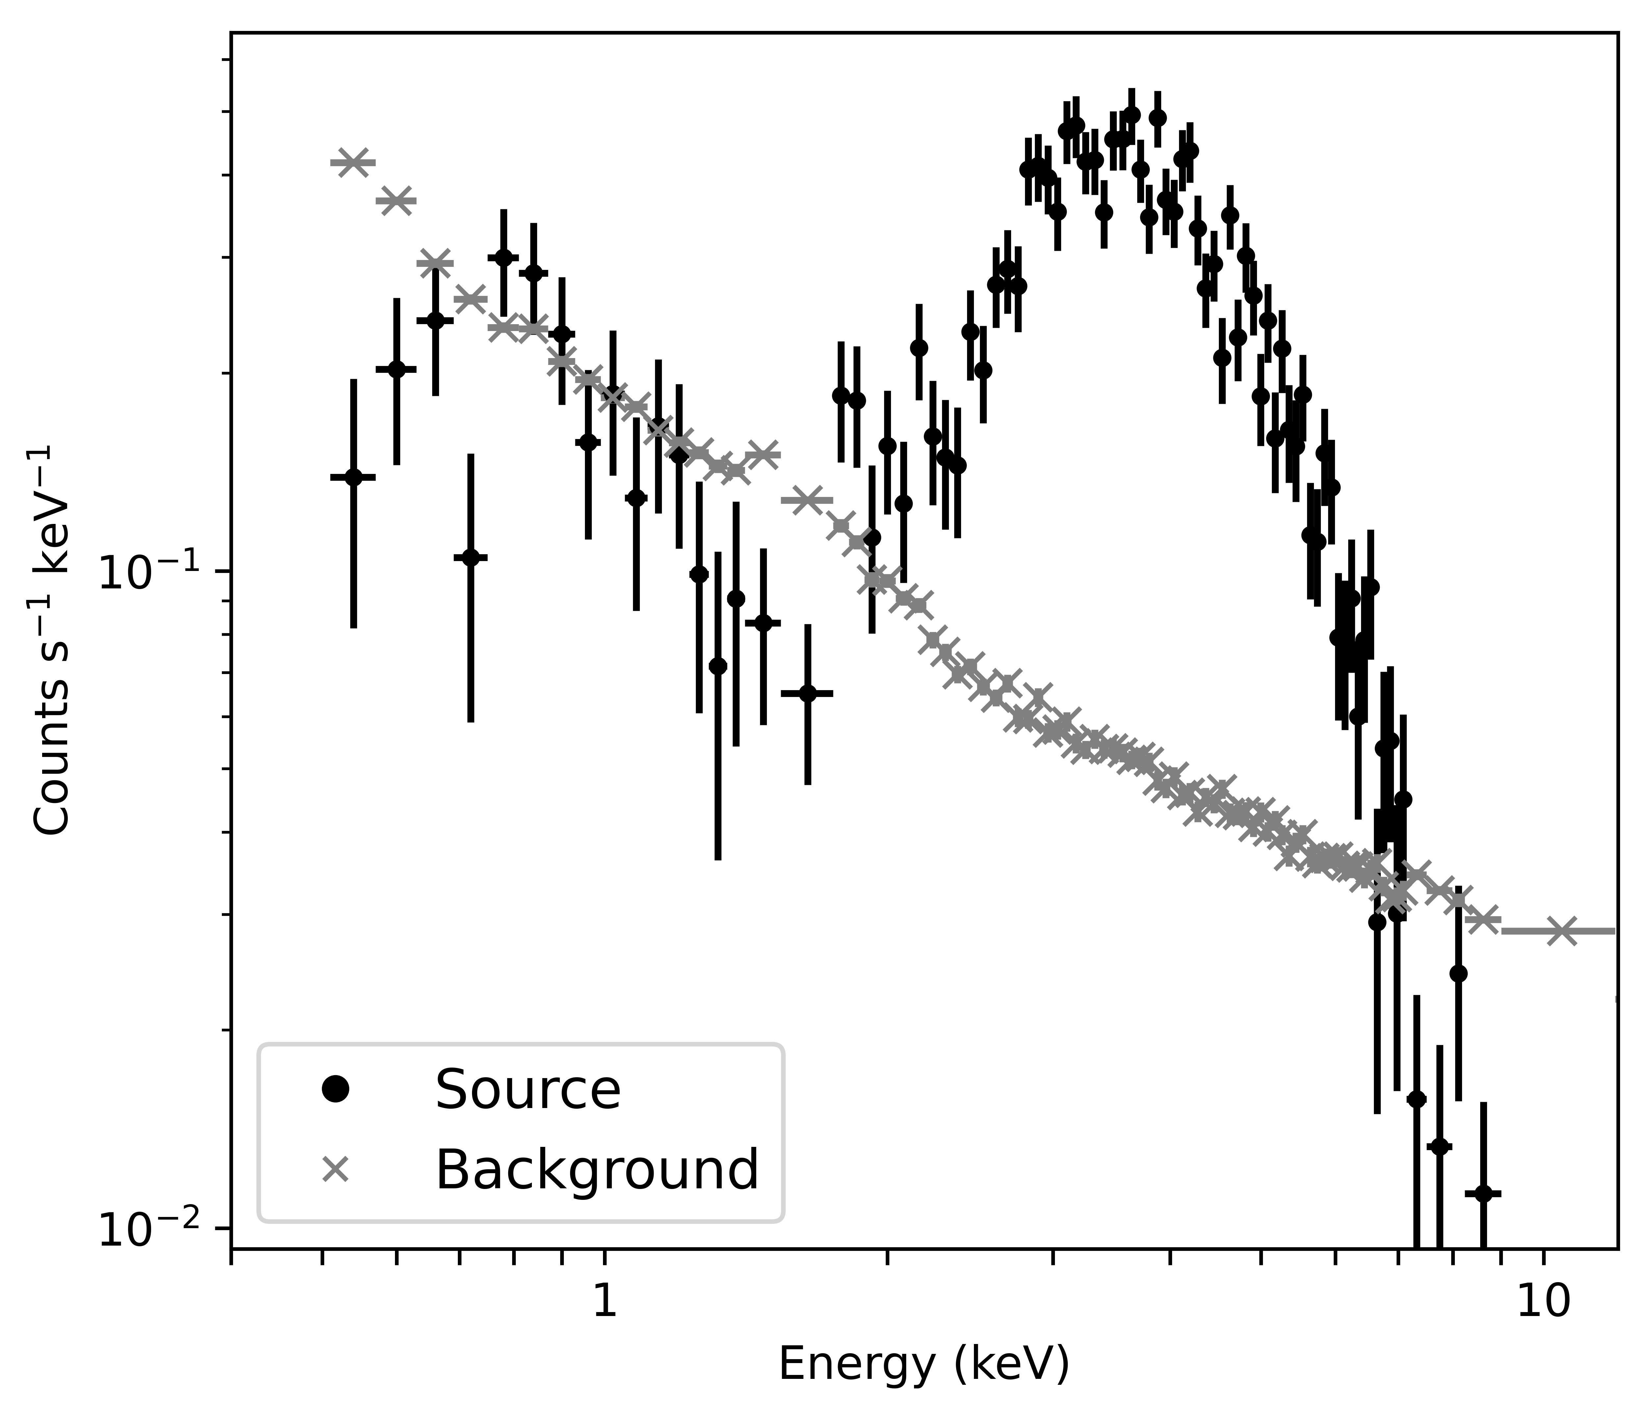
NICER Spectrum

Slide 31
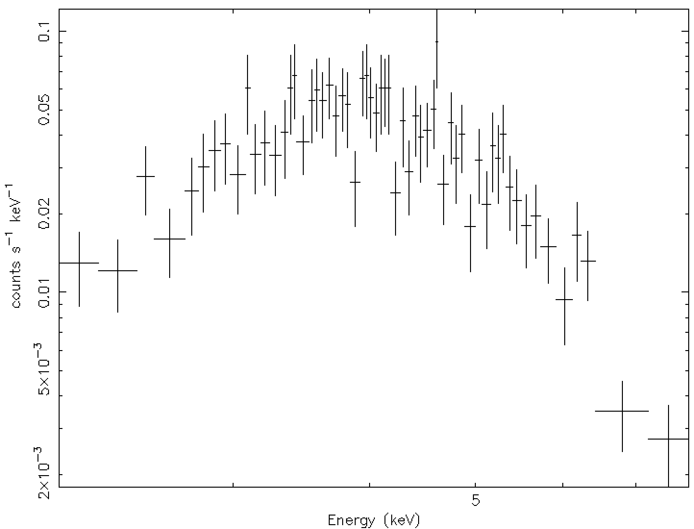
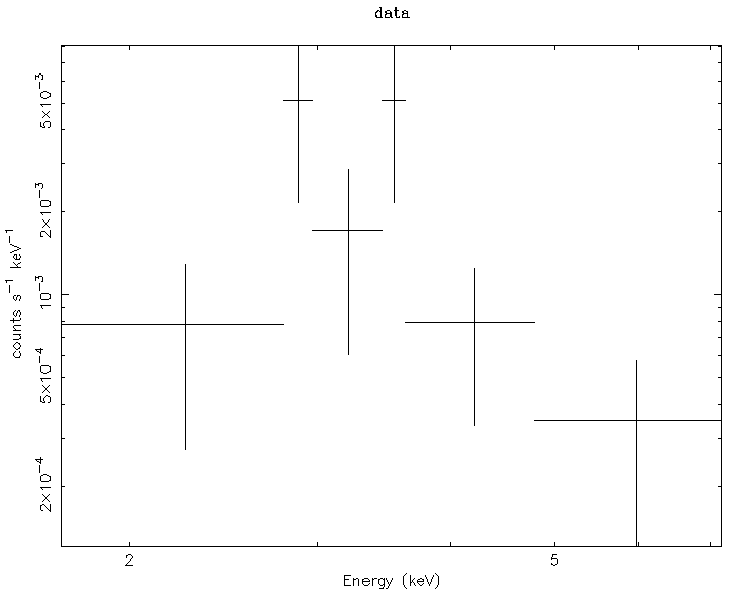
Swift Spectra
2020-03-12, 5ks
2021-07-18, 3ks
Notes:
Left: Swift obsid 00960986001, 2020-03-12, 5 ks
Right: Swift obsid 00013996018: 2021-07-18, 3 ks

Slide 32
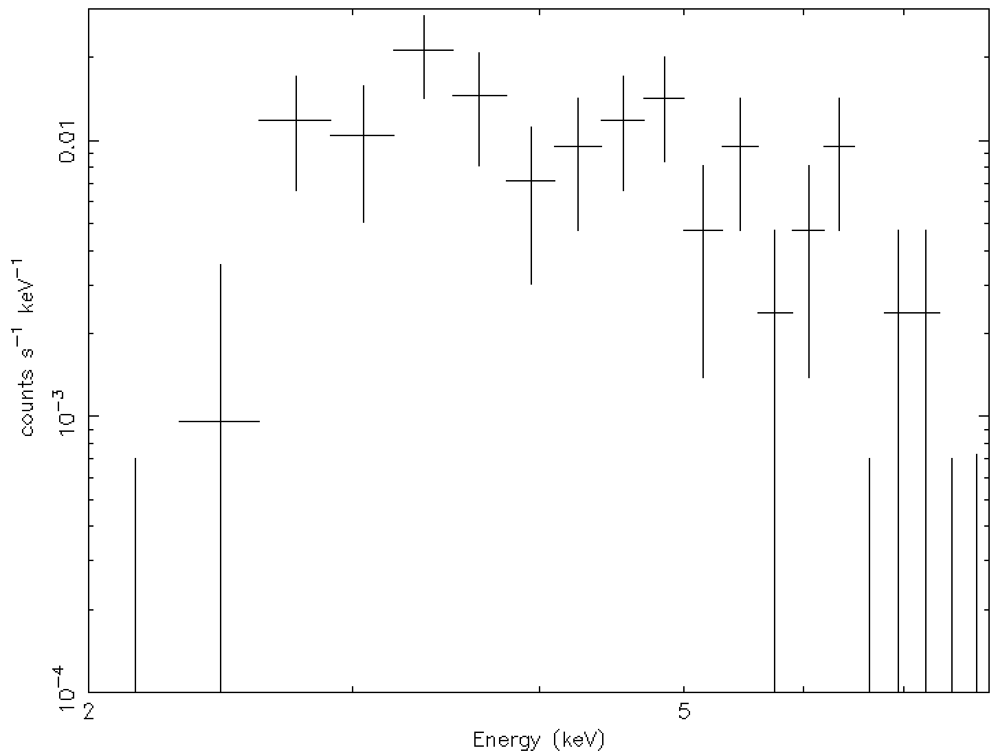
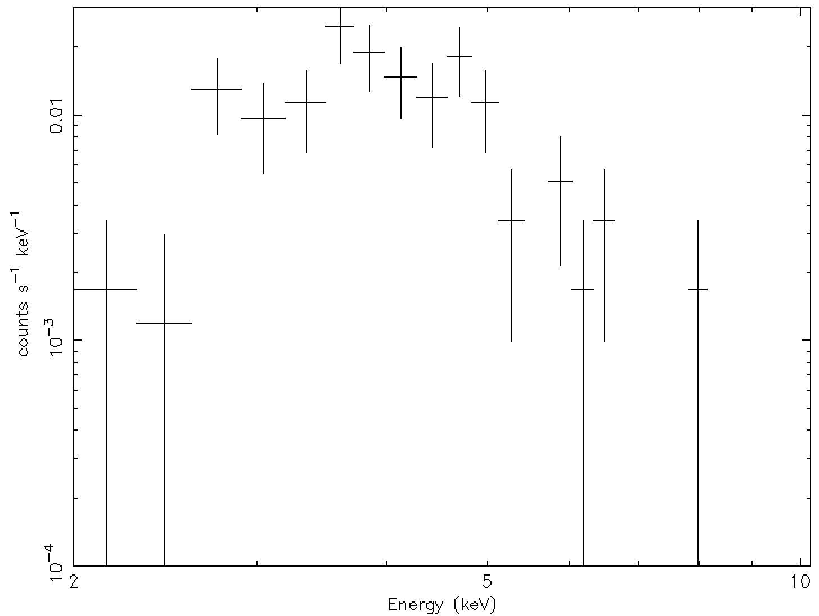
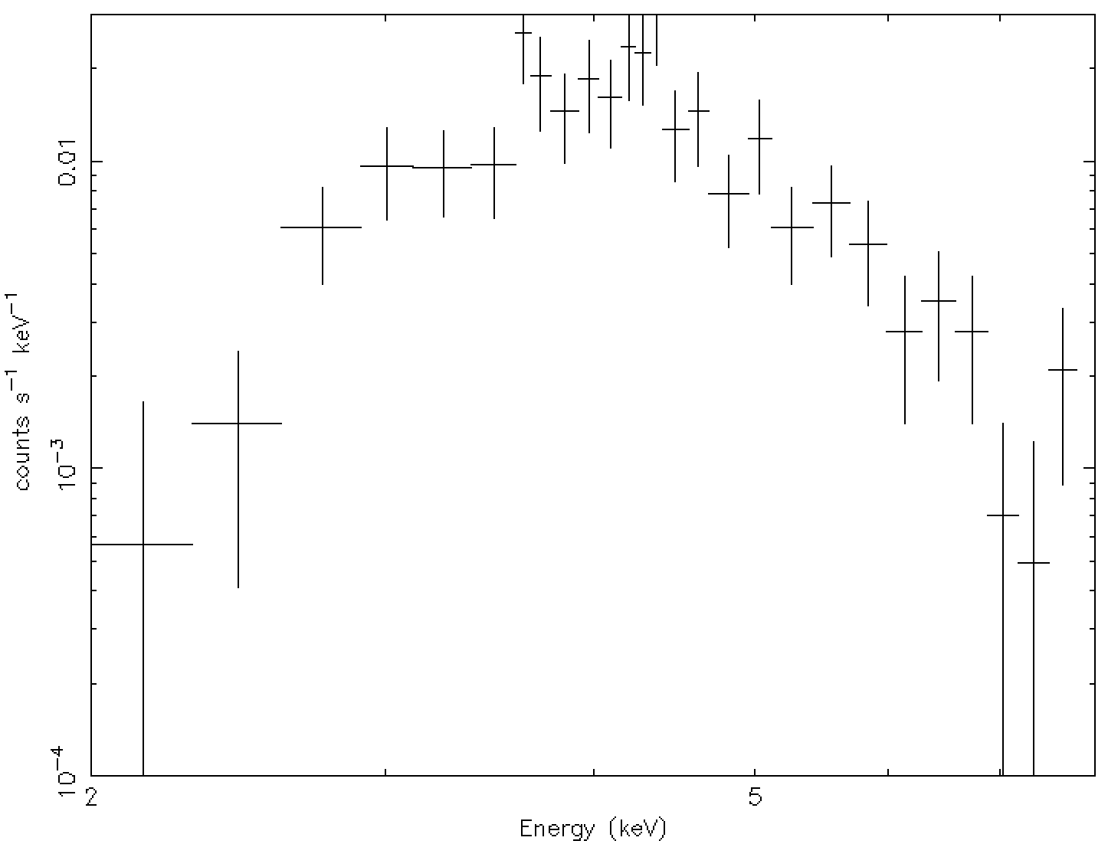
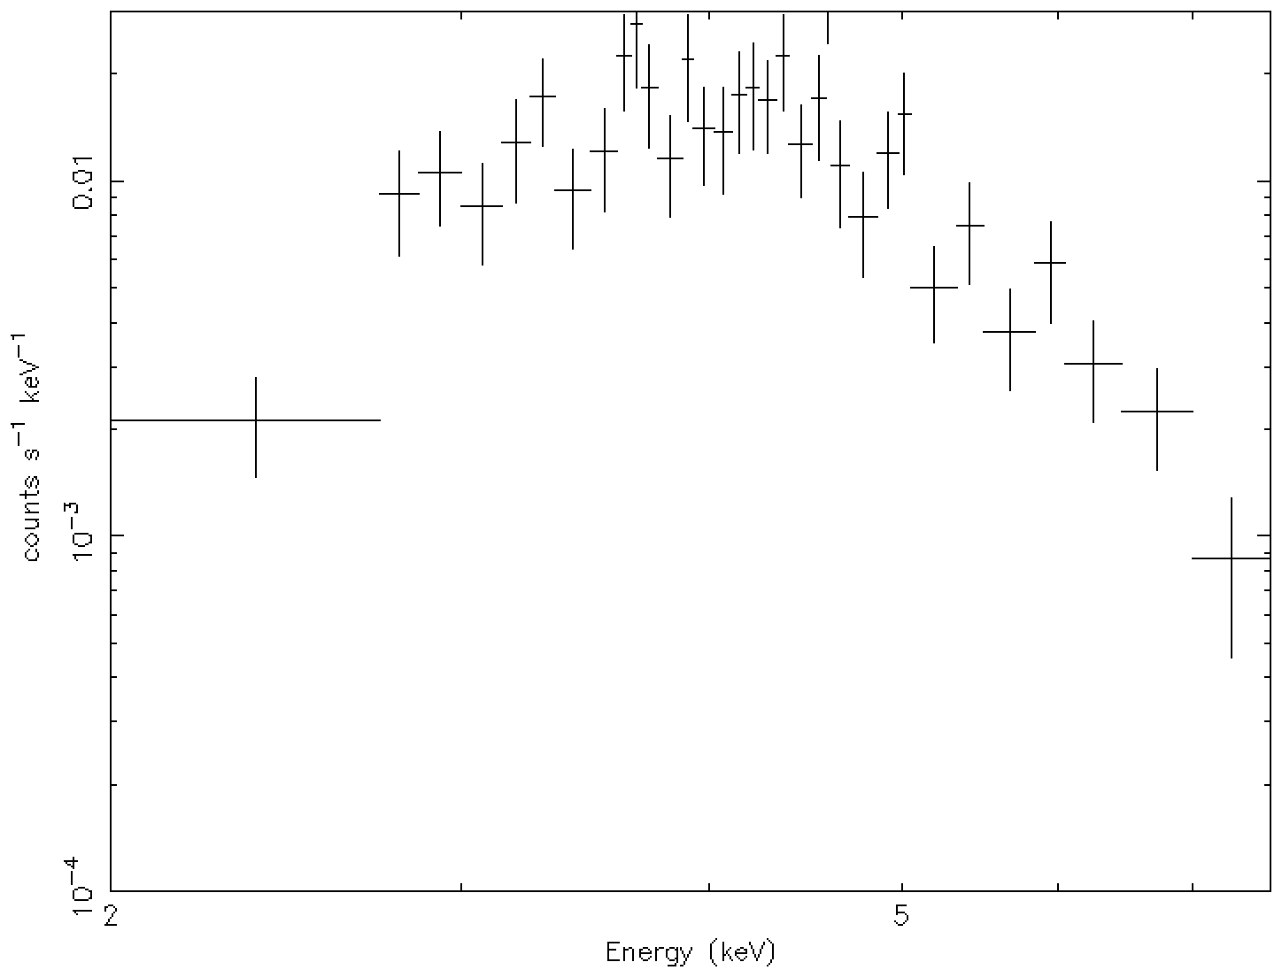
+
+
=

Slide 33
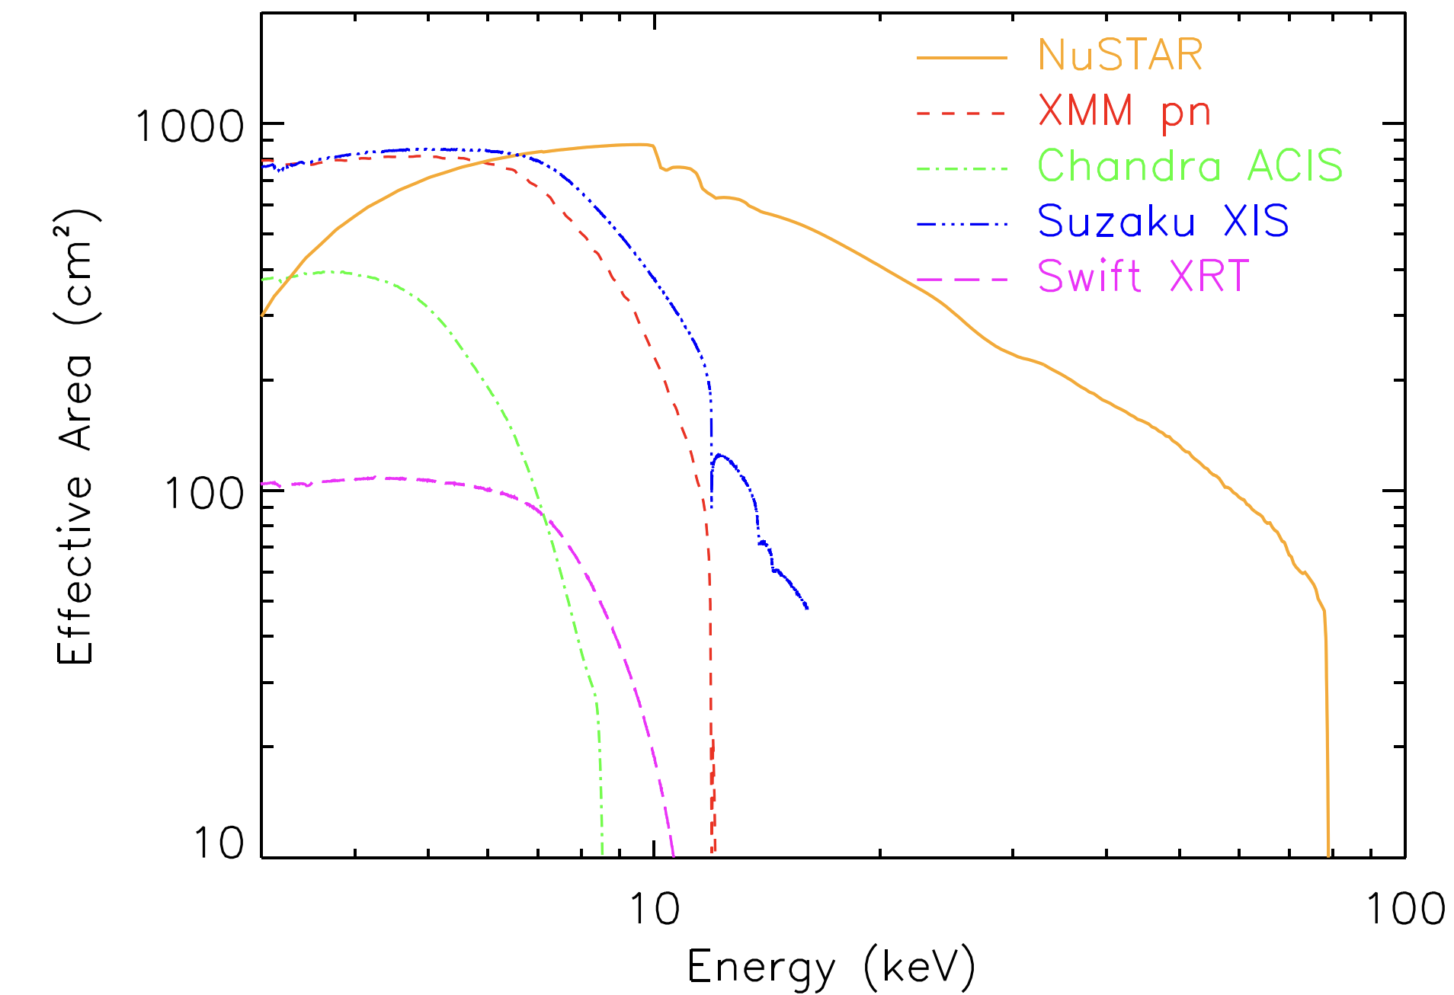
Effective Areas
Harrison et al. 2013

Slide 34
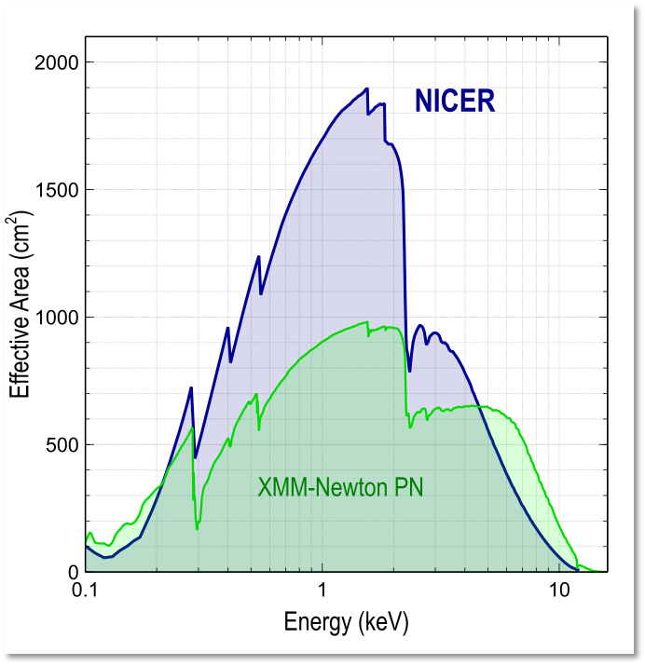
Effective Areas
NICER team

Slide 35
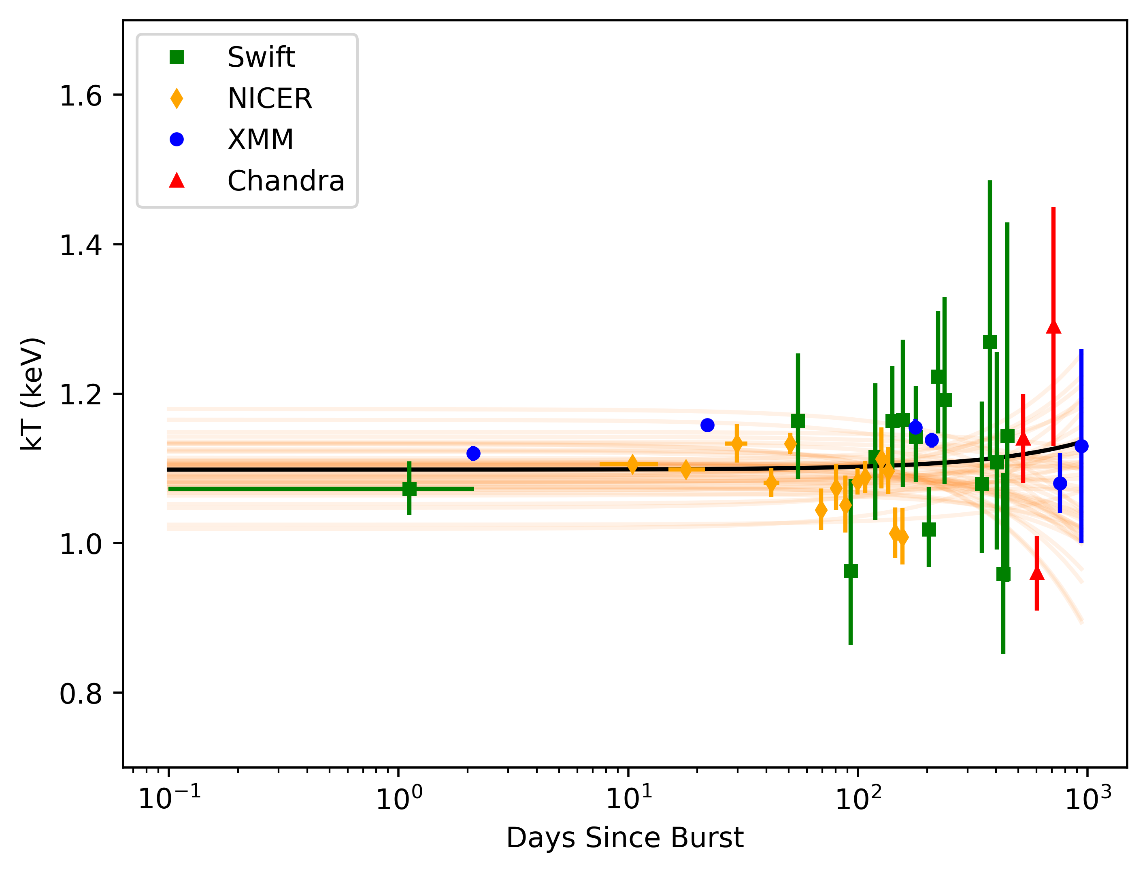
MCMC Fitting

Slide 36
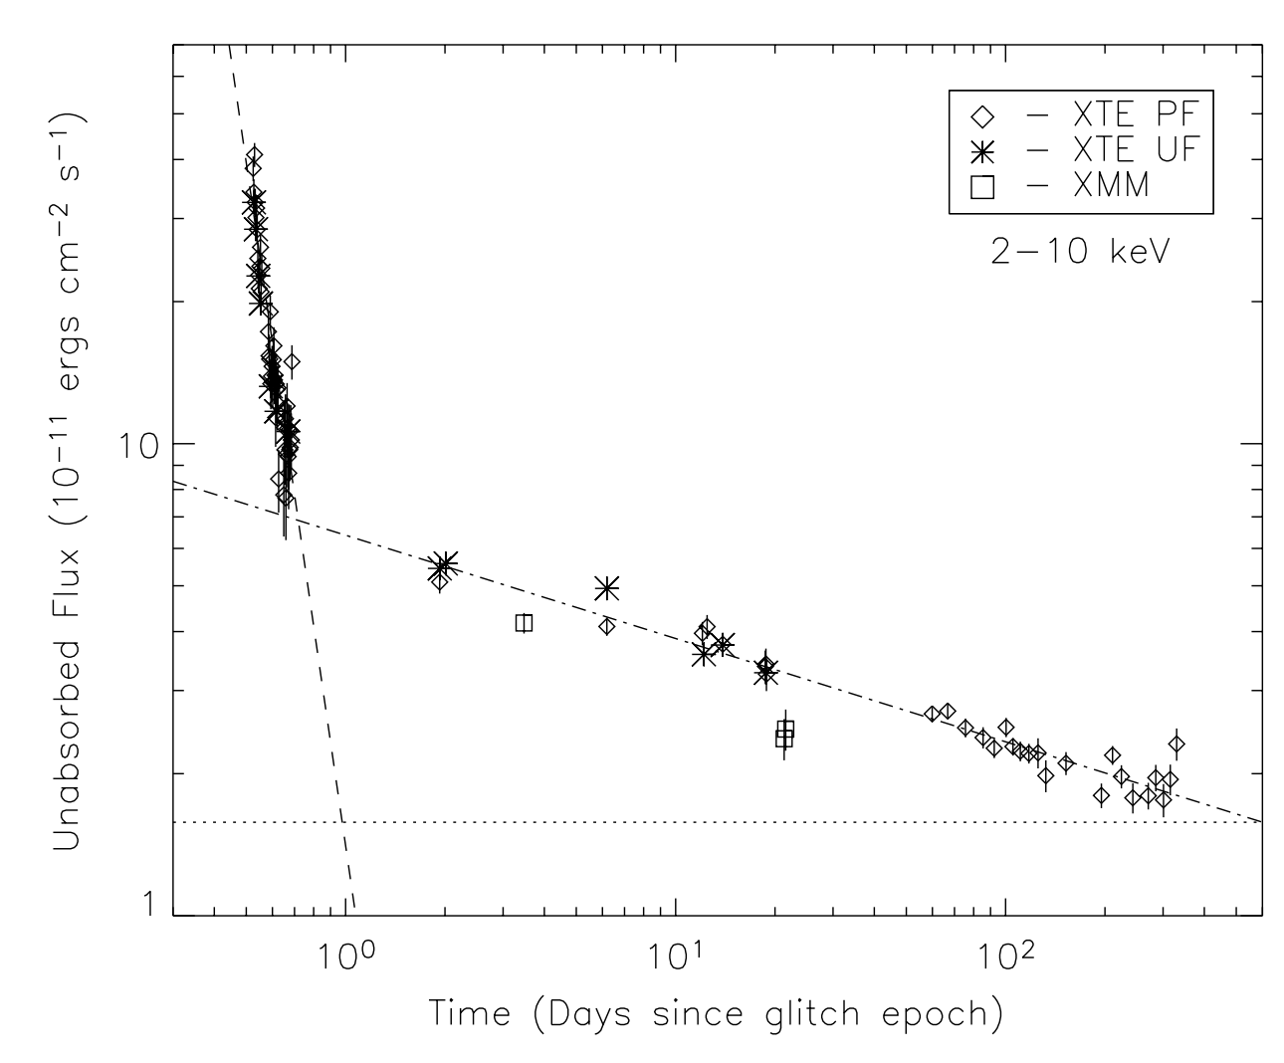
Complex Outburst Decay
Woods et al. 2004
Notes:
1E 2259+586 2002 outburst, using RXTE and XMM

