Slide 1
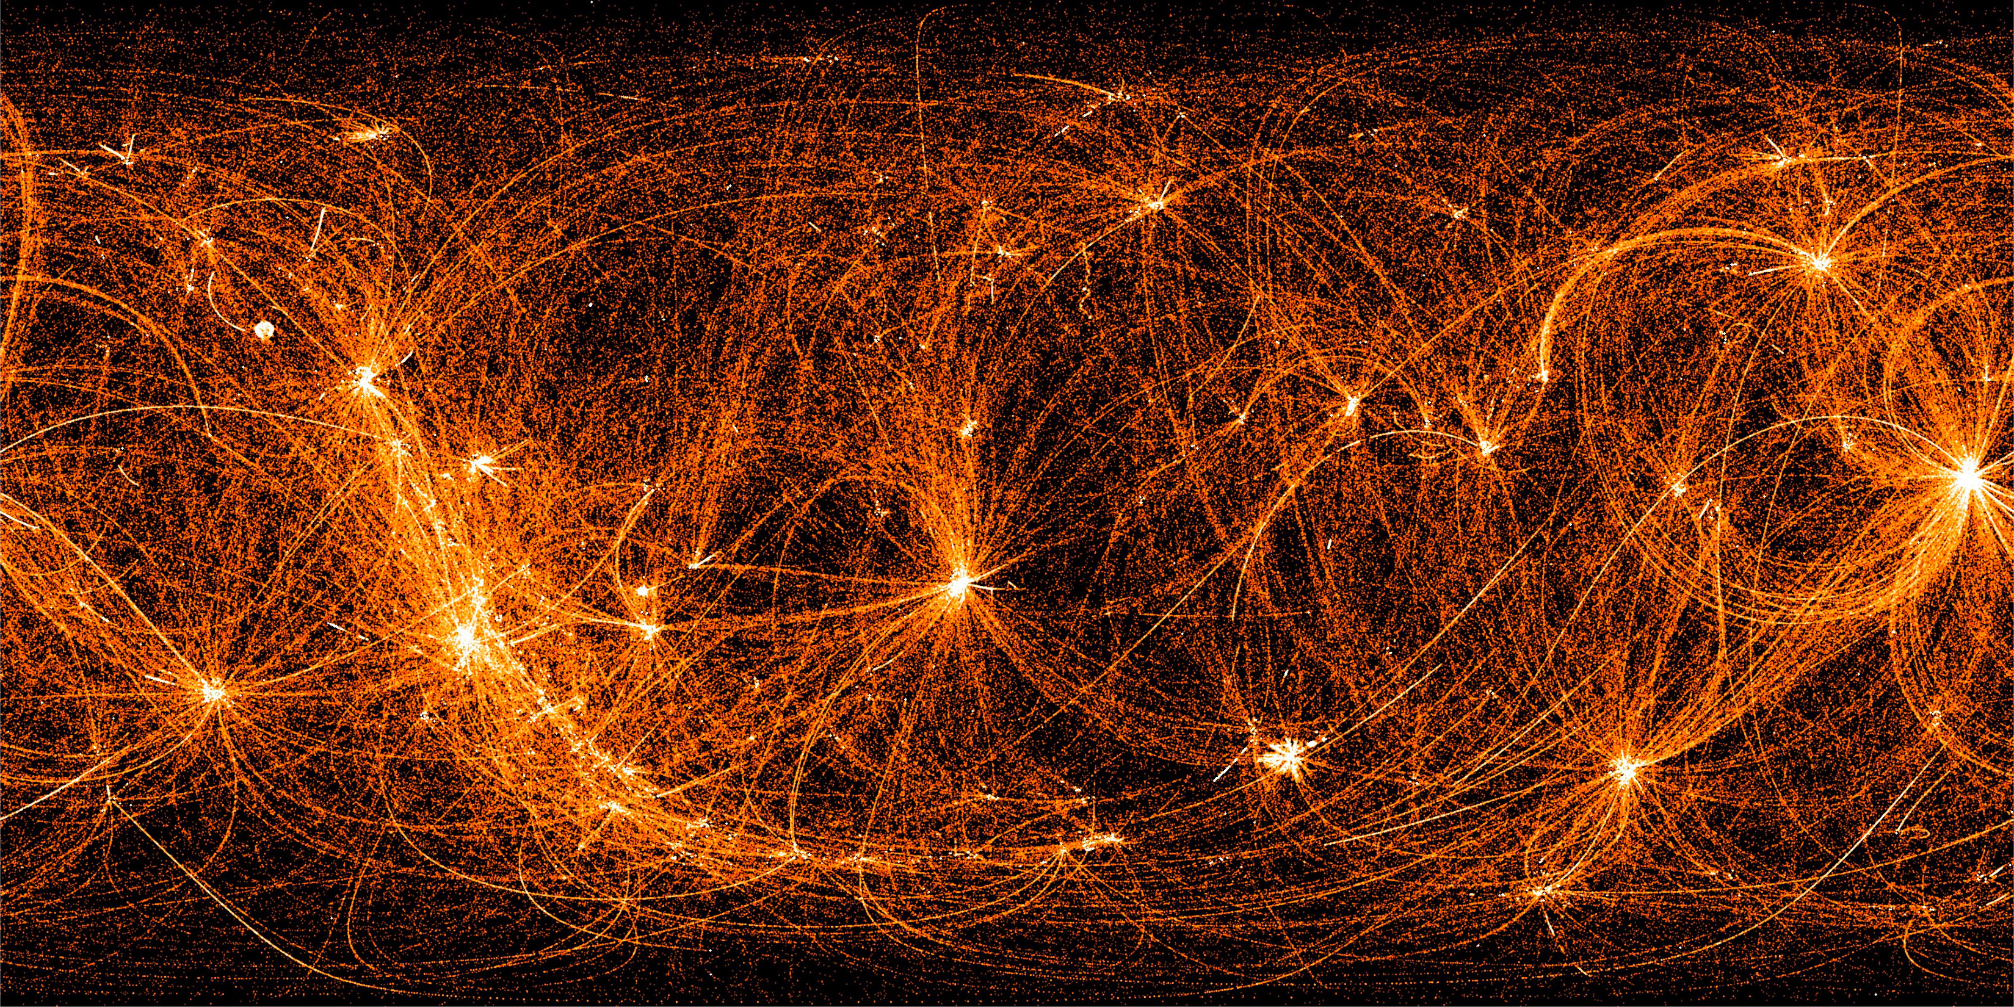


Exploring the neutron star interior with Wafle
Joanna Berteaud, Cole Miller
NICER/IXPE Workshop - July 2024
  Data recorded by NICER during its nighttime slews between targets – Credits: NASA/NICER

Slide 2
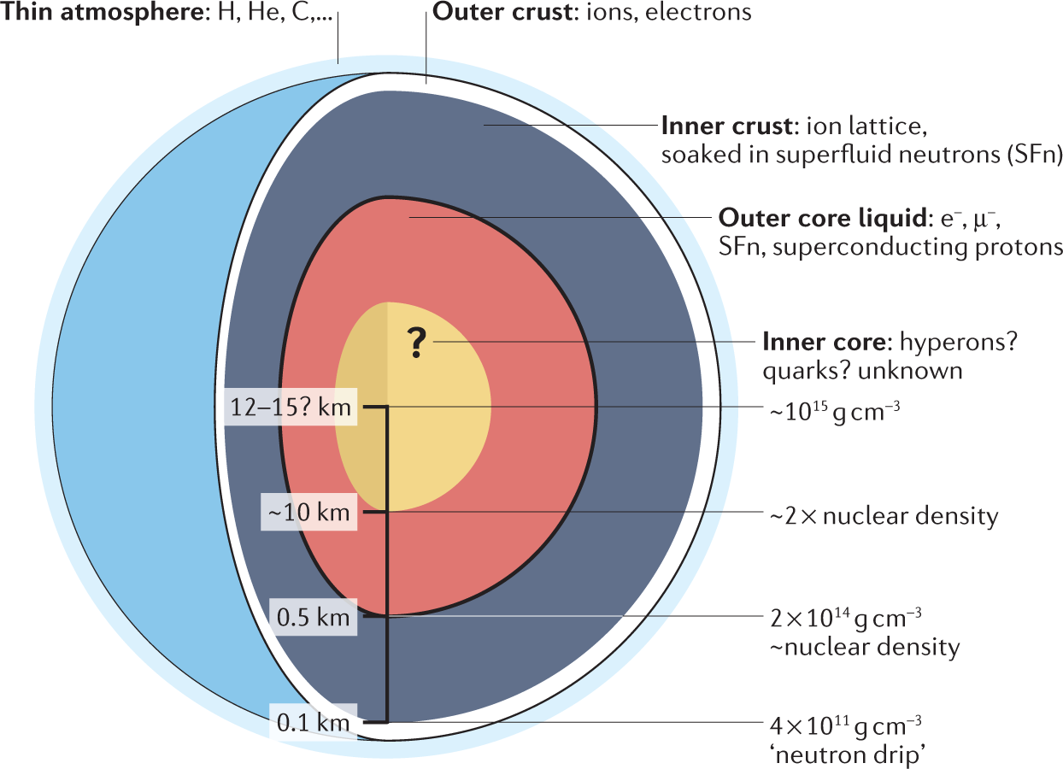
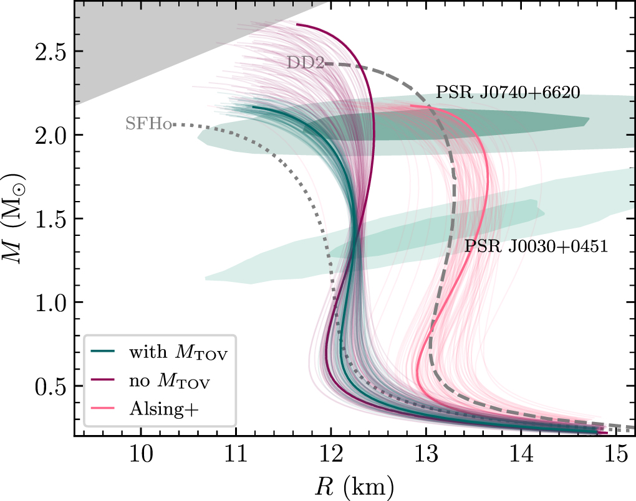

Neutron stars and their equation of state
$$M\left(R\right)↔P(ρ)$$
Holmbeck+22
Yunes+22
J. Berteaud – Exploring the neutron star interior with Wafle – NICER/IXPE Workshop – July 2024

Slide 3
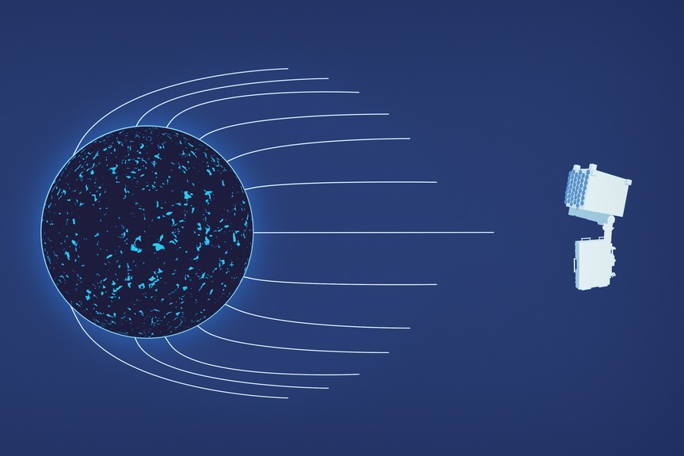
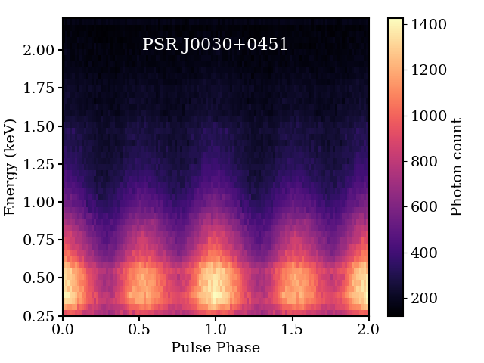
X-ray emission of neutron stars
Hot spot(s)
on the surface
Light bending
due to strong gravity
Modulated emission
Bogdanov+19
Miller+19
NASA GSFC
The X-ray emission contains information on the neutron star mass and radius!
J. Berteaud – Exploring the neutron star interior with Wafle – NICER/IXPE Workshop – July 2024

Slide 4
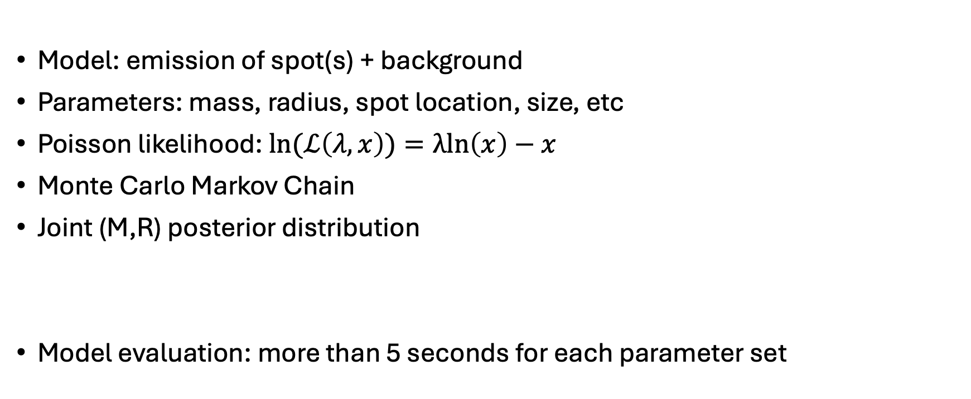
Likelihood fit
Model: emission of spot(s) + background
Parameters: mass, radius, spot location, size, etc
Poisson likelihood: $ln(ℒ\left(λ,x\right))=λln\left(x\right)−x$
Monte Carlo Markov Chain
Joint (M,R) posterior distribution
Model evaluation: more than 5 seconds for each parameter set
Miller+19
J. Berteaud – Exploring the neutron star interior with Wafle – NICER/IXPE Workshop – July 2024

Slide 5
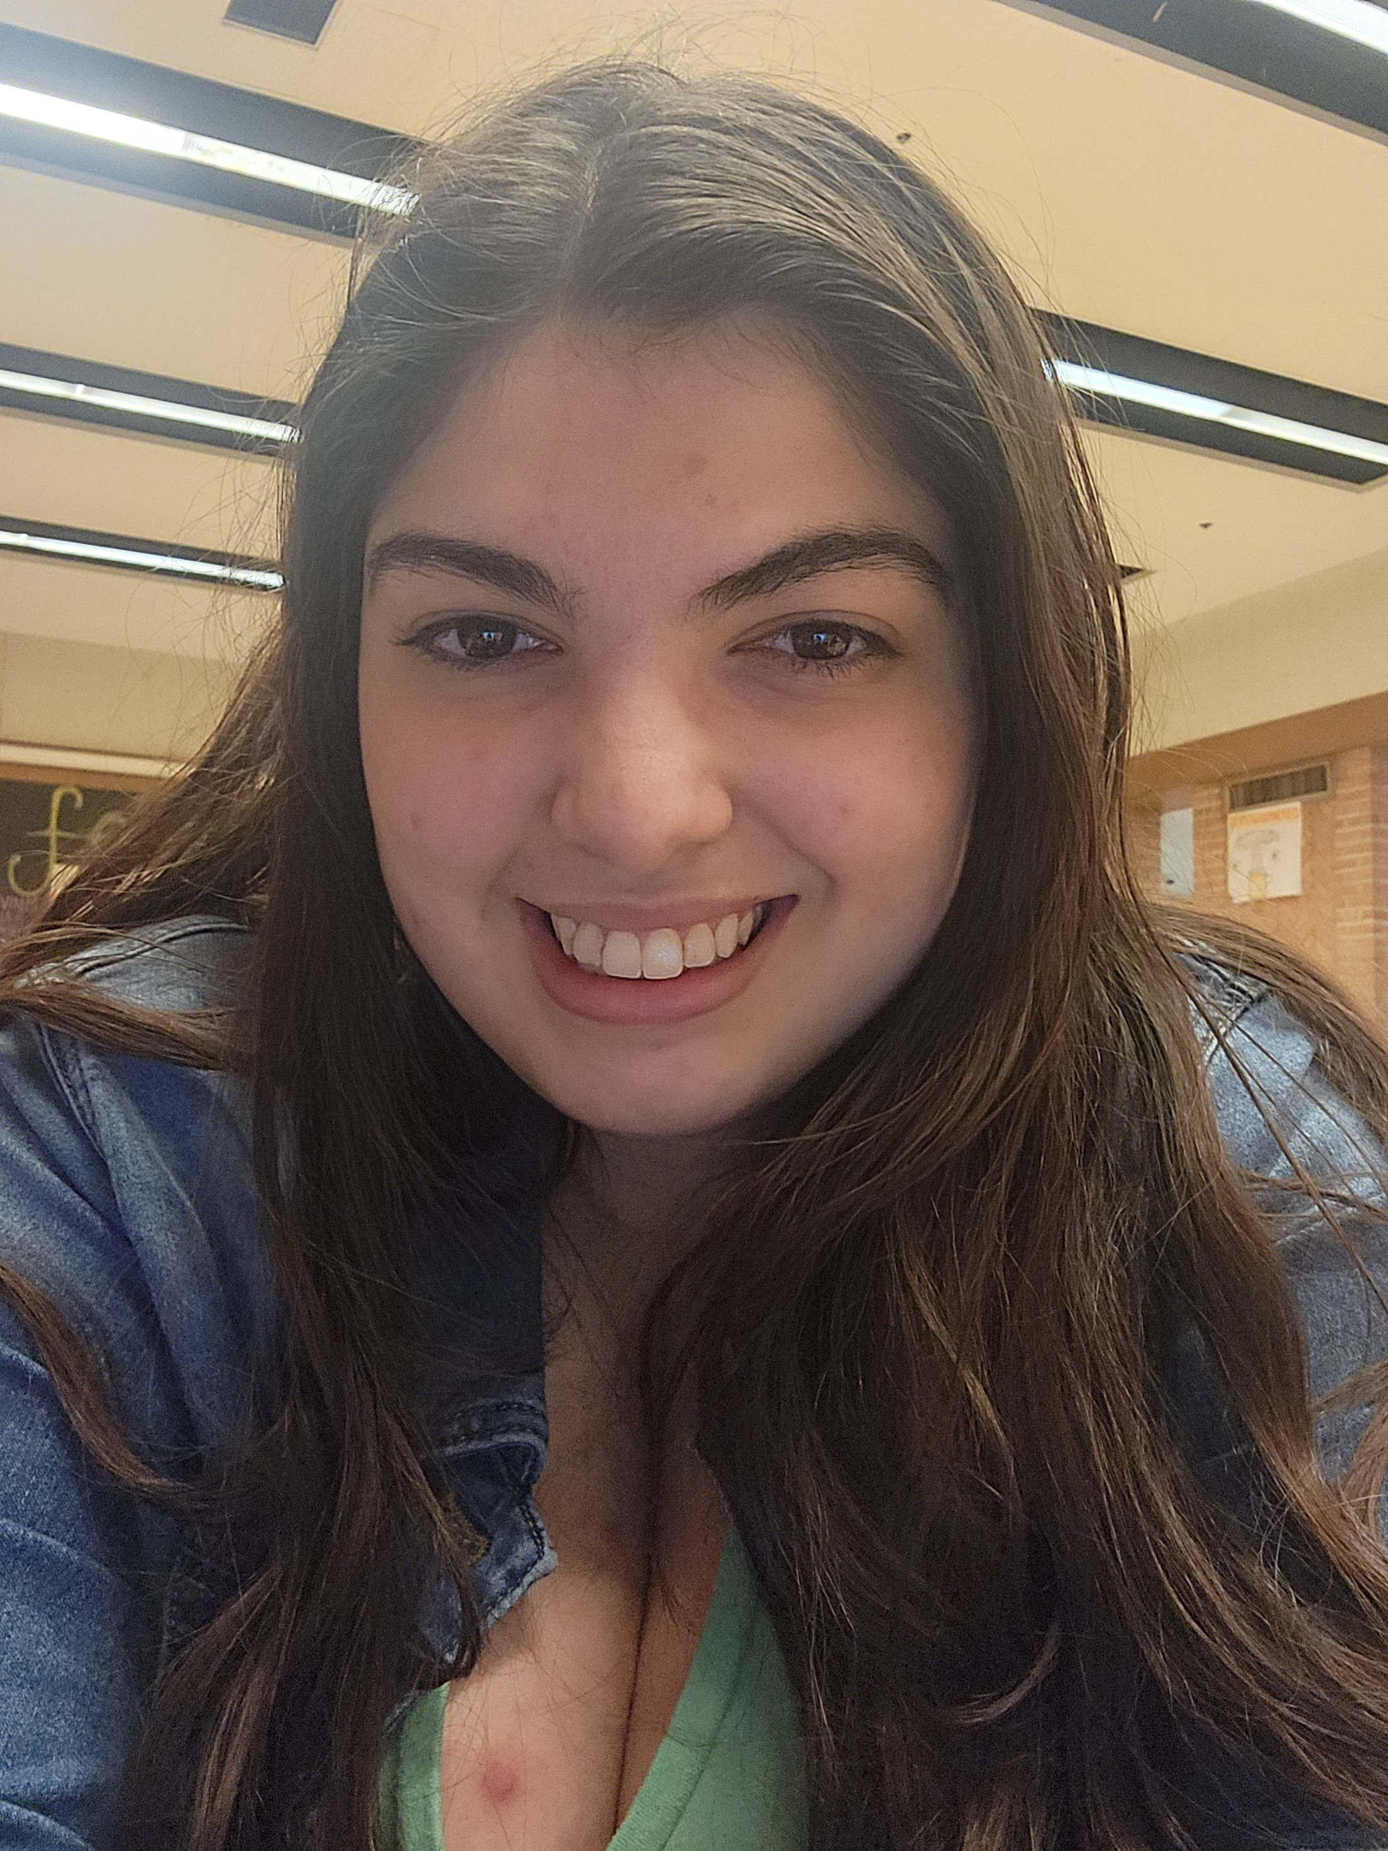
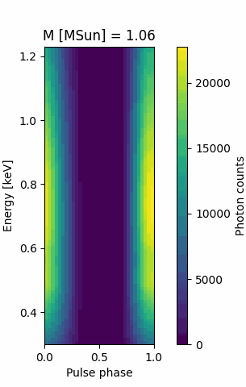
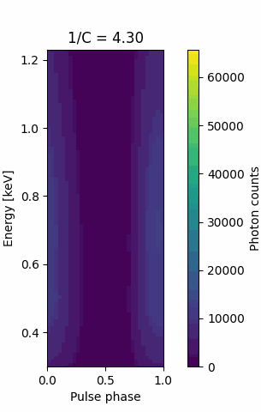

Machine learning
Random forest regressor: see Giula Nóbrega da Costa’s poster
Neural network
Simplified model:
  single circular spot
  only M and R vary
  => Inverse compactness $∝$ R/M
J. Berteaud – Exploring the neutron star interior with Wafle – NICER/IXPE Workshop – July 2024

Slide 6
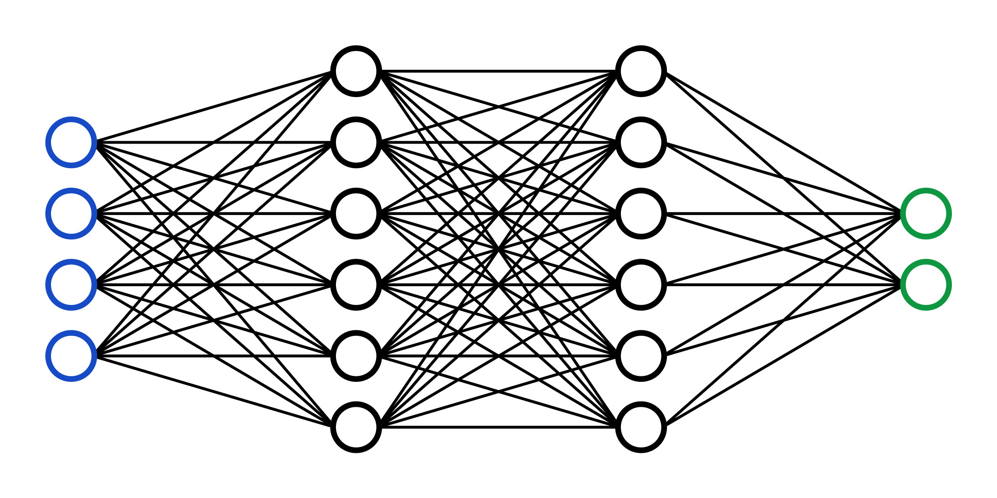
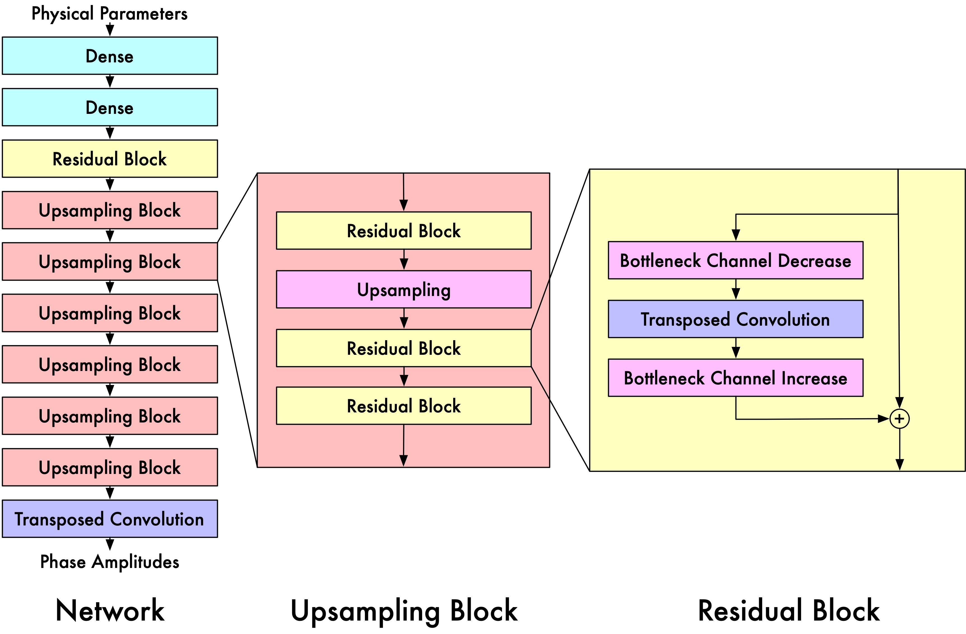
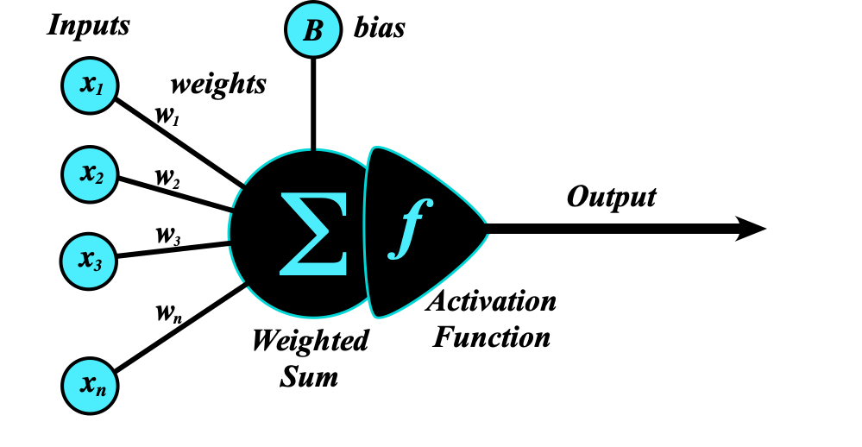
Wafle, the WAveForm LEarner
2D ResNet
See Constantinos Kalapotharakos’ talk!
Credits: V. Zhou
Credits: G. Olmschenk
Waveforms
Credits: A. D. Elster
J. Berteaud – Exploring the neutron star interior with Wafle – NICER/IXPE Workshop – July 2024

Slide 7

Setup
Mass: 1.0 to 2.4 M☉
Inverse compactness: 4.0 to 8.0
Wafle computes:
  spot emission
  10% phase-independent background
Loss function:
  $∆$ln(likelihood(model, Wafle))
J. Berteaud – Exploring the neutron star interior with Wafle – NICER/IXPE Workshop – July 2024

Slide 8
Results
Wafle achieves good accuracy across the entire (M, 1/C) parameter space
J. Berteaud – Exploring the neutron star interior with Wafle – NICER/IXPE Workshop – July 2024

Slide 9
Inference validation on mock data
“The 68% credible interval covers the true value in 68% of the cases”
Mock data:
  spot emission
  10% background
  Poisson noise
Inference more than 20 times faster
Conservative
Over confident
J. Berteaud – Exploring the neutron star interior with Wafle – NICER/IXPE Workshop – July 2024

Slide 10
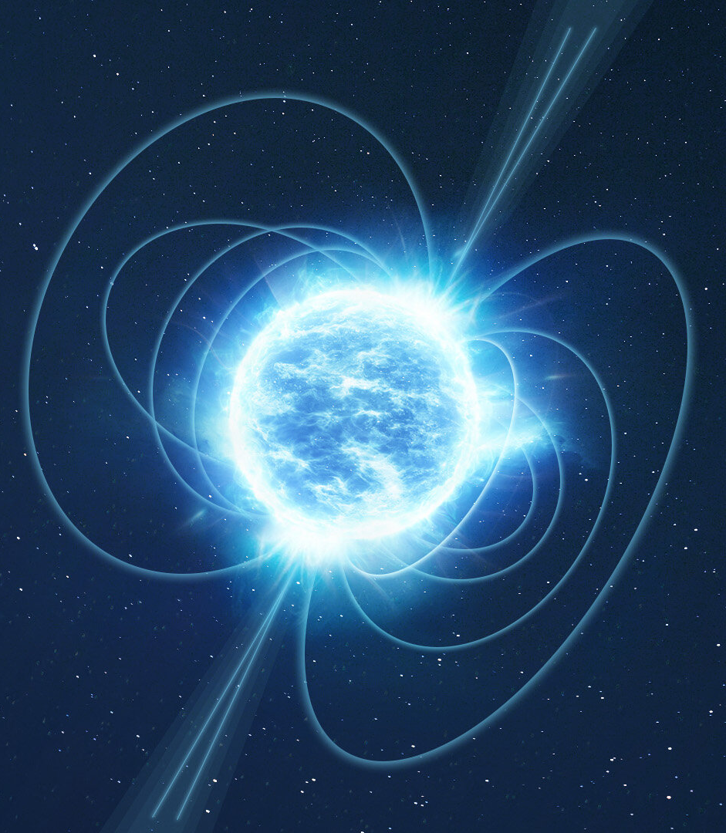
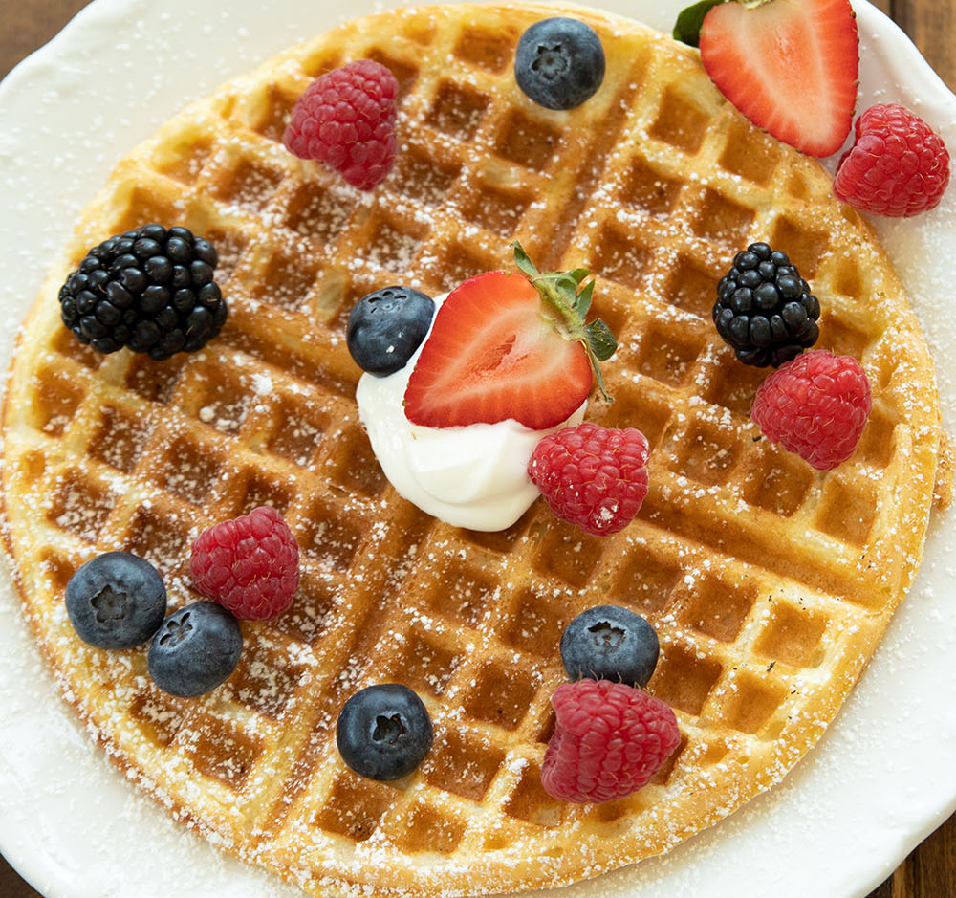
Perspective and conclusion
Promising results:
  Accuracy
  Speed
Motivate further development of Wafle
More parameters: spot size, location, temperature
Background: additional step in the inference
Credits: ESA, Mirlandra’s Kitchen
J. Berteaud – Exploring the neutron star interior with Wafle – NICER/IXPE Workshop – July 2024

Slide 11
Thank you for your attention!

