Slide 1


A NICER Understanding of How Type-I X-ray Bursts Interact with Accretion Discs
A. C. Albayati
Joint NICER/IXPE Workshop 2024
29th July 2024

Slide 2
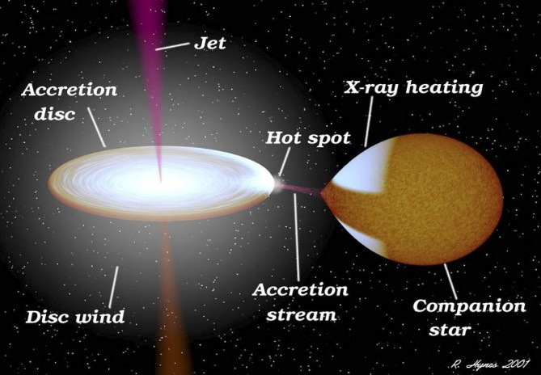



Low Mass X-ray Binaries
Compact Object
≲1 M⊙
Notes:
Here is my obligatory LMXB slide!
Compact object, accretion disc, companion star
In my talk, I will be discussing only neutron star LMXBs

Slide 3
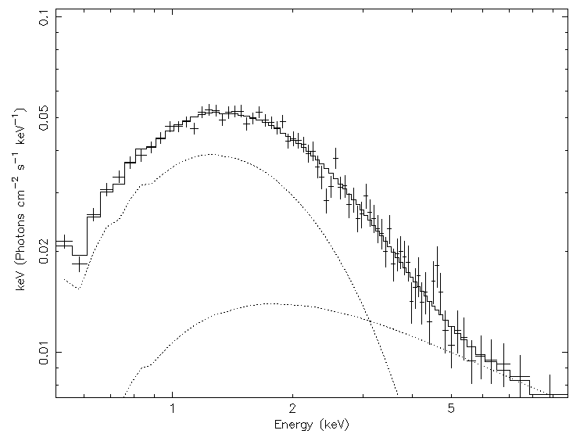
Spectral Analysis
Neutron star
Corona
(unspecific shape)
Accretion disk
absorption ✕ ( blackbody + powerlaw )
E.g. TBabs * (diskbb + nthcomp)
Notes:
When we spectrally analyse an X-ray binary, a typical spectrum contains two main components
We have a blackbody for the accretion disc
And a powerlaw component, which describes the corona
We also have an interstellar absorption component

Slide 4
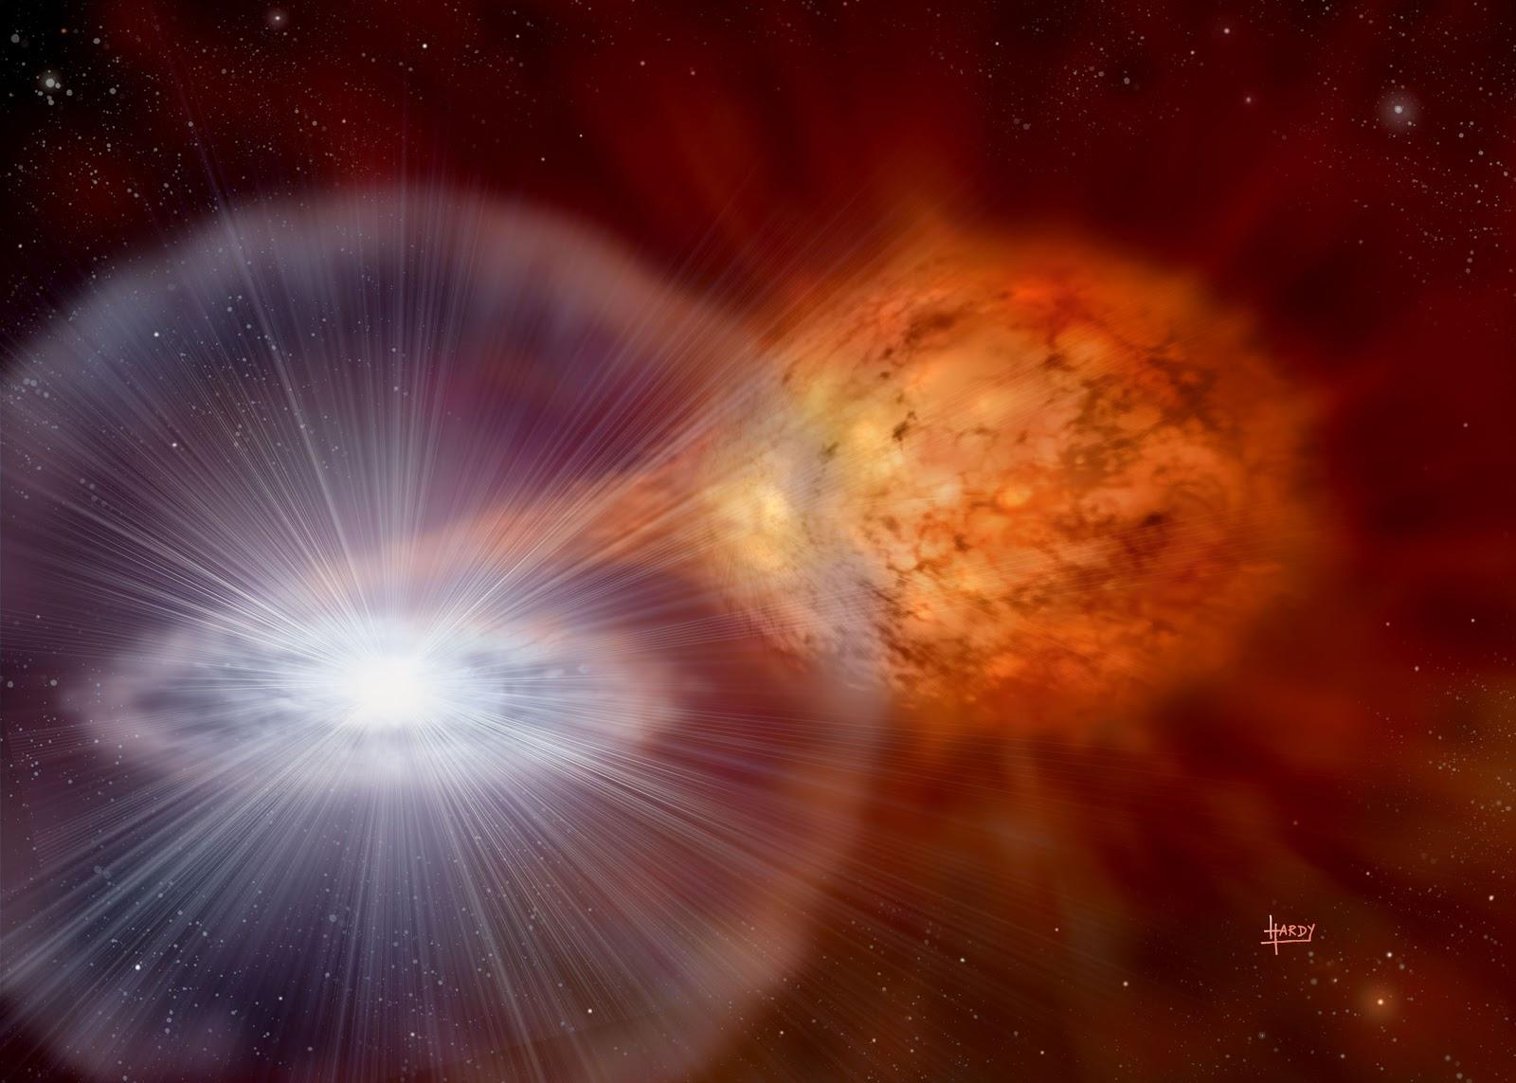
Thermonuclear Type-I X-ray Bursts
Material accreted onto neutron star
Compacted into a dense layer
Runaway thermonuclear fusion
Notes:
Unlike black holes, accreted material can settle on the surface of the neutron star
And it’s in neutron star LMXB systems only that we see X-ray bursts
The accreted material will spread across the surface of the neutron star
It is then compacted by gravity into a dense layer, until it reaches a critical density
At this density, the matter will ignite, causing a run-away thermonuclear explosion

Slide 5
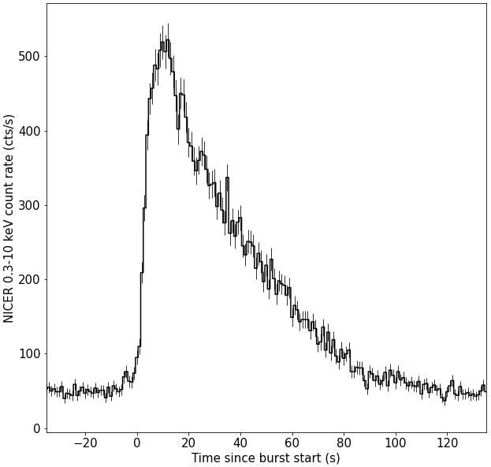
Observation & Analysis
X-ray Burst Lightcurve (Timeseries)
Exponential-like decay
Fast rise
10s - 100s of seconds long
Notes:
So what do we see observationally?
The thermonuclear explosion creates a burst of X-rays
We observe this as a bright “flash” in X-ray lightcurves such as this one here
These X-ray bursts generally last from 10s and 100s of seconds, and are typically described as having a fast rise and a roughly exponential decay

Slide 6
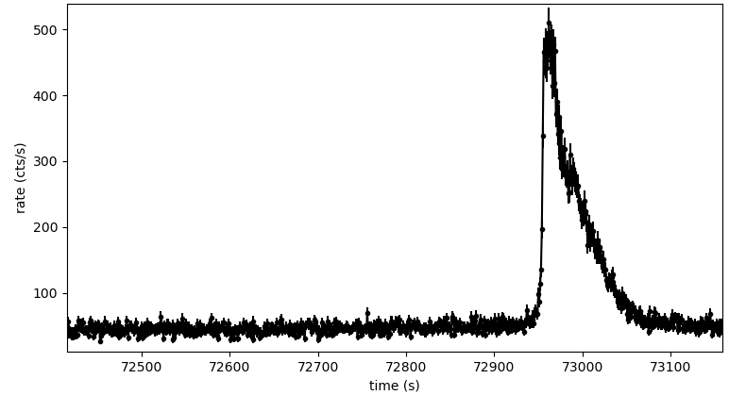
Spectral Analysis
Fit the persistent emission first…
absorption ✕ ( disk blackbody + powerlaw )
Assume the persistent emission is not changing during the burst…
… And then add the burst emission!
absorption ✕ ( disk blackbody + powerlaw + burst blackbody)
Notes:
Now how do we spectrally analyse X-ray bursts?
First, we must fit the persistent spectrum
Typically, we assume that this persistent emission is not changing during the burst
So when we fit the burst spectra, we can simply add the burst components on top of the fixed persistent components

Slide 7
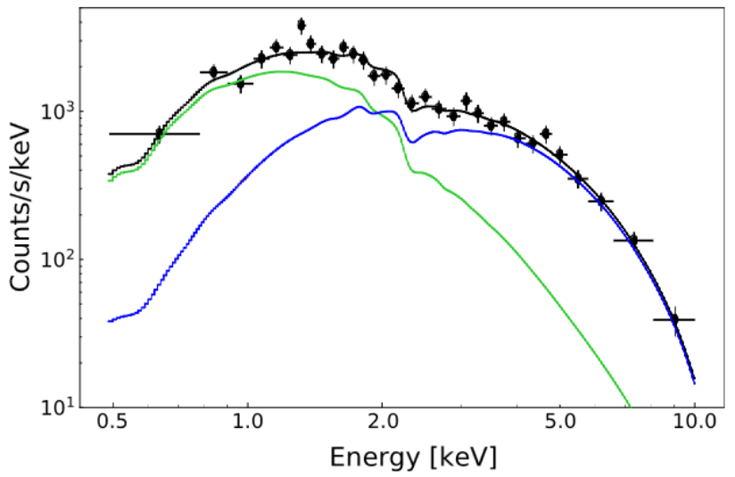
Spectral Analysis
Güver+22
Describes igniting photosphere
E.g. bbodyrad
absorption ✕ ( disk blackbody + powerlaw + burst blackbody)
Notes:
This is a typical spectra from the peak of an X-ray burst where we can separate it into it’s persistent and burst components
We model the burst emission as a blackbody which describes the igniting photosphere

Slide 8
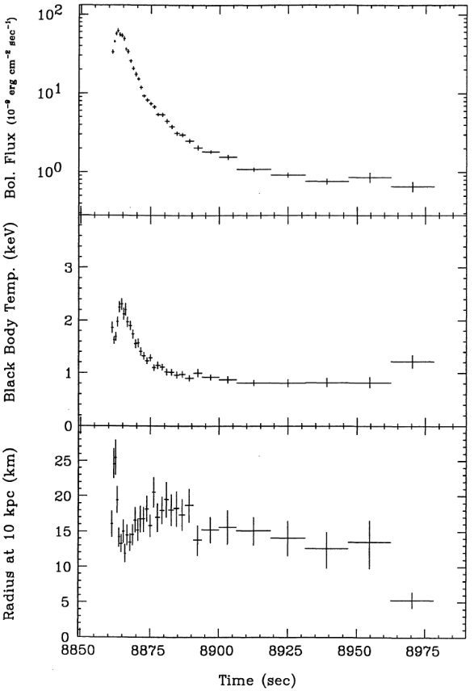
Time-Resolved Spectroscopy
Fitting individual spectra
FLUX
Thermonuclear signature
=
burst temperature rise and decay
BLACKBODY TEMPERATURE (best fit parameters)
BLACKBODY RADIUS
(from normalisation best fit parameters)
T. Oosterbroek
Notes:
Due to the high count-rate of X-ray bursts and the fact that the spectrum is changing very rapidly, we can do very fine time-resolved spectroscopy
We can then plot the best fit parameters with respect to time and track the evolution throughout the X-ray burst
The thermonuclear signature can be seen with the blackbody temperature increasing during the rise of the burst and decreasing in the decay
We can also track the emitting region of the blackbody

Slide 9
Unchanging Persistent Emission?
Simple, but naïve!
absorption ✕ ( disk blackbody + powerlaw + burst blackbody)
Fixed? Fixed? Fixed? Varying
Notes:
The assumption that the persistent emission isn’t changing at all during the X-ray burst is simple but naive
If there’s a huge burst of radiation from the neutron star’s atmosphere, it’s likely that it will interact with the disk and the corona

Slide 10
Poynting-Robertson Drag
Burst radiation removes angular momentum
Particles fall faster towards neutron star
Increased Ṁ = brighter inner accretion disc
Notes:
One example of how the burst emission can interact with the disc is through PR drag
This is where the burst radiation removes angular momentum from particles in the inner disc
This causes them to fall faster towards the NS
Which leads to an increased mass accretion rate and a brighter inner accretion disc

Slide 11
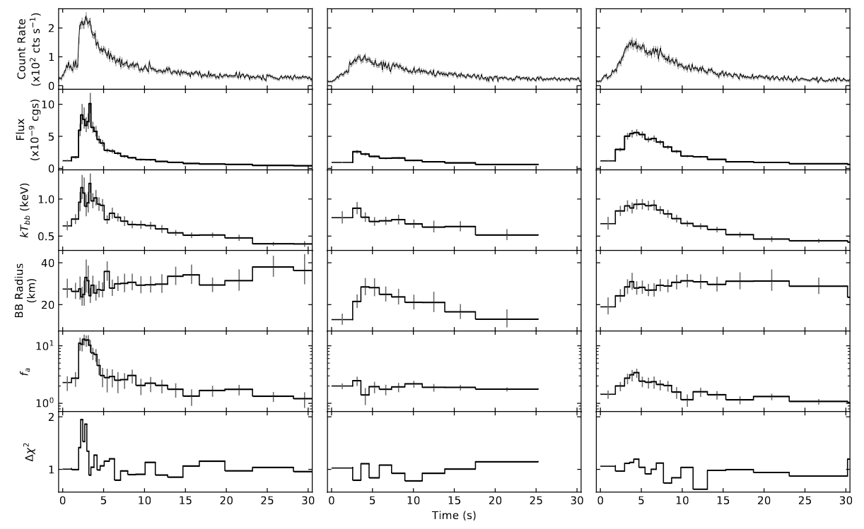
MAXI J1807+132 and f_{a} - method
Albayati+21
Scale the persistent emission with a constant, f_{a}
absorption ✕ ( f_{a} ✕ ( disk bb + powerlaw ) + burst blackbody )
Fixed Varying Fixed Varying
f_{a}
Notes:
I found evidence of this effect in the bursts of MAXI 1807
In order to get good fits, I needed to scale the fixed emission with a constant
This is called the f-a method
And has been widely used in order to fit burst spectra where the standard approach of a fixed persistent emission leaves soft excesses

Slide 12
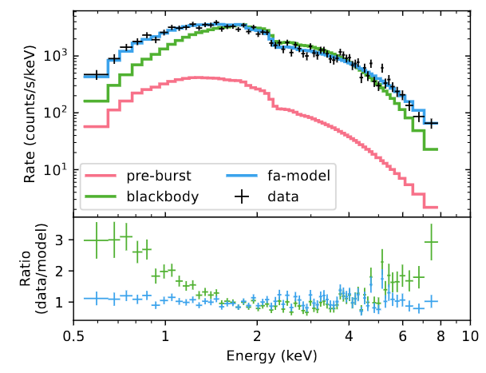
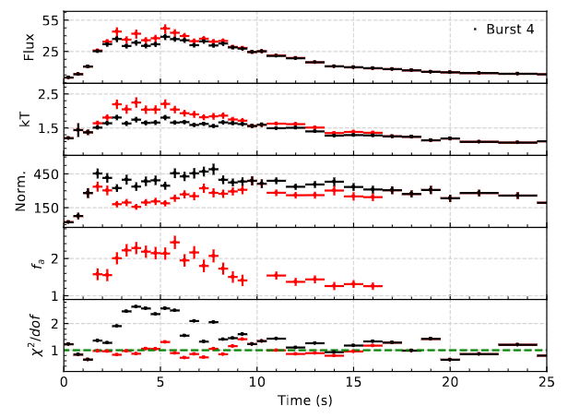
f_{a} - method = Scaled Persistent Emission
Bult+22
Güver+22
absorption ✕ ( f_{a} ✕ ( disk blackbody + powerlaw ) + burst blackbody )
Fixed Varying Fixed Fixed Varying
Notes:
On the left we have a spectrum taken from the peak of a burst
We can see from the residuals that the fits are much better for the fa-model in blue where the persistent emission has been scaled, compared with the standard fixed emission approach
And on the right, we see a full time resolved spectroscopy plot for a burst where the single black body model best fits are shown in black, and fa-method is shown in the red
Again, we see that the fits are much improved, especially around the peak where we’d expect to see the most enhancement of accretion rate

Slide 13
f_{a} - method issues?
Persistent spectrum shape unchanging?
Bult+22
Notes:
Whilst this method can improve fits in some cases, the fa method is still assuming that the shape of the persistent spectrum isn’t changing during the burst
This is still problematic, because there are many other phenomena which can’t be explained simply by increasing the intensity of the persistent emission

Slide 14
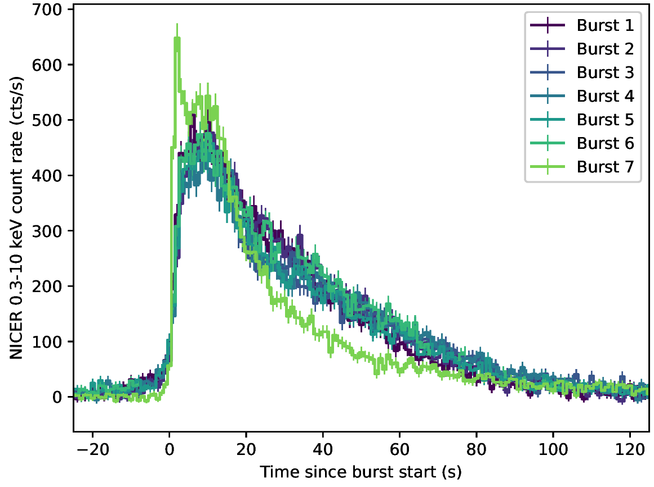
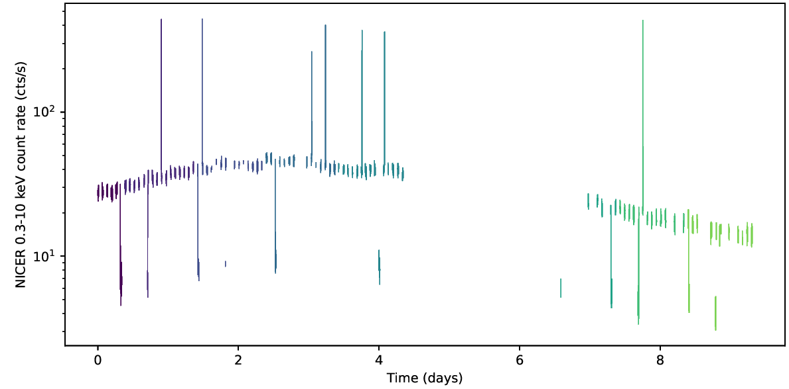
SWIFT J1749.4-2807
Albayati+23
X-ray bursts
Eclipses
i = low
i
i = high
Notes:
Swift 1749 is the only known eclipsing accreting millisecond pulsar.
This means that it has a very high inclination
In 2021 the system went into outburst for the first time in over a decade, and NICER observed the system exhibiting 7 type-I X-ray bursts
The spectra of these bursts showed that standard models over-predicted the spectrum at soft energies

Slide 15
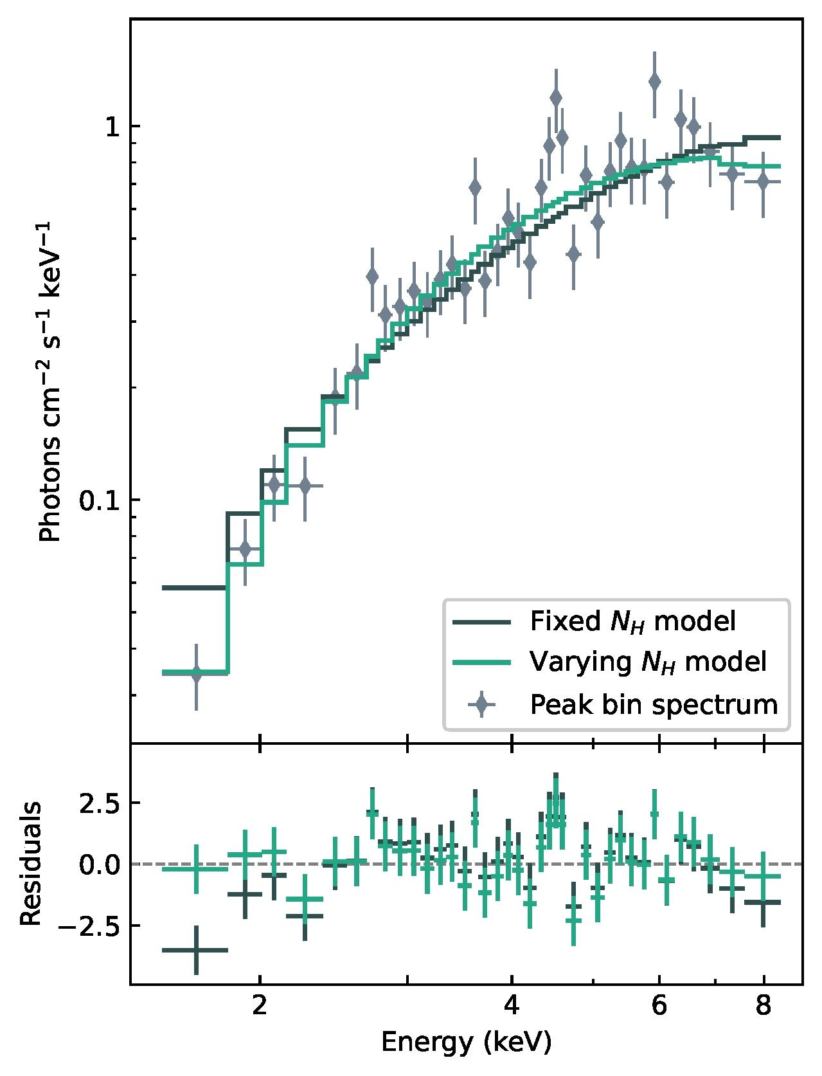
Soft Deficit?
Varying absorption!
absorption ✕ ( persistent parameters + burst blackbody)
Varying! Fixed Varying
Average persistent N_{H} ≃ 3.5 × 10²² cm⁻²
Average burst N_{H} higher by ~2 × 10²² cm⁻²
60% higher than persistent N_{H} during bursts!
Notes:
This lead me to vary the absorption during the burst spectroscopy
This greatly improved the fits
The average value of the column density during the bursts was 60% higher than the persistent value

Slide 16
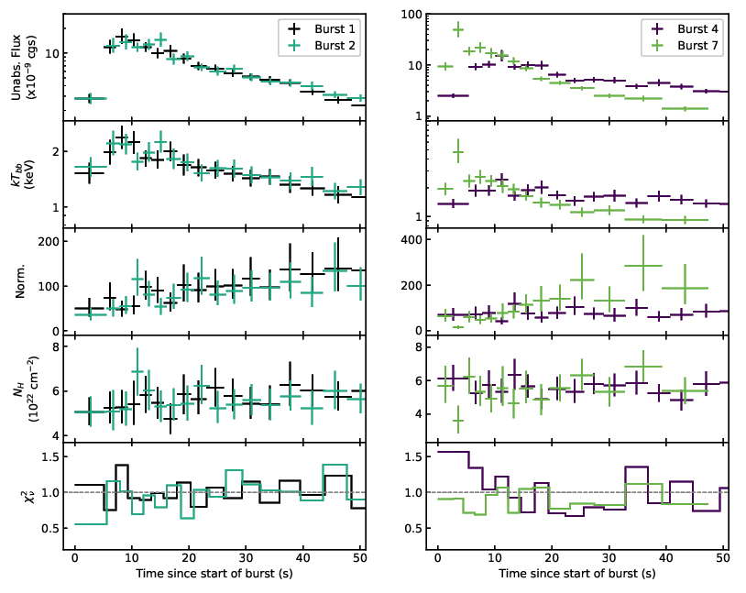
Varying absorption?
Burst-Disc Interaction!
Inner disc puffs up due to heating from burst radiation!
(a)
(b)
Notes:
I interpret this as due to the burst radiation interacting with the disk
The burst radiation causes the disk to puff up which introduces more absorbing material into our line of sight due to the high inclination of the system
You wouldn’t be able to see this puffing up in a low inclination system as you can see from the viewing point (a)

Slide 17
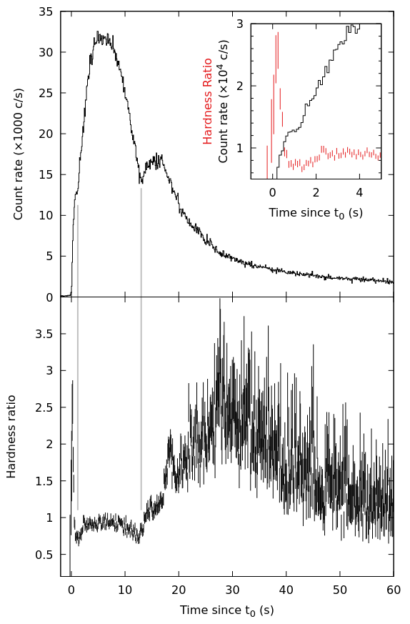
SAX J1808.4-3658
Brightest NICER X-ray burst detected
34,000 cts/s !!!
Many cts/s = good statistics
Bult+19
Notes:
SAX1808 is another AMXP
In 2019 NICER observed a very bright burst from this source – the brightest ever detected by NICER, in fact

Slide 18
SAX J1808.4-3658
Brightest NICER X-ray burst detected
34,000 cts/s !!!
Many cts/s = good statistics
What can we learn about the disc geometry?
Bult+19
Notes:
A previous study by Peter Bult already did spectral analysis, but this wasn’t the focus of the paper
I’m particularly interested in how the burst radiation affects disc geometry
And due to it’s very high count rate, it is a great candidate to better study these phenomena

Slide 19
This is all experimentation in progress!

Slide 20
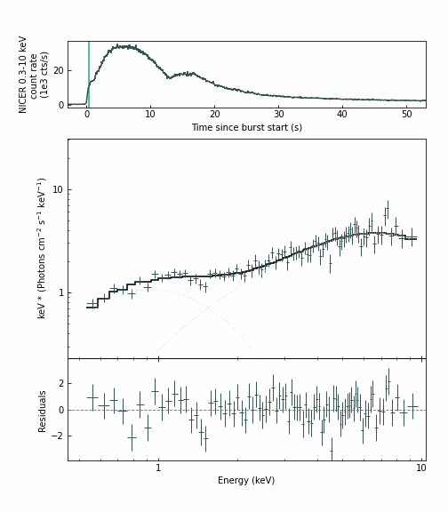
Warning: very preliminary!
F_{a}-method gives bad fits!
Shape of the persistent emission is changing
Allow disc blackbody to vary:
absorption ✕ ( disk blackbody + powerlaw + burst blackbody)
Fixed Varying! Fixed Varying
Significant soft component evolution! Disc evolution on burst timescales!
Inner disc temperature ⇩ Inner disc radius ⇧
Notes:
This burst’s spectra cannot be describes with a simple black body, or by using the f-a method
First I tried to vary the persistent emission disc blackbody
What I noticed was that there is a very significant soft component which increases in the rise of the burst and then decreases in the tail
This shows us that the disc is evolving on the timescale of the burst
The numbers we got out showed that the inner disc temperature dropped, and the radius increased
This is consistent with some modelling, but we can paint a better picture by looking at some other phenomena as well

Slide 21
Reflection Models
Emission lines:
Fe-L 1 keV
Fe-K 6.7 keV
Disc usually modelled as 1D slab in reflection models
Ionisation
absorption ✕ ( disk blackbody + powerlaw + burst blackbody + reflection )
Notes:
Disc reflection can create soft excesses that can’t be described with the fa method
Reflection models take into account ionisation in the disc
Burst radiation hits the disc and instantly photoionises the material
We then observe this reprocessed emission
Evidence of ionisation can be supported by the detection of Iron emission lines in the spectra

Slide 22
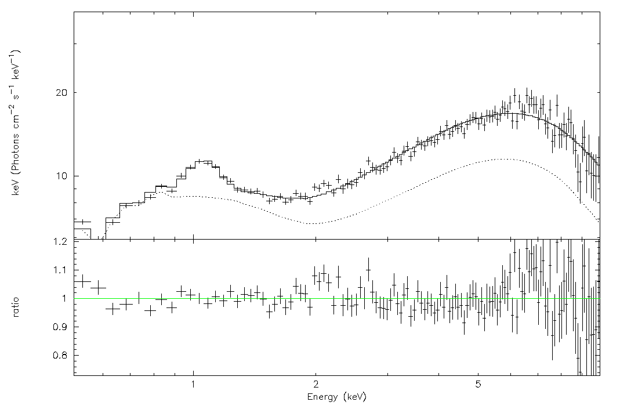
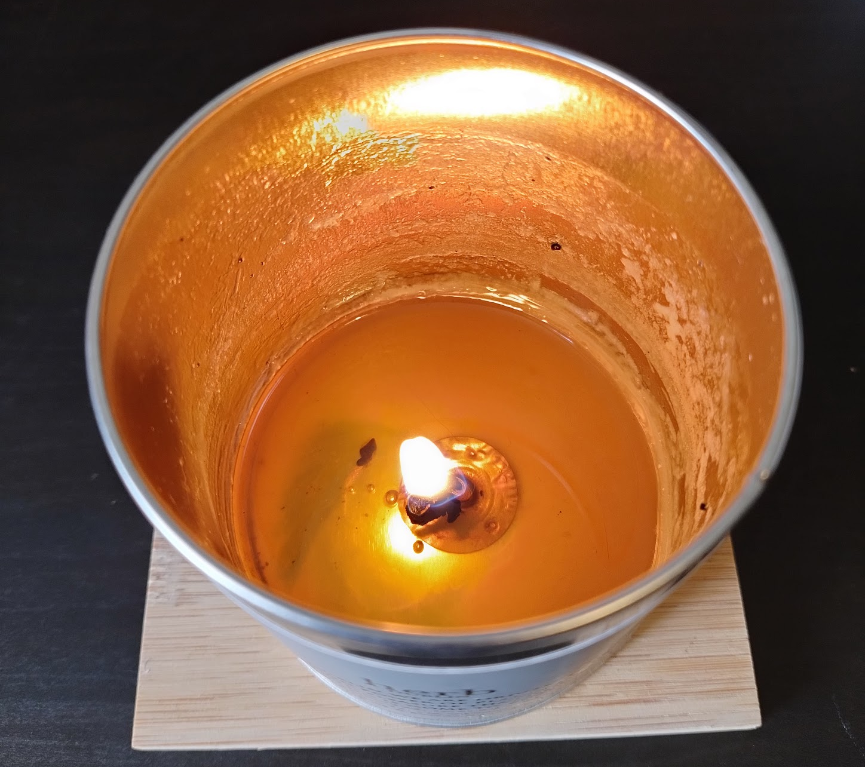


Reflection Model
Burst Peak
6.7 keV lines long
1 keV lines long
Ratio of reflection flux to burst flux :
F_{refl}/F_{bb} = f_{refl} = 2.81 ± 0.37
This is much larger than predictions for a flat disc!
Possible cause:
Blocking of NS by puffed up inner disc
Track the evolution?
2nd peak f_{refl} ≈ 1.27
Notes:
This is a spectrum taken from the peak of the burst
I fitted a reflection model to it, as Peter reported in 2019, the Iron emission lines strongly suggest that disc ionisation is playing a part here
The interesting thing is that the ratio of burst flux to reflection flux is much greater than 1
This is much larger than predictions, and is also the largest reflection fraction reported for a standard type-I X-ray burst which has good statistics
There are a number of explanations for this that involve the geometry of the disc
One is that the burst causes the inner accretion disc to puff up and partially block the neutron star
A simple analogy for this is a candle in a cup, depending on the viewing angle you may be seeing mostly reflection emission rather than burst emission
We can possibly even track the evolution of this puffed up disc, because later on in the burst in the 2nd peak, the reflection fraction has decreased to 1.27

Slide 23


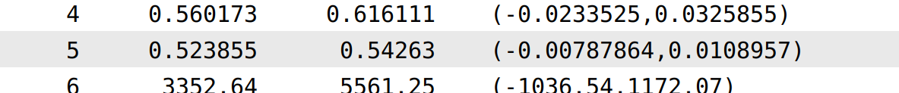
Deviations from the standard disc
Standard Shakura & Sunyaev disc temperature profile:
diskpbb model allows this profile to vary
TBabs * (diskpbb + nthcomp + bbodyrad)
p = 0.5 may suggest a geometrically thick accretion flow…
Notes:
It’s clear that bursts do cause significant impact on the inner accretion disc
This could mean deviations from the standard accretion disc model
We can probe these deviations with the temperature profile of the disc
And we can do this using the diskpbb model which allows the exponent on radius to vary
What I found was that p went to 0.5, which may suggest a geometrically thick inner accretion flow

Slide 24
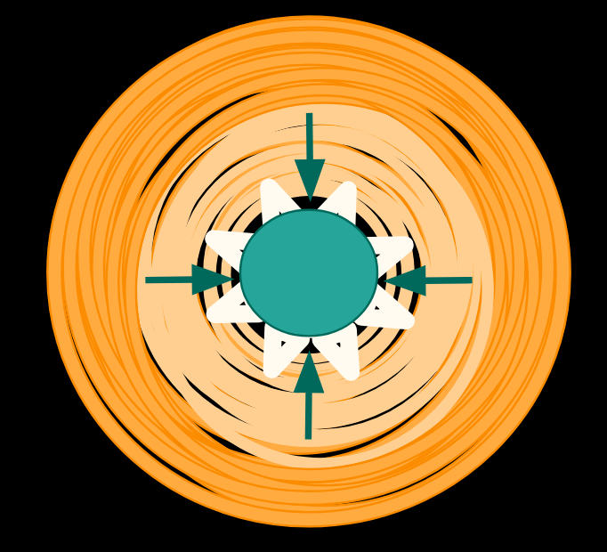
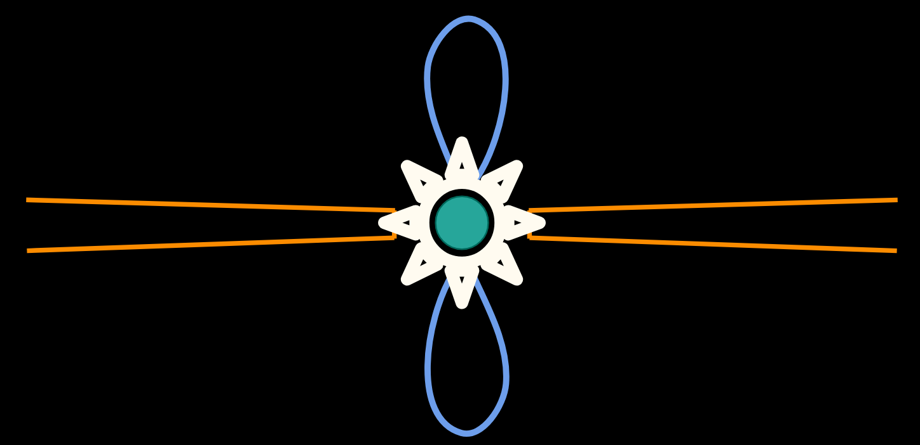
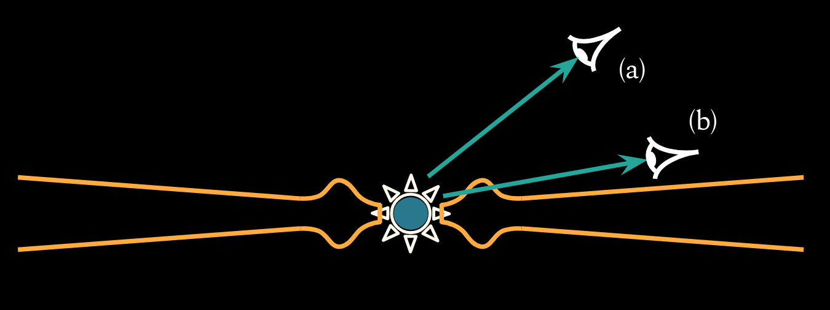

Thank you for listening!
This is a small look into the possible interactions between X-ray bursts and accretion discs
These interactions are complex, and observational effects are likely caused by a combination of many
We must keep improving our analysis techniques and observational models to better understand these phenomena
Obtaining higher quality data and broader datasets are key
Notes:
This is just a small look into the many possible interactions between X-ray burst emission and the accretion environment
These interactions are very complex, and observational effects are likely caused by a combination of many interactions
It was only a decade ago that we started modelling bursts with anything more complex than just a simple black body, so we’ve come a long way already!
As always, we must keep improving our analysis techniques and observational models in order to better understand these phenomena
And of course, obtaining higher quality data and broader datasets will be key here

Slide 25
Two black body model
Boundary Layer?
Add a second blackbody because it fits the soft excess!
Inner disc?
absorption ✕ ( disk blackbody + powerlaw + burst blackbody + another blackbody )
~ 2 keV ~ 0.2 keV
Notes:
Another method that is sometimes used is trying to fit the soft excess with a second black body
it has been suggested that it could be from the boundary layer, but papers modelling the boundary layer predict colour temperatures an order of magnitude higher
Other suggestions are that it could be emitted from the inner accretion disc, but in reality this is a purely phenomenological model and doesn’t align well with any physical predictions

Slide 26
MAXI J1807+132
Albayati+21
f_{a}
Notes:
I used this method in my first paper with varying success
These bursts were incredibly faint which made the fitting very tricky
But the fits were significantly improved by adding in the fa factor

Slide 27
SWIFT J1749.4-2807
Only known eclipsing AMXP
Eclipses mean tight constraints on inclination
Very important for pulsar timing!
i = low
i
i = high
Notes:
Swift 1749 is the only known eclipsing accreting millisecond pulsar
The eclipses are a result of the system having a very high inclination angle, i.e. we see it edge on, and the companion star regularly passes through the line-of-sight
Being able to tightly constrain the inclination means that the system is really important for pulsar timing, but that’s not what I’m here to talk to you about

Slide 28
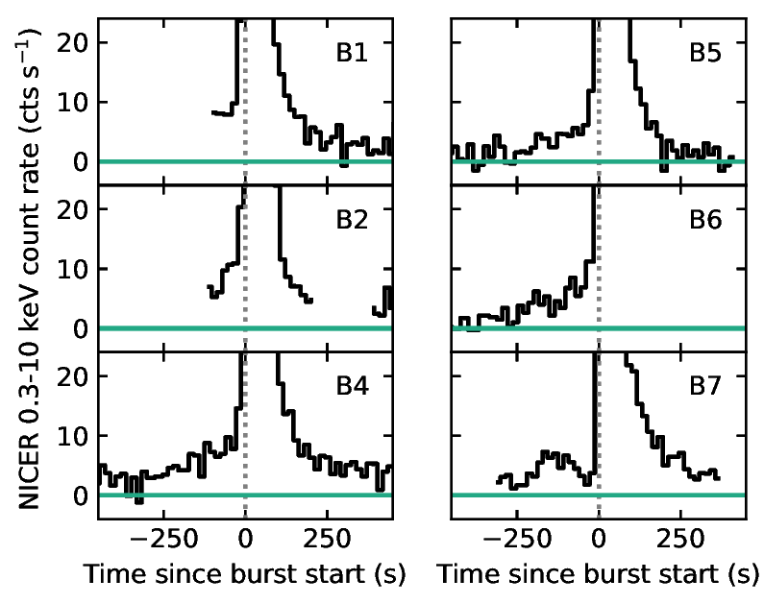
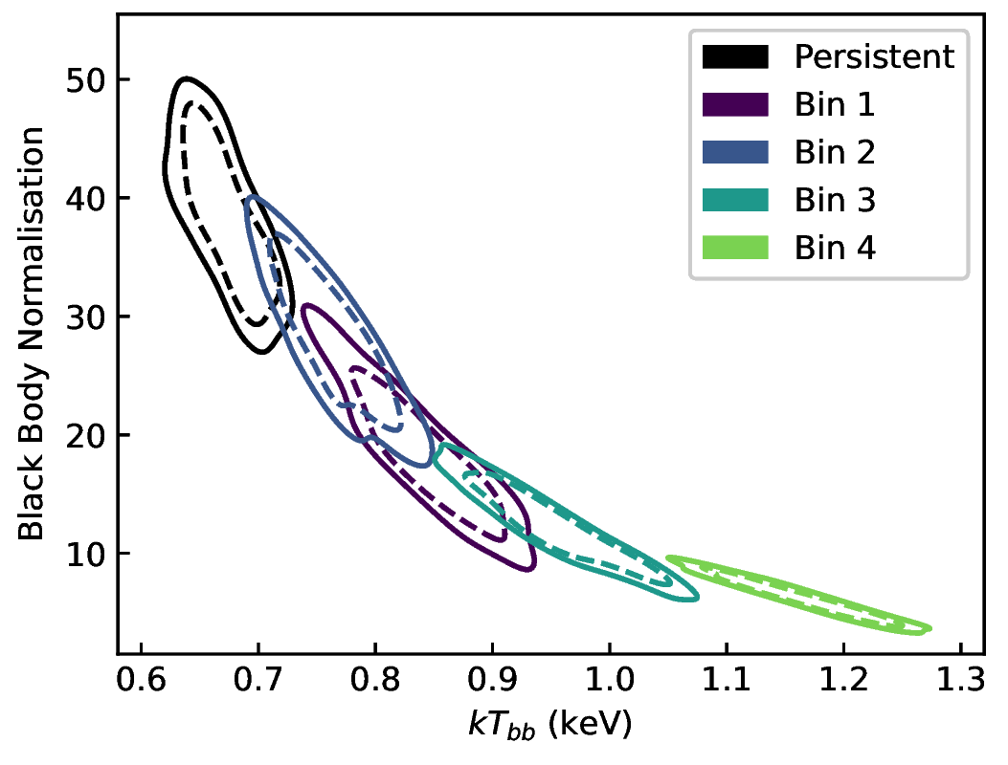
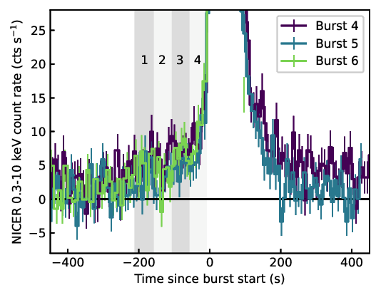
SWIFT J1749.4-2807
Albayati+23
absorption ✕ ( disk blackbody + powerlaw )
Fixed Varying Fixed

Slide 29
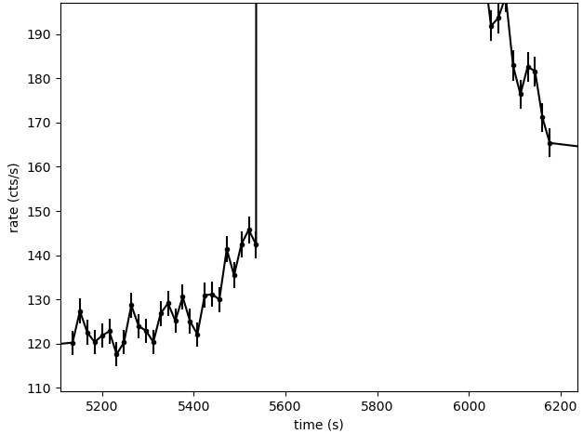
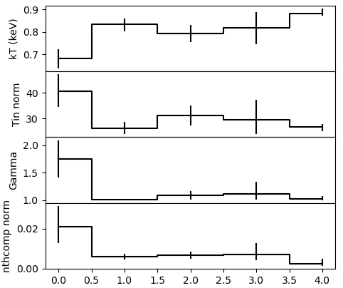
SAX J1808

Slide 30
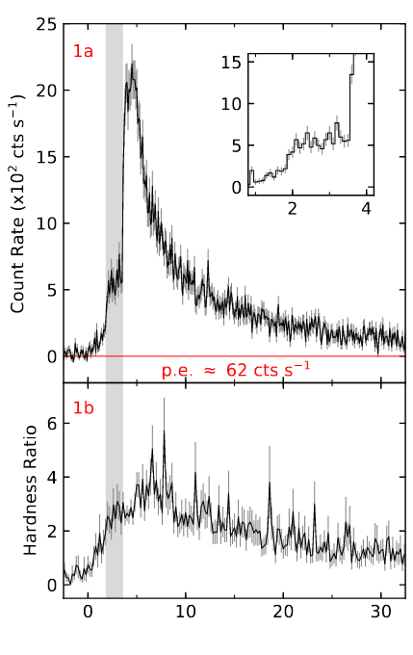
SAX J1808.4-3658
Brightest NICER X-ray burst detected
Pause in rise!
Many cts/s = good statistics
Very dim :(
MAXI J1807+132
Bult+19
Pause in rise!
Albayati+21
Notes:
The exceptionally high count rate gave me hope that I could perform time resolved spectroscopy over that pause itself as I’m very interested in the physics behind the phenomena
In fact the original reason I was given the data I used in my first paper was because there was a pause in one of the bursts, but they were so dim that I had no hope of TRS analysing the pause itself
I’m still working on this! I had a lot of trouble getting any sort of TRS to work with this burst, so I haven’t even got to trying to analyse just the pause
But along the way I’ve discovered something pretty interesting

Slide 31
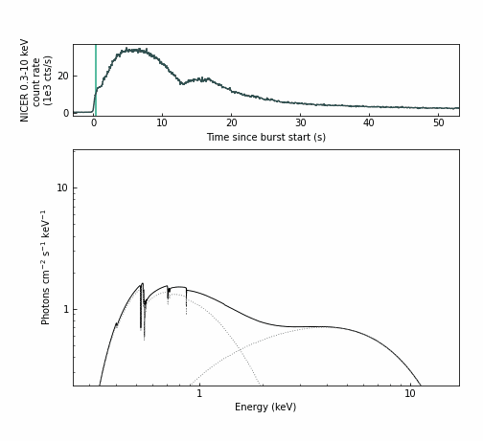
TBabs ✕ ( diskbb + nthcomp + bbodyrad)
Fixed Varying Fixed Varying

