Slide 1
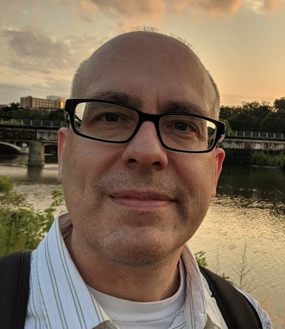
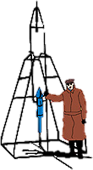
NICER/IXPE Workshop July/August 2024
NICER Analysis and Calibration Craig Markwardt (NASA/GSFC) & NICER Team
GSFC

Slide 2
Summary
Motivation
`nicerl2’ and how to use it
Basic calibration recommendations
Understanding basic screening

Slide 3
Motivation
Why are we here? ASTROPHYSICS!
NICER is non-imaging, but has high throughput and good spectral resolution
Astrophysics Topic | Dimension | Technique | NICER?
Energy Dissipation | Energy | Spectroscopy | ✅
Geometry | Image | Imaging | ❌
“Physics” | Time | Light curve / timing | ✅

Slide 4
NICER Workflow Overview
NICER Data (from archive)
Level 1
This Presentation
nicerl2 (calibration, screening)
Level 2
nicerl3-spect (extract, responses, bkg, syserr)
nicerl3-lc (extract)
Level 3
Spectrum Responses & Bkg
Light Curve

Slide 5
NICER Tools Come from HEASARC
The High Energy Astrophysics Science Archive Research Center (HEASARC) distributes NICER’s
Software
Calibration products
Data
Documentation https://heasarc.gsfc.nasa.gov/docs/nicer/

Slide 6
Ways to Get Help
Consult on-line NICER documentation for analysis issues
Software guide overview
Analysis “Threads” - procedures for common tasks
Analysis tips for specific known problems or issues you may encounter
Send questions to the NICER helpdesk: https://heasarc.gsfc.nasa.gov/cgi-bin/Feedback

Slide 7
Introducing “nicerl2”
nicerl2 is the standard NICER pipeline preparation script. It has three main duties
Apply energy scale and other calibration
Construct filter file (MKF file)
Apply screening to remove “bad” times and misbehaving detectors
Results:
Cleaned event list, called the “cl” file
Event list has Good Time Intervals or GTI
Event list has NICER FPM Selection Information or FPM_SEL

Slide 8
Before Running nicerl2
If this is your first time with NICER data, you will have to set up the environment variable GEOMAG_PATH and put it in your start-up file
Make sure you have up-to-date geomagnetic quantities by running nigeodown
Do this before starting any new project, or with very newly observed data
Download data from archive
We have a Thread that describes how to do this

Slide 9
How to Use ”nicerl2”
From the command line nicerl2 /path/to/1234567890 clobber=YES
This may take some time
clobber=YES will allow the task to overwrite old files
Results
1234567890/auxil/ni1234567890.mkf
“Filter” or “MKF” file
1234567890/xti/event_cl/ni1234567890_0mpu7_cl.evt
“cl” or cleaned event file
1234567890/xti/event_cl/ni1234567890_0mpu7_ufa.evt
“ufa” or lightly cleaned event file
See example notebook NICER_data_reduction
DEMO
Path to Observation

Slide 10
Basic Calibration Recommendations
When starting a new project, always reprocess data with newest software and calibration, and update your geomagnetic quantities
The NICER pipeline often does not use the newest releases
Archival data may indicate “zero exposure” but you may recover some data
Be prepared for changes due to optical light leak
Ask for help at the NICER website

Slide 11
Calibration Done by “nicerl2”
nicerl2 applies a gain correction to all events so that all detectors are on the same energy scale
Column name PI in event file
”Energy” = (10 eV) x PI
Also PI_FAST which is a secondary pulse height channel (not normally used for science)
Accurate to ~10 eV in 0.3-7 keV range
Time correction based on known time offsets
Accurate to 50 nanoseconds
Identifying correlated noise/undershoot ringing events

Slide 12
Screening by “nicerl2”
Temporal screening
Orbit: SAA (saafilt), cutoff rigidity (cor_range)
Pointing: tracking target (trackfilt), on target (angdist), star tracker tracking (st_valid), earth elevation (elv), bright earth avoidance (br_earth)
Detector behavior: undershoot resets (underonly_range), overshoot resets (overonly_range), threshold setting (threshfilter)
Per-detector screening
FPM: Undershoots (underonlyscr), overshoots (overonlyscr), noise peak (noise25scr), extended noise peak (noiseextscr), noise ringing (kee_noisering)
MPU: “shredded GTIs” (mpugtiscr), “round robin” effect (roundrobbinscr), high data rate losses (lowmemscr)

Slide 13
What are Undershoots?
Optical photon
X-ray photon
Cathode
SDD
Leakage Current
Anode
Silicon drift detector anode gradually charges due to various effects
“Undershoot” is due to discharge/reset events
Completely normal
Reset Threshold
X-ray or charged particle
Charge
Reset
Reset
Time

Slide 14
Cause and Effect of Undershoots
Typical causes of undershoots are
Optical light!
This is a special problem after the light leak event of May 2023
X-rays, cosmic rays, leakage current (minor)
Undershoots cause increased noise and shift of energy scale
Desirable range for undershoots
0-500 ct/s/FPM is calibrated range
0-100 ct/s/FPM is desirable
You can adjust filtering with underonly_range=0-500
See example notebook MKF

Slide 15
What are Overshoots?
Charged Particle
X-ray photon
Cathode
SDD
Anode
If an X-ray or charged particle deposits more than ~20 keV in a detector, we get an overshoot
Basically “too much energy to measure”

Slide 16
Cause and Effect of Overshoots
Typical causes of overshoots are
High energy charged particles which deposit ~200 keV of energy in a detector as they pass through
High energy X-rays, low energy charges (minor)
Overshoots are a good diagnostic for a “dirty” or “clean” background environment
Desirable range for overshoots
0-30 ct/s/FPM is calibrated range
0-100 ct/s/FPM is typical SAA range
0-1000 ct/s/FPM is typical max range
You can adjust filtering with overonly_range=0-100

Slide 17
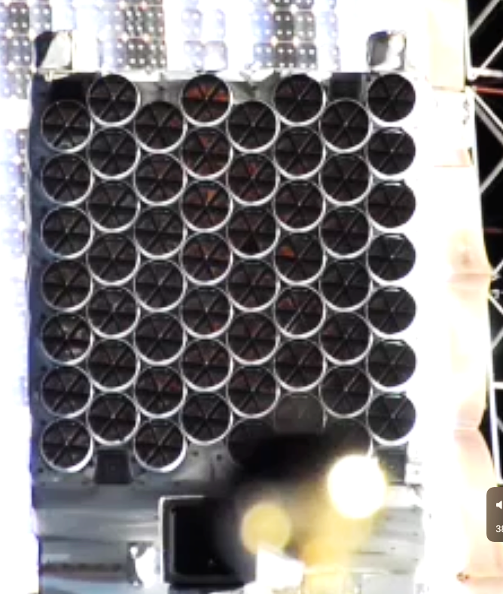
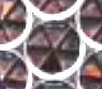
Special Topic: Light Leak
Starting in May 2023, NICER experiences the effects of damage and light leak
Several leaks found, including worst one:

Slide 18
Light Leak Effects
The impacts of the light leak during orbit day are
Much higher data rate
Increased chances of lost or “shredded” data
Much higher undershoots
Increased chances distortion of energy scale
Low-energy detection threshold is now adjusted at every orbit day and night transition
Affects analysis
Still very good chances of high-quality data!
During orbit night, expect continued excellent performance
Current software handles most of these conditions

Slide 19
How to Deal With Light Leak
By default, nicerl2 only lets through “night” threshold level (night-only data)
You need to re-screen your data, by hand, to get a separate set of “day” data nicerl2 1234567890 threshfilter=DAY clobber=YES
And then proceed with this data as normal
See example notebook Day_Versus_Night_Example

Slide 20
What is Next?
Once you have a cleaned event list (“Level 2”) you are ready to make spectra and light curves
Cleaned Event Data
Level 2
nicerl3-spect (extract, responses, bkg, syserr)
nicerl3-lc (extract)
Level 3
Spectrum Responses & Bkg
Light Curve

