Slide 1


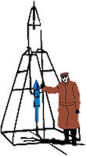






NICER/IXPE Workshop
July/August 2024
NICER Advanced Topics and Pitfalls
Craig Markwardt (NASA/GSFC) &
NICER Team
GSFC

Slide 2
Summary
Where’s my data?
  Day/night issues after light leak of May 2023
  Diagnosing screening losses quickly
  Adjusting filtering by undershoots & overshoots
Features to look out for
  Detector artifacts and background lines
  Astrophysical artifacts
  Dust halo effects
Background Flares

Slide 3
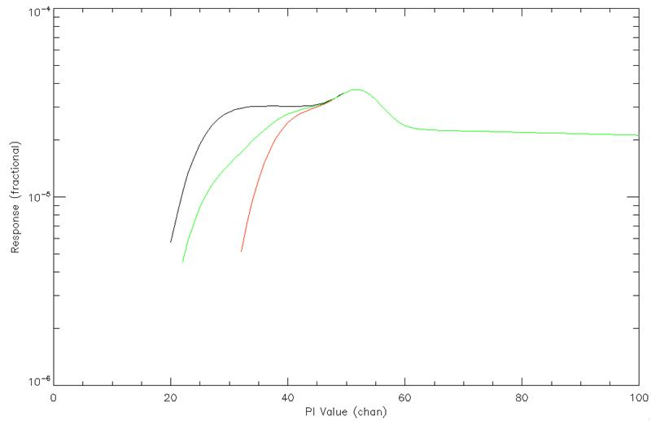
Where’s My Data? Day/Night 1
Since May 2023, NICER operates with different orbit day and night low-energy detector thresholds
  The default nicerl2 ONLY keeps data with orbit night threshold!
  Currently the
  number one
  source of “no
  exposure”
  questions to the
  help desk
Night
250 eV
Day
380 eV
Day/Night
Mix

Slide 4
Where’s My Data? Day/Night 2
The solution is to run nicerl2 TWICE, once for orbit night and once for orbit day
nicerl2 1234567890 clobber=YES
(and extract spectra and light curves for night)
nicerl2 1234567890 clobber=YES threshfilter=DAY
(and extract spectra and light curves for day)
See example notebook Day_Versus_Night_Example
You will have to keep day and night spectra separate during analysis
  In a future release we will streamline this workflow
NOTE: target visibilities are seasonal, so may be day-only or night-only. You may get zero exposure with default nicerl2 and that’s OK.

Slide 5
Where’s My Data? Screening Losses
If you have zero exposure, you can diagnose where the exposure is lost
nicerl2 prints a report of exposure at each step of screening
Summary of Temporal Filtering
Successive Filtering Stage GoodTime #GTI
------------------------------ ---------- ----
On-Target + Observing 1277.00 7
SAA + COR + Orbit 1277.00 7
Undershoots 0.00 0
Overshoots 0.00 0
Filtered GTI 0.00 0

Slide 6
Where’s My Data? Auto-Screening
Auto-screening deals with noisy detectors
  nicerl2 also produces a report for auto-screening, both by MPU & FPM detector
---------------------------- Pointing GTIs ---------------------------
---------- MET ------------ ------------------UTC--------------------
GTI START - STOP START - STOP
1 259731497.00 - 259732012.00 2022-03-26T03:38:15 - 2022-03-26T03:46:50
2 259759177.00 - 259759592.00 2022-03-26T11:19:35 - 2022-03-26T11:26:30
3 259764754.00 - 259765052.00 2022-03-26T12:52:32 - 2022-03-26T12:57:30
Screened FPM / MPU quicklook table
DET_ID Number | MPU Num.
F0 1 2 3 4 5 6 |
GTI F01234567012345670123456701234567012345670123456701234567 | M0123456
1 F.........O......O.O..........X..................O....... | M.......
2 F.........O......O.O..........X..................O....... | M.......
3 F.........O......O.O..........X..................O....... | MXXXXXXX
Footnotes O=known non-functional; X=screened; '.'=good

Slide 7
Where’s My Data? Over/Undershoots
We have defaults in place for screening for a reason: to avoid “bad” or poorly calibrated data
  You can try adjusting the defaults, but with care!
Undershoots
  Default range: 0-500 ct/s/FPM
  Going outside this range is not advisable because the energy scale can become very distorted
  Change with: nicerl2 … underonly_range=0-600
Overshoots
  Default range: 0-30 ct/s/FPM
  Default will capture most orbital variations but avoid extremes
    SAA typically 0-90 ct/s/FPM
    Extreme precipitation flares 0-1000 ct/s/FPM
  Change with: nicerl2 … overonly_range=0-100
See example notebook MKF

Slide 8
NICER Detector Features: Low Energy
50-250 eV
350-2000 eV
Noise Peak
Undershoots ct/s/FPM
500
400
300
Target Counts
0.35-2.5 keV (ct/s/52FPM)
200
10000
100
0
2000
200
Forced
Trigger
vs Under-
shoots
500
5
NICER Array Average

Slide 9
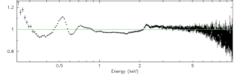
Detector Features 0.4 keV and Above
Crab (Old Calib)
1.56 keV – Aluminum K edge/fluorescence (detector window)
1.84 keV – Silicon K edge (window & bulk detector)
~2.2 keV – Gold M edge from XRC reflector gold coating
(actually a complex from 2.1 – 4.5 keV)
7.48 & 8.26 keV – Nickel K fluorescence lines
9.62-10.30 keV – Gold L⍺ fluorescence lines
11.4-11.6 keV – Gold Lβ fluorescence lines

Slide 10
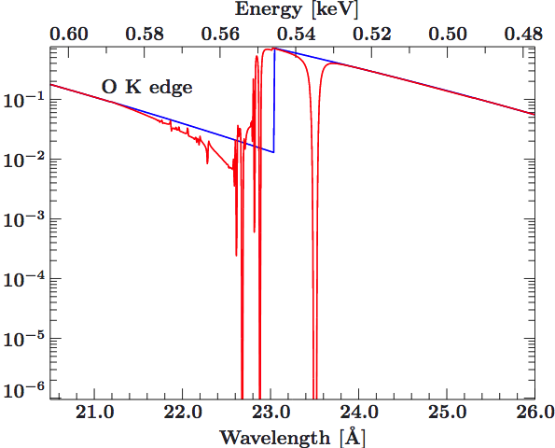
Astrophysical Features to Watch Out For
Crab (Old Calib)
The interstellar medium is often modeled with neutral N_H models such as wabs, tbabs (Wilms et al.), etc.
Most common ISM features:
  Oxygen K edge (0.56 keV)
  Iron L edge (0.71 keV)
  Neon K edge (0.87 keV)
If you see residuals in this energy range, consider using “tbfeo” or “tbvarabs” to allow abundances to vary; check literature for reported abundances
Even so, actual edge profiles may not match “perfect” profiles tabulated in tbabs model (due to ionization, molecular compounds, or dust composition of ISM)
tbabs
Wilms
XMM RGS Crab
Kaastra et al. 2009

Slide 11
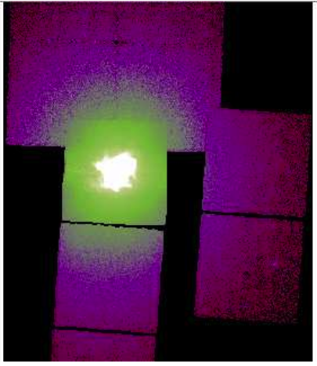
NICER Concerns: Bright Targets
Pile-up is a concern only for the brightest targets (>>3.5 Crab); this is a difficult issue to model
Dust scattering halos have significant effects
  Energy dependent
  Aperture size dependent
    complicates comparing observatories with different apertures (NICER 360”, RXTE 1°, CCD imagers ~few arcsec)
  Halo is time dependent if source varies
  ‘xscat’ model in XSPEC larger radius apertures such as NICER. Use radius=180”
Crab Dust Halo
(Chandra ACIS)
Seward et al. 2005

Slide 12
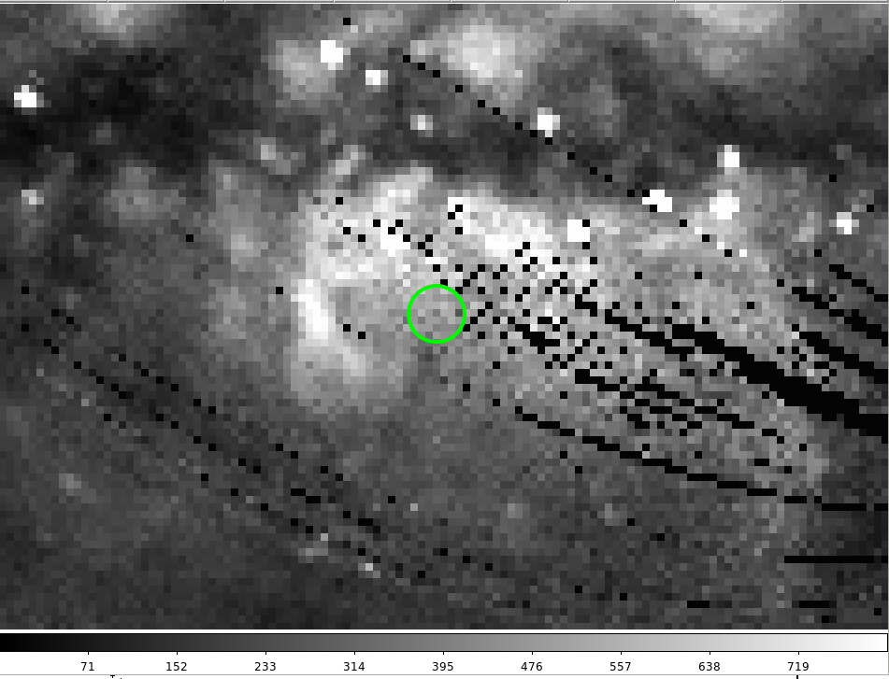
NICER Concerns: Faint Targets
The primary concern for faint targets is proper background subtraction
Working near the galactic plane,
beware of additional diffuse
emission not in the background
model (example of RX J1856)
ROSAT All-Sky Survey
RX J1856 Region

Slide 13
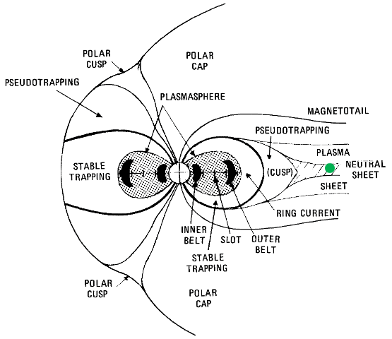
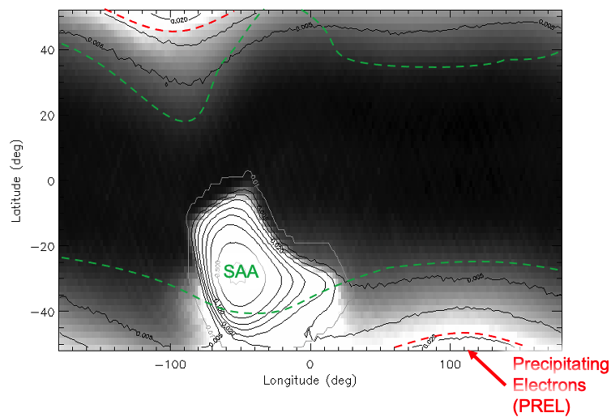
Pitfall: Background Flares
NICER is susceptible to medium to strong background flares, often due to electron precipitation

Slide 14
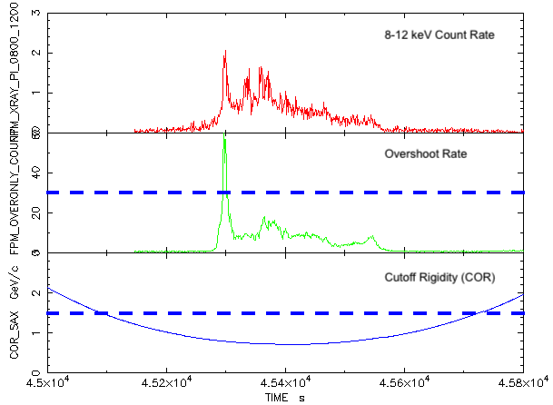
Flare Example

Slide 15
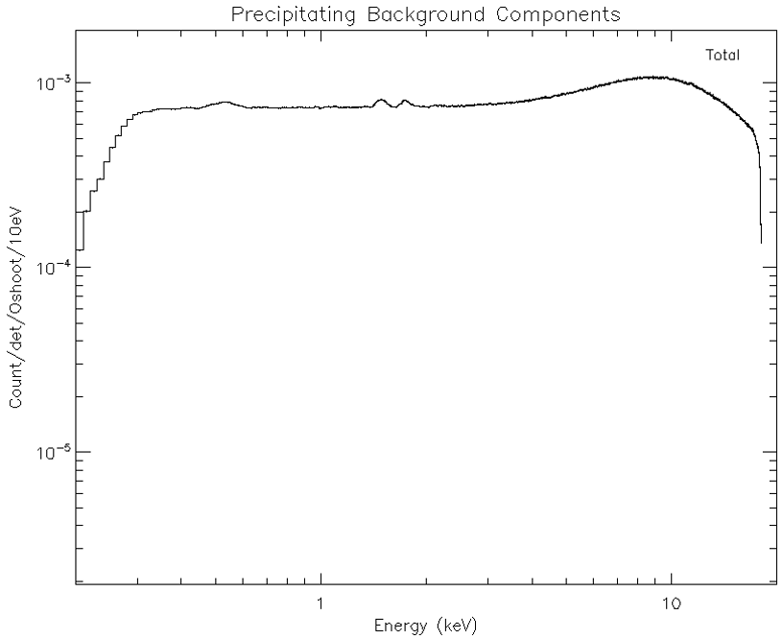
Properties of Flares
When: Not predictable but almost always when COR_SAX < 1.5
Intensity:
  Few-70,000 ct/s
Spectrum:
  Nearly flat
  Hump, Turnover
  ~10 keV

Slide 16
How to Diagnose Flares
We have two new tools to help diagnose precipitating electron background flares
  niprelflarecalc – provides a flaring “index” and an estimate of the flare intensity
  niprelflaregti – provides a GTI you can use for additional screening
These tools are not perfect and we are seeking feedback to help improve them
  It is best if you also manually check your data
If you suspect flaring and are using SCORPEON, make sure prel_norm is allowed to vary

Slide 17
Conclusions
This presentation should provide guidance to diagnose and avoid the top data loss and data quality issues
  Screening losses (zero exposure)
  Overshoots and undershoots
  Detector and astrophysical artifacts
  Background flares

