Slide 1
On the road to polarised reflection with XILLVER
Edward Nathan - enathan@caltech.edu
Javier García, Ekaterina Sokolova-Lapa,
Kun Hu, Henric Krawczynski
NICER/IXPE Workshop
30/07/24

Slide 2
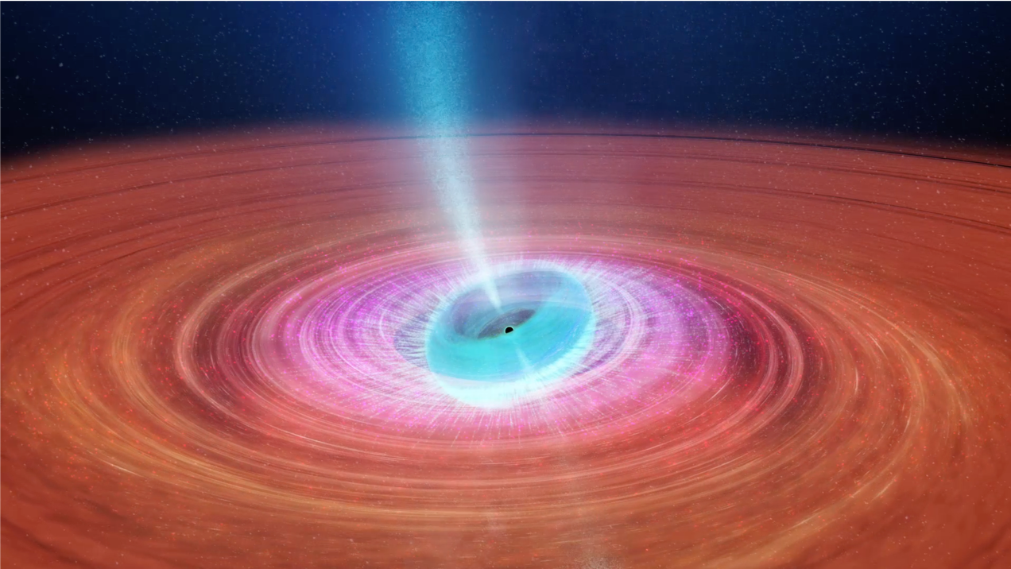
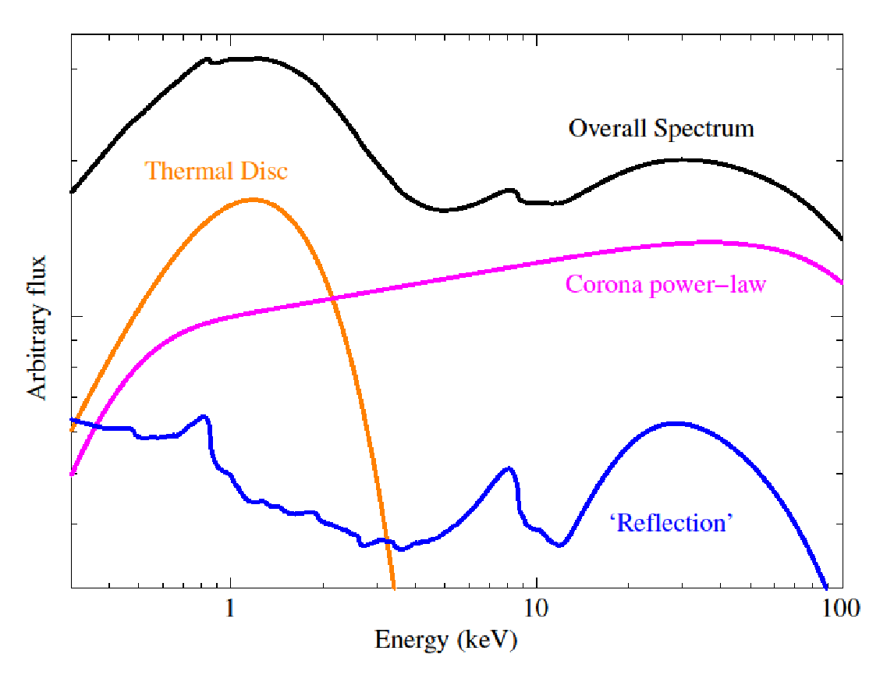
Reflection: For example - accretion systems
Corona continuum
Disc black body
Reflection
Still from ICRAR, Miller-Jones et al (2019):
https://www.icrar.org/Cygni/
6.4 keV Iron kα fluorescence line - relativistically blurred

Slide 3
Local reflection
Reflection spectra contain:
Atomic effects:
Fluorescence lines
Absorption edges
Scattering effects:
Compton hump

Slide 4
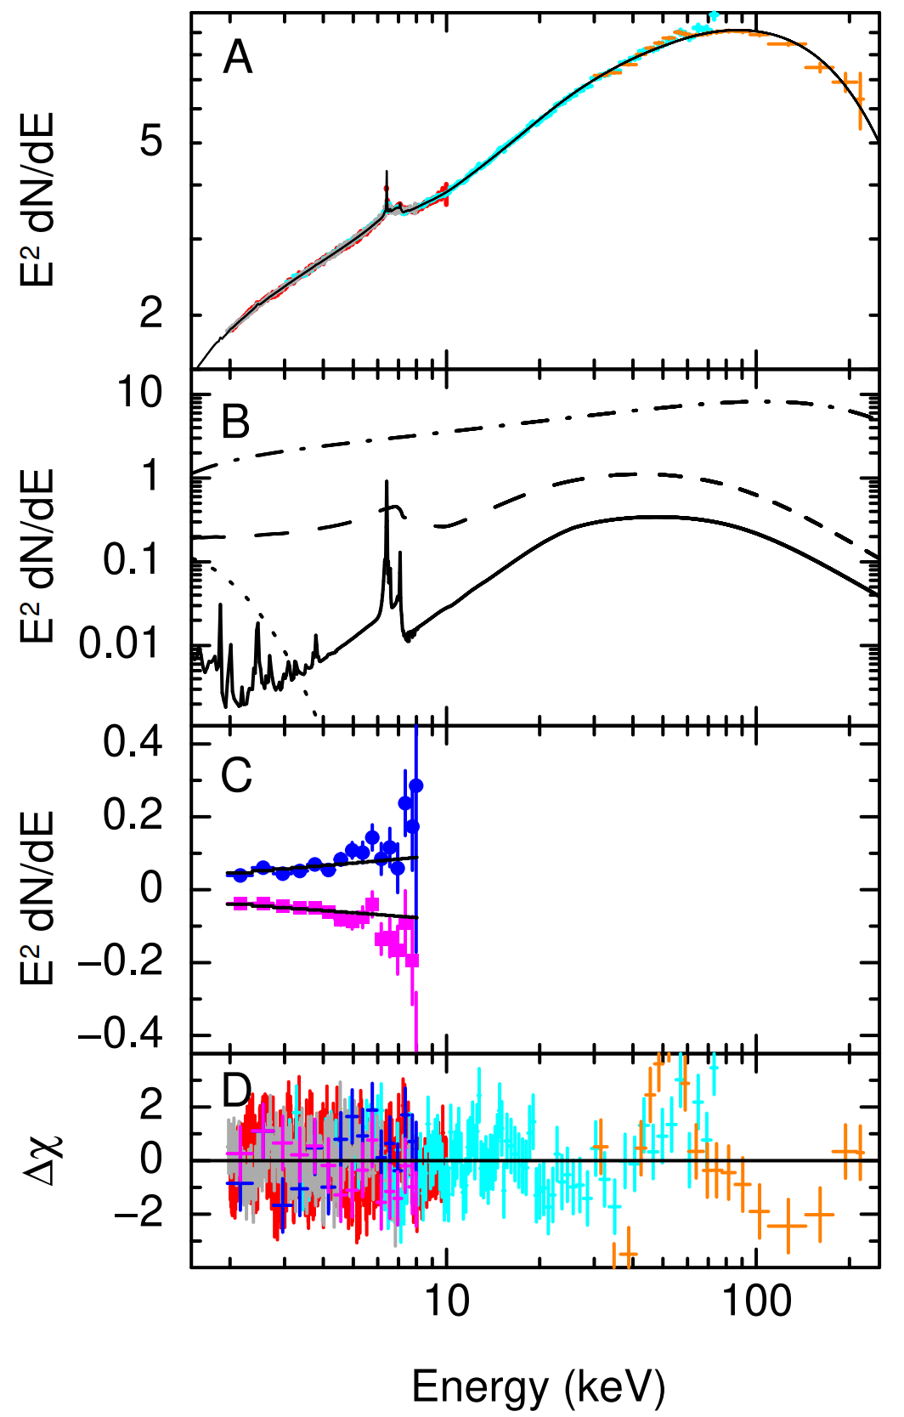
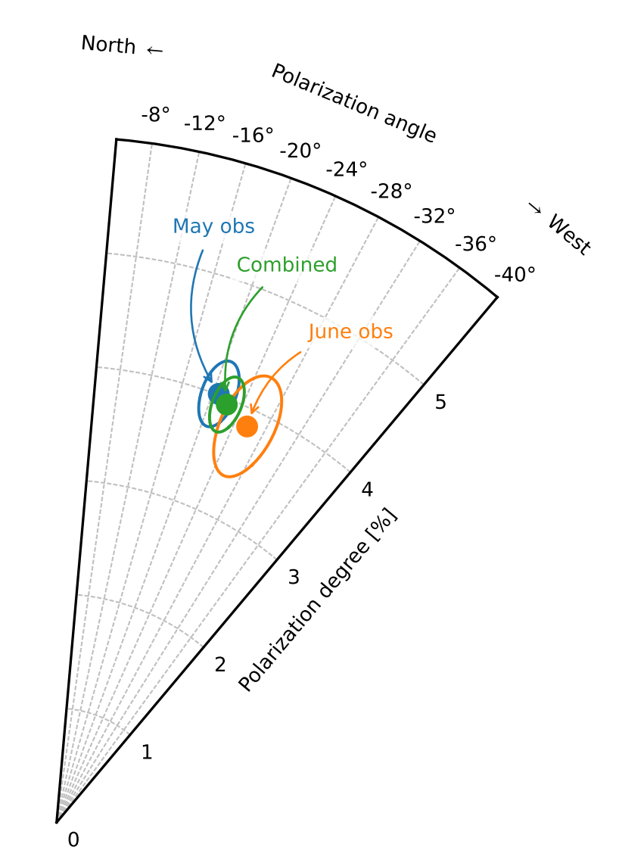
Reflection in Cyg X1 - hard state
Hard state observation of Cyg X1 (Krawczynski et al. 2022)
Coronal flux dominates in IXPE band - therefore reflected flux needs to be ~40% polarised to explain overall ~4% polarisation

Slide 5
Reflection in Cyg X1 - ‘soft’ state
If flux is reflection only
If flux is coronal only
‘Soft’ state observation of Cyg X1 - significant reflection features were still seen (Steiner, Nathan, et al. 2024)
Calculations with kerrC code suggests that almost all of the polarisation signal comes from reflection

Slide 6
How to calculate reflection
We have to solve the radiative transfer equation for a semi-infinite, plane parallel slab of gas
Slab depth
z
∂I(z,E, 𝜇)
∂z
𝜇 = 𝜂(z,E, 𝜇) −Ꭓ(z,E, 𝜇) I(z,E, 𝜇)

Slide 7
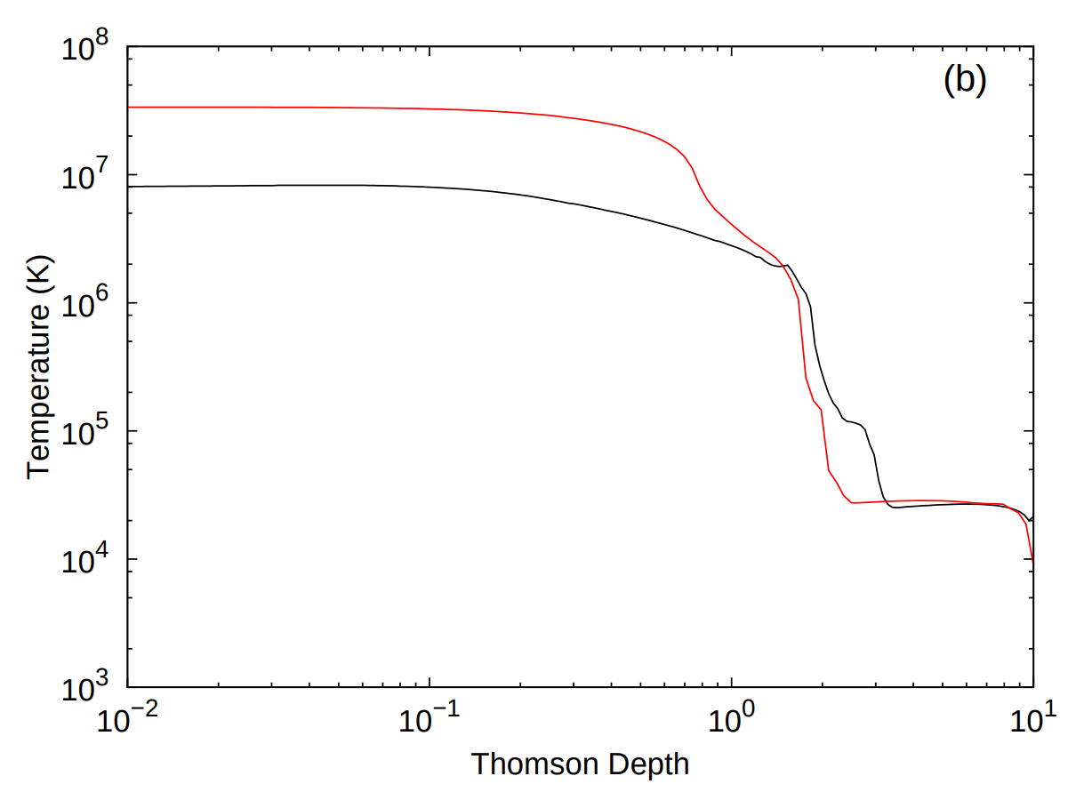
Temperature profile
Temperature profiles for two illumination spectra
Upper layers of the disc atmosphere get very hot and are highly ionised
Lower layers can be cooler and impart stronger atomic features
Spectral features produced at lower levels are affected by scattering as the photons leave the disc
Compton scattering imparts polarisation
Top
Centre
From Garcia et al. (2013)

Slide 8
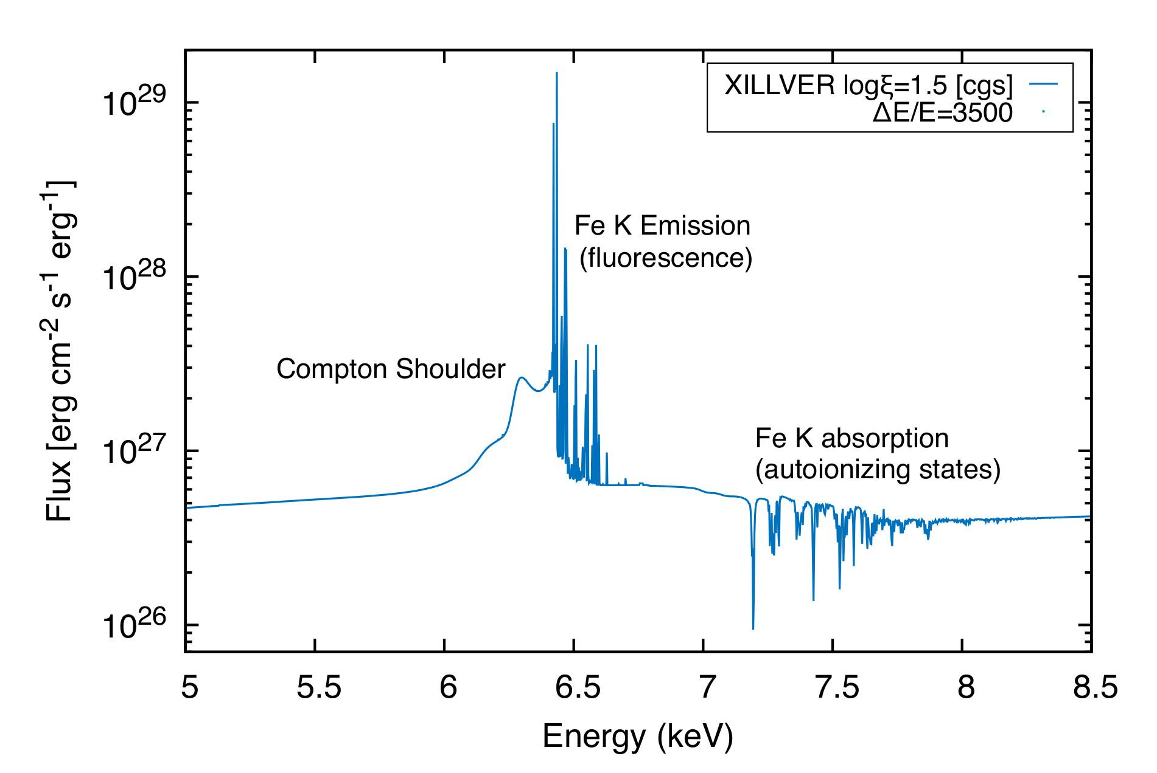
High resolution XILLVER table example - Compton Shoulder
In high-res, we see clear signs of scattering of fluorescence lines
At lower-res, this could look like polarisation of the emission line

Slide 9
How to calculate polarised reflection
We have to solve the radiative transfer equation for a semi-infinite, plane parallel slab of gas
But now for both Stokes I and Q
Geometry implies azimuthal symmetry
Therefore Stokes-U reflection is 0
Slab depth
z
∂I(z,E, 𝜇)
∂z
𝜇 = 𝜂(z,E, 𝜇) −Ꭓ(z,E, 𝜇) I(z,E, 𝜇)

Slide 10
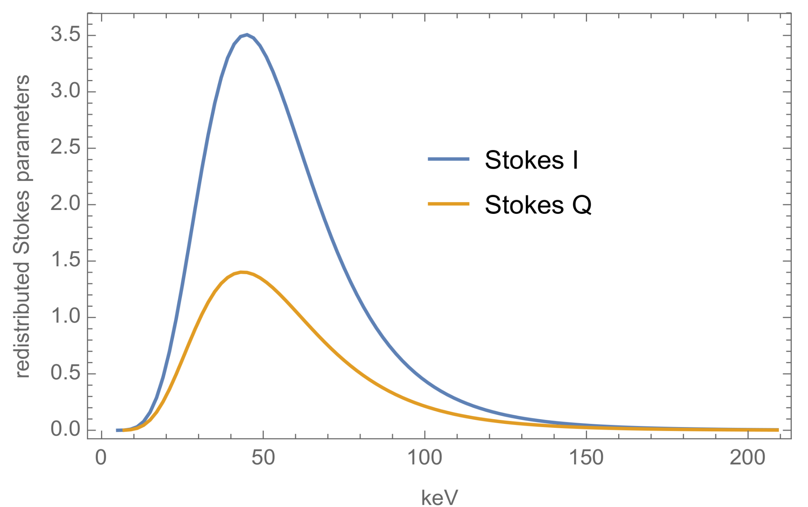
An important factor - Stokes redistribution
We will have to include scattering/redistribution between Stokes vectors
We will be able to update current XILLVER models to contain both Stokes I and Q
Figure - example redistribution for one beam of unpolarised light

Slide 11
Chandrasekhar's semi-infinite diffuse reflection (1960)
An approximate solution to the problem - should be close when very highly ionised
The polarisation is highly angle dependent
Therefore, our reflection models will be angle dependent.
XILLVER inclination currently only takes into account the effective optical depth, the scattering is isotropic
Angle of incident light
Angle of observation

Slide 12
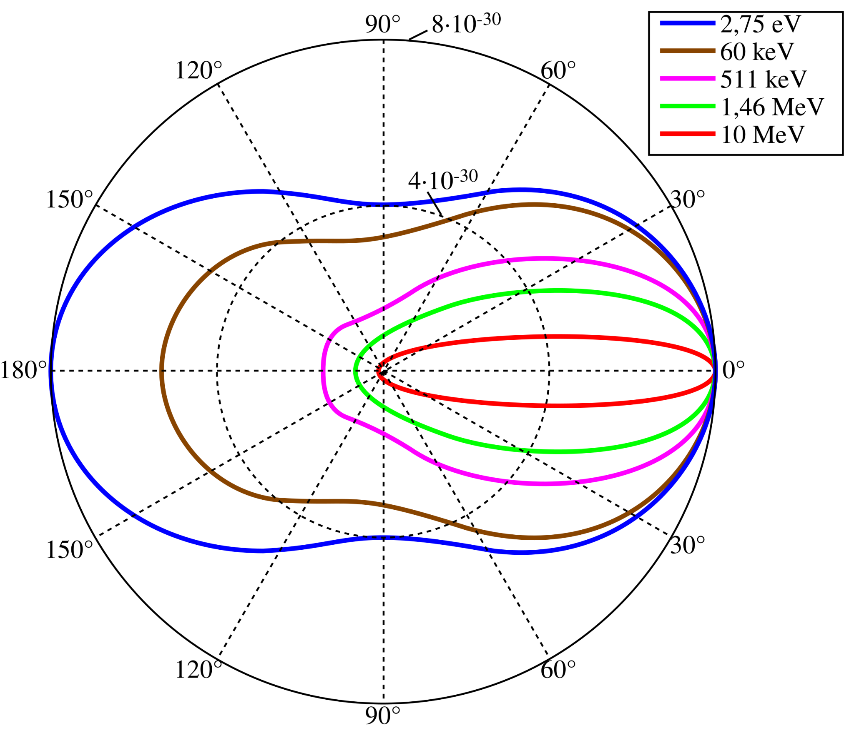
Electron scattering
Klein-Nishina electron scattering is angle dependent
Until now, XILLVER has considered electron scattering in an isotropic, angle-averaged way
We move to a method in which the angle dependence of the scattering can be calculated

Slide 13
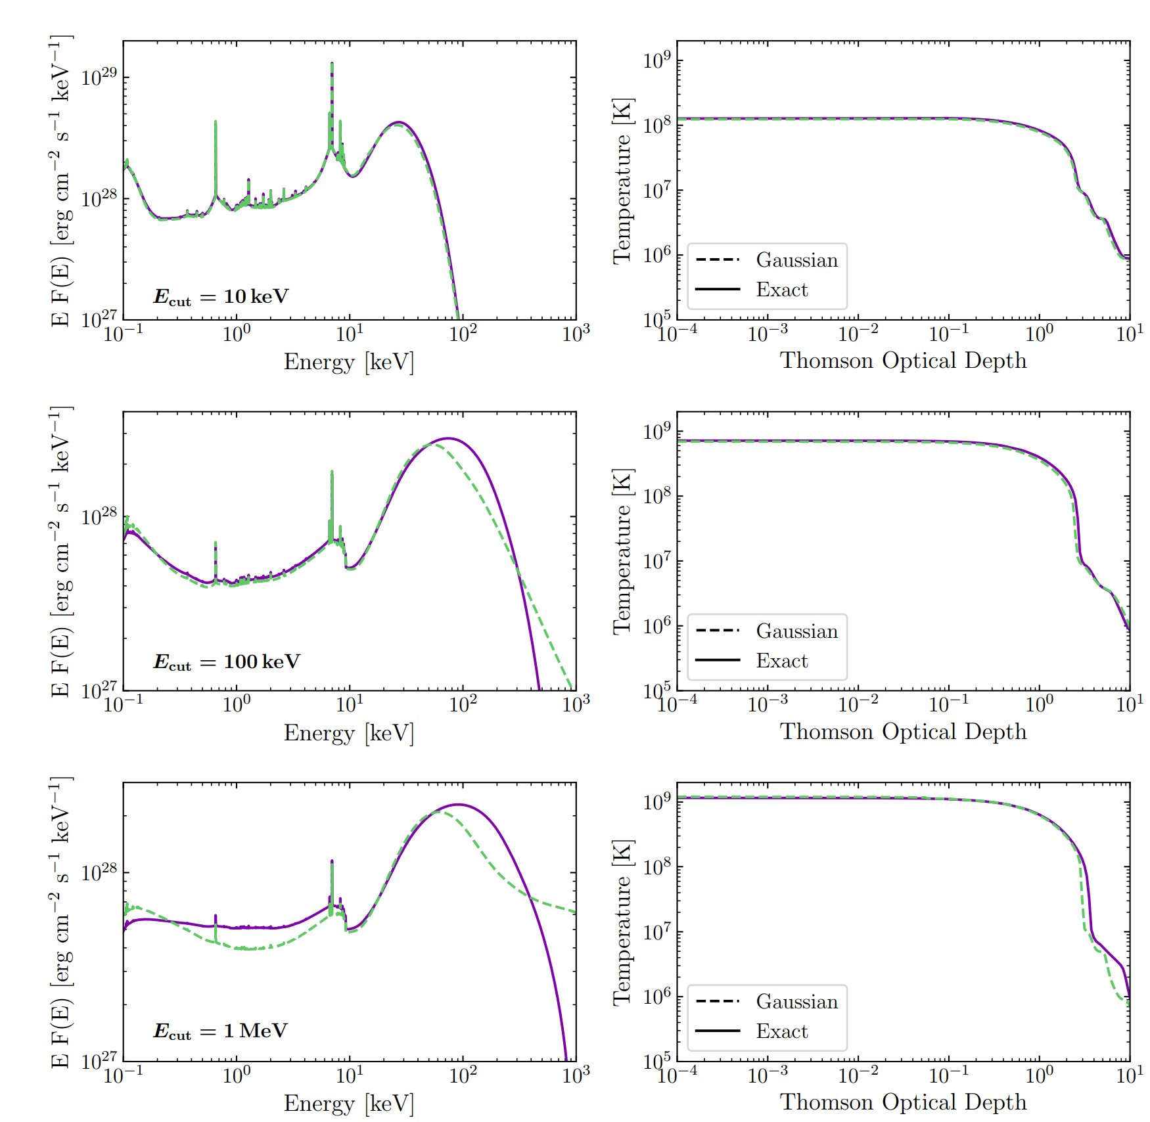
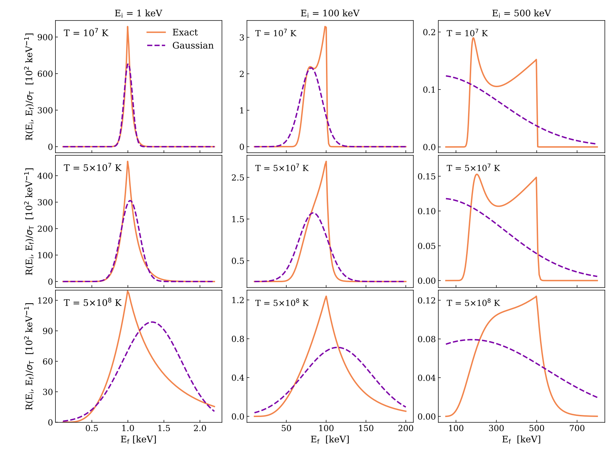
Building upon García et al. (2020)
Current XILLVER tables assume Gaussian energy redistribution
We now use an exact form from Nagirner & Poutanen (1993)

Slide 14
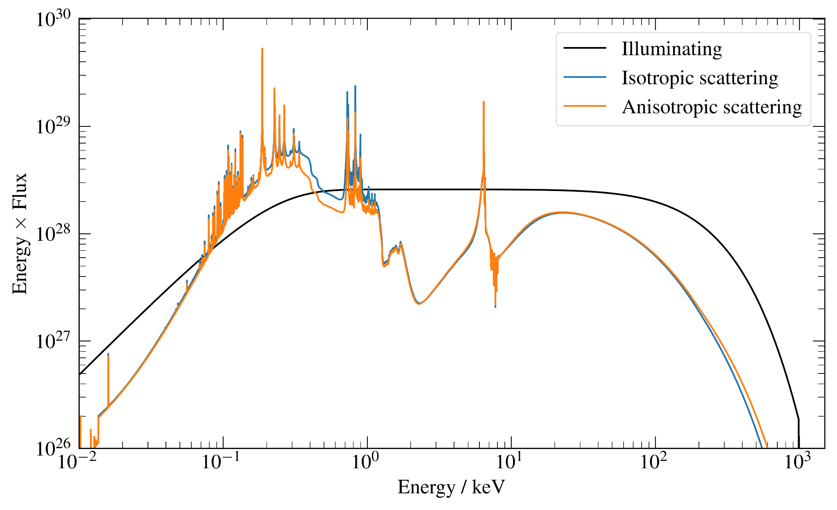
Angle dependent scattering (H and Fe only)

Slide 15
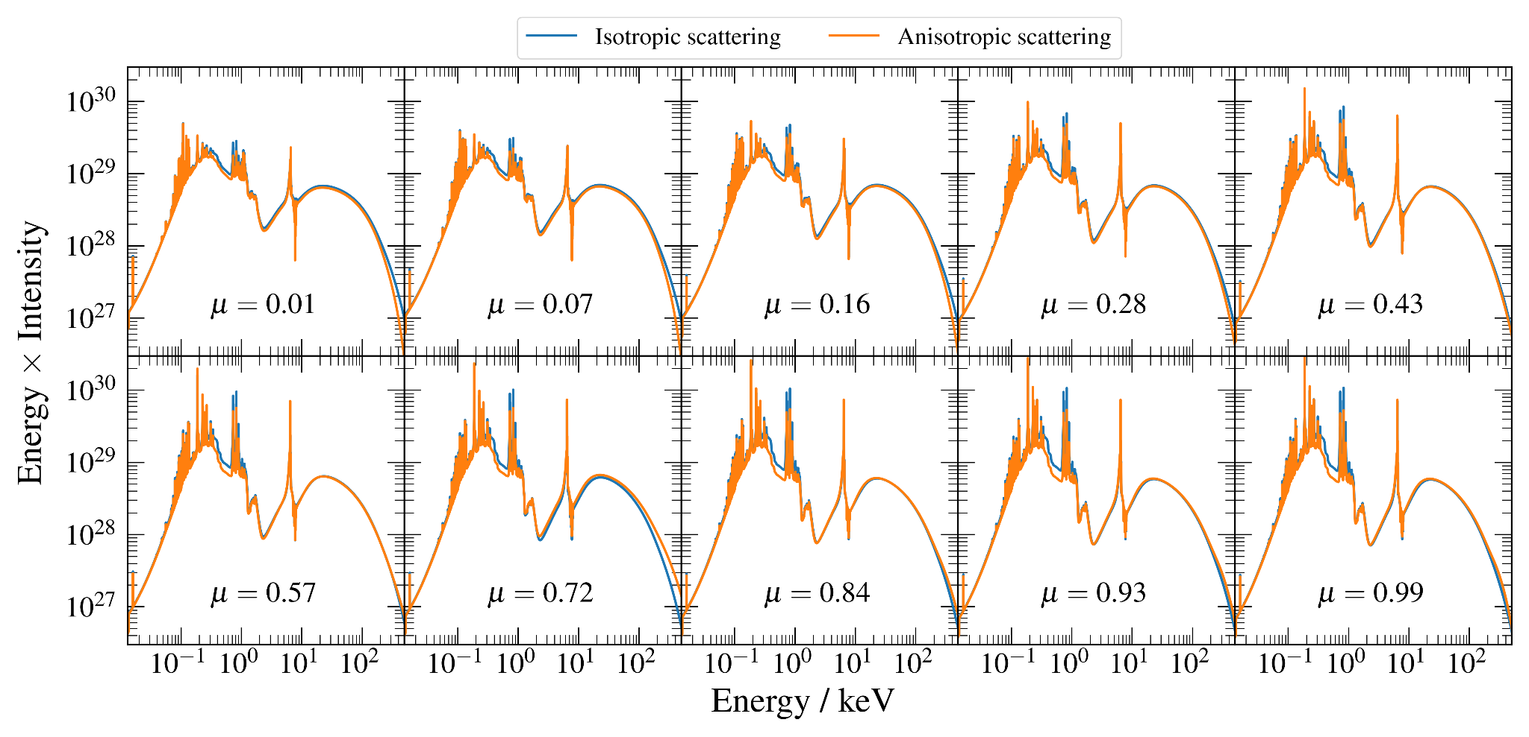
Angle dependent scattering (H and Fe only)

Slide 16
In conclusion
Understanding polarised reflection is crucial for interpreting observations of accretion discs
XILLVER reflection spectra with Stokes Q are on their way!
Intermediary work with anisotropic scattering is proving interesting per se
Finally - this work is not standalone, and ties into other improvements being made to XILLVER

