Slide 1
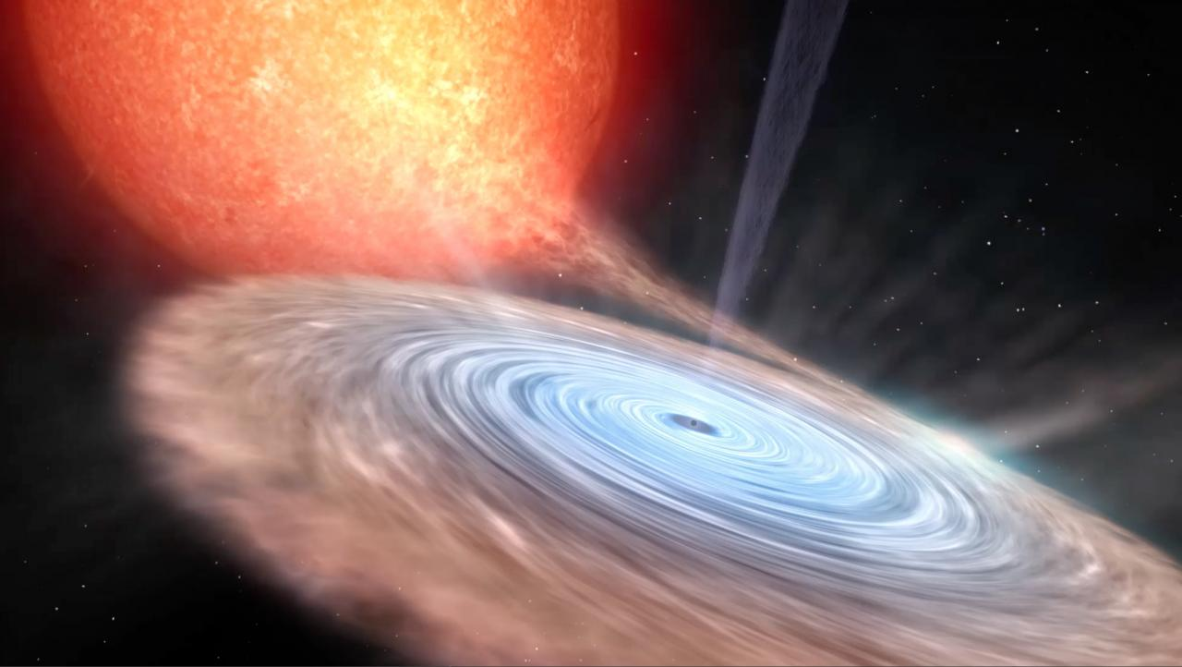
Understanding the Supercritical Accretion onto the Strongly Magnetized Neutron Stars
Lizhong Zhang (张力中) ^{1,2,3}, Omer Blaes ² and Yanfei Jiang (姜燕飞) ³
¹ Institute for Advanced Study, Princeton
² Department of Physics, University of California, Santa Barbara
³ Center for Computational Astrophysics, Flatiron Institute, New York
Image Credit: Instituto de Astrofísica de Canarias

Slide 2
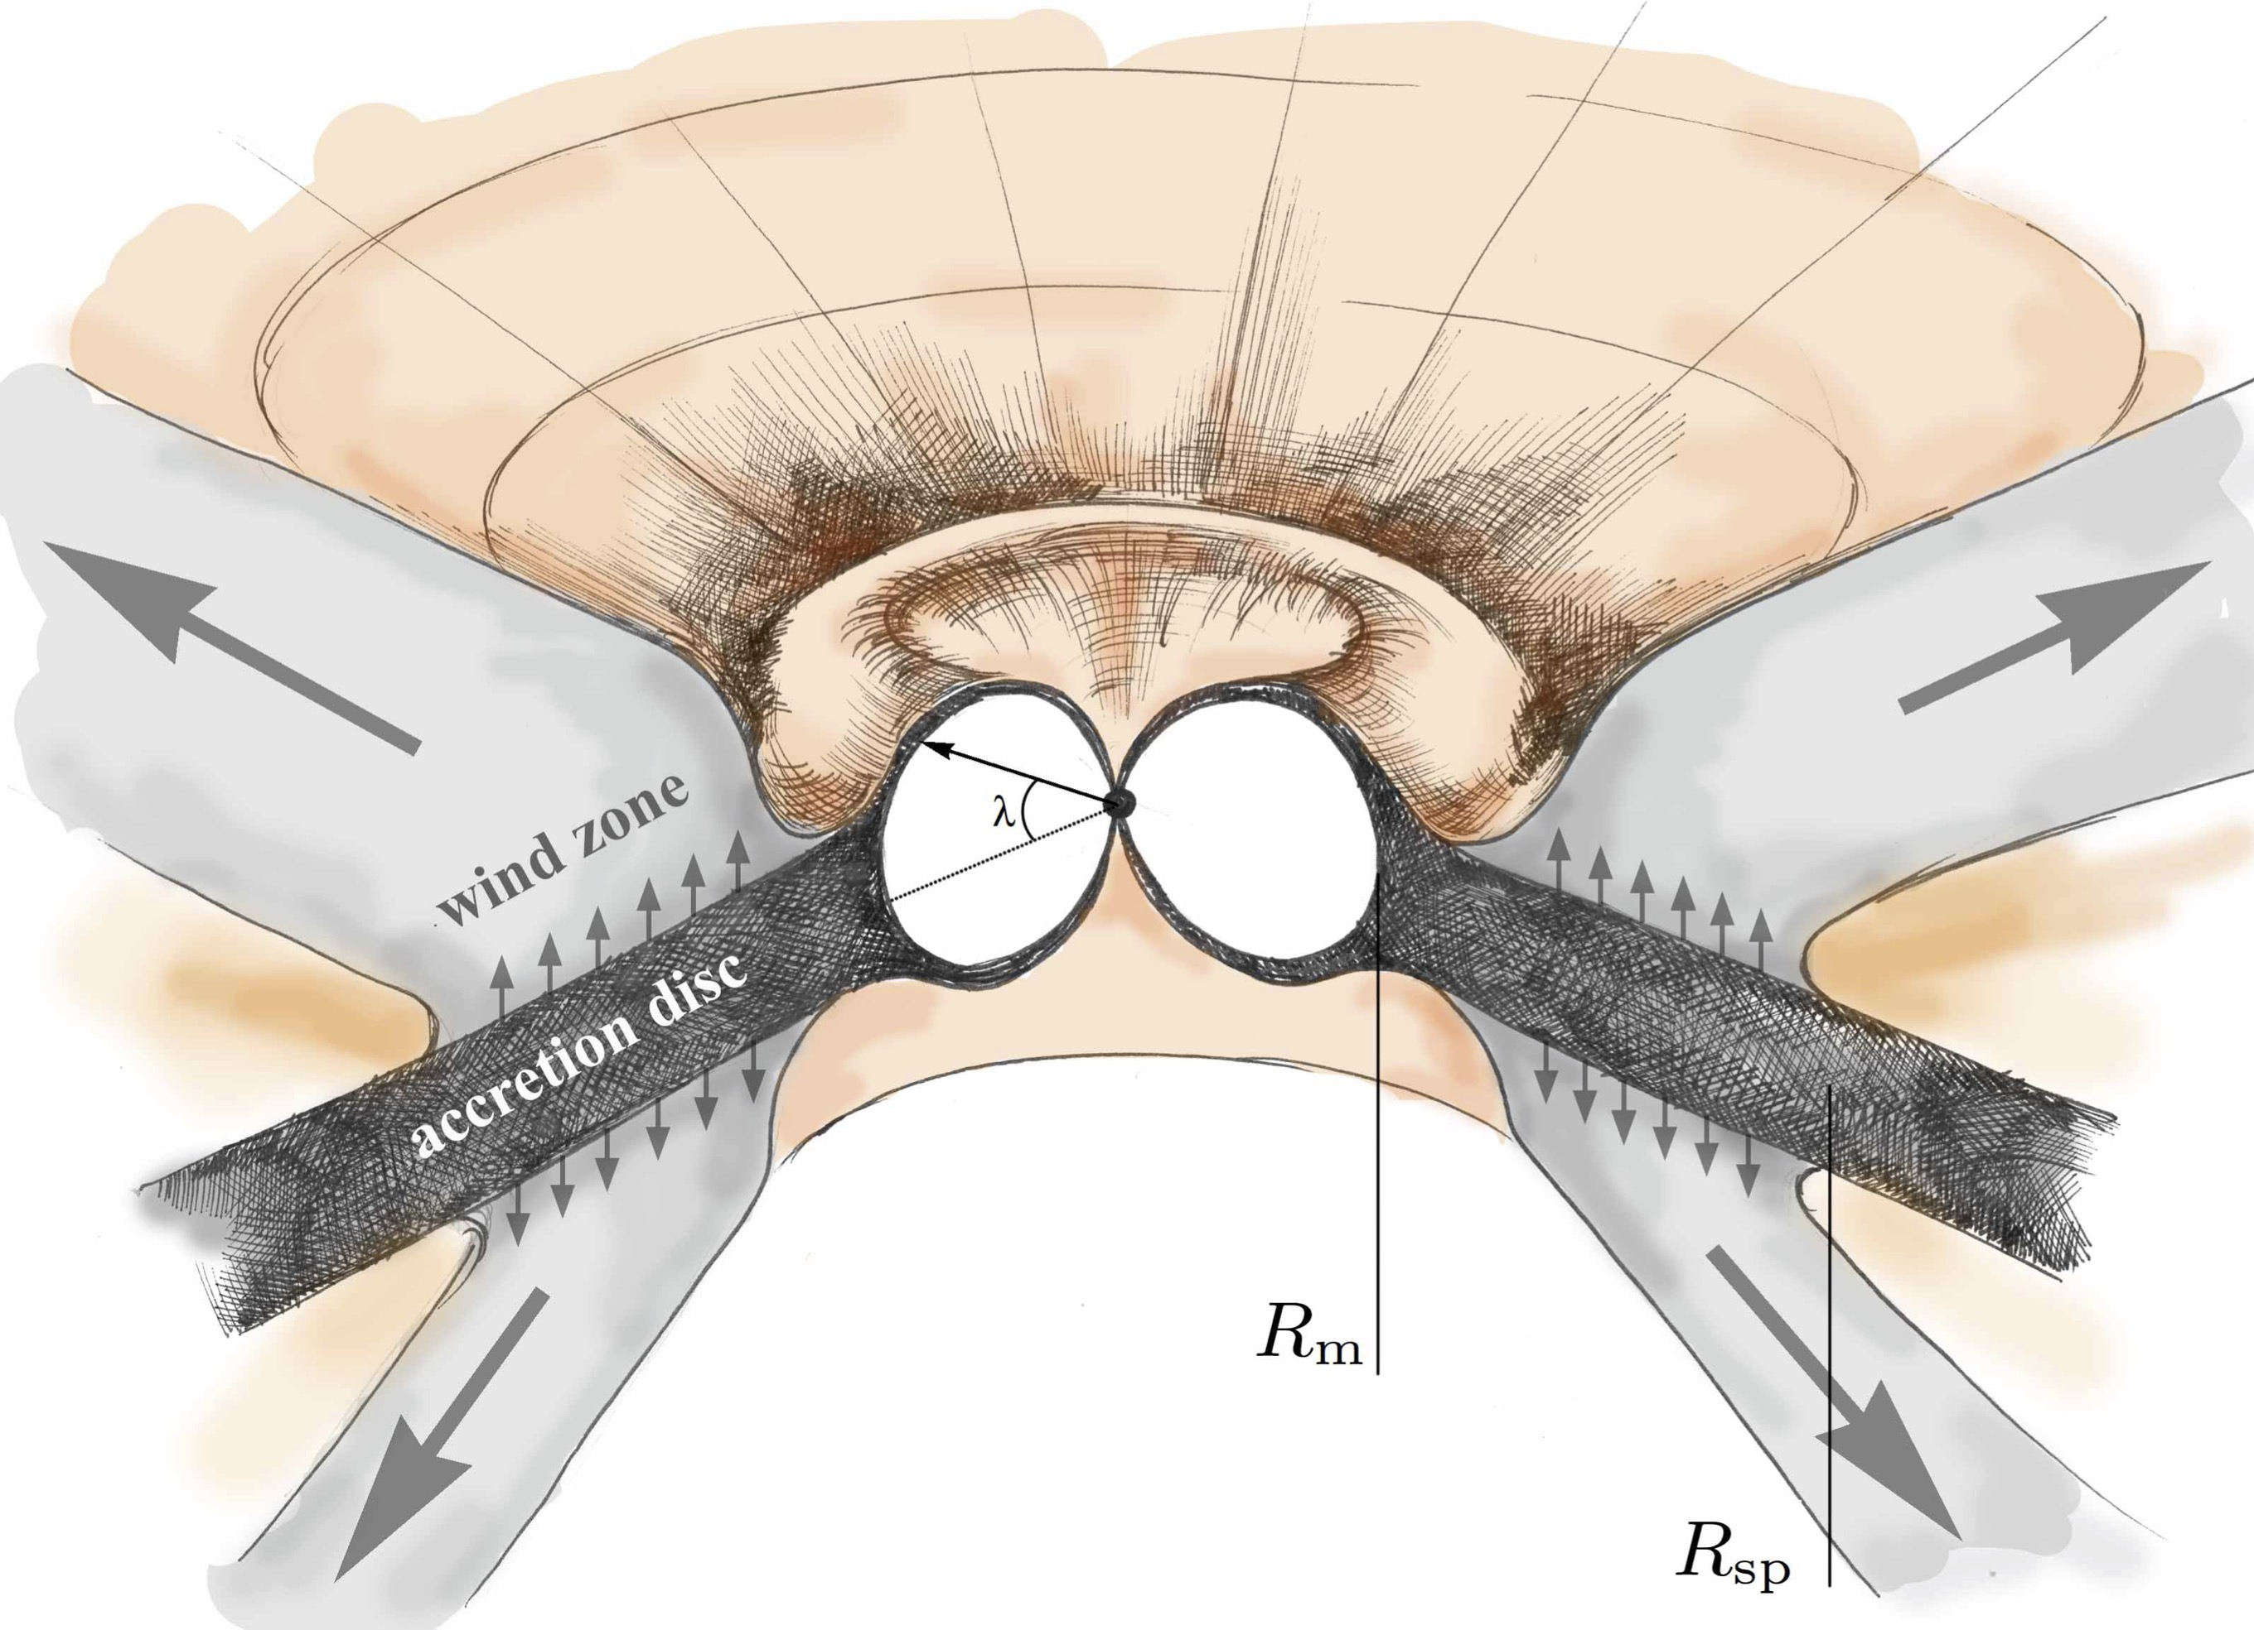
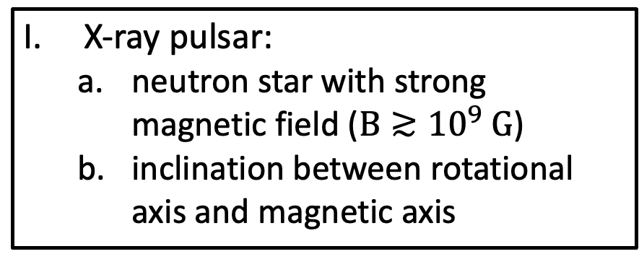
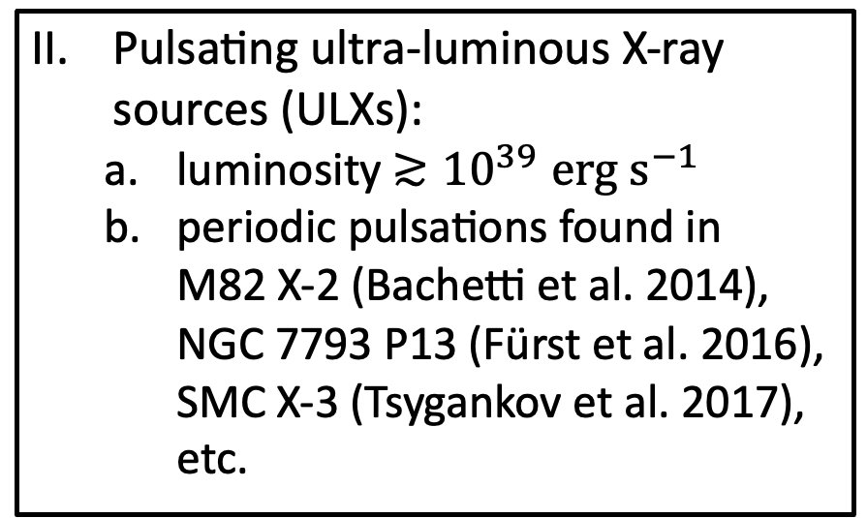
X-ray Pulsars and Pulsating ULXs
Neutron Star Accretion
Numerical Simulation Results
Ongoing & Future
X-ray pulsar:
  neutron star with strong magnetic field ($B≳{10}^{9} G$)
  inclination between rotational axis and magnetic axis
Pulsating ultra-luminous X-ray sources (ULXs):
  luminosity ${≳10}^{39}erg s^{−1}$
  periodic pulsations found in
    M82 X-2 (Bachetti et al. 2014),
    NGC 7793 P13 (Fürst et al. 2016), SMC X-3 (Tsygankov et al. 2017), etc.
Mushtukov et al. (2019)

Slide 3
Accretion Column and Hotspot
Neutron Star Accretion
Numerical Simulation Results
Ongoing & Future
Hotspot
Stronger Magnetic Field
Column
CRSF
(cyclotron resonant scattering features)
Higher Accretion Rate
Staubert et al. (2019)

Slide 4
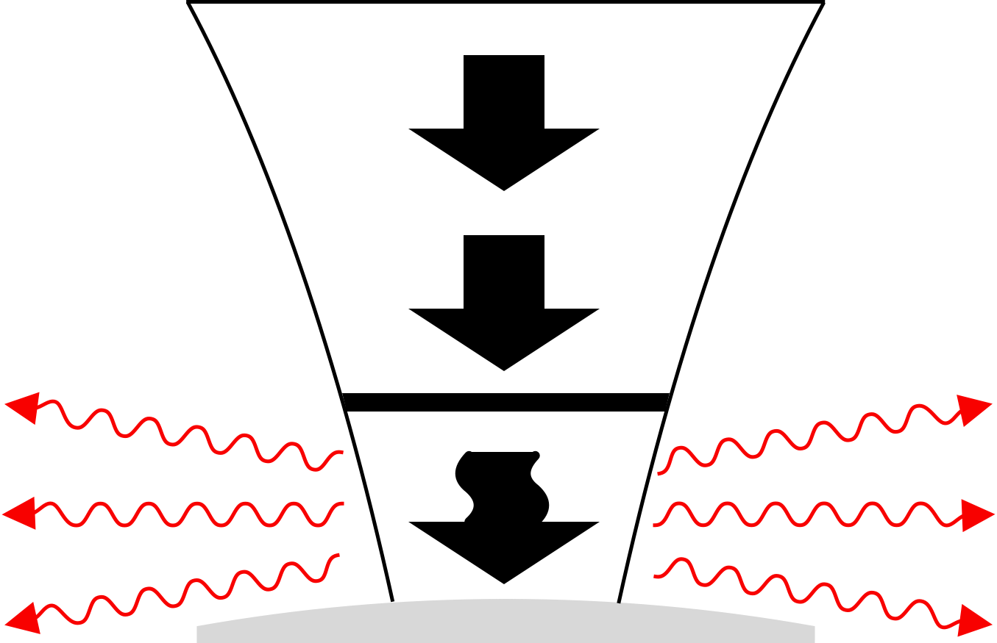
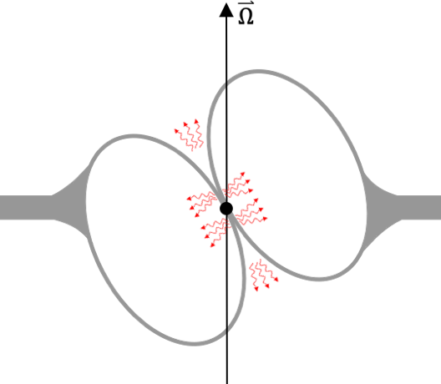
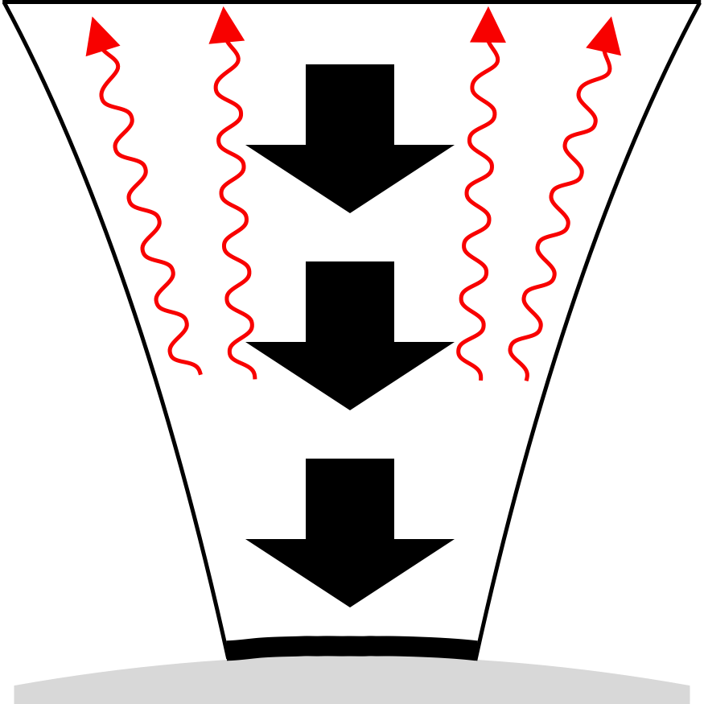
Accretion Column and Hotspot
Neutron Star Accretion
Numerical Simulation Results
Ongoing & Future
1D Stationary Model:
proposed by Basko & Sunyaev (1975, 1976)
fan beam
free-fall zone
shock front
sinking zone
accretion column
High accretion rate
pencil beam
free-fall zone
Alfvén radius
hotspot
Low accretion rate

Slide 5
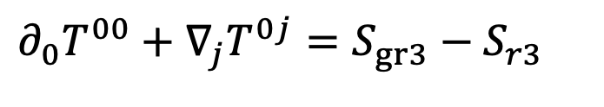
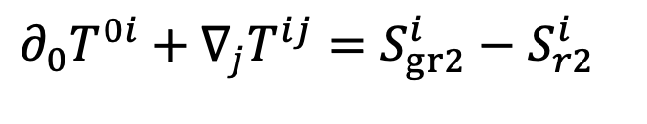
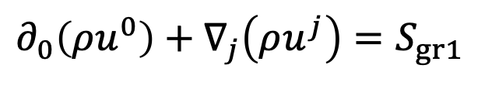
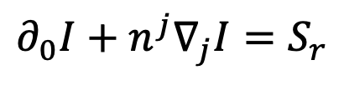
Accretion Column Simulations
Neutron Star Accretion
Numerical Simulation Results
Ongoing & Future
Numerically solve both relativistic MHD and frequency-integrated, angle-dependent radiative transfer equations:
$∂_{0}\left(ρu^{0}\right)+∇_{j}\left(ρu^{j}\right)=S_{gr1}$
$∂_{0}T^{00}+∇_{j}T^{0j}=S_{gr3}−S_{r3}$
$$∂_{0}I+n^{j}∇_{j}I=S_{r}$$
$∂_{0}T^{0i}+∇_{j}T^{ij}=S_{gr2}^{i}−S_{r2}^{i}$
Study the dynamics of accretion columns depending on column geometry, accretion rate, and magnetic field:
Step1: Numerical method validation (2021, MNRAS, 508, 617)
Step2: Overall dynamics in accretion columns (2022, MNRAS, 515, 4371)
Step3: Dynamical effects due to the geometry of magnetic fields (2023, MNRAS, 520, 1421)
Step4: Dynamical effects of classical magnetic opacity (2023, MNRAS, 524, 2431)
Step5: Dynamical effects of quantizing magnetic opacity with vacuum polarization and pairs
(ongoing)
Step6: Post-processing of the simulated accretion columns for X-ray polarization, spectrum,
angle-dependent variability (ongoing)
Zhang, Blaes & Jiang (2023)

Slide 6
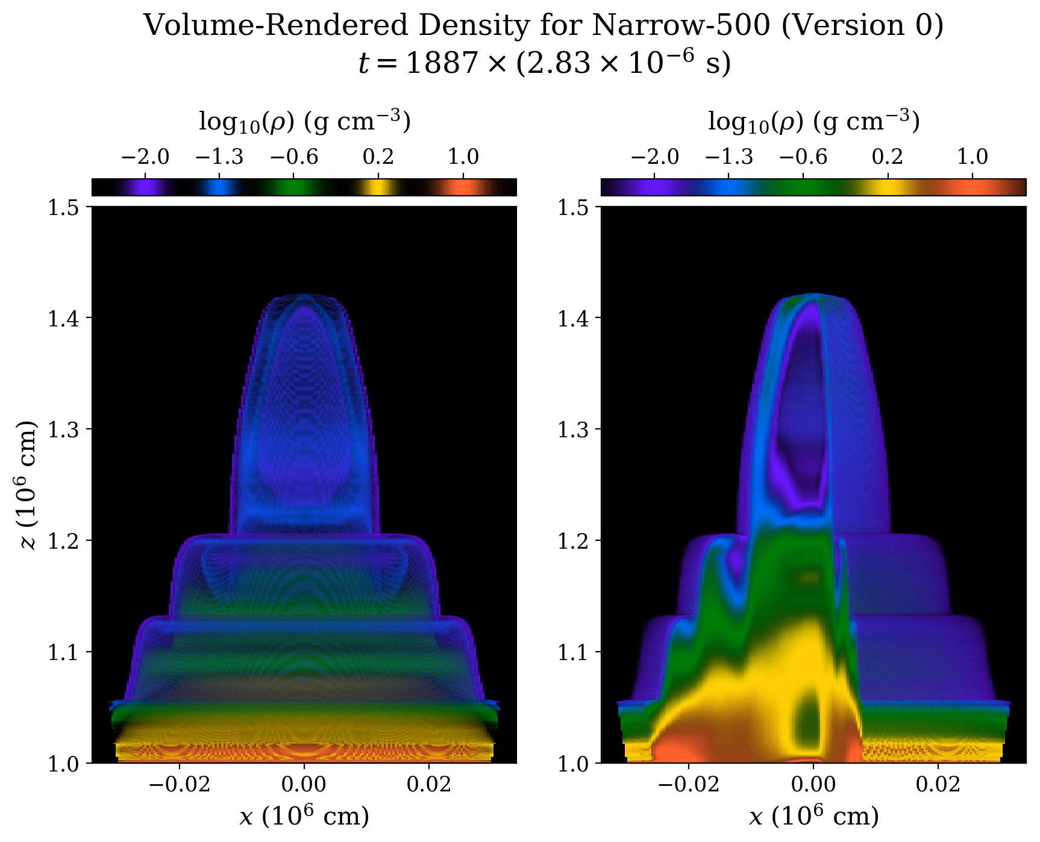
High-Frequency Nonlinear Oscillation
Neutron Star Accretion
Numerical Simulation Results
Ongoing & Future
Numerical simulations of neutron star accretion columns found:
Accretion column is dynamical due to the global thermal imbalance
Quasi-periodic oscillatory behavior near kHz frequency
Luminosity variations arising from the shock oscillations
Finger-shaped (fountain-shaped) structure introduced by the entropy waves that are associated with slow-diffusion photon bubbles
Zhang, Blaes & Jiang (2023)

Slide 7
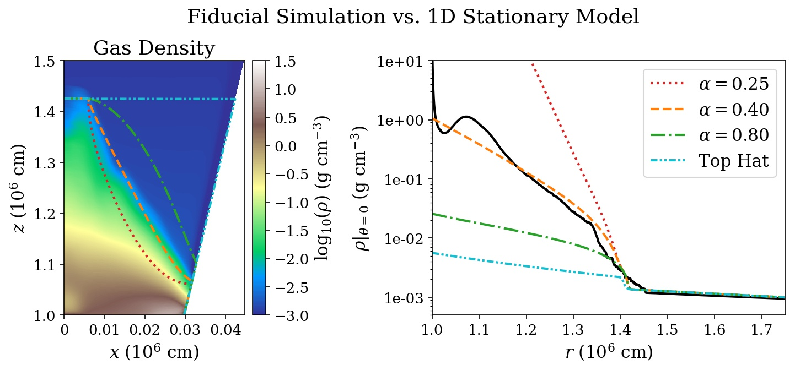
Time-Averaged Structure
Neutron Star Accretion
Numerical Simulation Results
Ongoing & Future
Zhang, Blaes & Jiang (2023)

Slide 8
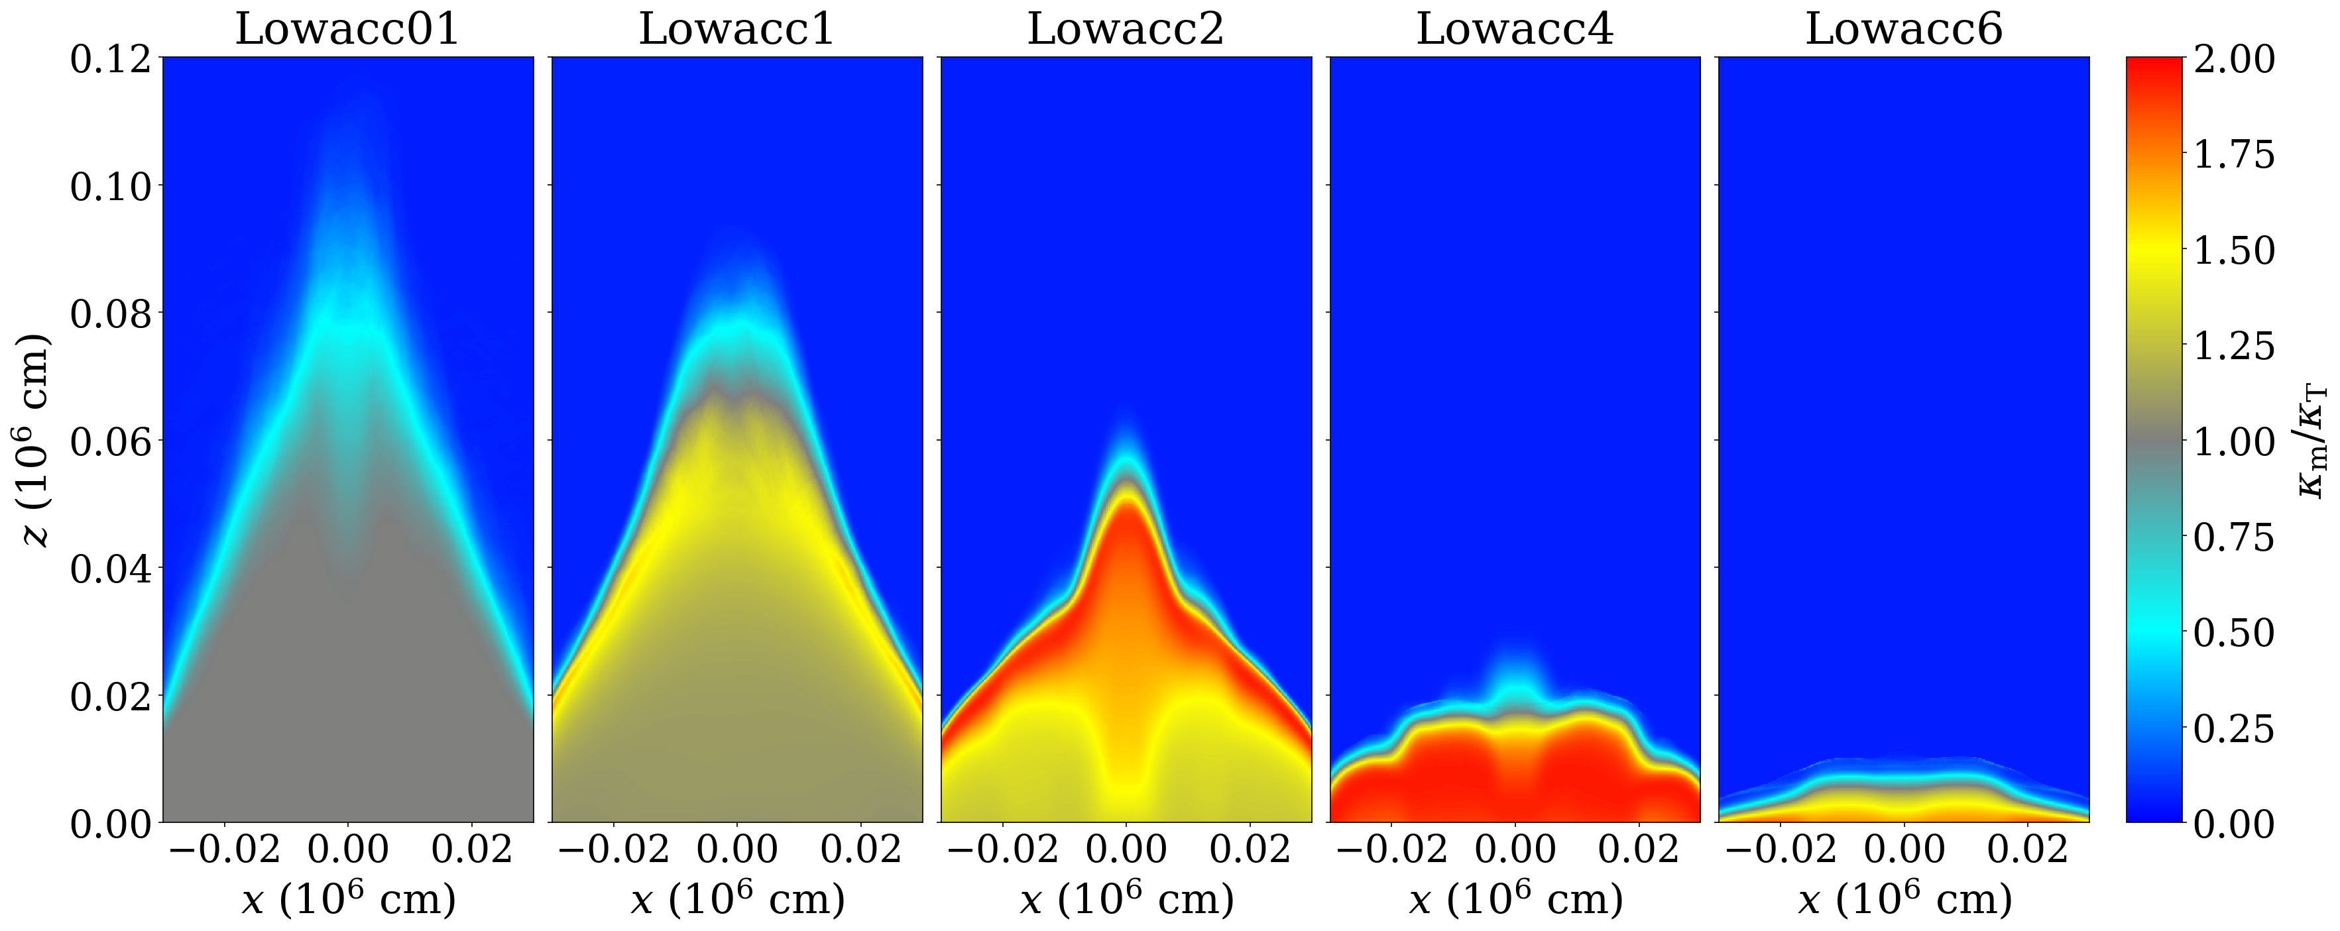
Classical Magnetic Opacity
Neutron Star Accretion
Numerical Simulation Results
Ongoing & Future
Sheng, X., Zhang, L., Blaes, O., Jiang, Y. (2023)

Slide 9
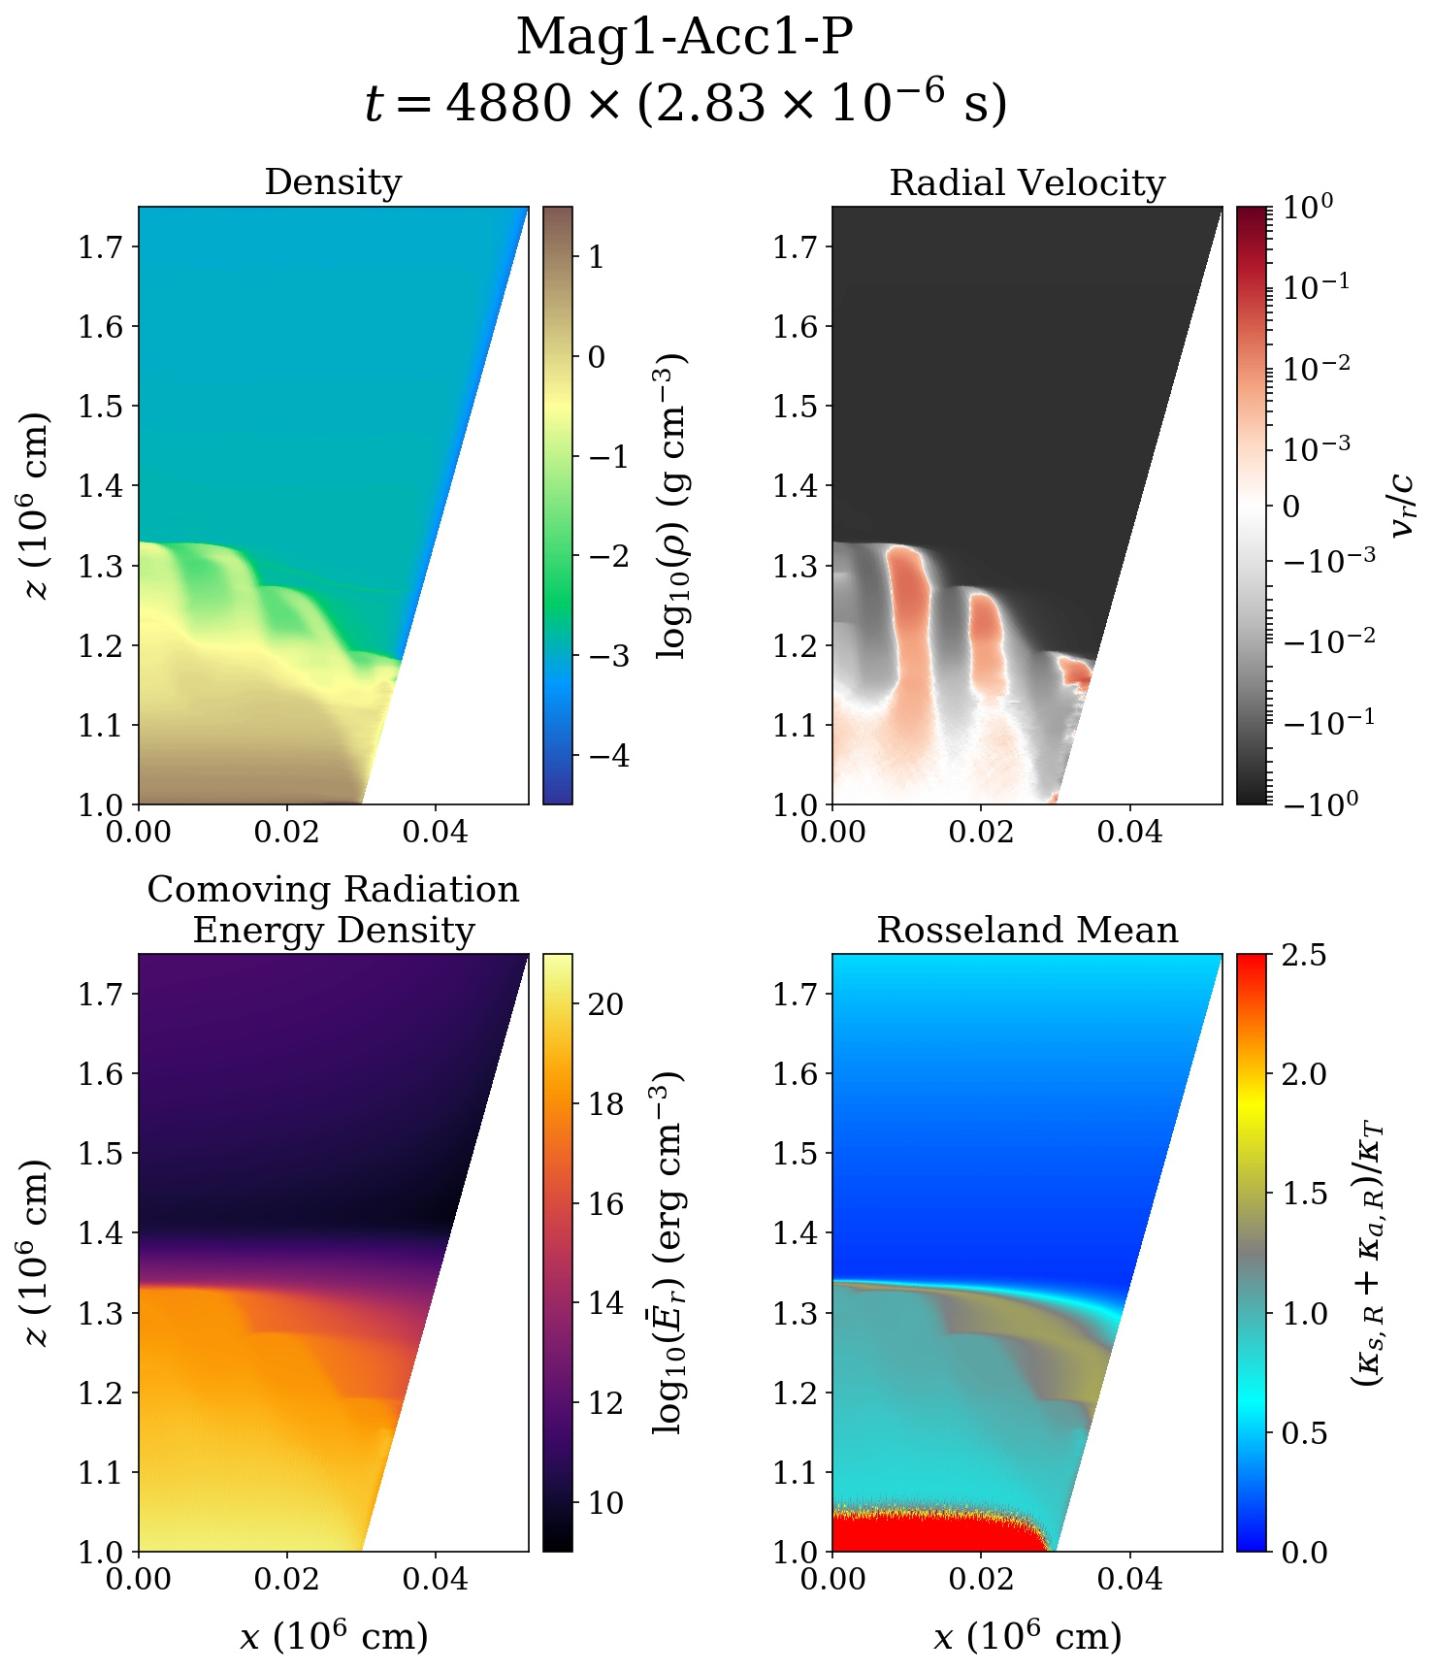
Quantizing Magnetic Opacity
Neutron Star Accretion
Accretion Column Simulation Results
Ongoing & Future
Temperature dependence of magnetic opacities
Pair effects at high temperature
Reproduction of the opacity table in Suleimanov et al. (2022)
Zhang, L., Blaes, O., Jiang, Y. (in prep)

Slide 10


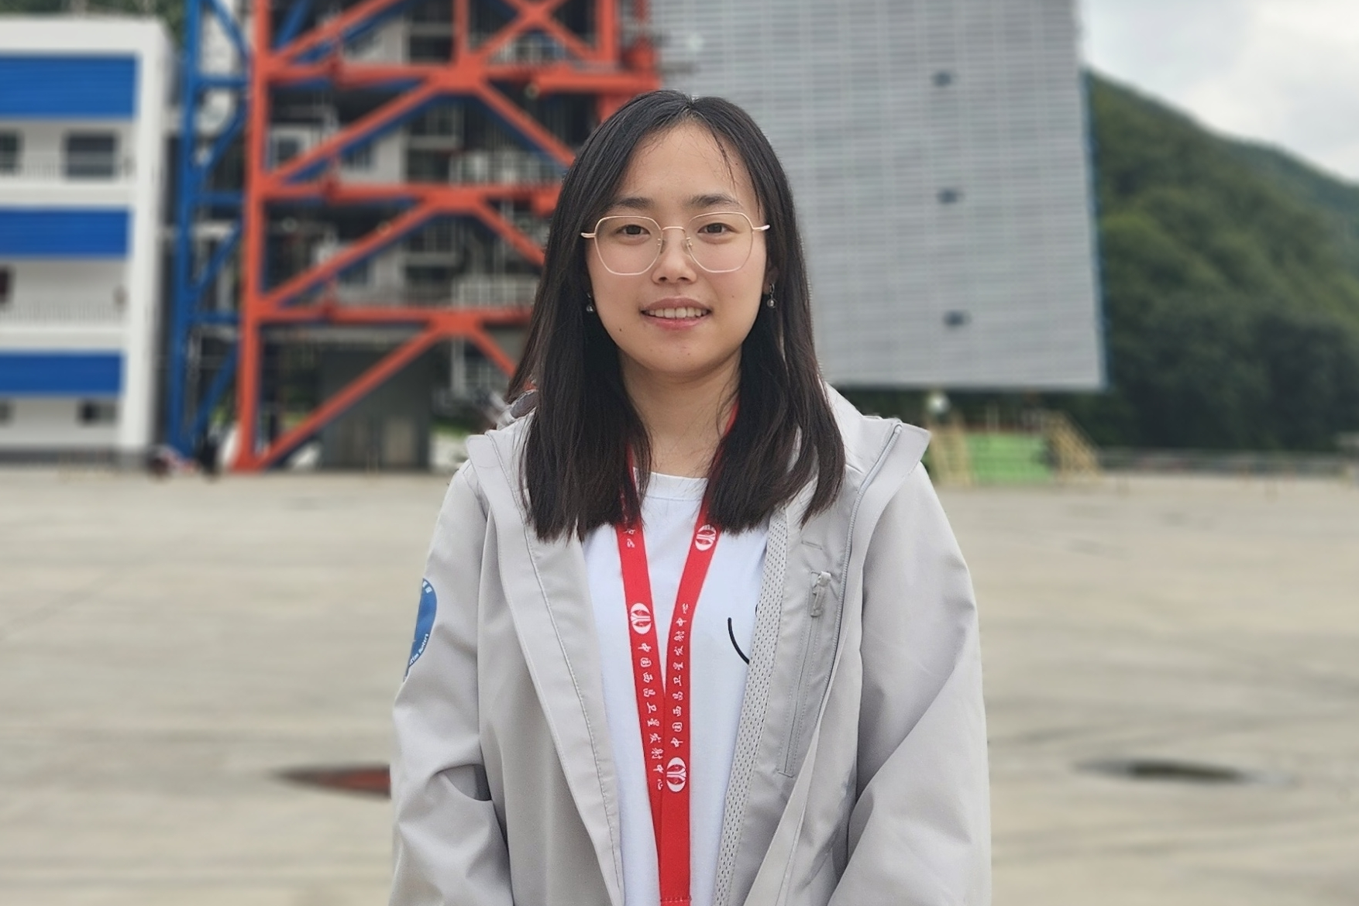
Post-processing for Observables
Neutron Star Accretion
Accretion Column Simulation Results
Ongoing & Future
Compute X-ray polarization due to the magnetic scattering and vacuum resonance for the comparison with IXPE observations
Compute spectrum with cyclotron resonance
Viewing angle dependencies
Current team members:
B. Connor McClellan (UVA)
Nick Loudas (Princeton)
Shane Davis (UVA)
Lizhong Zhang (IAS & CCA)
Omer Blaes (UCSB)
Yanfei Jiang (CCA)
Panping Li (IHEP)
Post-processing
Fluid Dynamics
Observation

Slide 11
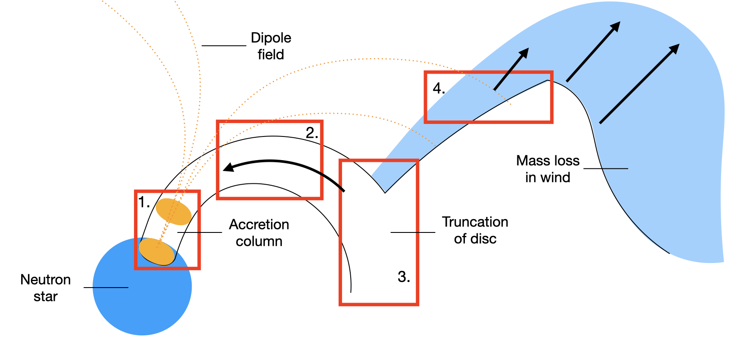
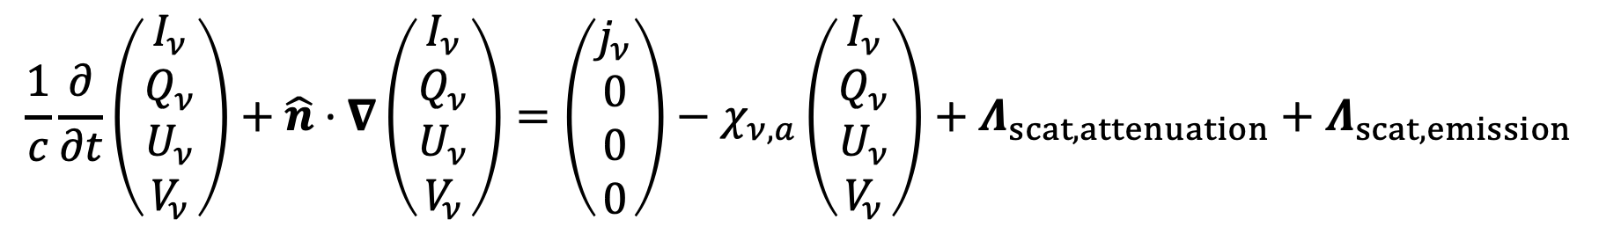
Future Exploration
Neutron Star Accretion
Accretion Column Simulation Results
Ongoing & Future
Dynamics introduced by the magnetic polarized radiative transfer
Simulate the radiative feedback in the accretion curtain (e.g. Mushtukov et al. 2024)
Simulate the radiation dynamics between magnetosphere and disk
$$\frac{1}{c}\frac{∂}{∂t}\left(\begin{aligned}I_{ν} \\ Q_{ν} \\ U_{ν} \\ V_{ν}\end{aligned}\right)+\hat{n}⋅∇\left(\begin{aligned}I_{ν} \\ Q_{ν} \\ U_{ν} \\ V_{ν}\end{aligned}\right)=\left(\begin{aligned}j_{ν} \\ 0 \\ 0 \\ 0\end{aligned}\right)−χ_{ν,a}\left(\begin{aligned}I_{ν} \\ Q_{ν} \\ U_{ν} \\ V_{ν}\end{aligned}\right)+Λ_{scat,attenuation}+Λ_{scat,emission}$$
scattering attenuation
scattering emission
thermal emission
thermal absorption
Image Credit: Matthew Middleton

