Slide 1
IXPE General Observer Program
Kavitha Arur
NASA GSFC/UMBC/CRESST
IXPE GOF Lead

Slide 2
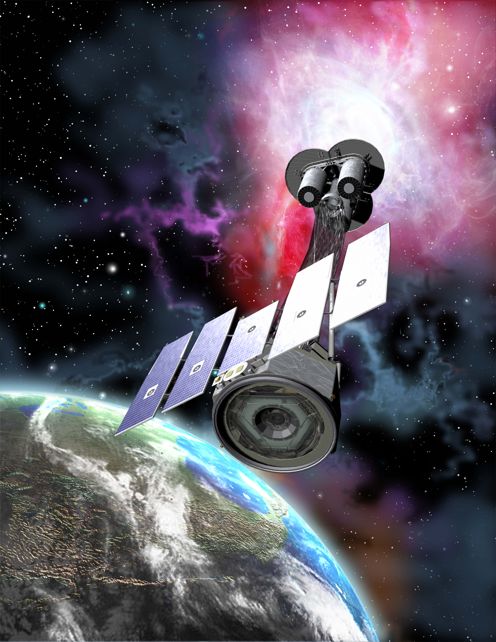
Overview
IXPE extended past the 2 year prime mission, initiating the General Observer (GO) program
GO Cycle 1 – Feb 2024
GO Cycle 2 – Feb 2025
General Observer Facility (GOF) at NASA GSFC
GOF website: https://heasarc.gsfc.nasa.gov/docs/ixpe/
30 July 2024
IXPE GO Cycle 2

Slide 3
Timeline
Event | Date
ROSES 24 Announcement | Feb 2024
Proposal submission opens | July 2024
Phase I submission deadline | August 29th, 2024
Proposal review | October 2024
Results/ Phase II | December 2024
Cycle 2 GO observations start | February 2025
30 July 2024
IXPE GO Cycle 2

Slide 4
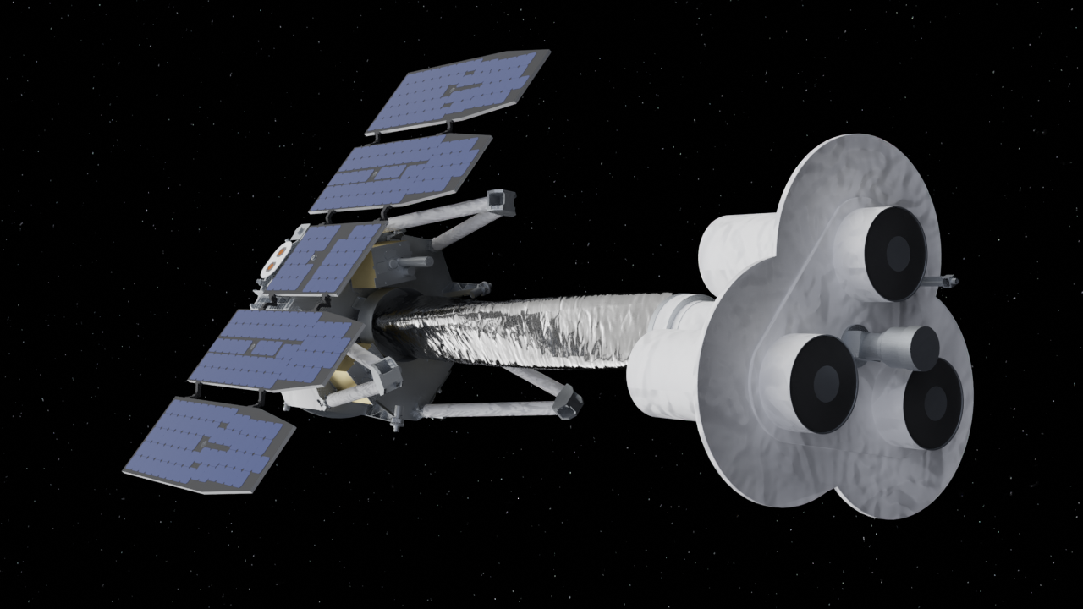
Cycle 1
A total of 135 proposals submitted
115 regular (~85%)
14 theory (~10%)
6 large (~5%)
11 Msec available, additional 4Msec for large program
Total of 39 proposals selected
Oversubscription rates
Overall IXPE time ~6
ToO triggers ~9
Worldwide interest, with PIs from over 15 countries!
30 July 2024
IXPE GO Cycle 2

Slide 5
Cycle 2 Highlights
Approximately 15 Msec GO observing time in total
Up to 4 Msec for large proposals
Joint NICER, NuSTAR and Swift time
Regular, Large and Theory proposals
ToO proposals also solicited
Can request up to 6 months exclusive-use
Multi cycle proposals NOT allowed
30 July 2024
IXPE GO Cycle 2

Slide 6
Large Proposals
~4 Msec for large program (LP)
All proposals requesting over 1.5 Msec considered large
No exclusive use period for LP
30 July 2024
IXPE GO Cycle 2

Slide 7
Targets of Opportunity
ToO proposals for known and unknown targets – New this cycle!
Multiple triggers allowed per proposal (max 3)
Max. exposure for individual ToO trigger – 1.5 Msec
Credit: NASA’s Marshall Space Flight Center/Daniel Kocevski
30 July 2024
IXPE GO Cycle 2

Slide 8
Targets of Opportunity
High: IXPE observations to begin within 4 days of trigger
Medium: IXPE observations to begin between 4 days to 3 weeks from the trigger
Low: IXPE observations to begin after 3 weeks from the trigger
IXPE anticipates executing approximately 1 high and 7 medium triggers in this GO cycle
30 July 2024
IXPE GO Cycle 2

Slide 9
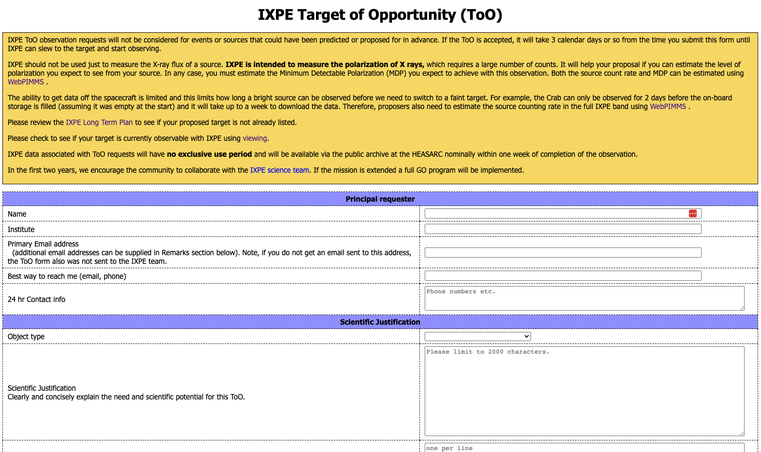
Targets of Opportunity
Unanticipated ToOs through DDT time
ToO form on IXPE project website at MSFC at https://ixpe.msfc.nasa.gov/for_scientists/too.html
30 July 2024
IXPE GO Cycle 2

Slide 10
Joint Programs
NICER
Up to 300 ks of NICER time available
NuSTAR – New this cycle!
Up to 400 ks of NuSTAR time available
Minimum NuSTAR observation is 20 ks
Swift – New this cycle!
Up to 200 ks of Swift time available
30 July 2024
IXPE GO Cycle 2

Slide 11
Theory Proposals
Proposals for theoretical investigations are also solicited
No observations, only funding!
Aid in the interpretation of IXPE results
Advance the science return of IXPE
One year period of performance
30 July 2024
IXPE GO Cycle 2

Slide 12
Constraints and Designations
Accepted proposals are ranked Category A or C
Category A guaranteed
Will be carried over to next cycle if not observed
ToOs will not be carried over.
Category C executed on best effort basis
Funding available if C targets observed
Time constrained and joint proposals need to be designated Category A
30 July 2024
IXPE GO Cycle 2

Slide 13
Proposal Submission
Two phase process
Phase 1 – scientific justification
Dual anonymous
Phase 2 – budget proposal
30 July 2024
IXPE GO Cycle 2

Slide 14
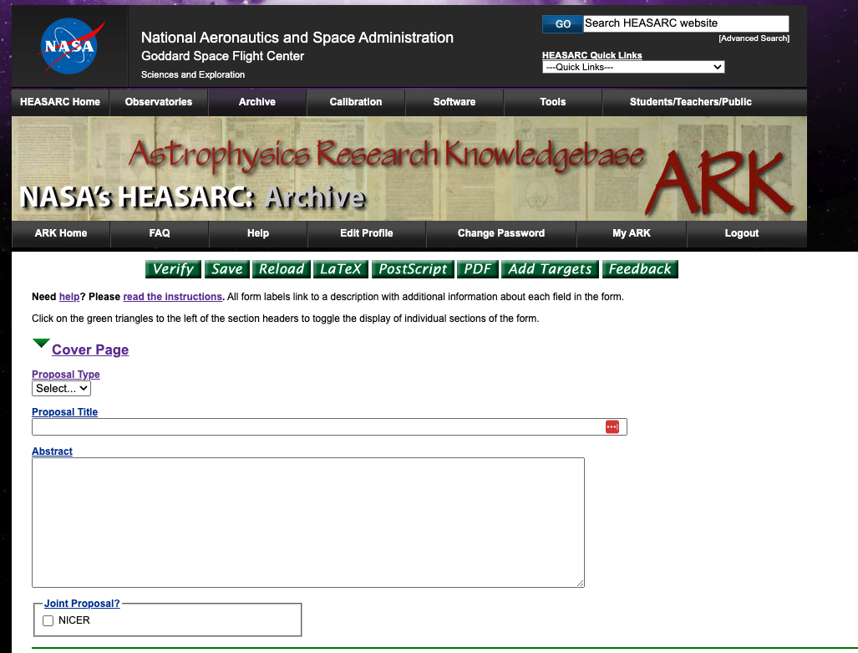
Phase 1 Proposal Submission
Submission through ARK/RPS
RPS form
Scientific/Technical Justification
Expertise and resources document
30 July 2024
IXPE GO Cycle 2

Slide 15
Phase 1 – RPS Form
Title, abstract, PI and co-I information
Must estimate MDP!
WebPIMMS
Justify any time constraints
Make sure time constraints do not conflict with visibility windows
Use the HEASARC visibility tool to check
Target form for each different target/trigger
Observing plan, joint/coordinated observations, estimated count rate
The information in this form is used by the SOC to plan observations. Please fill in the information carefully and accurately!
30 July 2024
IXPE GO Cycle 2

Slide 16
Phase 1- Science/Technical Justification
Please respect the page limits!
4-page limit (incl. figures & tables)
5 pages for large proposal and joint NICER/NuSTAR/Swift proposals
References do not count against page limit, can use one extra page
Introduction
Brief overview of topic
Key science questions being answered
Justification for observations:
Has the target been observed before?
Technical feasibility
Use WebPIMMS to estimate count rate and MDP
Use measured polarization from similar sources from IXPE publications
Use a theory that predicts polarization
Simulations (e.g using user contributed software such as ixpeobssim)
MUST maintain anonymity!
30 July 2024
IXPE GO Cycle 2

Slide 17
Phase 1 - Expertise and Resources
1 page PDF, not anonymized
Only seen by panel after ranking is finalized
For highly ranked/ tentatively selected proposals
Team members, including ranks, affiliations and research expertise
Access to pre-approved data, institution specific facilities
Justification for exclusive use period (if requesting)
If you have any questions, or run into any issues, please see the RPS help page or contact the help desk as soon as possible!
30 July 2024
IXPE GO Cycle 2

Slide 18
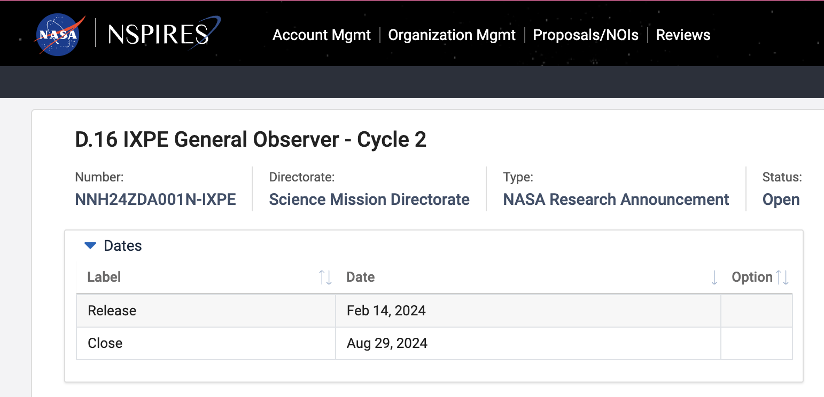
Phase 2 Proposal Submission
Submission through NSPIRES
US PIs of selected proposals will be invited to submit a budget
Non-US PIs may nominate one US Co-I to submit a budget
Fair share amount will be emailed to the budget/admin PI
Includes:
NSPIRES form
2 page budget narrative
Current and pending support for the PI
PI CV
30 July 2024
IXPE GO Cycle 2

Slide 19
IXPE specific considerations
Need lots of counts to measure polarization!
Observations >=1 Msec are welcomed and encouraged!
Telemetry limits
Roughly 75 ksec for the Crab
Long observations of bright sources must be broken up with observations of dimmer sources
Galactic center is popular!
Feb-01 to May-01 observing window – very competitive!!
May-01 to Aug-01 observing window - less competition
See Allyn Tennant’s talk for more details!
30 July 2024
IXPE GO Cycle 2

Slide 20
Joint program considerations
Different joint programs have different rules and requirements.
Double check the solicitation/ relevant webpages as these can change from cycle to cycle!
Science/technical justification must hold true for both.
An extra page for this!
Ensure that visibility windows overlap.
30 July 2024
IXPE GO Cycle 2

Slide 21
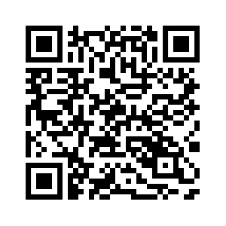
Conclusions
IXPE cycle 2 proposal deadline is coming up – August 29th 2024, 4:30pm Eastern Time
IXPE’s unique polarization capabilities can help your science!
We are looking for volunteers for the review panels!
Proposal reviewers (must have PhD at the time of review)
Executive secretaries (graduate students)
Please contact the IXPE Help Desk if you have any questions!
IXPE Help Desk
30 July 2024
IXPE GO Cycle 2

Slide 22
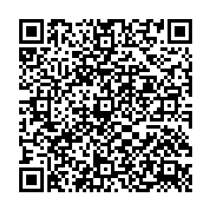
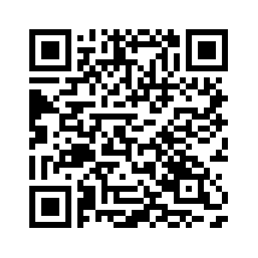
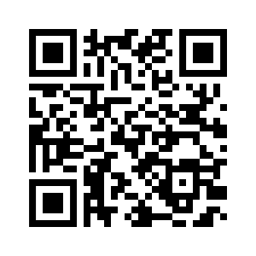
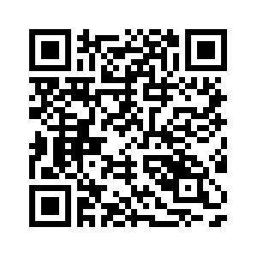
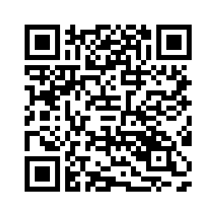
Useful Links
IXPE Cycle 2 Call for proposals
IXPE Cycle 2 Proposers Guide
IXPE RPS – Proposal Submission site
HEASARC Viewing Tool
HEASARC WebPIMMS
30 July 2024
IXPE GO Cycle 2

