Slide 1
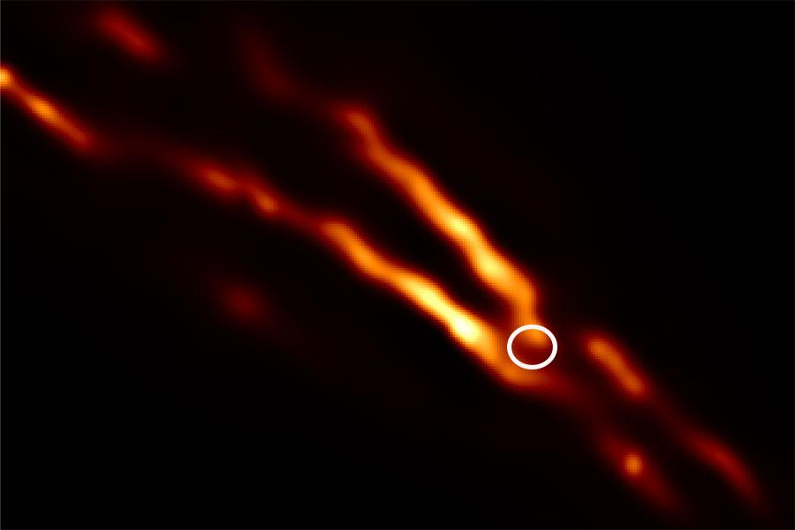
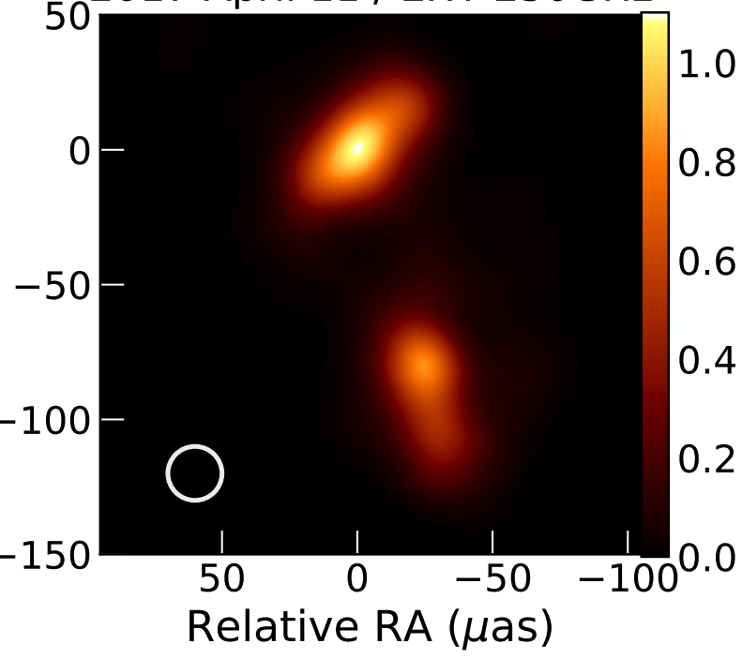
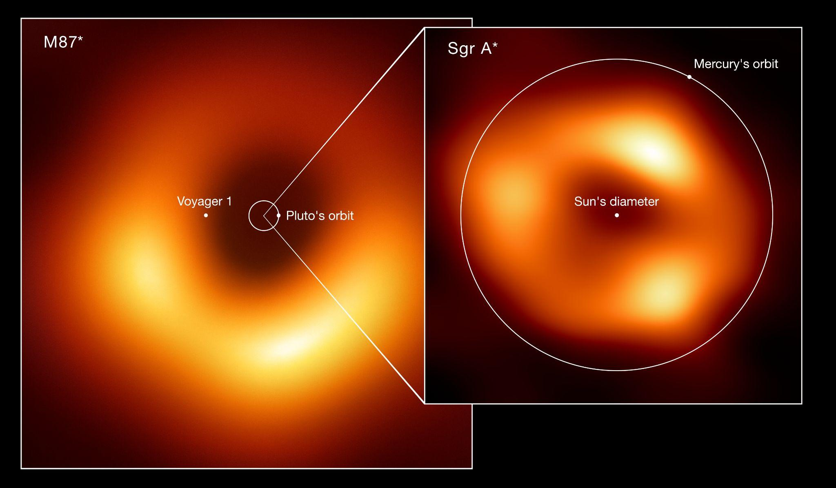
Constraining the Accretion and Jet Properties of Next Gen. EHT Targets with NICER and NuSTAR (and Swift!)
Nicole Ford (PhD Student, McGill University)
Advisor: Daryl Haggard
1

Slide 2
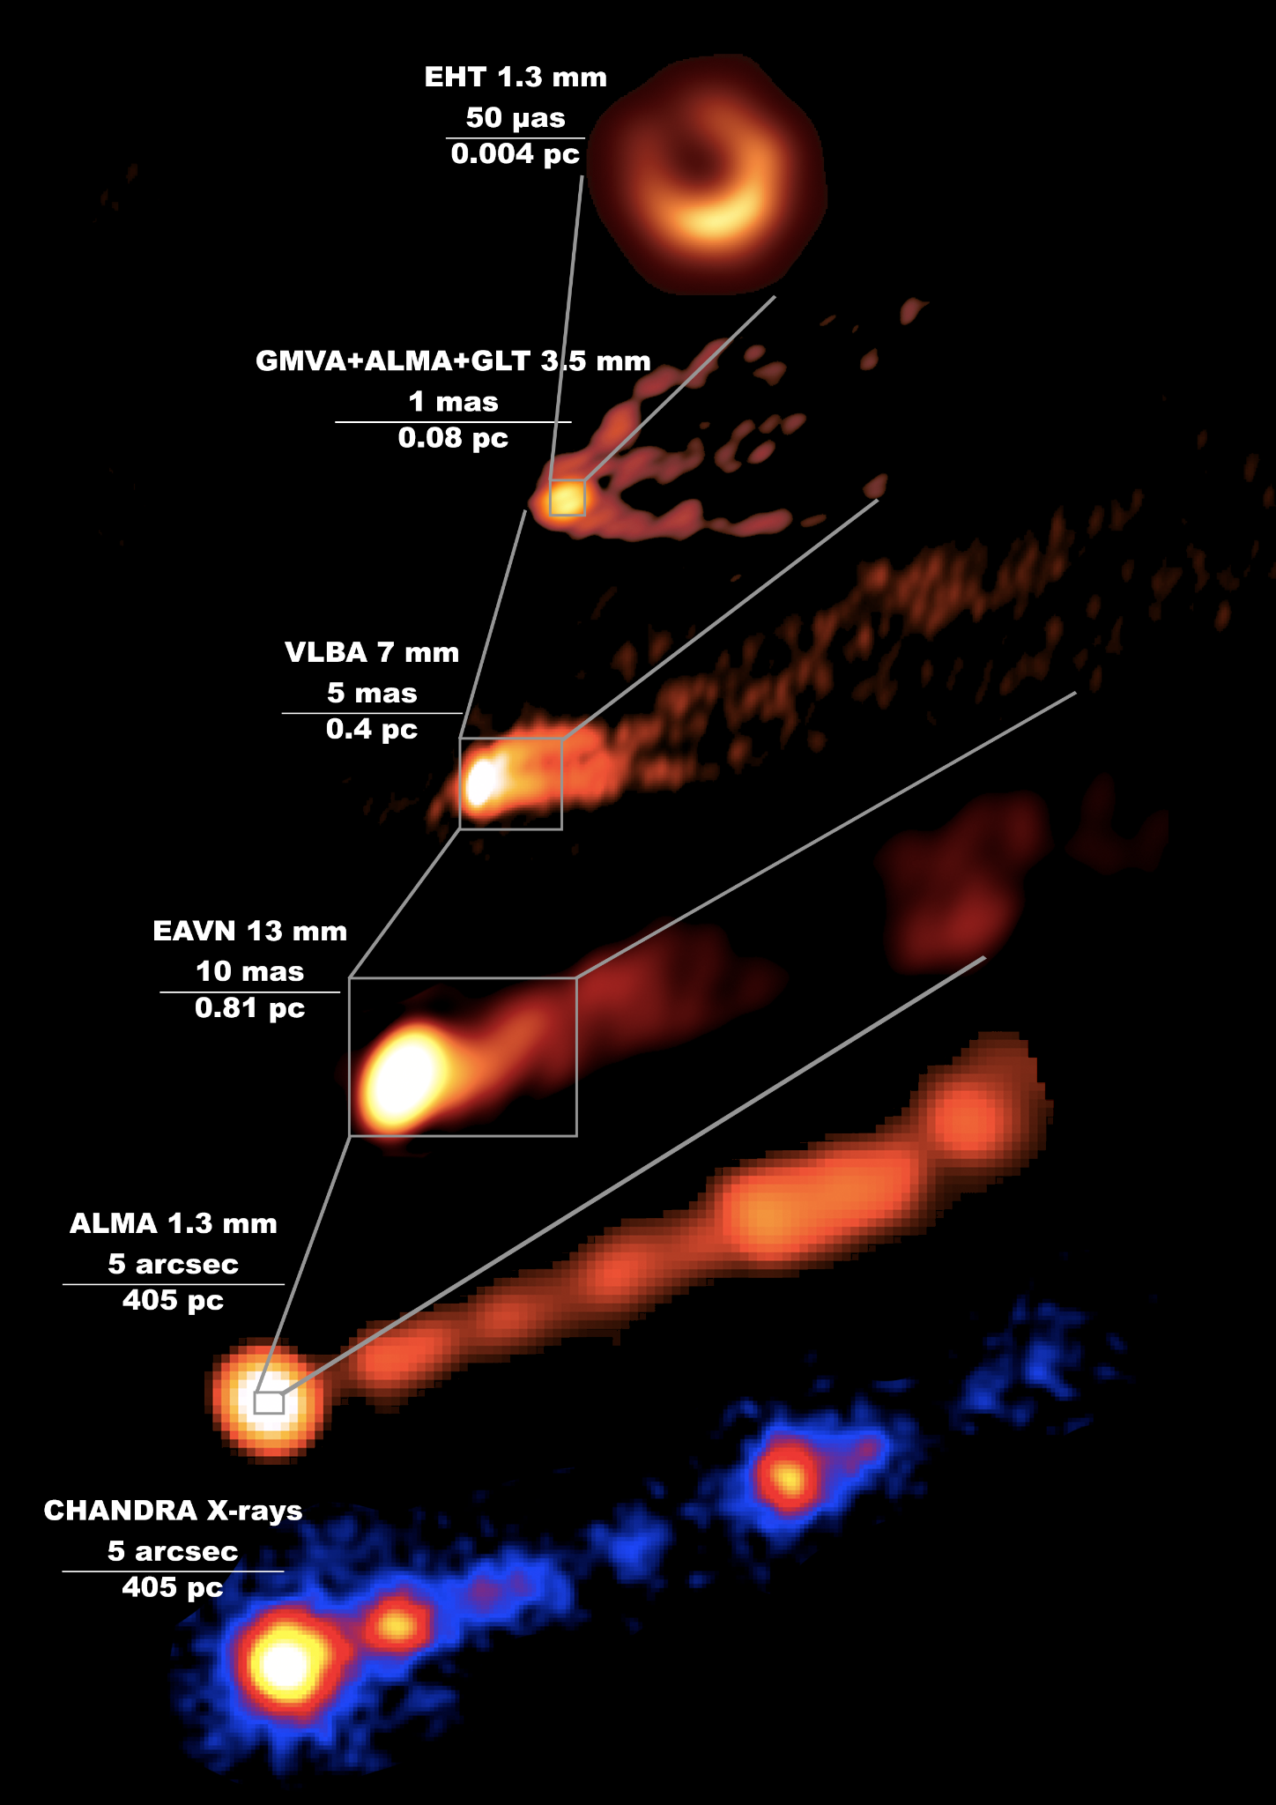
NEW MWL RESULTS!
EHT MWL Science
Working Group et al., 2024
(submitted)
Nuclear emission is optically thin at radio/sub-mm and X-ray!
Together, they tell us about
the accretion flow and the jet
Notes:
EHT is also complemented by multi-wavelength observations, in particular at high energies, since…
Example here, from very recently released work that I’m involved with…
Emphasize OOM scales (spans 6 OOM in size)
Benefits – across radio and X-ray, seeing emission from jet base and/or inner accretion flow, allows us to disentangle where emission is coming from

Slide 3
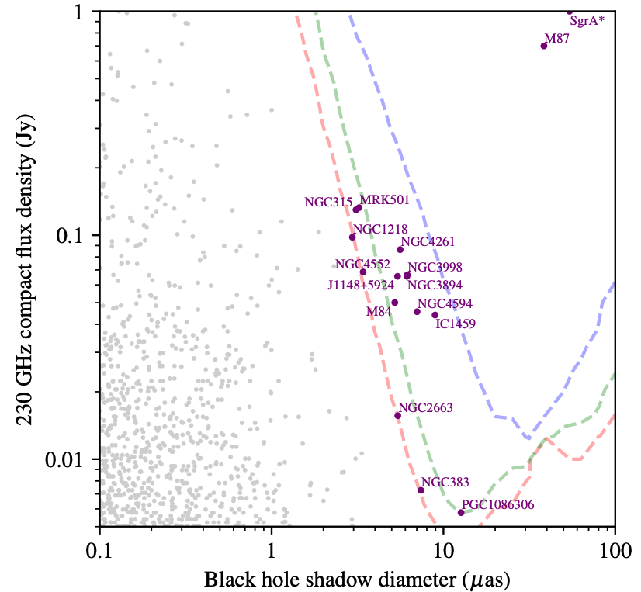
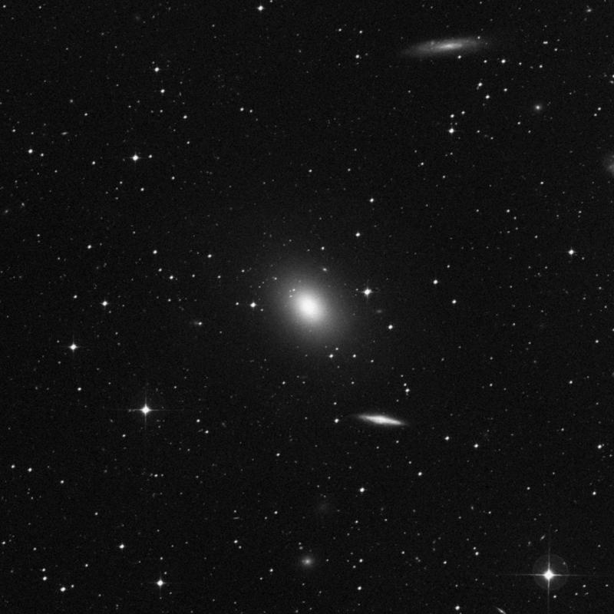
EHT ETHER Sample
SMBH Shadow resolved
SMBH Spin resolved
SMBH Mass resolved
Above mass threshold
IC 1459
NGC4594
IC1459
Adapted from Johnson et al. 2023
Notes:
Now, EHT is asking the question, what’s next?
Plot axes (apparent ring size vs EHT flux) -> M87 & SgrA* are most obvious choices (brightest and biggest) -> purple points

Slide 4
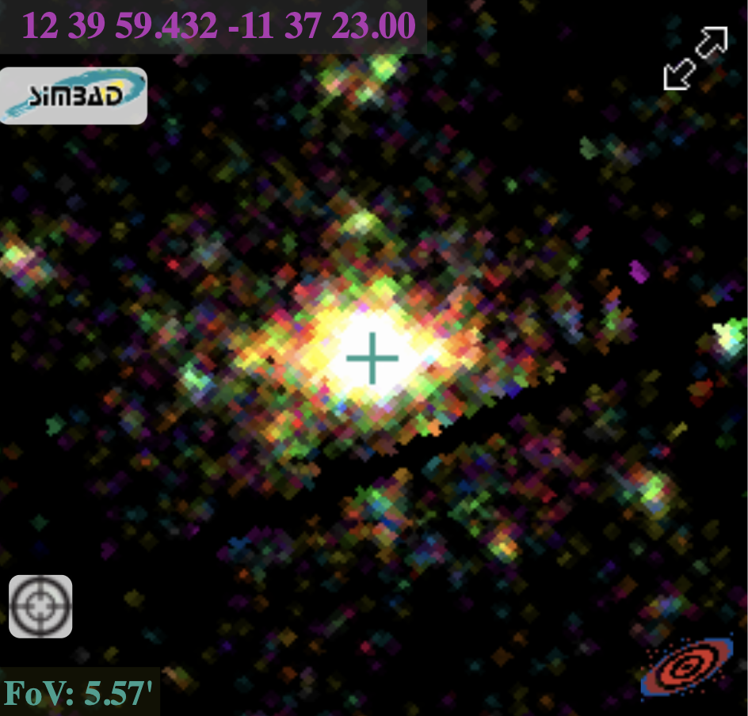
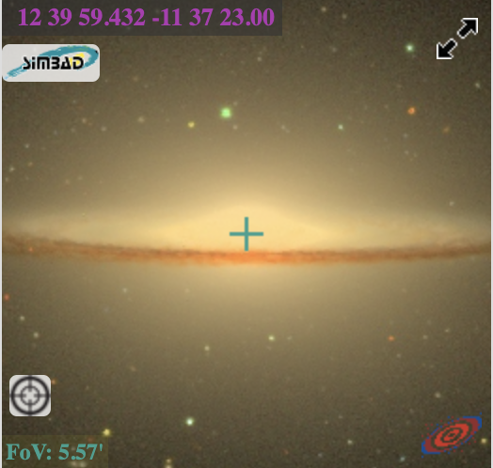
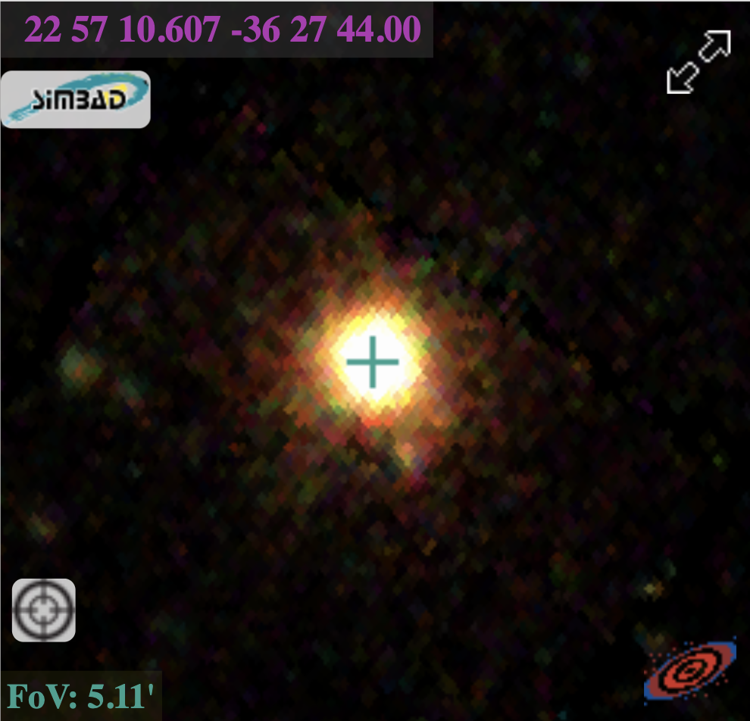
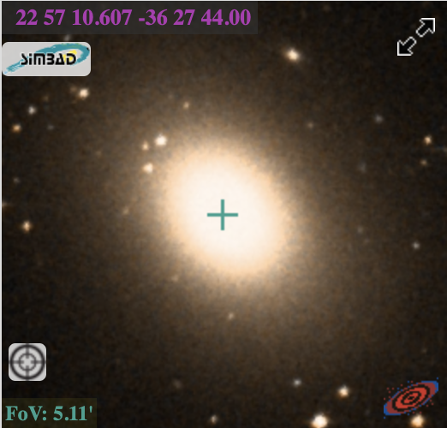
EHT ETHER “Gold Sample”
Sombrero
SMBH Shadow resolved
SMBH Spin resolved
SMBH Mass resolved
Above mass threshold
SMBH Shadow resolved
SMBH Spin resolved
SMBH Mass resolved
Above mass threshold
IC 1459
M_{BH} = 6.3 x 10⁸ M_{sun}
Ring size = 7.0 μas
FoV: 5.57’
FoV: 5.57’
IC1459
NGC4594
IC1459
M_{BH}: 2.5 x 10⁹ M_{sun}
Ring size : 8.9 μas
FoV: 5.11’
FoV: 5.11’
Adapted from Johnson et al. 2023
Optical (SDSS)
X-ray (XMM)
Notes:
X-ray and optical -> MBH -> ring size (just below current EHT resolution) w/future additional detectors they could be resolved -> low luminosity agn
https://science.nrao.edu/science/highlights/fy2014-1/detailed-imaging-of-the-sombrero-galaxy-jet
Sombrero SMBH mass estimated dynamically (from stellar motions)
IC1459 ring uncertainty ~ 1.5 mas, Sombrero ~ 0.5 mas

Slide 5
Low Luminosity AGN in X-ray
Bipolar Jets/outflows
Very common! ~⅓ of nearby galaxies
f_{Edd} ≲ 0.001
No Broad Line Region, radio loud
SMBH
~5 R_{g}
~100 R_{g}
> 10³⁻⁴ R_{g}
Radiatively Inefficient Accretion Flow (RIAF)
warm (~10⁶ K) corona*
+ hot (~10⁹ K) corona
“Thin” Truncated Outer Disk
Notes:
In the X-ray, we think that …
Add length scales for thin disk thickness (, jet size,
Note: instead of a warm corona, some people think hot corona emission reflecting off the accretion flow could suffice

Slide 6
Low Luminosity AGN in X-ray
Bipolar Jets/outflows
How to model X-ray:
Warm corona/hot ISM (?) = thermal gas (blackbody)
Hot corona = Inverse Compton (power law)
Jets = synchrotron (power law)
SMBH
~5 R_{g}
~100 R_{g}
> 10³⁻⁴ R_{g}
Radiatively Inefficient Accretion Flow (RIAF)
warm (~10⁶ K) corona*
+ hot (~10⁹ K) corona
“Thin” Truncated Outer Disk
Notes:
In the X-ray, we think that …
Add length scales for thin disk thickness (, jet size,
Note: instead of a warm corona, some people think hot corona emission reflecting off the accretion flow could suffice

Slide 7
Soft and Hard X-ray LLAGN Observations
NICER: Soft (0.2 - 12 keV) Non-Imaging, 5’ FOV
Observations:
~ 5 months monitoring
Fitting:
Model: tbabs*(ztbabs*power law + mekal)
Background: Joint source-background modeling w/SCORPEON
Fluxes: 0.3 - 8 keV
Sombrero
SCORPEON Settings:
‘script’ joint fit mode
If reduced C-statistic ≳ 1.3, thaw:
Cosmic ray bkg
Constant non-X-ray bkg
Solar Wind Charge Exchange Lines (O K & O VII)
Freeze any parameters w/ unconstrained uncertainties and refit
Notes:
For this project, we conducted the first soft x-ray monitoring campaign of these targets to characterize their X-ray emission and variability
tbabs * (ztbabs * powerlaw + mekal)
Mention that absorption has a contribution from our galactic line of sight as well as intrinsic absorption in the target galaxy

Slide 8
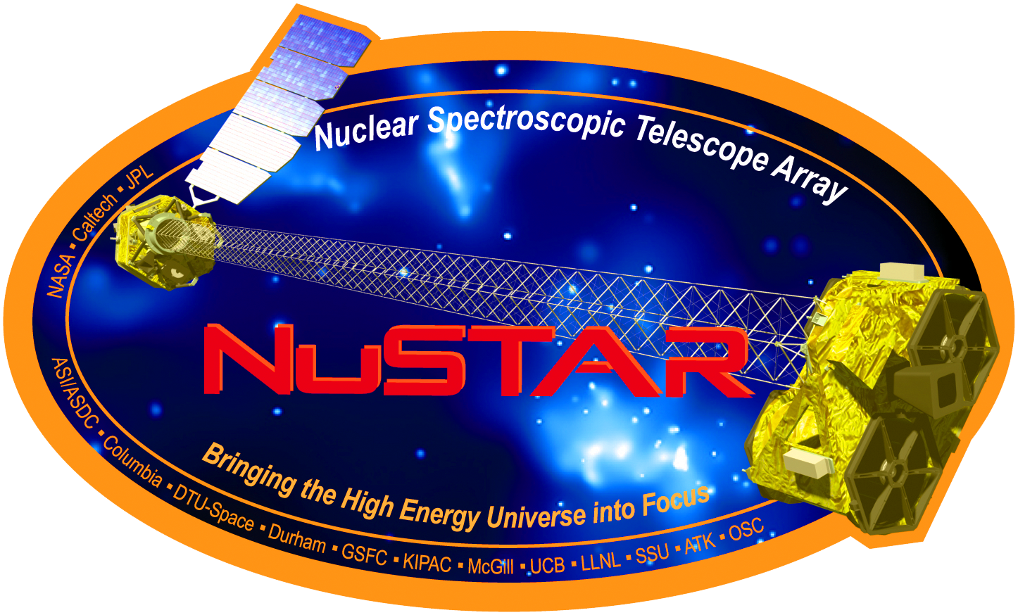
Soft and Hard X-ray LLAGN Observations
Swift (XRT): Soft (0.2 - 10 keV),
18’’ resolution, ~24’ FOV
Observations:
1x ~ 1 ks / target
Fitting:
Background: Separate extraction region
Fluxes: 0.3 -5 keV
NuSTAR: Hard (3 - 79 keV),
18’’ resolution, ~10’ FOV
Observations:
1x ~ 20 ks / target, FPMA + FPMB
Fitting:
Background: 50’’ (source), 110’’ (background)
Fluxes: 3 - 20 keV
Sombrero
Joint Fit: const*tbabs*(ztbabs*broken power law + mekal)
Notes:
For this project, we conducted the first soft x-ray monitoring campaign of these targets to characterize their X-ray emission and variability
tbabs * (ztbabs * powerlaw + mekal)
Mention that absorption has a contribution from our galactic line of sight as well as intrinsic absorption in the target galaxy

Slide 9
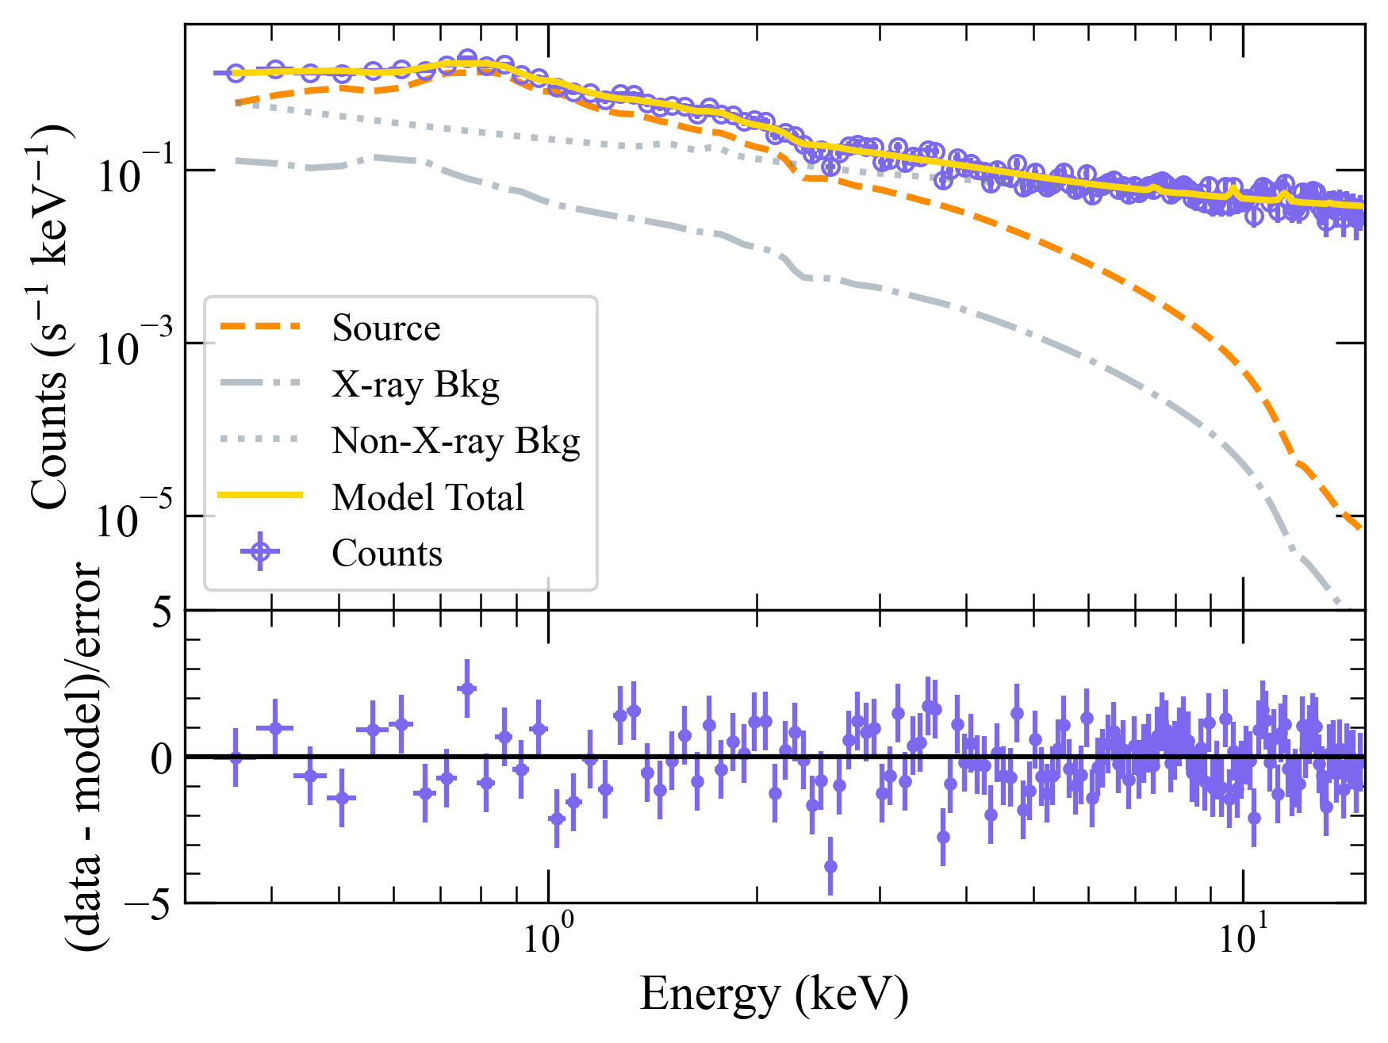
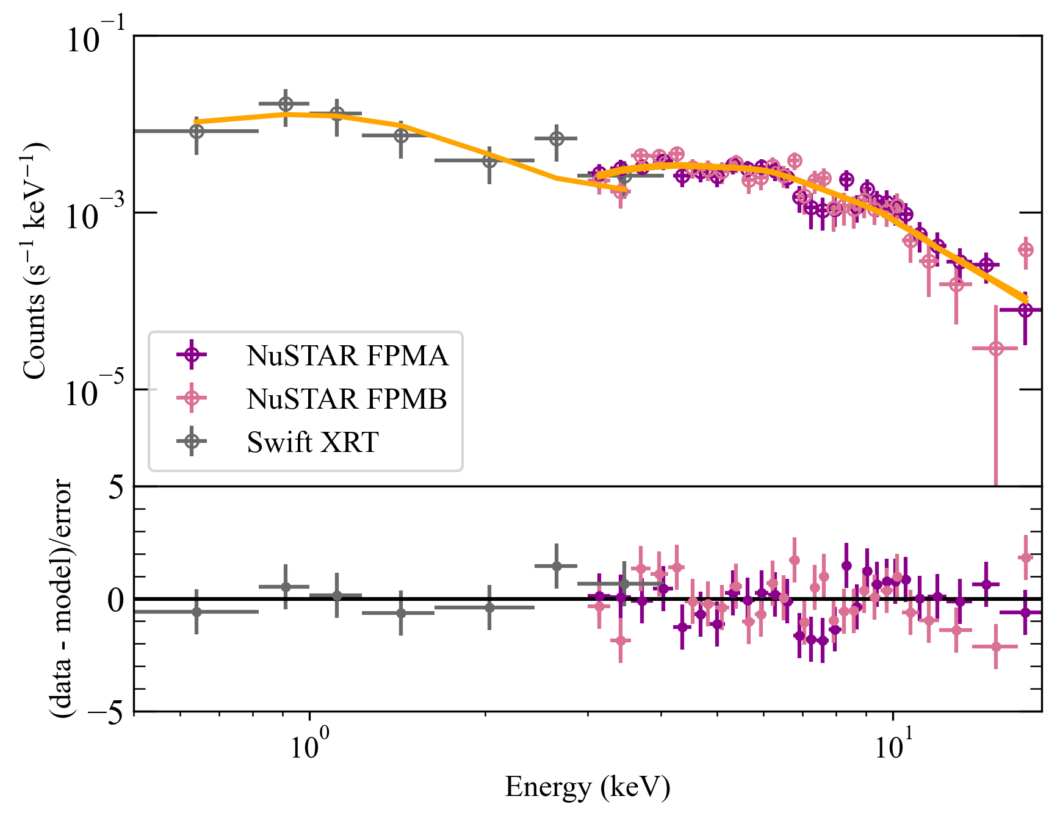
Soft and Hard X-ray Spectra (Sombrero)
NICER
Swift+NuSTAR
(Bkg.+source)
(Bkg. subtracted)
Red. Cstat. ~ 0.98
Red. Cstat. ~ 0.98
Power Law + Blackbody: Dominates @ < 2 keV
Non-X-ray Background: Dominates @ > 2 keV
Broken Power Law + Blackbody: Pre-break slope 1.6, post-break 2.9, break @ ~6 keV

Slide 10
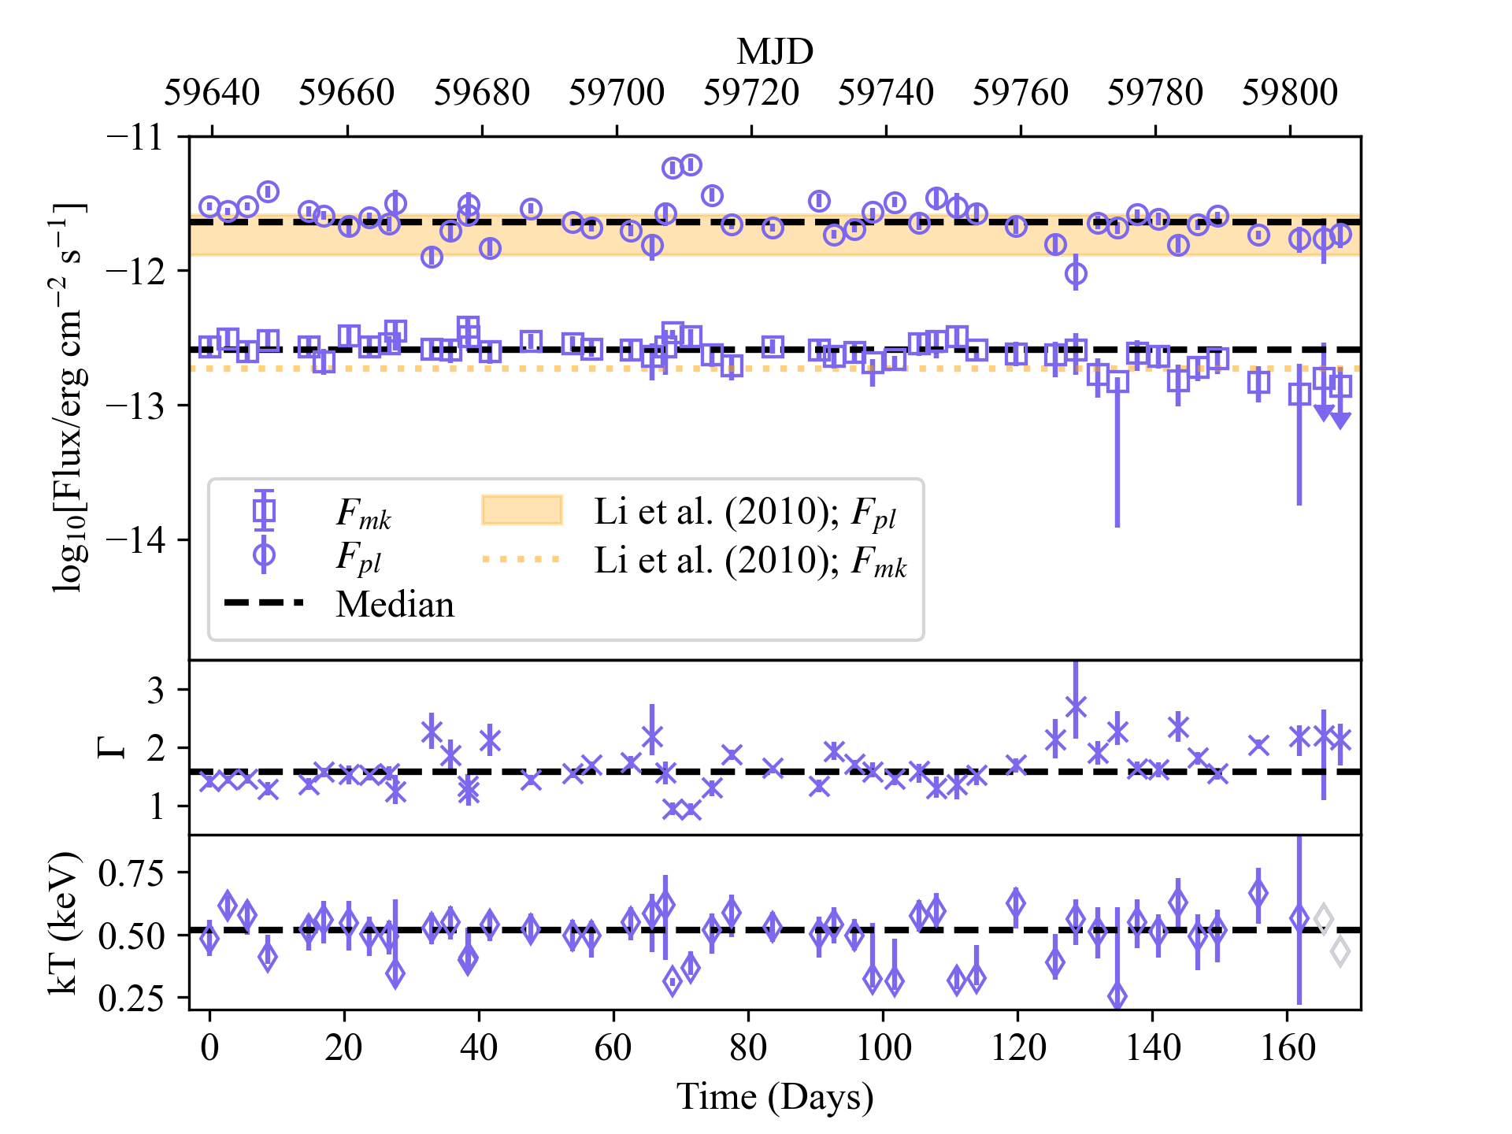
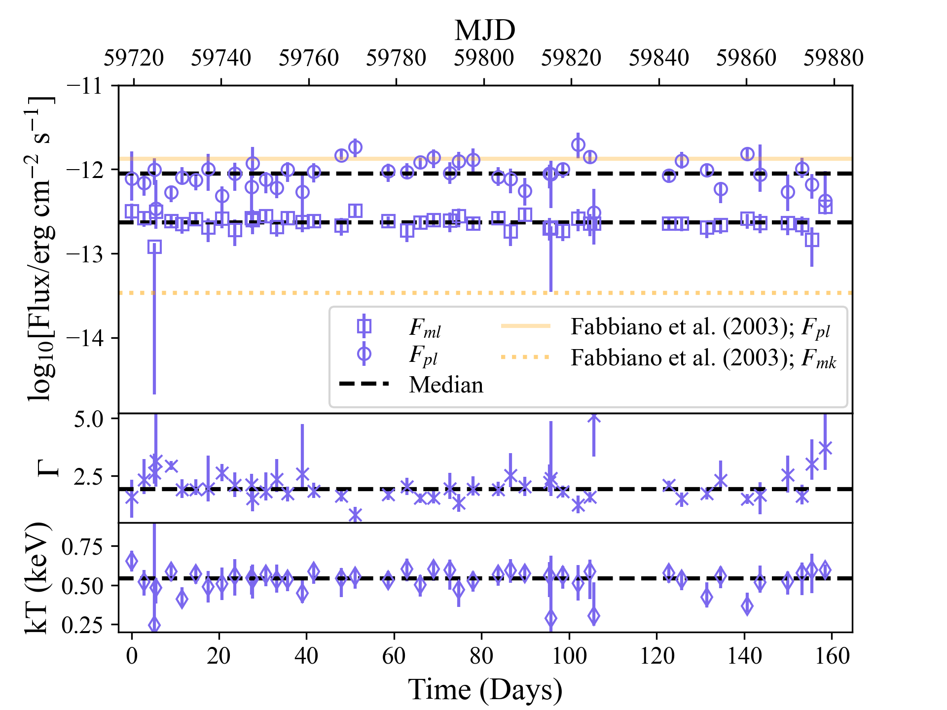
NICER Soft X-ray Light Curves
Sombrero
IC1459
05-20 – 10-29 (2022)
Slightly fainter than Sombrero, uncertainties too large for detailed variability study
Notes:
Don’t discuss lightcurve yet, first just mention these are lightcurves and IC459 is going to be ignored for now

Slide 11
NICER Soft X-ray Light Curves
Sombrero
Power Law:
Sometimes brighter than historical Chandra obs.
Flux variable by up to factor of 6, significant excess variance
Aperiodic, ~ week timescale (corresponds to ~80r_{g} )
Blackbody:
Roughly constant
T ~ 5 x 10⁶ K (warm)

Slide 12
NICER Soft X-ray Light Curves
Sombrero
Power Law:
Slope ~ 1.5 - 2.5, typical of RIAF or jet
Slope and flux/luminosity anti-correlated

Slide 13
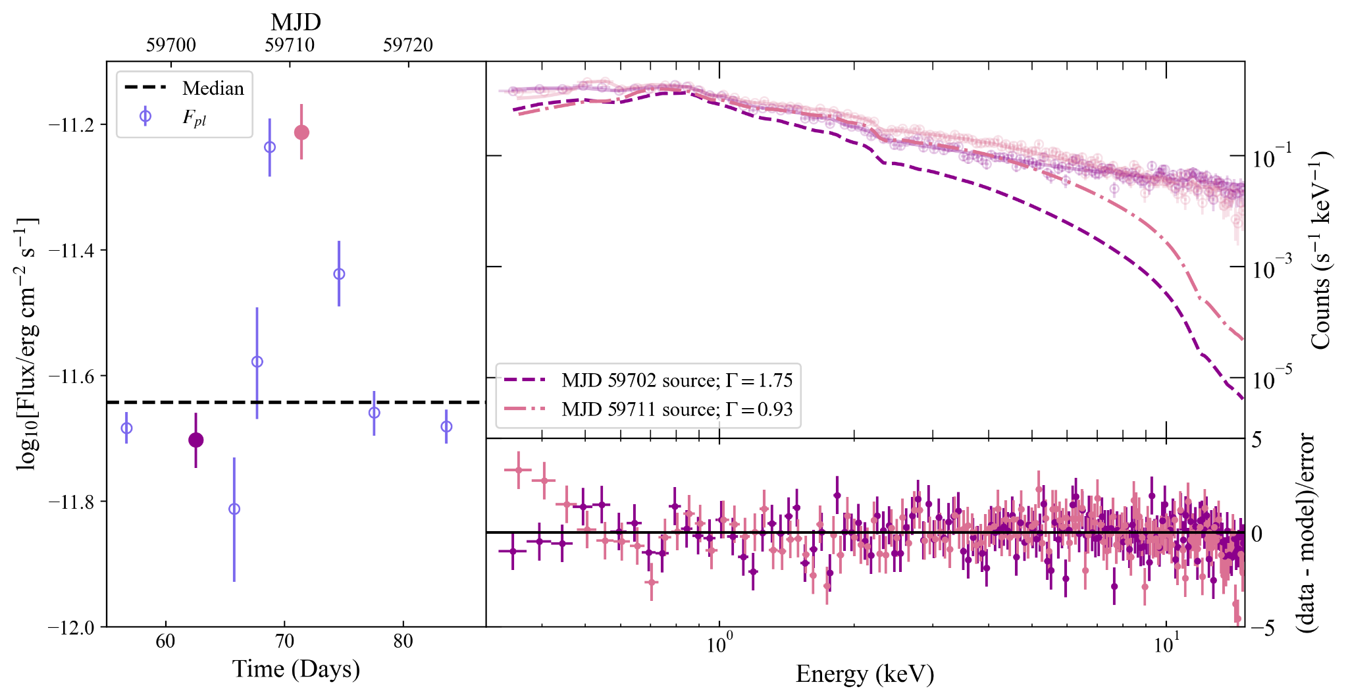
Power Law Flux-Photon Index Anti-Correlation
Sombrero
“Harder when brighter”
(RIAF, optically thin regime)
More luminosity
more accreted material
more compton scatterings
more hard X-ray photons
(e.g., Gu & Cao 2009,
Younes et al. 2011,
Niu et al. 2023)

Slide 14
Interpretation
X-ray flux-Photon Index anti-correlation explainable by a RIAF.
NuSTAR power law spectral break → synchrotron / inverse compton transition?
Sombrero aperiodic soft X-ray variability is > previous obs.
Variability timescale corresponds to 10s of r_{g} from central SMBH, likely within RIAF.
Highly recommend Sombrero for further multi-wavelength obs.
Publication coming soon to an arxiv near you!
Notes:
For broad spectral modeling, there are degeneracies between models that only consider radio/sub-mm emission, and X-ray can break those degeneracies to tell us what physical scenario produced the emission we’re seeing. This is especially important when interpreting EHT observations, since the EHT frequency happens to fall very very close to where emission transitions from being jet to accretion dominated. So, we want to have as much information as possible to inform our model and tell us whether EHT is really seeing the jet base or the accretion flow (or both).
In this SED for Sombrero, I’ve added the luminosity range found from the NICER lightcurve, as well as the hard X-ray luminosity measured by NICER – I’d like to emphasize that the NICER range covers quite a bit more than what Chandra has seen. Often, we use data spanning several decades and combine it all together in one SED model, but the variability seen throughout the NICER campaign indicates that we should try to do time-resolved SED modeling to account for changes in the flux and improve model accuracy.

Slide 15
What’s Next?
More modeling!
Accretion + jet models for broad (radio to x-ray) spectrum w/updated data
Time-resolved SED models to address variability
More observations!
Quasi-simultaneous soft/hard X-ray monitoring, longer hard X-ray exposures
NuSTAR+NICER 2025 Accepted (PI: N. M. Ford)
Coordinated sub-mm/radio observations
Existing quasi-simultaneous multi-wavelength data from other instruments:
Fermi, Swift, eROSITA, TESS, …
Notes:
For broad spectral modeling, there are degeneracies between models that only consider radio/sub-mm emission, and X-ray can break those degeneracies to tell us what physical scenario produced the emission we’re seeing. This is especially important when interpreting EHT observations, since the EHT frequency happens to fall very very close to where emission transitions from being jet to accretion dominated. So, we want to have as much information as possible to inform our model and tell us whether EHT is really seeing the jet base or the accretion flow (or both).
In this SED for Sombrero, I’ve added the luminosity range found from the NICER lightcurve, as well as the hard X-ray luminosity measured by NICER – I’d like to emphasize that the NICER range covers quite a bit more than what Chandra has seen. Often, we use data spanning several decades and combine it all together in one SED model, but the variability seen throughout the NICER campaign indicates that we should try to do time-resolved SED modeling to account for changes in the flux and improve model accuracy.

Slide 16
Backup Slides

Slide 17
NRAO530
J1924–2914
Jorstad et al., 2023
Issaoun et al., 2022
3C279
CenA
M87*
Sgr A*
Kim et al., 2020
Janssen et al., 2021
Notes:
“We’re more than just donuts!”
Here are some other images EHT has released for AGN that are slightly smaller and/or further away
https://eventhorizontelescope.org/array
3C279 elongated core region, could be jet base or bent jet (rotating over time?) https://www.aanda.org/component/article?access=doi&doi=10.1051/0004-6361/202037493&#figs
J1924 precessing jet and compact core region
https://iopscience.iop.org/article/10.3847/1538-4357/ac7a40
NRAO530 bright core, polarization indicates magnetic field-powered w/helical shape
https://iopscience.iop.org/article/10.3847/1538-4357/acaea8
CenA Double sided jet “sheaths” viewed from the side – high E emission beamed along the “spine” away from our line of sight appears dark, but slower moving particles along the perimeter emit light in a variety of directions

Slide 18
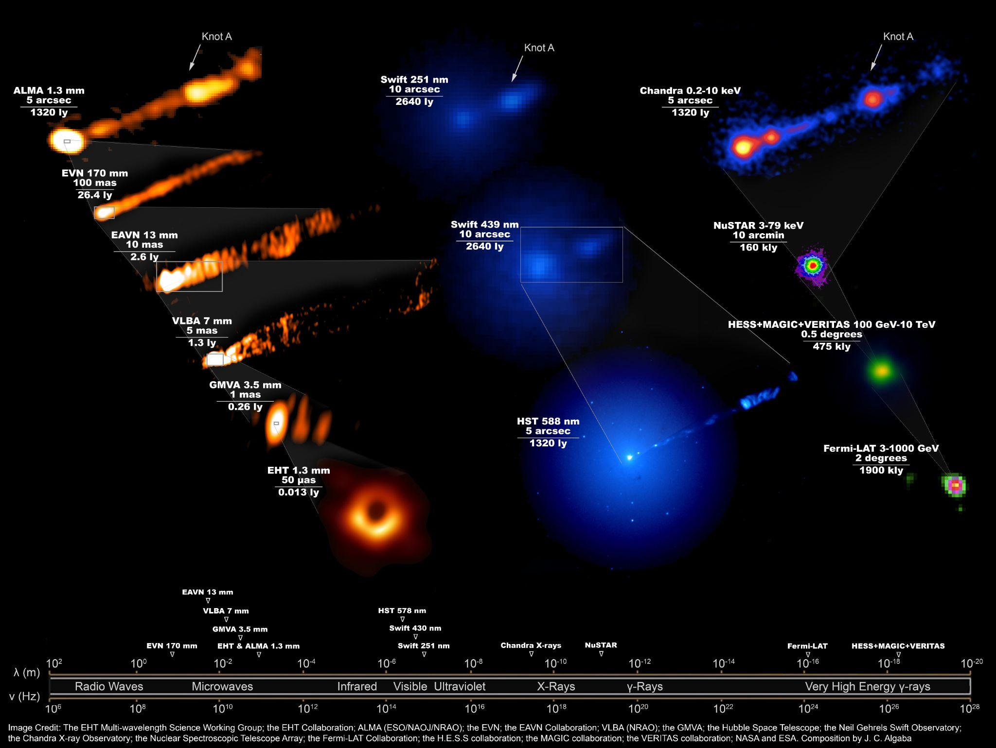
Multi-wavelength Benefits

Slide 19
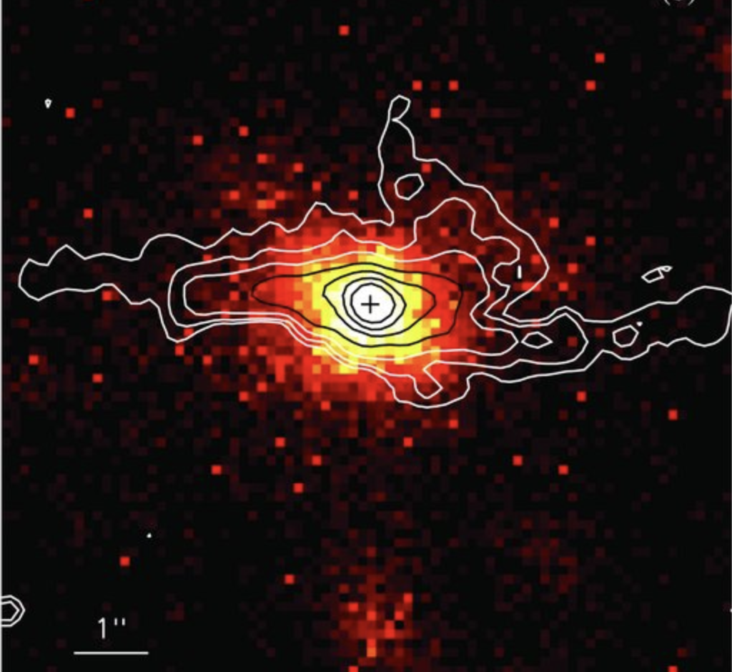
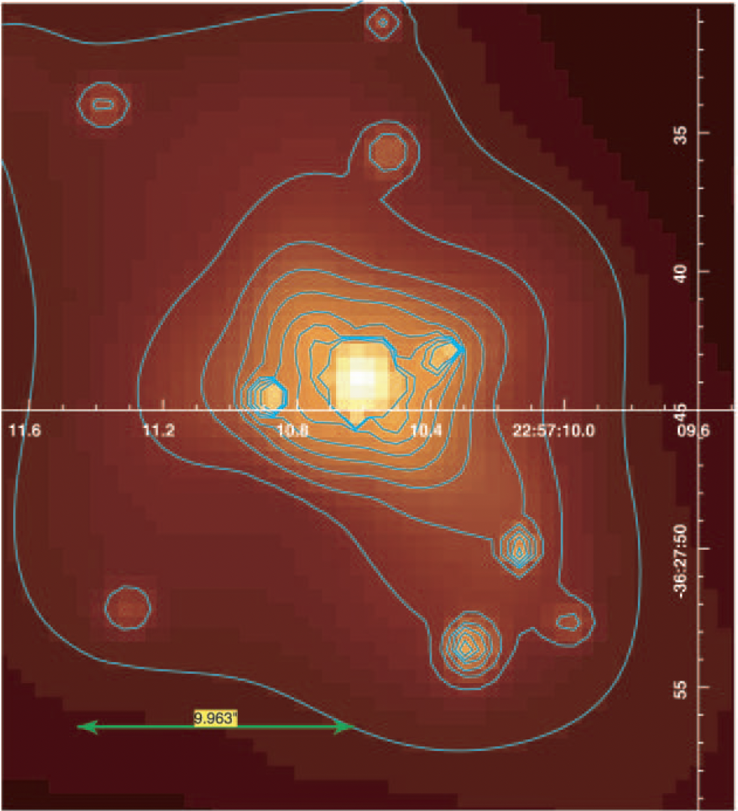
Low Luminosity AGN
Sombrero
D = 9.9 Mpc
M_{BH} = 8.8 x 10⁹ M_{sun}
Ring size = 7.0 μas
F_{0.3-8 keV} ~ 1.5 x 10⁻¹² erg/cm²/s
IC1459
D = 28.9 Mpc
M_{BH} = 9.4 x 10⁹ M_{sun}
Ring size = 8.9 μas
F_{0.3-8 keV} ~ 1 x 10⁻¹² erg/cm²/s
Notes:
We have a previous NICER campaign that collected ~60 nights of soft X-ray observations for 3 LLAGN ETHER sources in 2022. The goal with this data is to start characterizing the soft X-ray spectrum, brightness, and variability of these sources. I’ve started developing a set of scripts for processing the data using NASA’s Heasoft package, and I’m learning how to use Xspec for fitting a model to the observations in order to extract flux information. This analysis is very challenging because these sources are quite faint, on the borderline of being background-dominated. I have to use special, fine-tuned background models that were newly released by NICER in late 2022.

Slide 20
Low Luminosity AGN
Bipolar Jets/outflows
Very common! ~⅓ of nearby galaxies
L/L_{Edd} ≲ 0.001
No Broad Line Region, radio loud
R_{g} = GM/c²
SMBH
5 R_{g}
> 10³⁻⁴ R_{g}
~100 R_{g}
“Thin” Outer Disk
Radiatively Inefficient Accretion Flow (RIAF)
+ warm (~10⁷ K) corona*
+ hot (~10⁹ K) corona
Notes:
LLAGN are a very common type of AGN
Add length scales for thin disk thickness, jet size
Note: instead of a warm corona, some people think hot corona emission reflecting off the accretion flow could suffice

Slide 21
Comparing NICER & NuSTAR
NGC4594 | NICER (0.3 - 8 keV) | NuSTAR (3 - 20 keV)
<F_{𝚪1} > (10⁻¹² erg/cm²/s) | 2.4 ± 0.7 | 1.09 ± 0.09
<𝚪₁> | 1.7 ± 0.4 | 1.6 ± 0.06
<kT> (keV) | 0.5 ± 0.1 | ——
<E_{break}> (keV) | —— | 6.1^{+1.3}_{-0.6}
<𝚪₂> | —— | 3.0 ± 0.04
Norm. Excess Variance (NEV) | 0.12 ±0.05 | ——
Sombrero
IC1459 | NICER (0.3 - 8 keV) | NuSTAR (3 - 20 keV)
<F_{𝚪1} > (10⁻¹² erg/cm²/s) | 0.9 ± 0.3 | 0.7 ± 0.4
<𝚪₁> | 2.1 ± 0.7 | 2.0 ± 0.4
<kT> (keV) | 0.5 ± 0.1 | ——
<E_{break}> (keV) | —— | > 3
<𝚪₂> | —— | > 0.5
Norm. Excess Variance (NEV) | -0.02 ± 0.05 | ——
Notes:
Idea is, once we finish model fitting and extracting the fluxes/luminosity for each observation, we can compare the results with other wavelength observations to start understanding the overall SED of these systems. In particular, the SED shape can be fit by different disk accretion and jet models to see which model accurately describes the data.

Slide 22
Sombrero NICER Light Curve Auto-Correlation

Slide 23
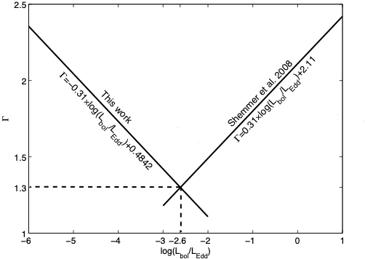
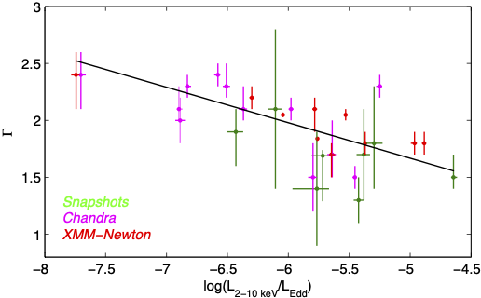
Historical LLAGN X-ray Flux-Photon Index Anti-Correlation
Younes et al. 2011
Notes:
LX/LEdd for our targets is ~10^-5 (slightly higher)

Slide 24
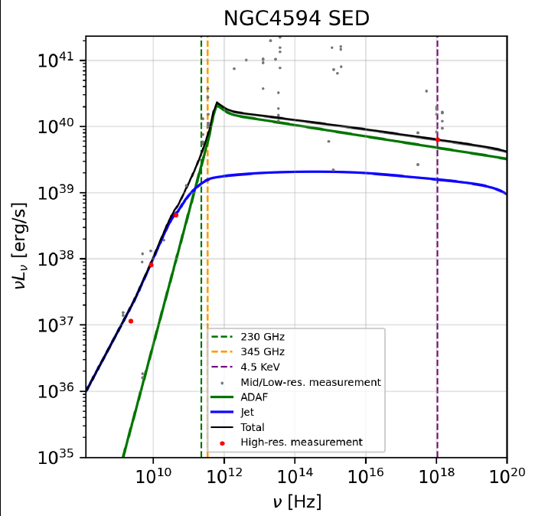
Broadband SED Modeling
EHT+
ALMA
band
NICER+
NuSTAR
X
X
Accretion
Jet
𝜈L_{𝜈} (erg/s)
𝜈 (Hz)
Arratia et al., in prep.

Slide 25
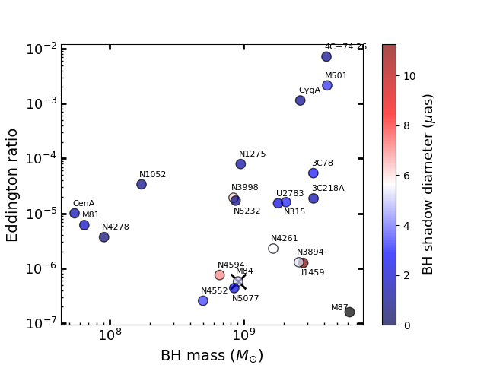
BH mass - Eddington Ratio - Ring Size

Slide 26
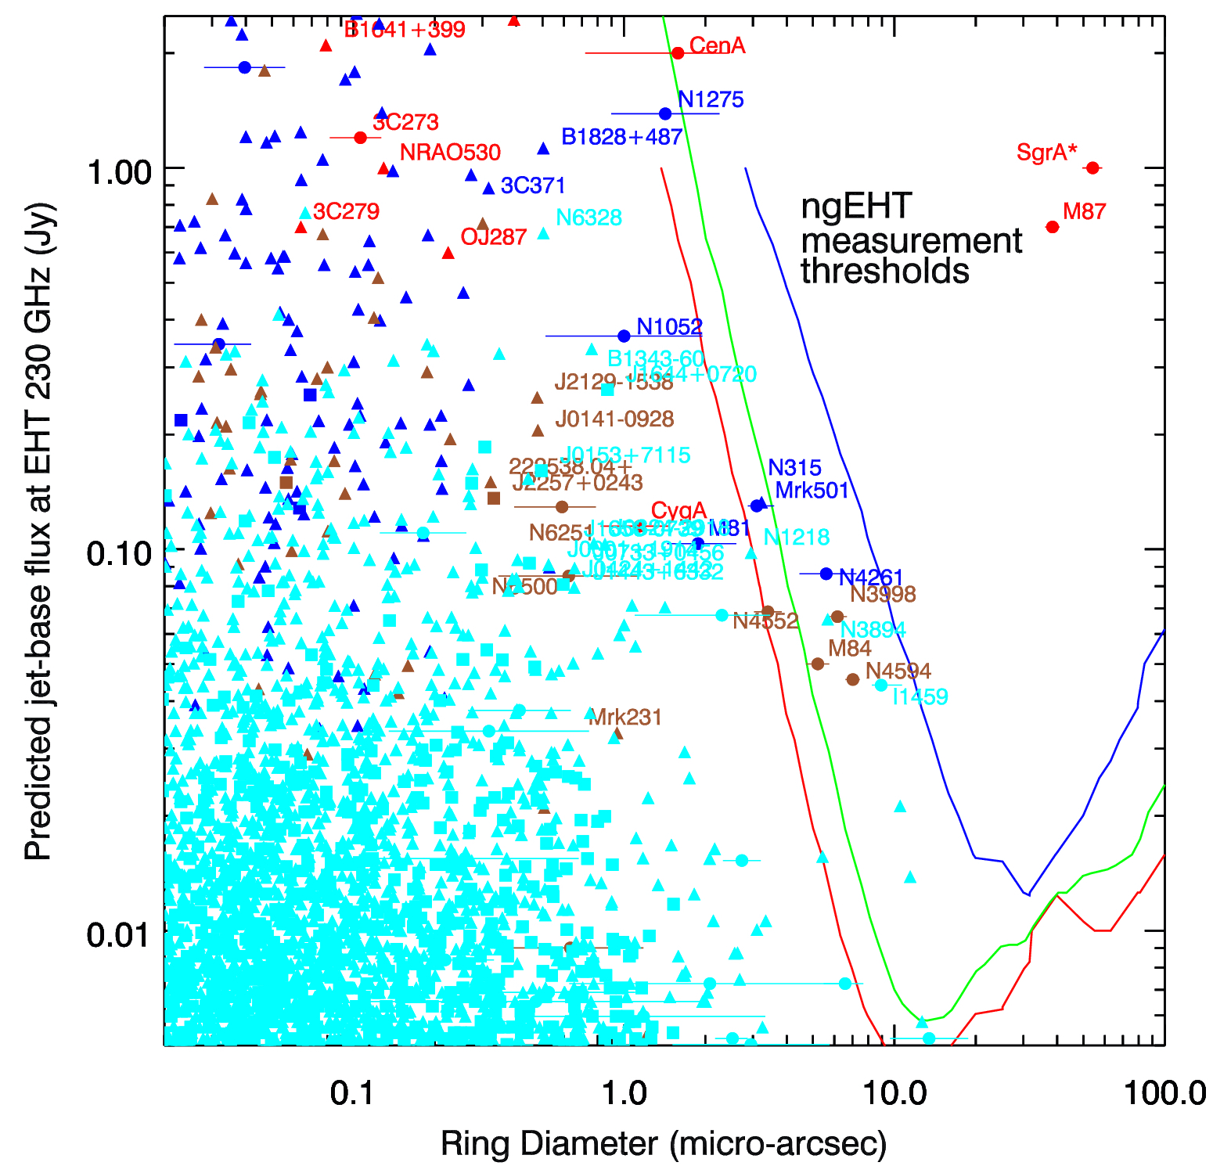
ETHER Sample Alternate plot

Slide 27
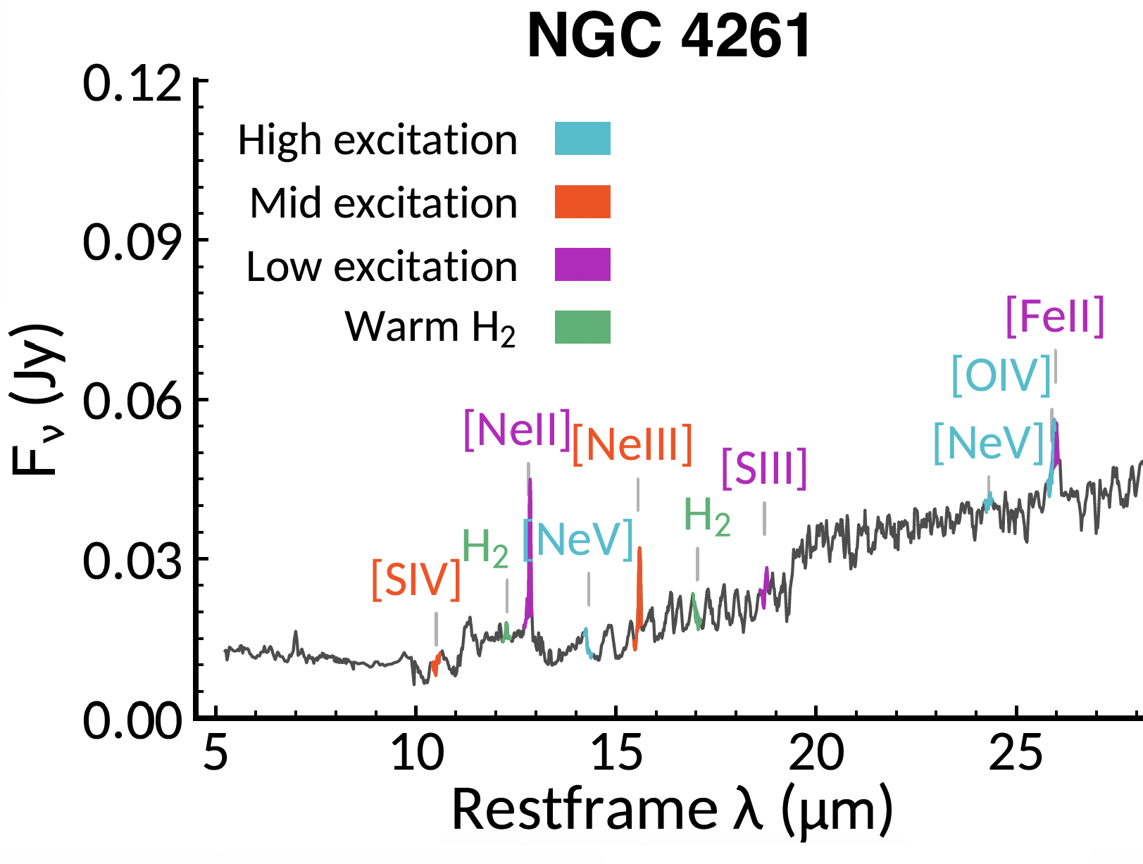
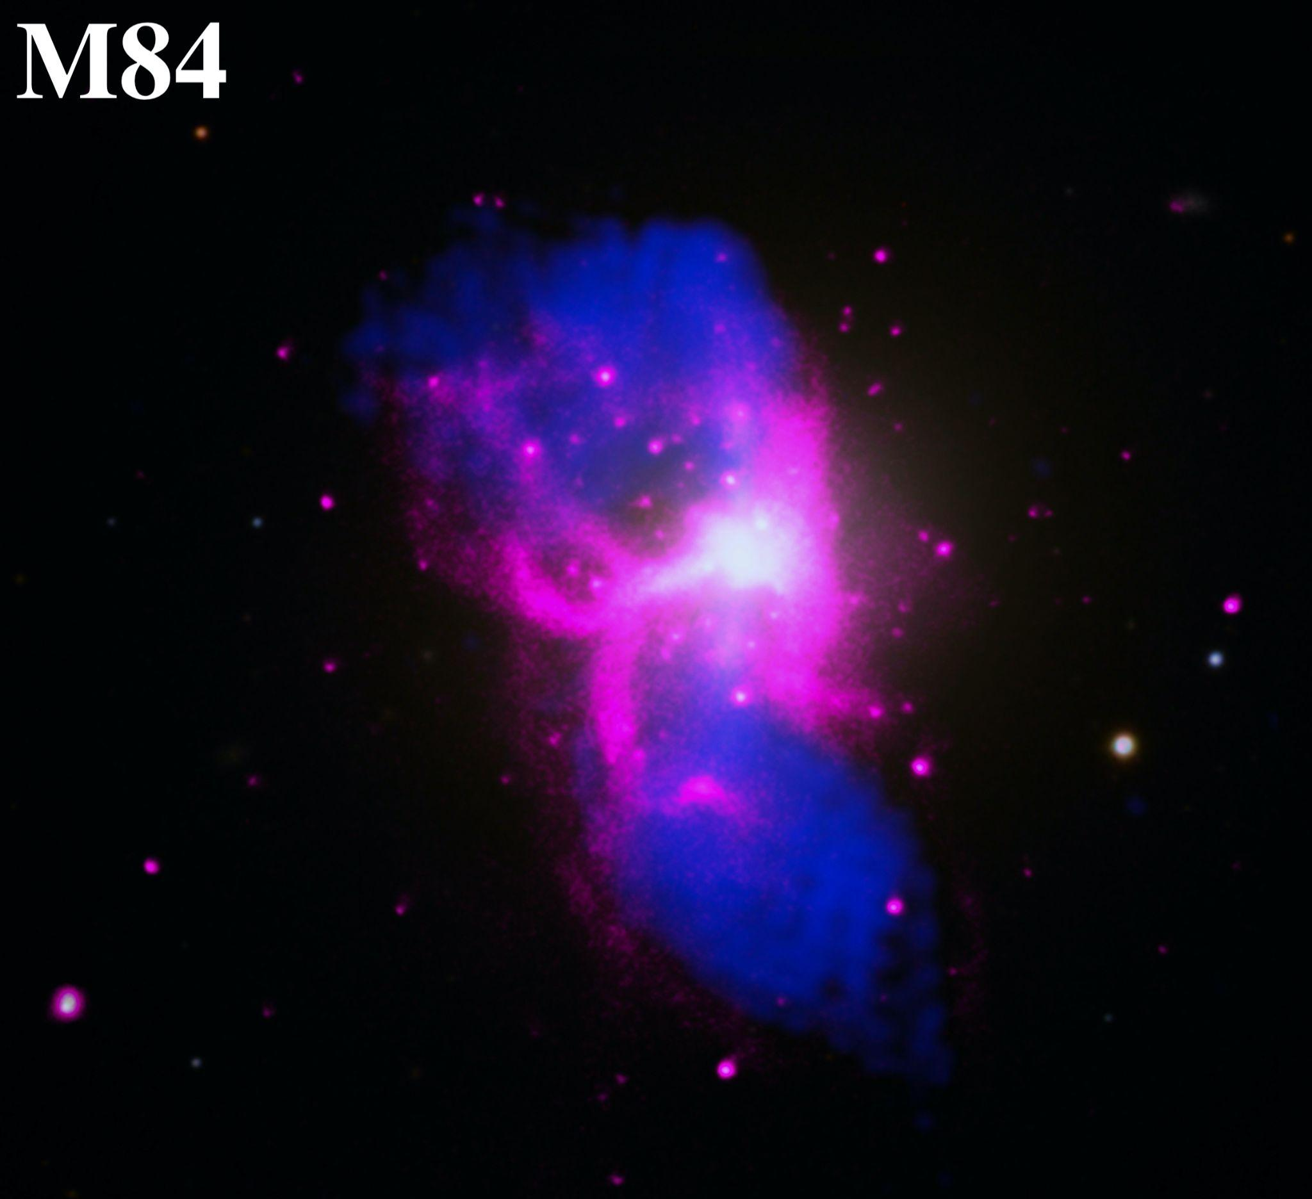
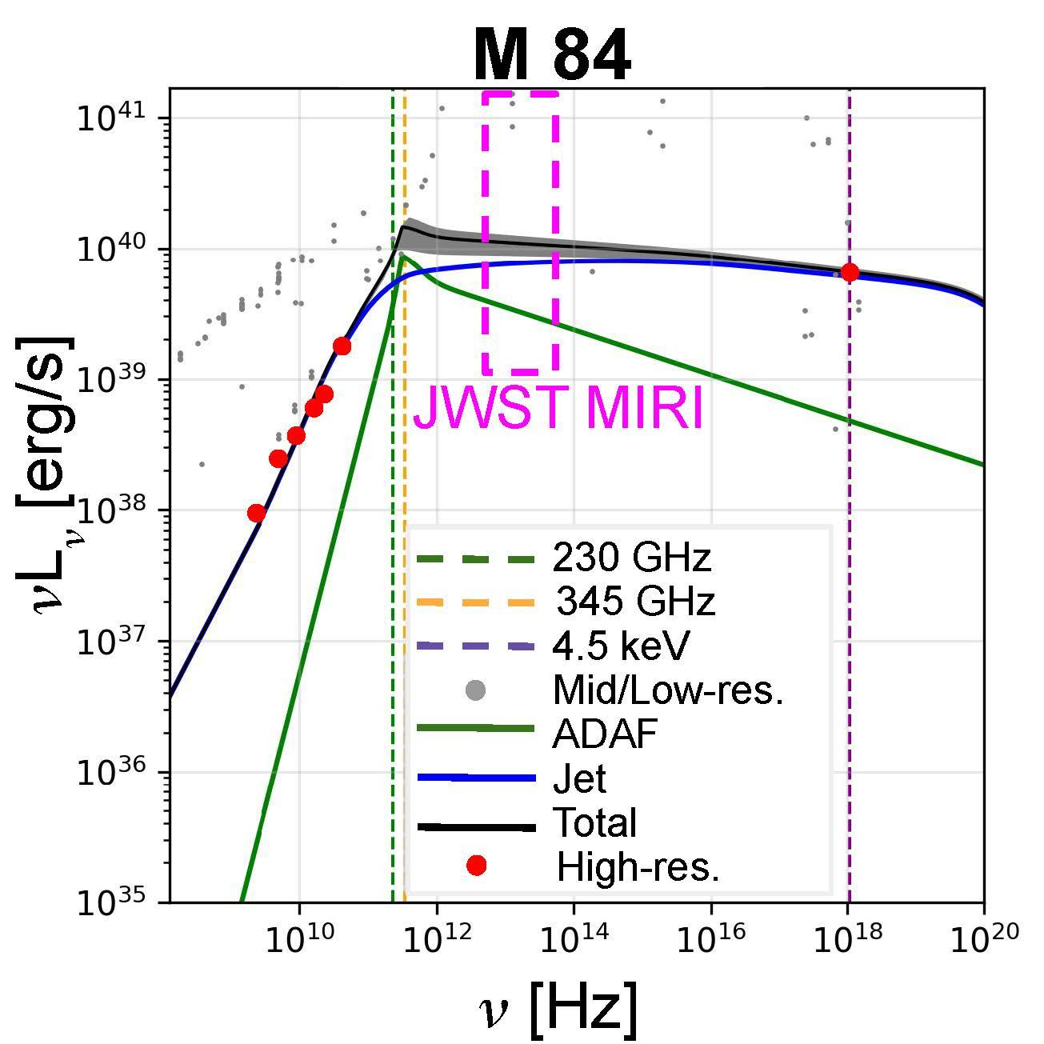
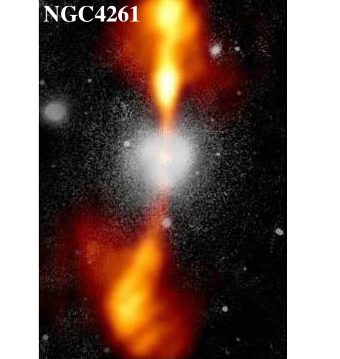
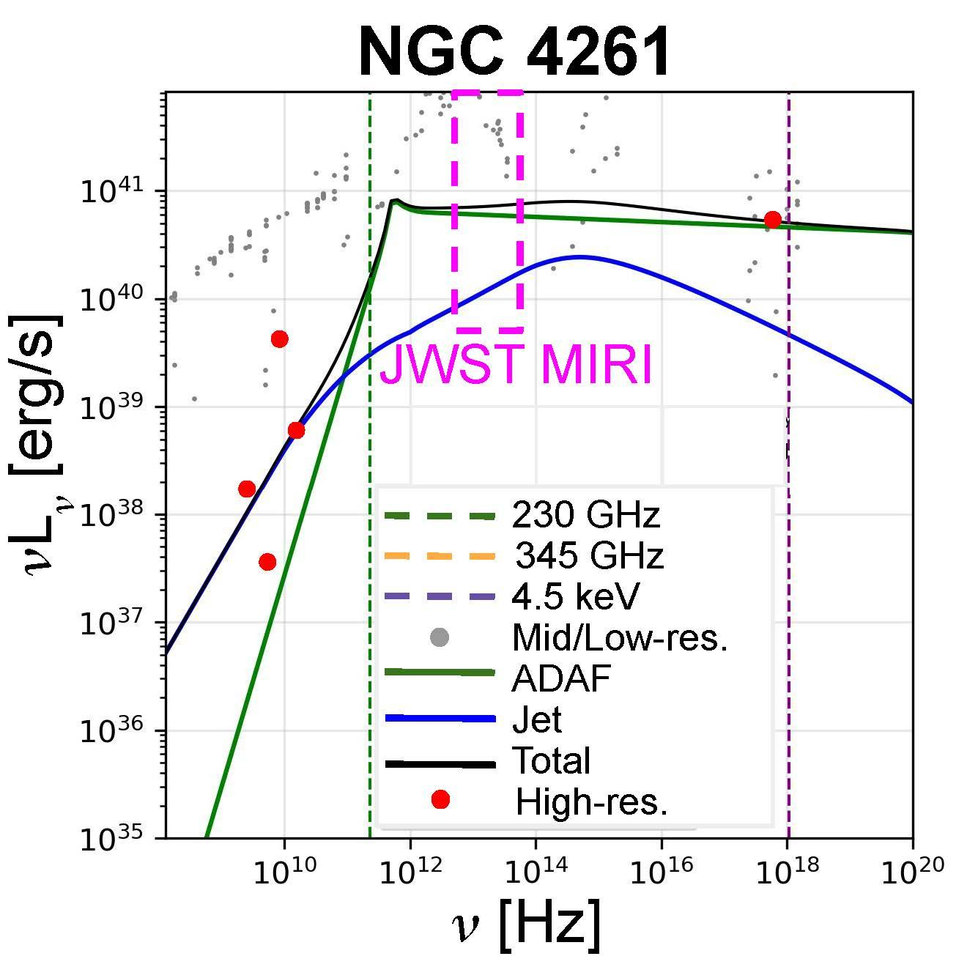
JWST Proposal (Mid-Infrared)
M87, SgrA*, Sombrero already observed (PI: Seth)
➤ We proposed 5.5 hours w/JWST MIRI MRS (5 - 28.8 μm) for
M 84 and NGC4261 (PIs: Nair & Ford) -> rejected, but ranked highly!
Key Science Goals:
Fill in MIR region of broad SED
Fit Accretion/Jet/SMBH models
Measure key MIR emission lines
➤ Constrain SMBH mass (e.g., H₂) and UV emission (Mid - High E)
Fernández-Ontiveros+2023
Bambic+2023
HST/NASA/ESA/NRAO

