Slide 1

Using HEASARC@Sciserver
Abdu Zoghbi
University of Maryland / NASA GSFC
NICER/IXPE Workshop, DC. July 31, 2024

Slide 2

Use Cases For Sciserver
Sciserver: An online platform where you connect to virtual machine through a browser where both data and software are available.
Experienced X-ray Astronomer:
  Wants a quick look analysis.
  Need to update to the latest software.
  Installing and compiling issues.
Newcomer: Undergraduate and starting Graduate students:
  Need to get started quickly.
  Focus on data analysis not setup.
Workshops & Tutorials.
Large data (Rubin, Roman, Euclid. X-rays: Strobe-X?)

Slide 3
HEASARC @ Sciserver: Features
Sciserver is a jupyter-based science platform hosted at JHU.
Open to anyone.
Heasoft and all of HEASARC archive is available ‘locally’.
Additional software:
  XMM SAS, Chandra CIAO, and Fermitools, SPEX.
Tutorials to do different tasks.
  github.com/HEASARC/sciserver_cookbooks

Slide 4
HEASARC @ Sciserver: Features
Groups & File-sharing
  Create groups, add people, create shared data drives etc.
Persistent and (large) Temporary storage.
Work interactively (notebooks and terminal):
  16 CPU, 240GB RAM.
Run Batch jobs:
  Large Jobs: 32 CPU, 240GB RAM. Run for 16 hours.
  Small Jobs: 32 CPU, up to 6 jobs, with 32GB/job. Run for 1 hour each.
Upgrades being implemented (next a few months) for more CPU and persistent space.

Slide 5
HEASARC @ Sciserver: Intro
Getting started:
  Login
  Choose either Compute (for interactive analysis) or Jobs (for batch jobs)
  Create a container
  Choose a software image
  Select the data to be mounted (all of HEASARC data)
  Access the Jupyter environment.

Slide 6
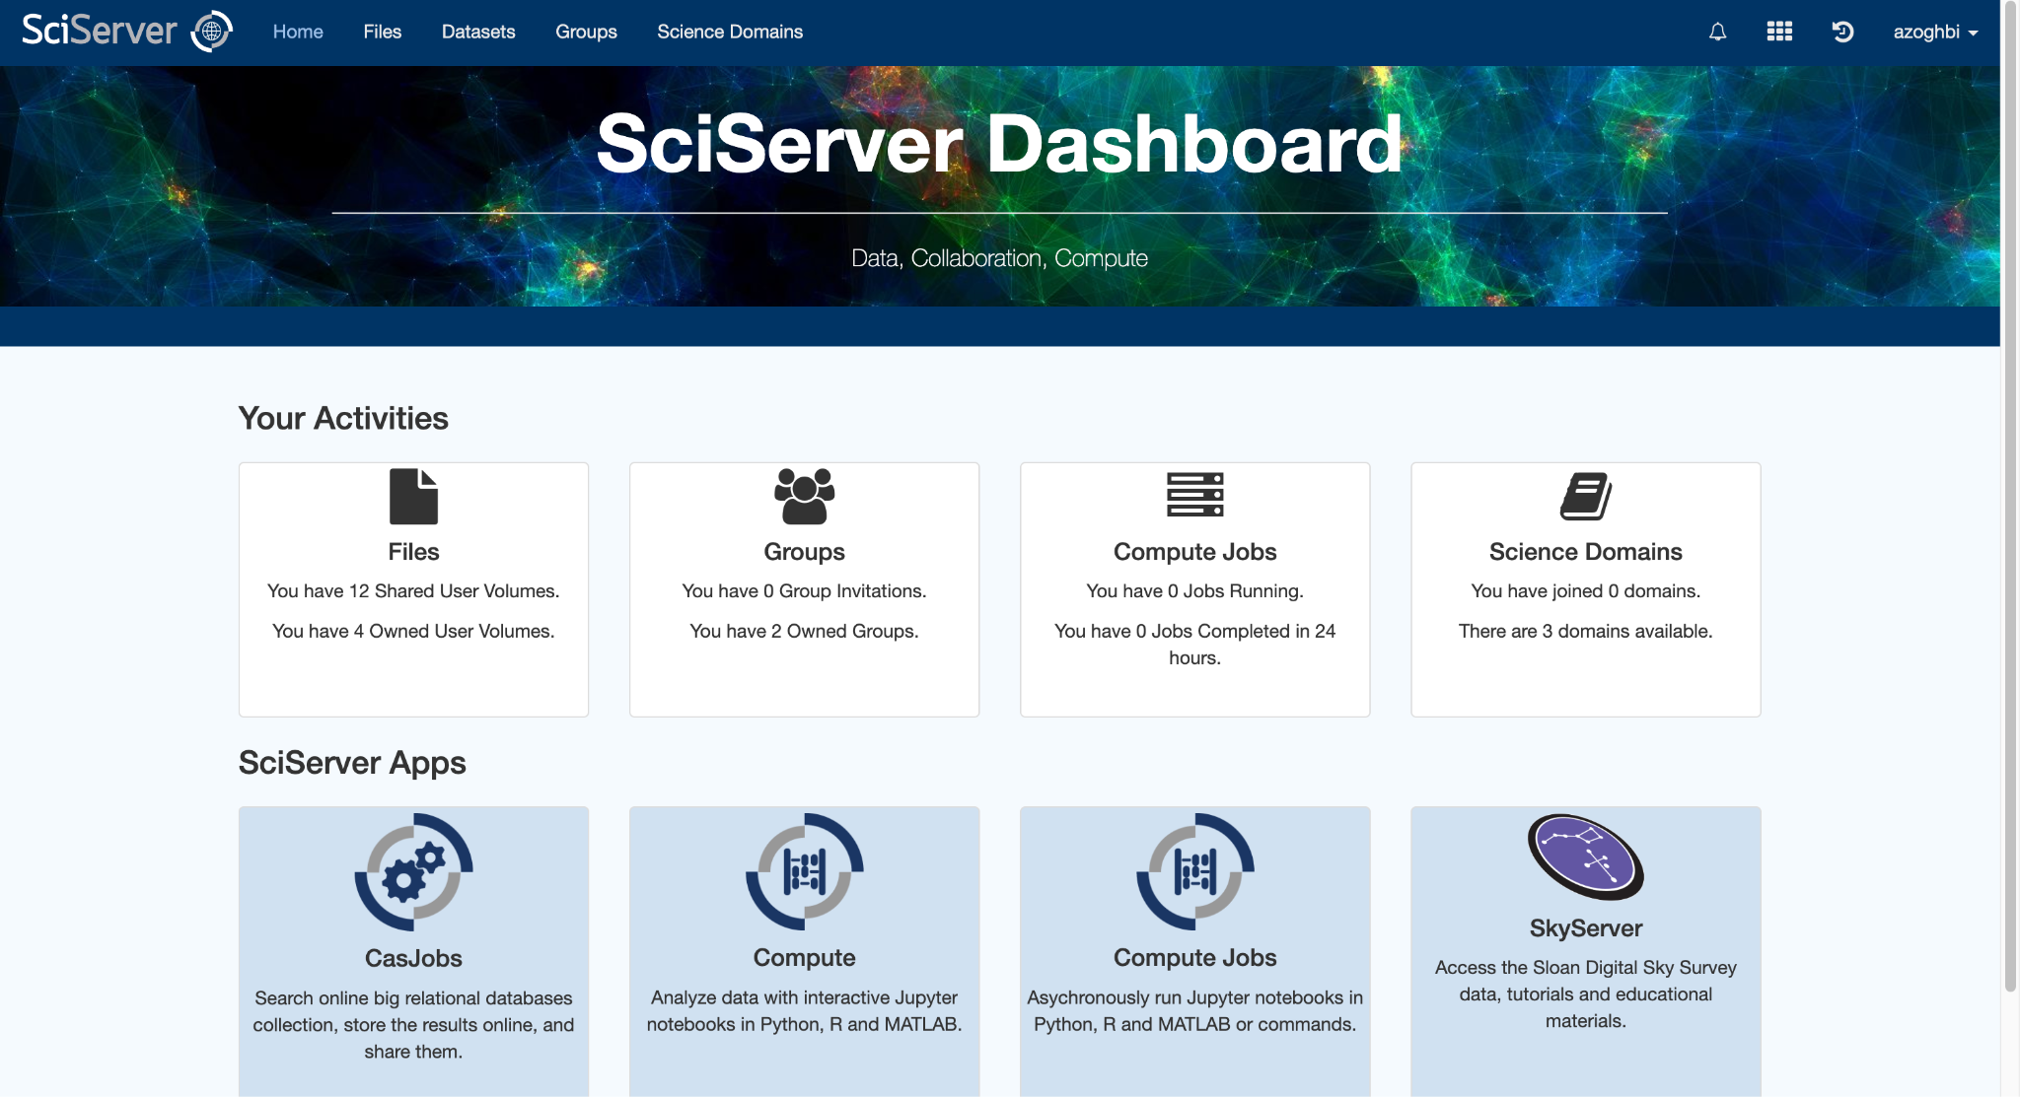
HEASARC @ Sciserver: Intro
Getting started:
  Login
  Choose either Compute (for interactive analysis) or Jobs (for batch jobs)
  Create a container
  Choose a software image
  Select the data to be mounted (all of HEASARC data)
  Access the Jupyter environment.

Slide 7
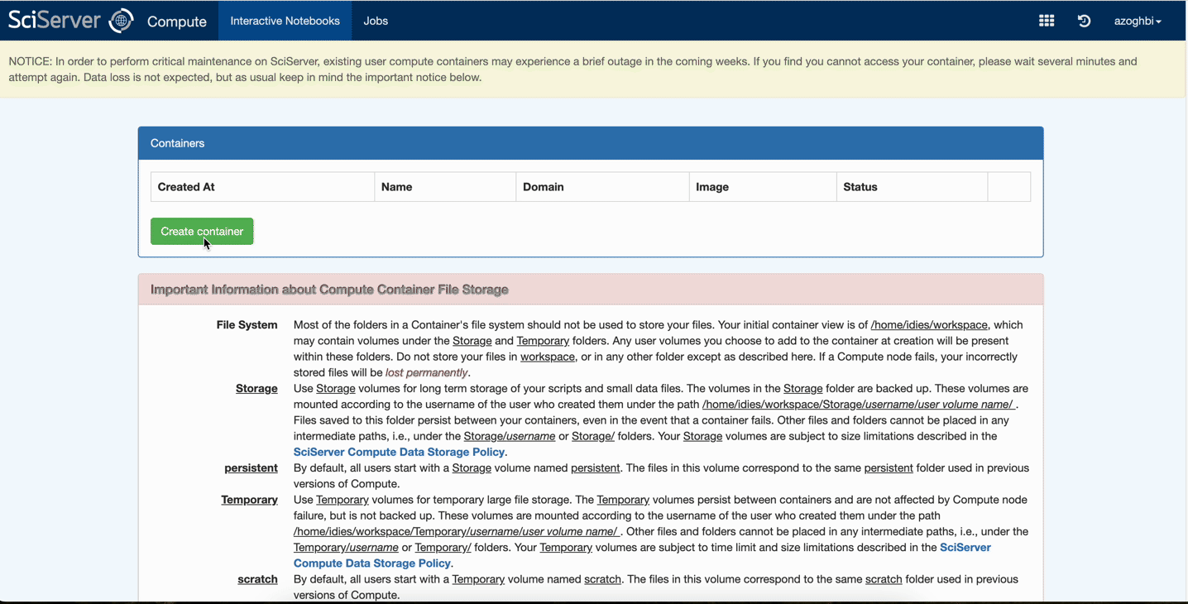
HEASARC @ Sciserver: Compute

Slide 8
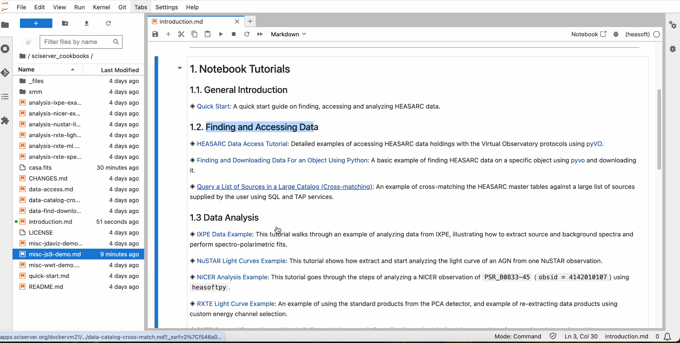
HEASARC @ Sciserver: Compute

Slide 9
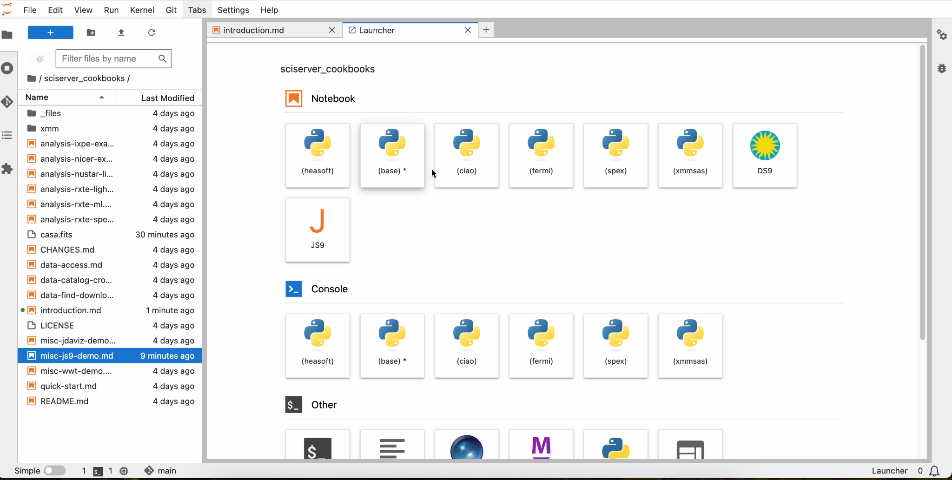
HEASARC @ Sciserver

Slide 10
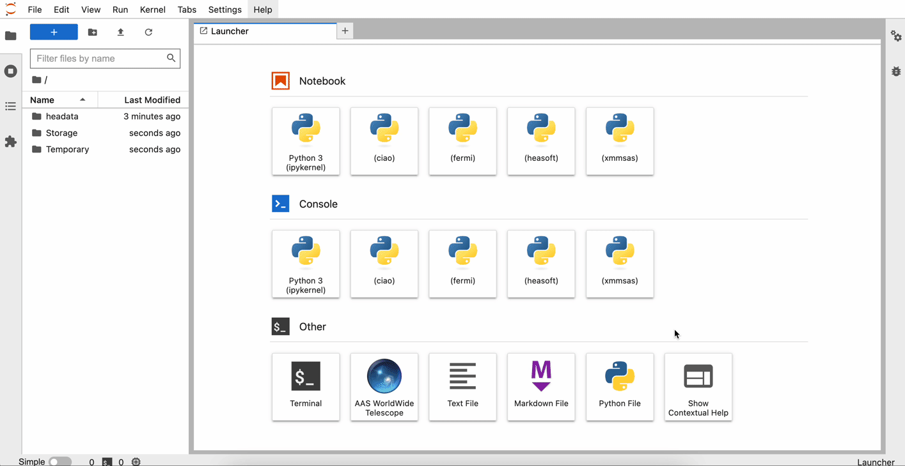
HEASARC @ Sciserver

Slide 11
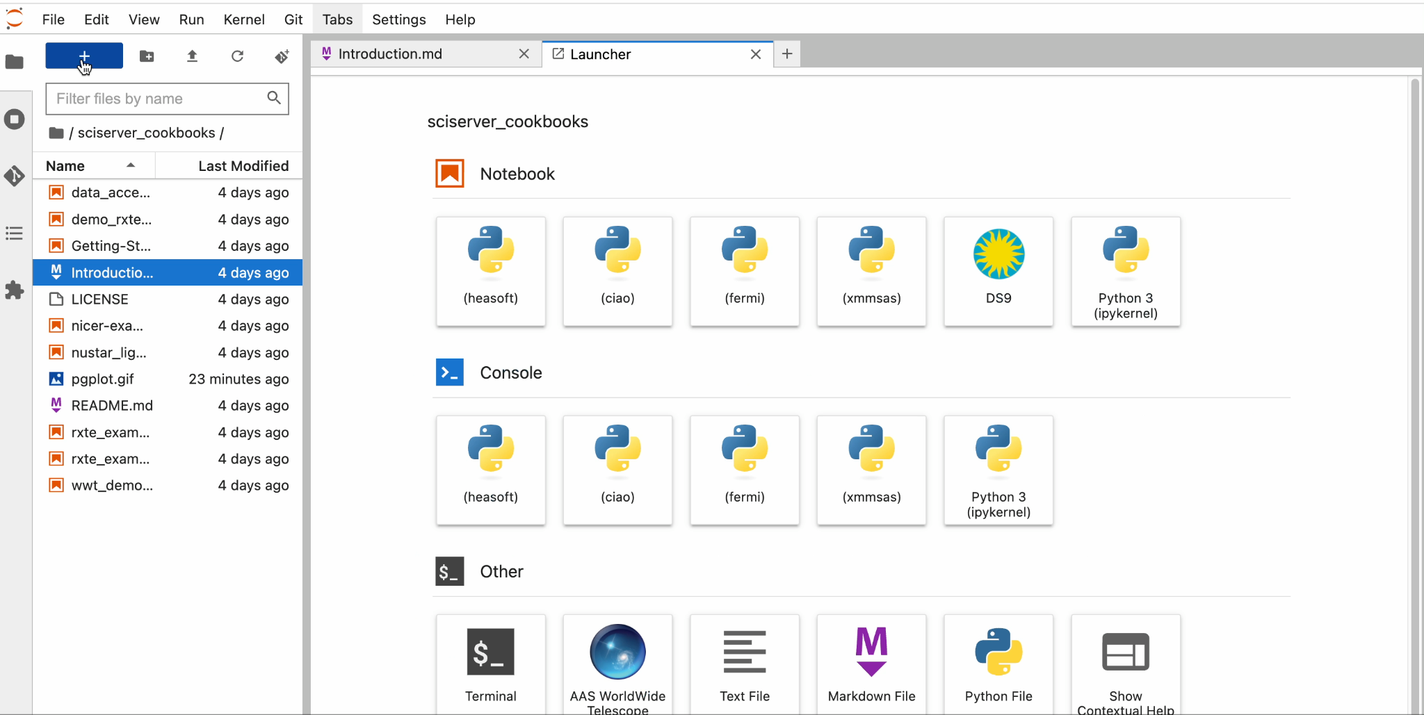
HEASARC @ Sciserver: DS9

Slide 12
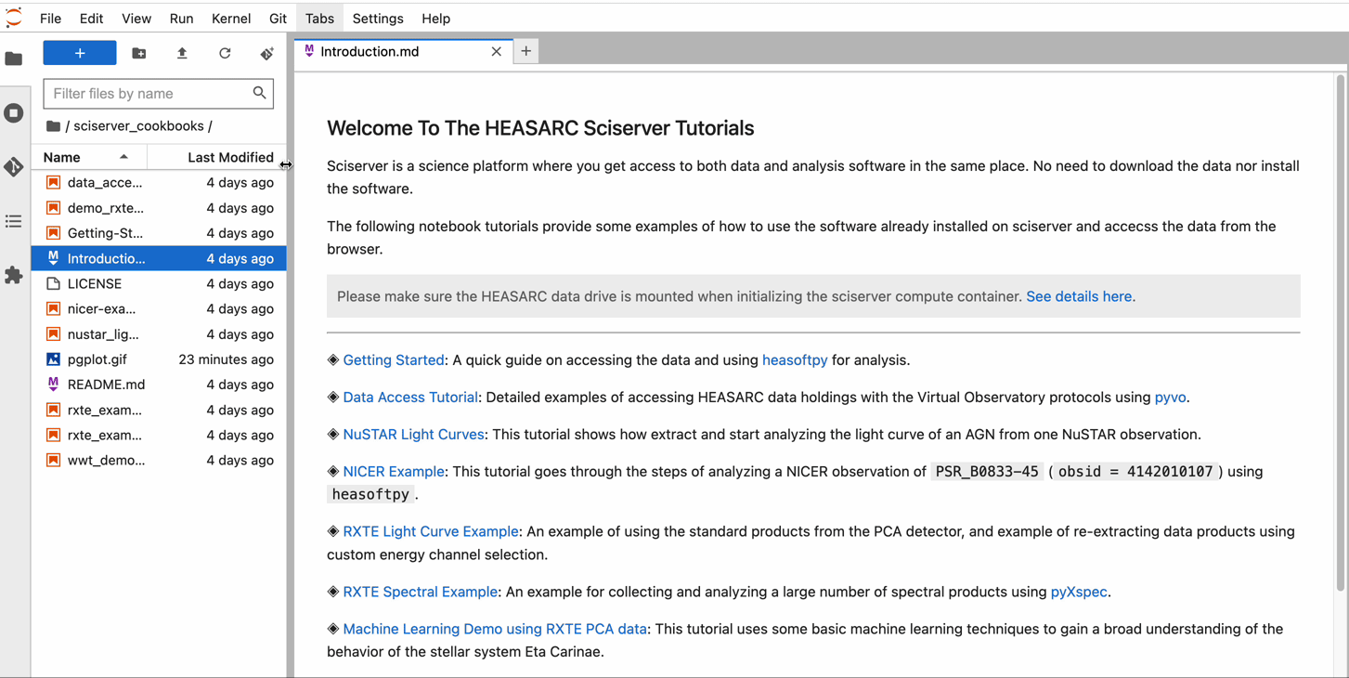
HEASARC @ Sciserver: DS9

Slide 13
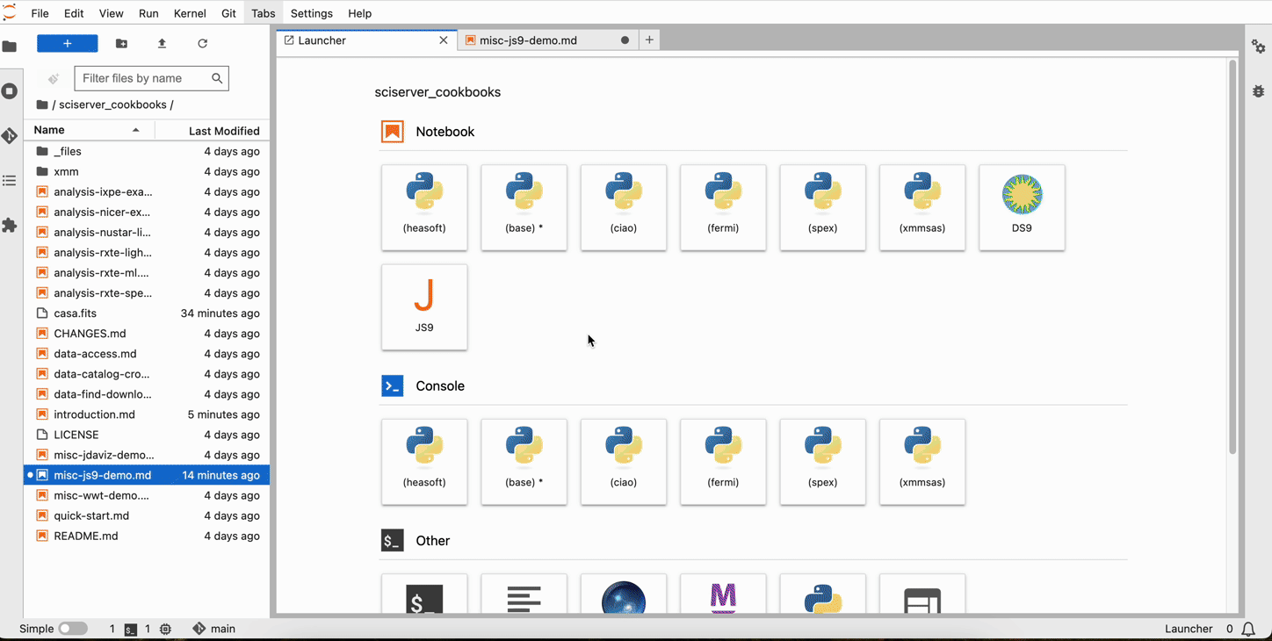
HEASARC @ Sciserver: JS9

Slide 14
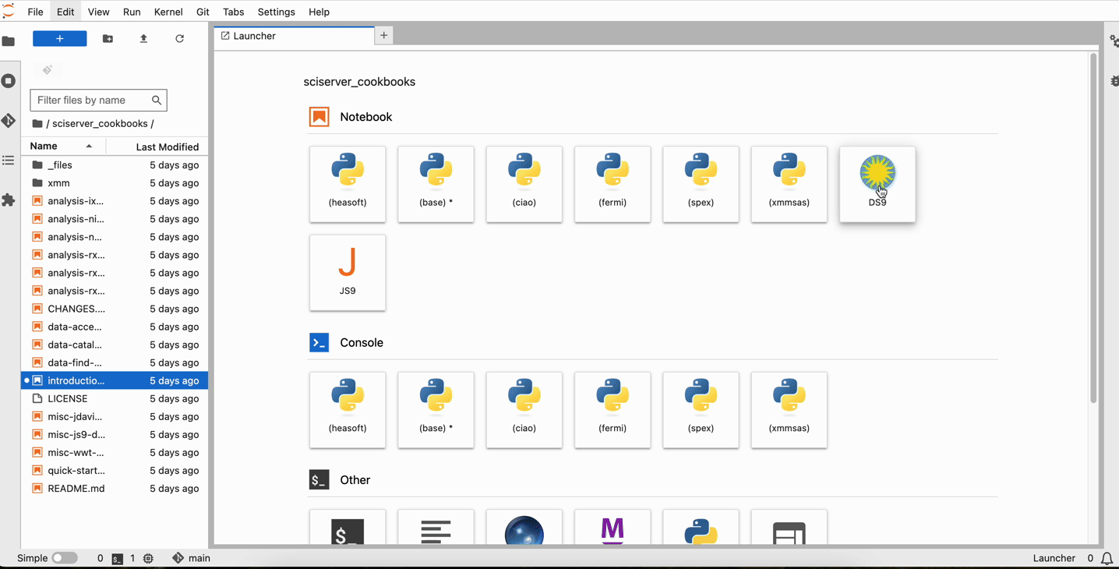
HEASARC @ Sciserver: Xserver

Slide 15
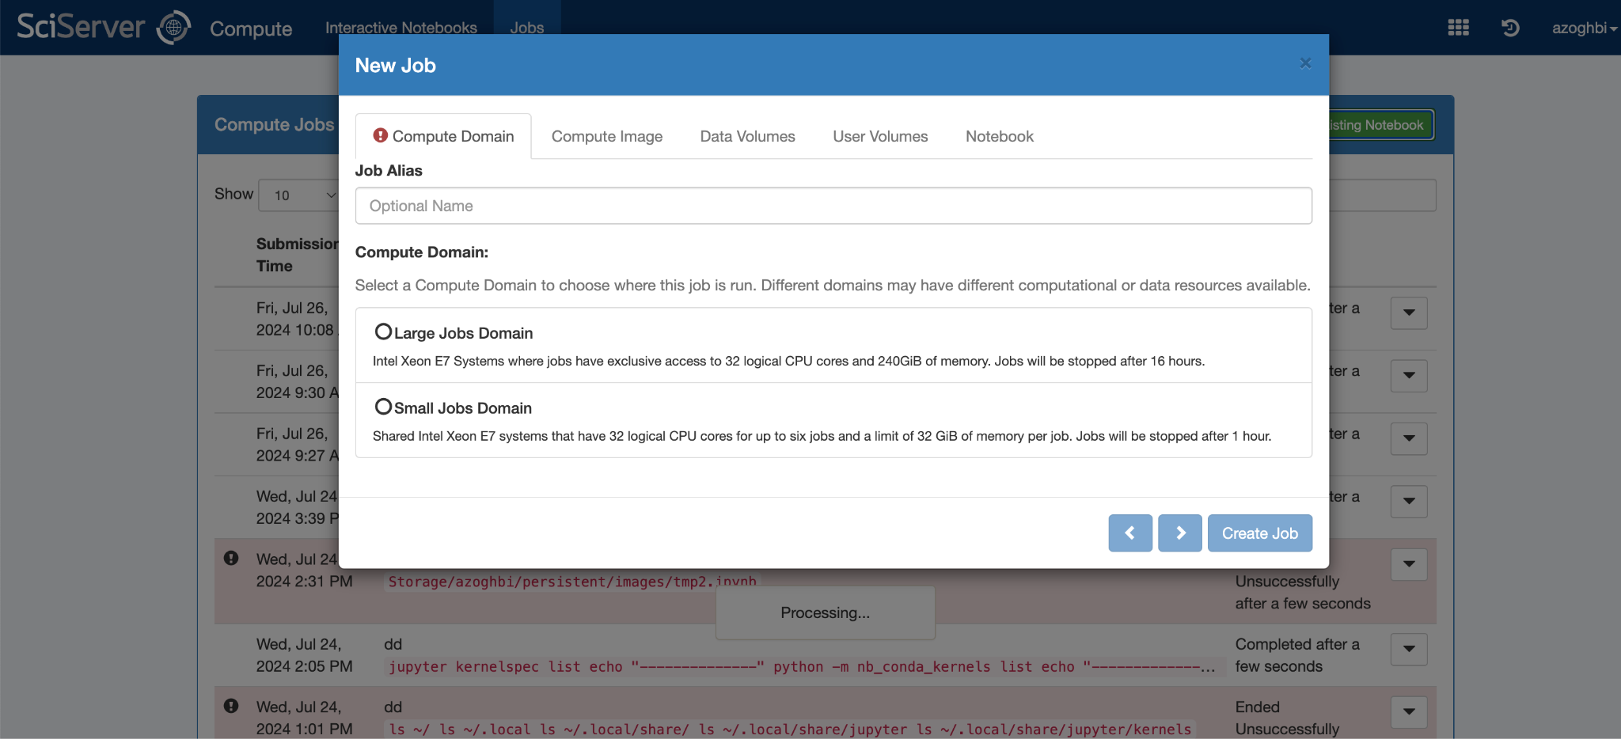
HEASARC @ Sciserver: Batch Jobs

Slide 16
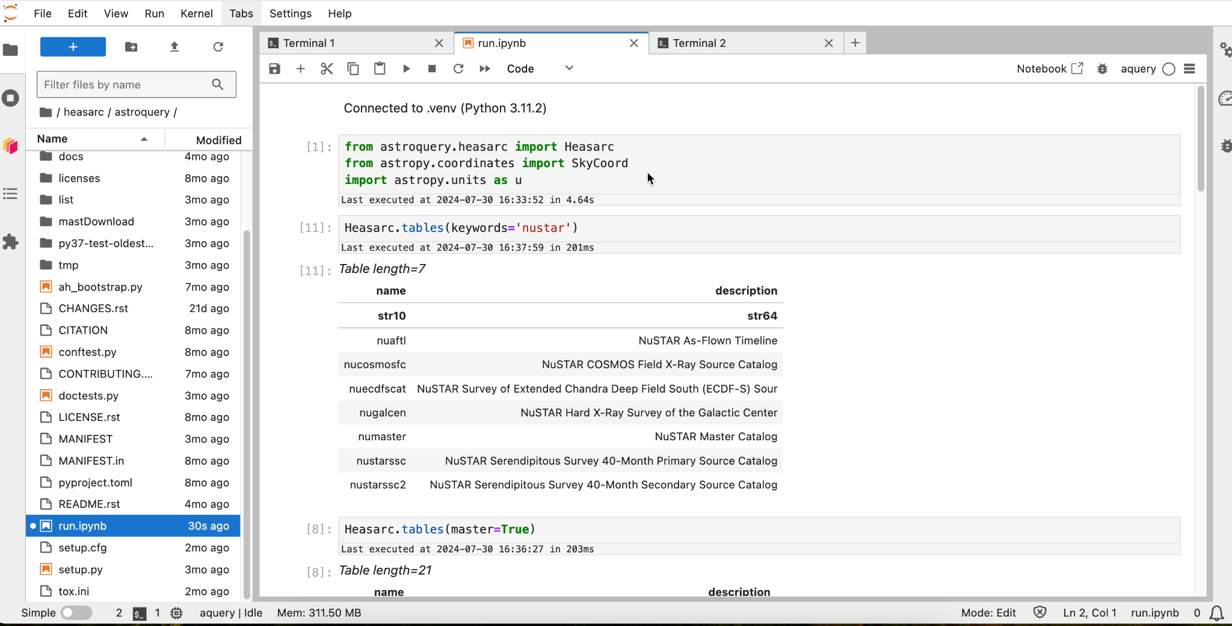
Coming soon: astroquery.heasarc

Slide 17
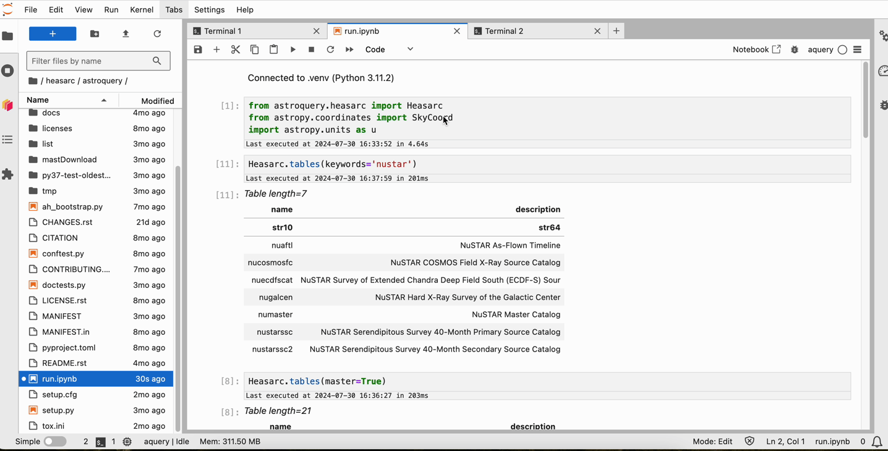
HEASARC @ Sciserver: astroquery

Slide 18
Summary
Sciserver is for you, use it and send us feedback, requests etc.
If you have analysis notebooks that you want to share, get in touch.
Querying data is simplified with astroquery.heasarc (test it and give feedback: github.com/astropy/astroquery/pull/2997).
Next is Fornax, NASA's Science Platform Initiative in the Cloud. Will be available for early use ~ Mid-2025.

